Slide 1
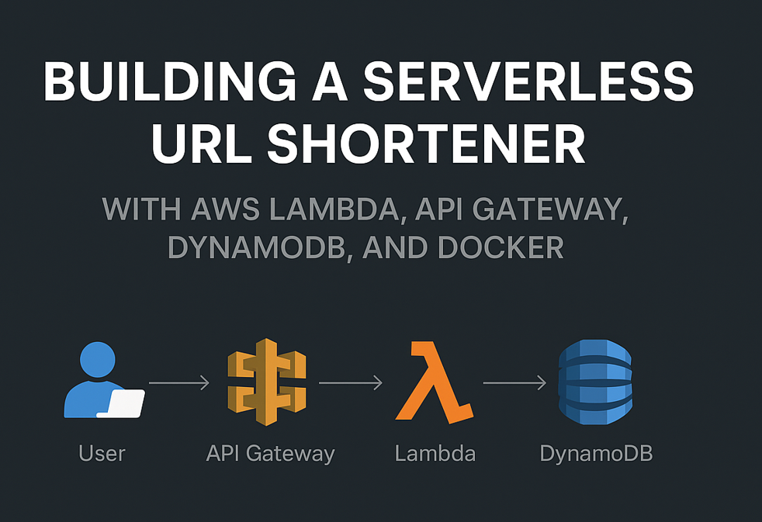

Slide 2
Agenda
What is a URL Shortener?
Why Serverless?
Architecture Overview
Implementation Steps
Demo Flow
Advantages & Challenges
Conclusion

Slide 3
What is a URL Shortener?
Converts long URLs into shorter, manageable links
Example: bit.ly, tinyurl
Improves shareability and tracking

Slide 4
Why Serverless?
No server management
Scales automatically
Pay-per-use model
Faster development cycle

Slide 5
Architecture Overview
API Gateway: Exposes REST API endpoints
AWS Lambda: Executes business logic
DynamoDB: Stores URL mappings
Docker: Local testing & portability

Slide 6
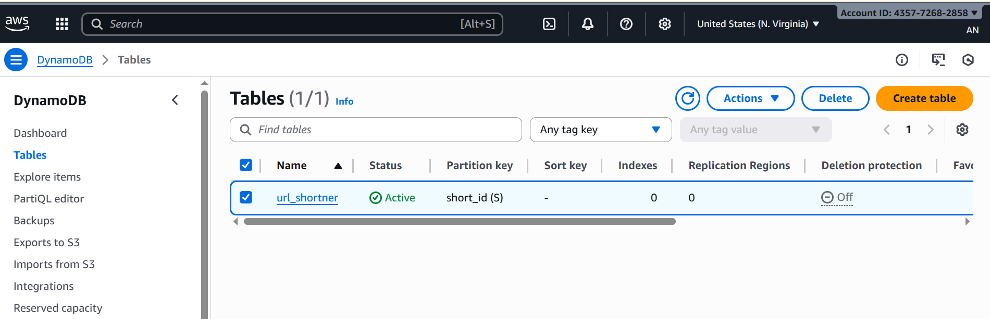
Implementation Steps
Create DynamoDB table (UrlShortener)
hh

Slide 7
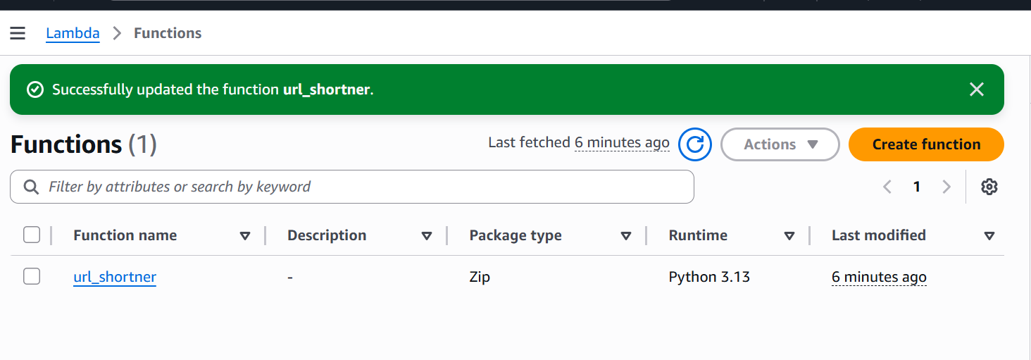
.
Write Lambda function (shorten & redirect)
Write url shorten code. This is the code that will be called when the user wants to shorten a URL.

Slide 8
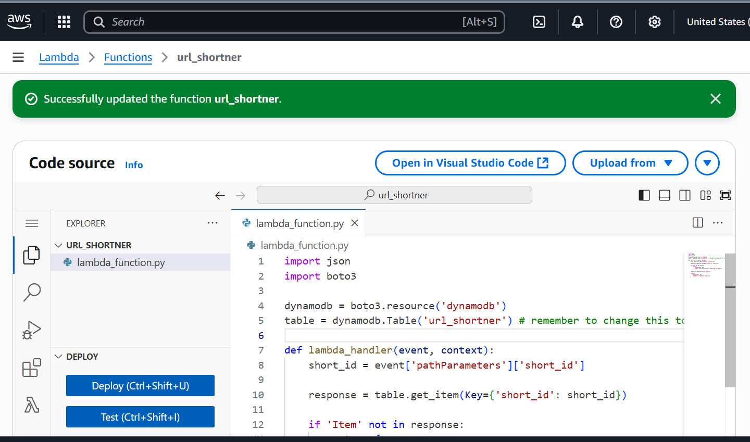
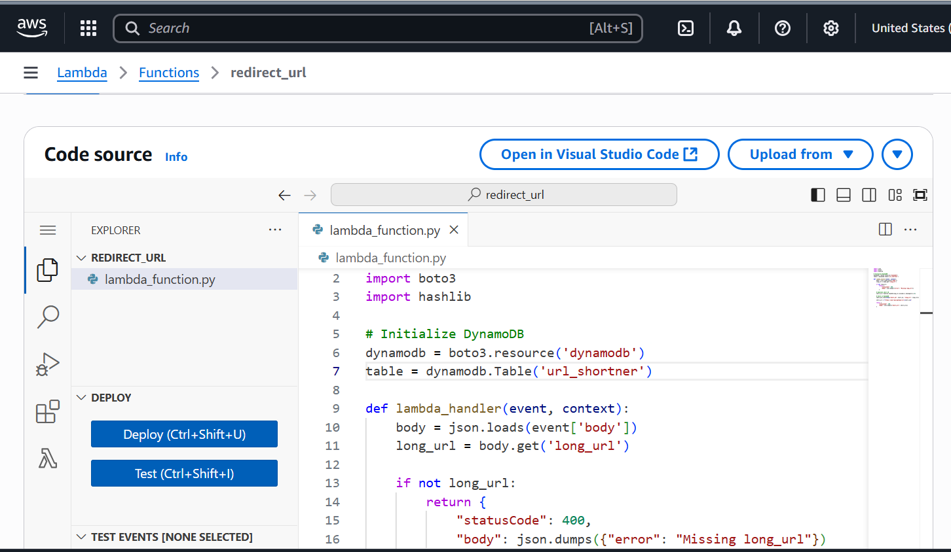
.
Redirect function this is the function that will be called when the short URL is accessed

Slide 9
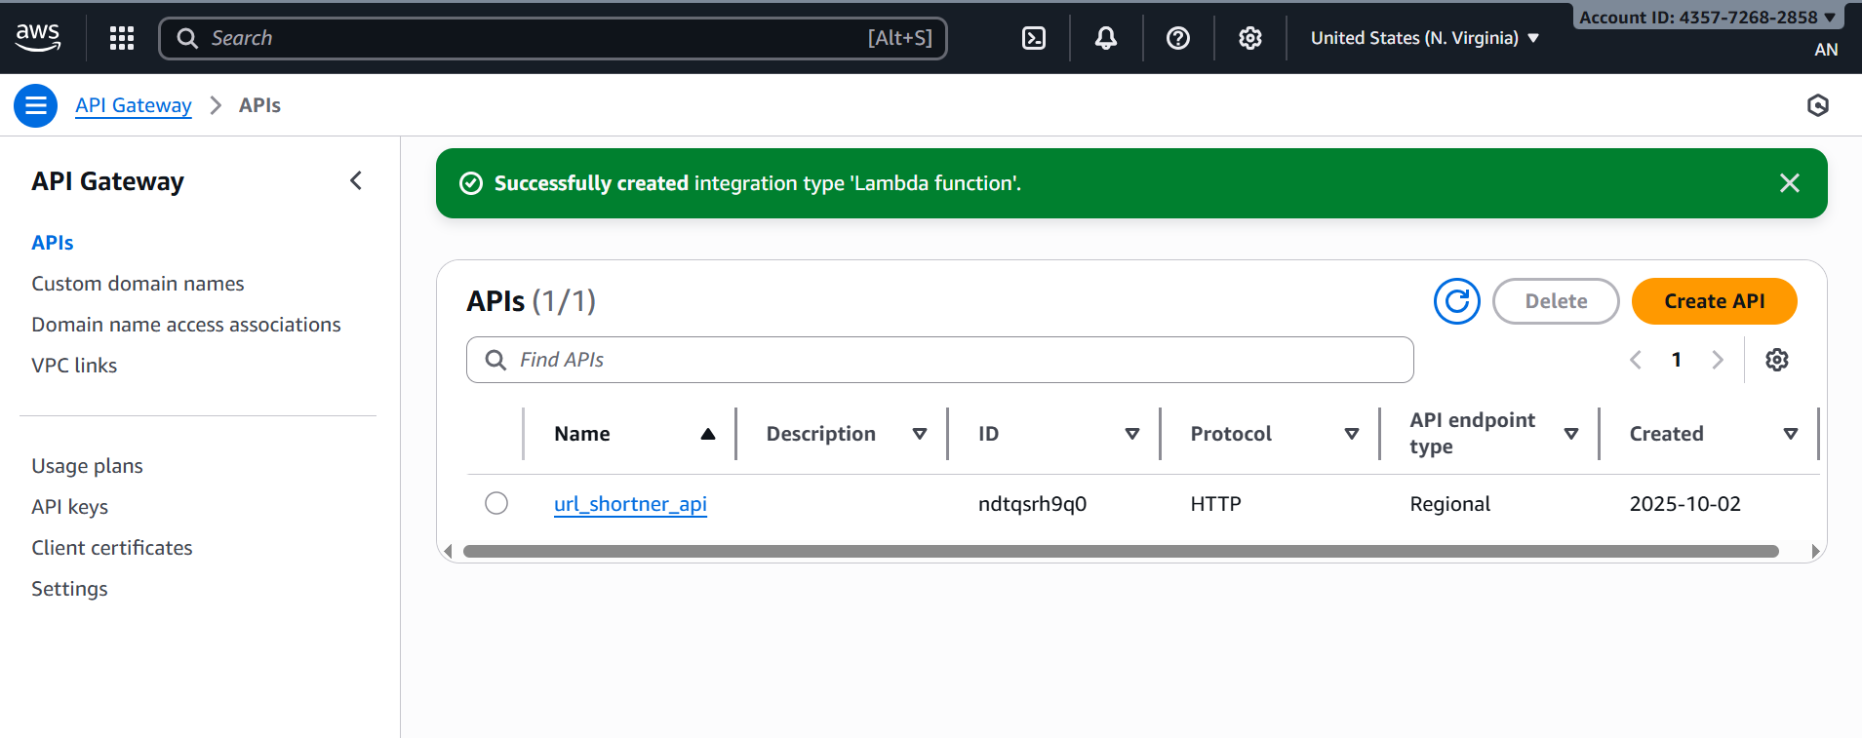
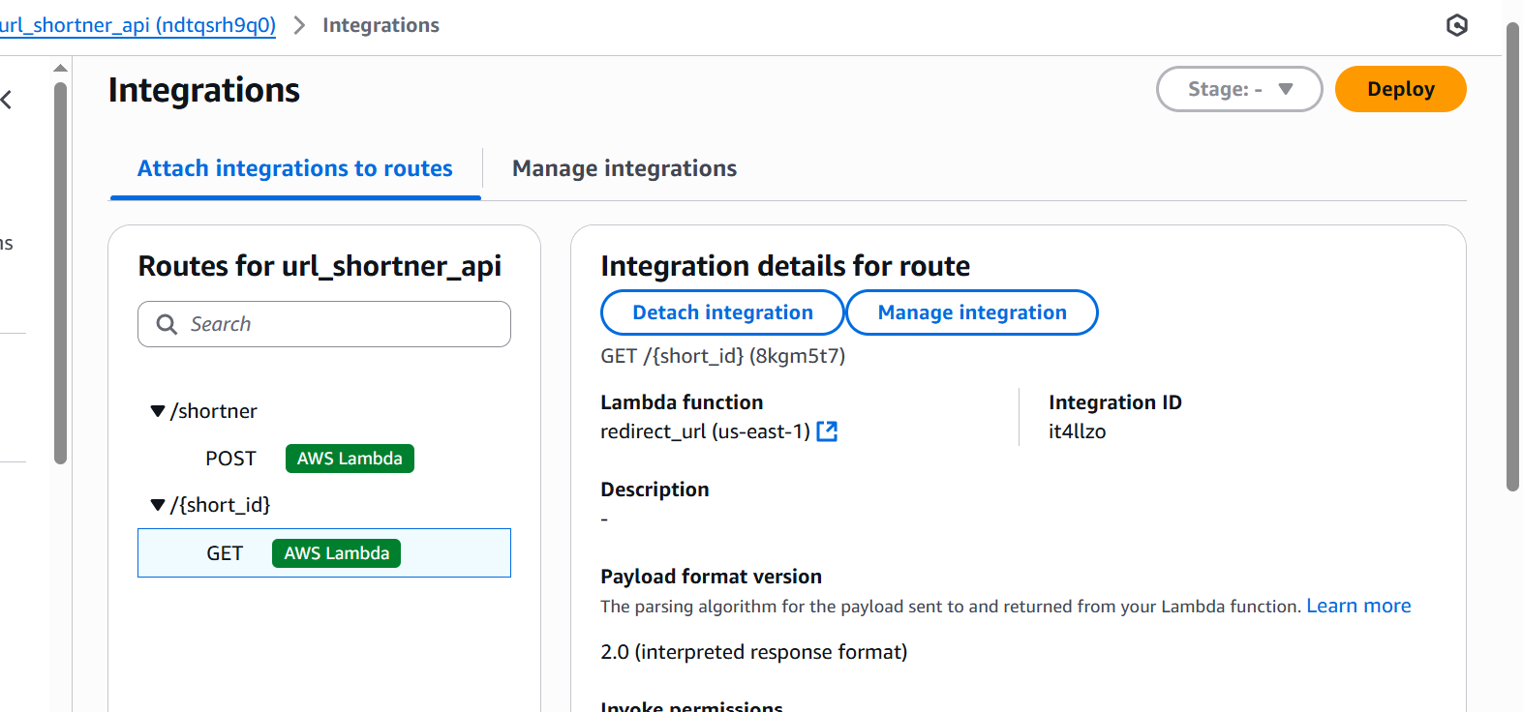
.
Setup API Gateway.
Create Route for API and integrated Lambda function to it

Slide 10
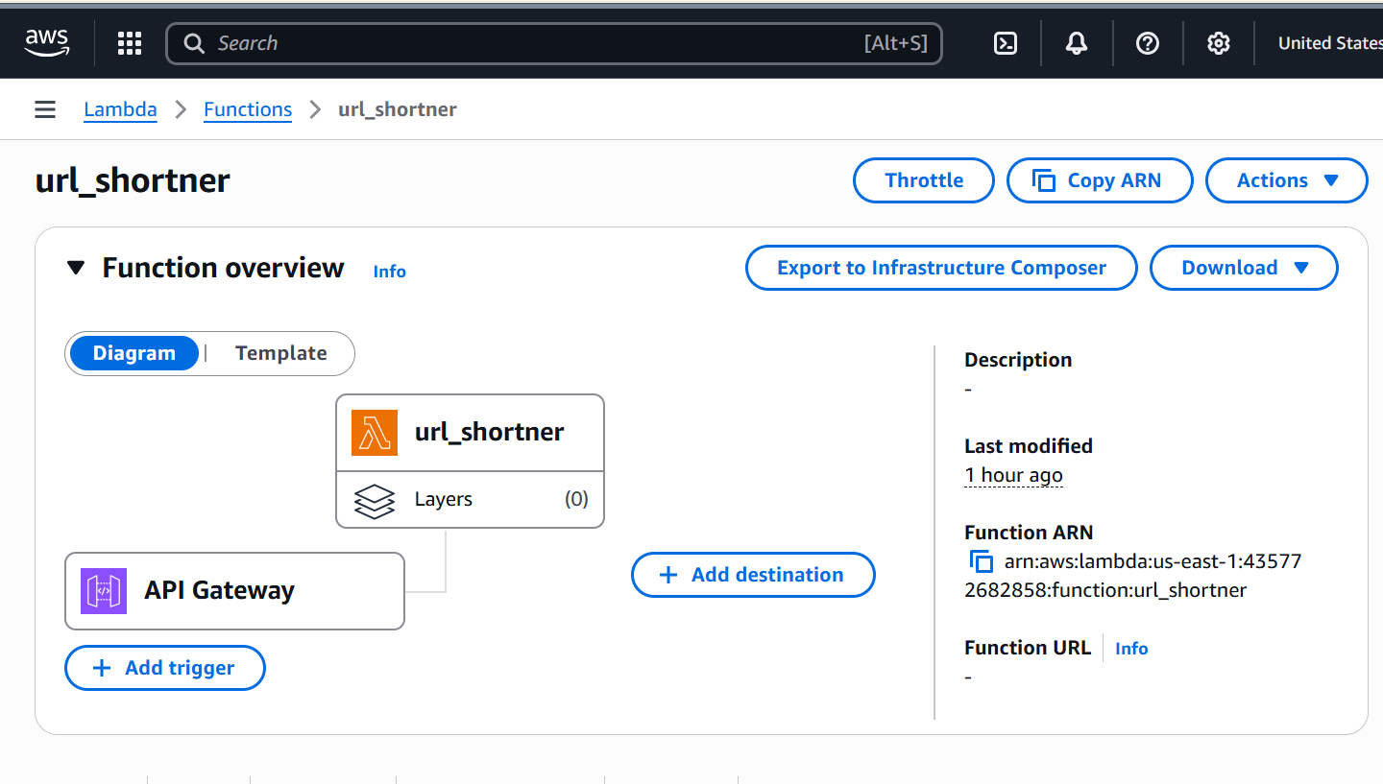
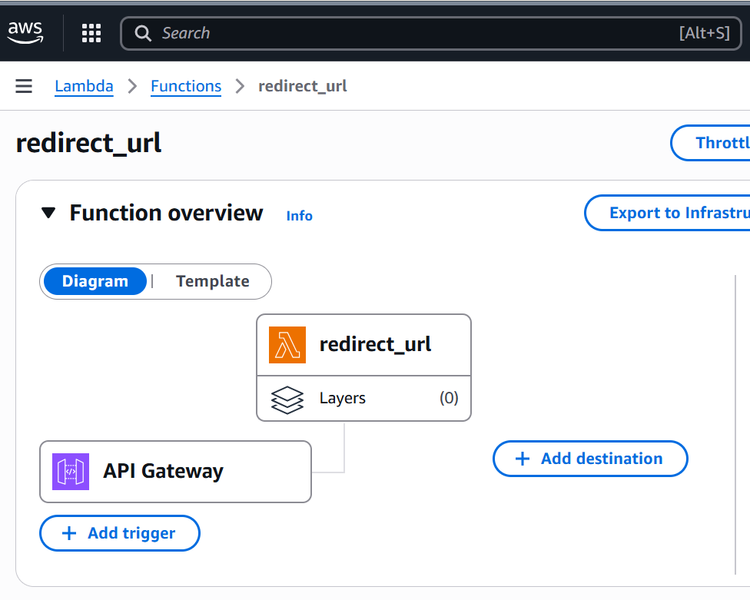
.
Attach API Gateway to url_shortner function.
Also attach API Gateway to redirect_url function.

Slide 11
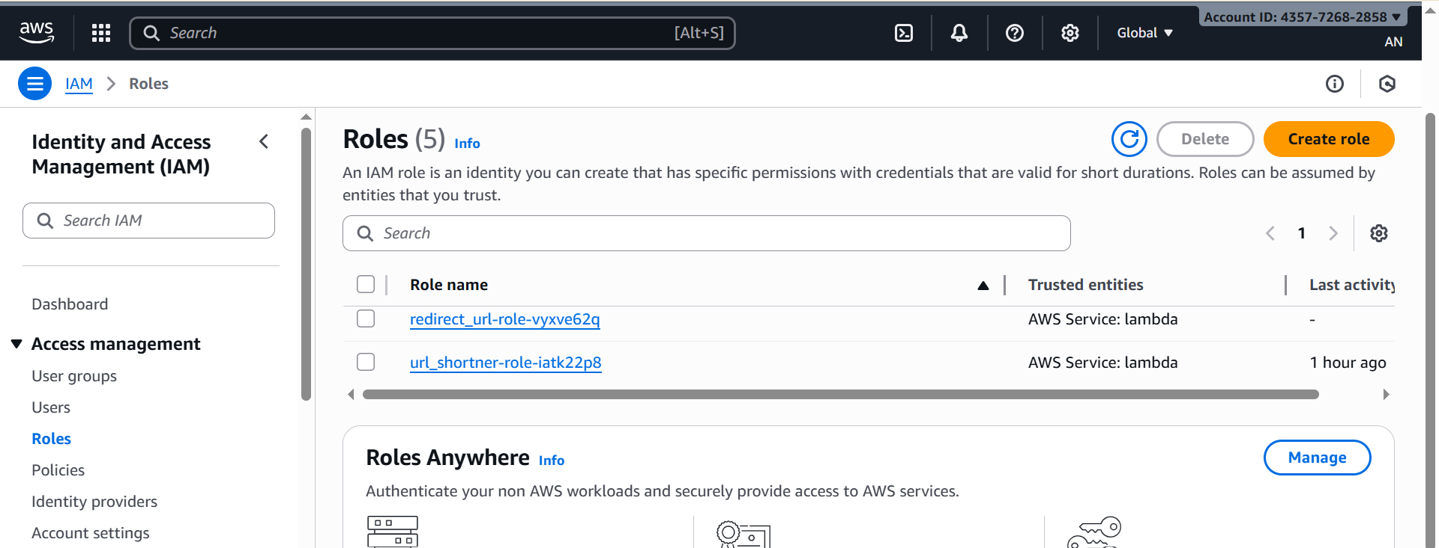
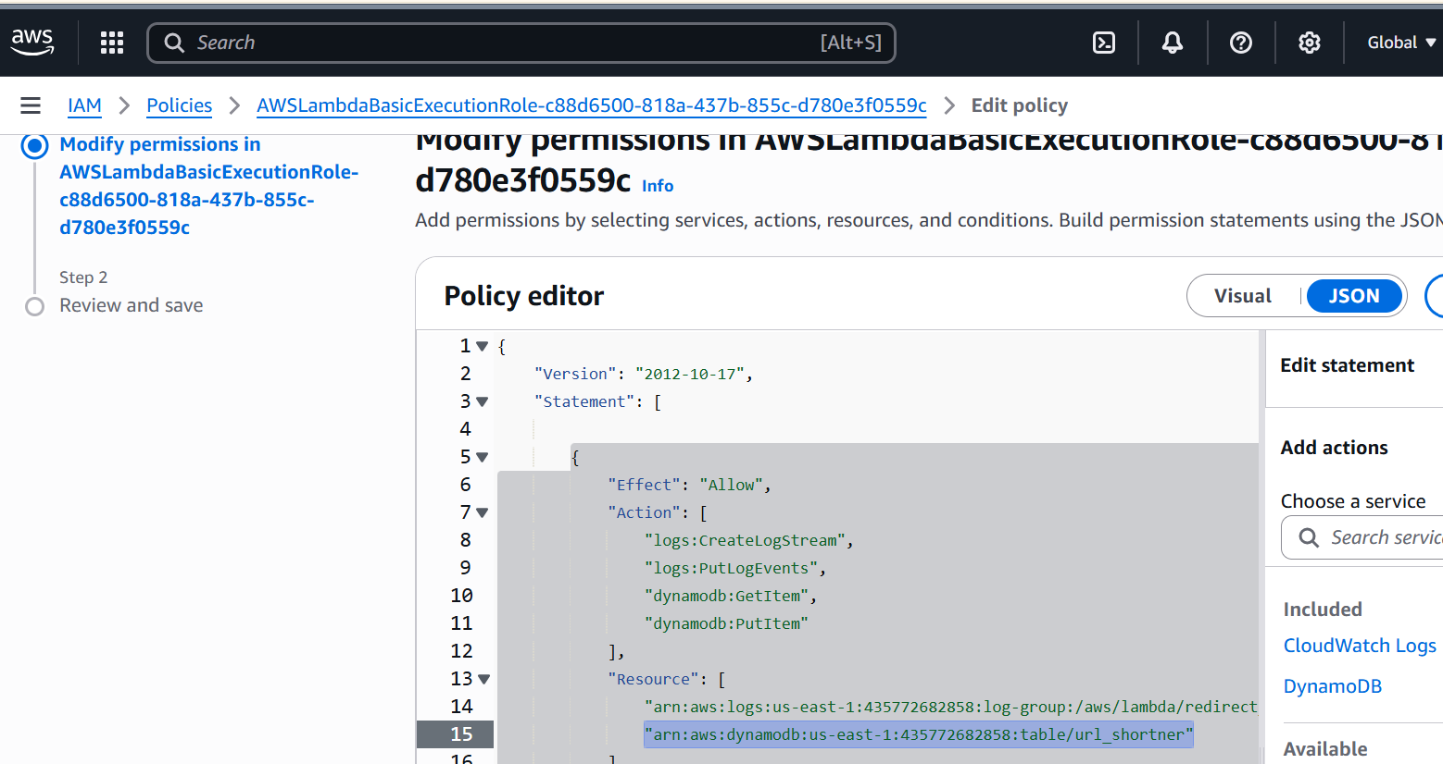
.
Made change to the roles created redirect_url and url_shortner.
Added resource arn for dynamodb table.

Slide 12
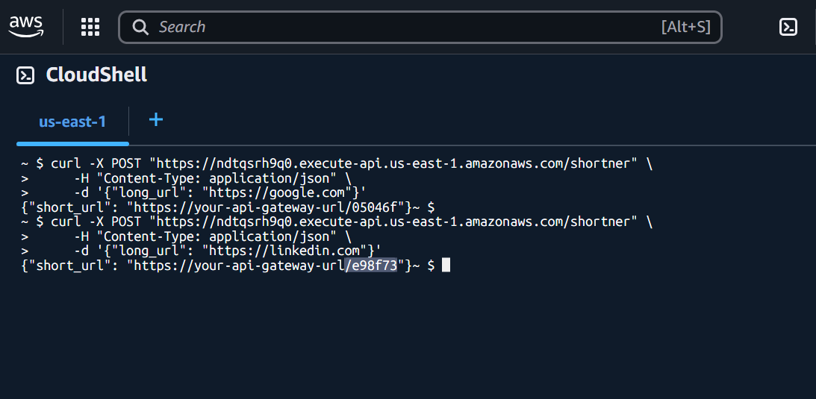
.
Test API Gateway Endpoint.
Test url on any browser :
https://ndtqsrh9q0.execute-api.us-east-1.amazonaws.com/e98f73

Slide 13
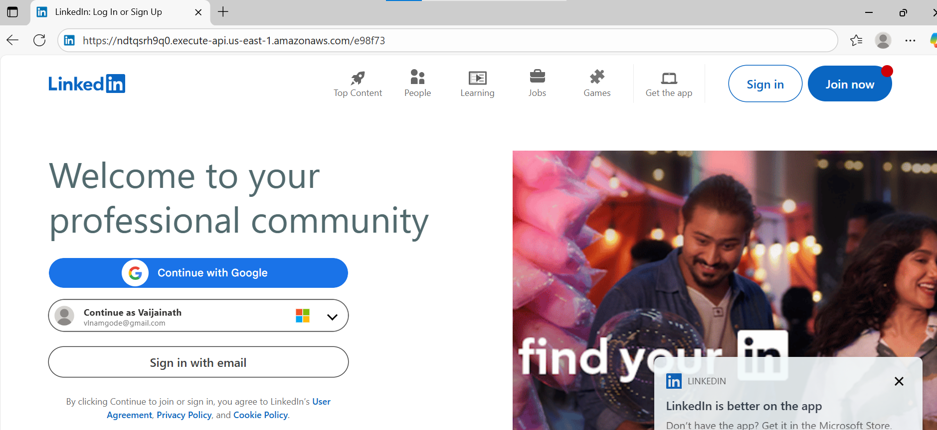
.

Slide 14
Advantages
No infrastructure overhead
Auto-scalable & fault-tolerant
Cost-efficient
Easy deployment with Docker

Slide 15
Challenges
ResourceNotFoundException: DynamoDB Table Not Found.
The table name in your Lambda function code does not match the actual DynamoDB table name
AccessDeniedException: Lambda Lacks Permission to Access DynamoDB
The Lambda function lacks the necessary IAM permissions to interact with DynamoDB.

Slide 16
Conclusion
Serverless simplifies infrastructure
URL shortener = great demo project
Future: Add analytics, authentication, and custom domains

Slide 17
.
Thank You
ANUJA N.

