Slide 1
C.R.E.A.T.E
Chatbot

Slide 2
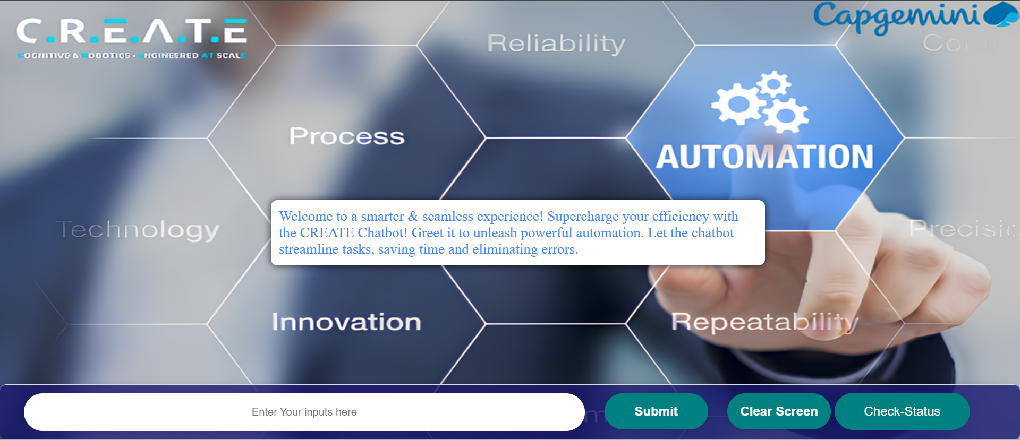

Slide 3


