Slide 1
Set and their Operations

Slide 2
Set
• Definition: A set is a (unordered) collection of objects. These objects are sometimes called elements or members of the set. (Cantor's naive definition)
• Examples: –
Vowels in the English alphabet V = { a, e, i, o, u }
First seven prime numbers. X = { 2, 3, 5, 7, 11, 13, 17 }

Slide 3
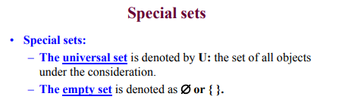
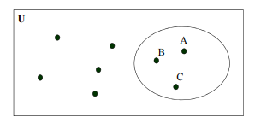
A set can be visualized using Venn Diagrams: – V={ A, B, C }

Slide 4
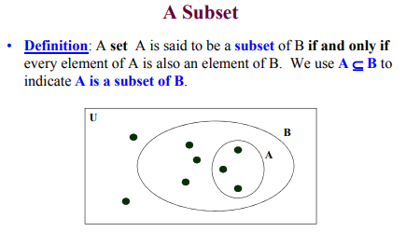

Slide 5
Set Operations
There are four set operations
1) union
2) Intersection
3) Difference
4) Disjoint
5) Cartesian Product
6) Power

Slide 6
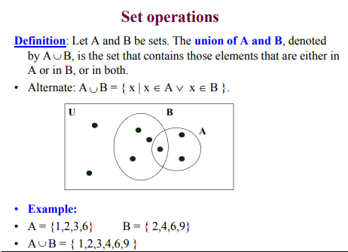

Slide 7
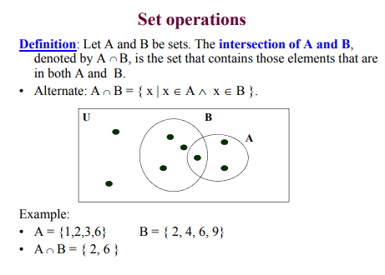

Slide 8
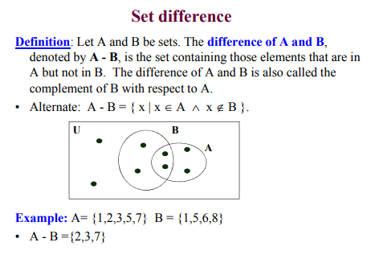

Slide 9
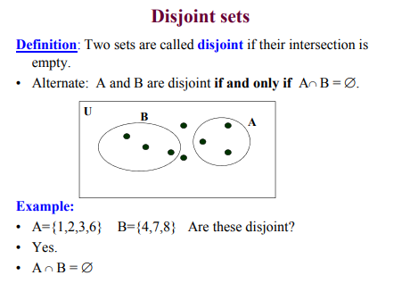

Slide 10
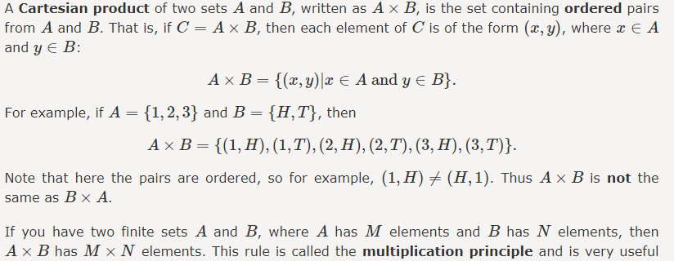

Slide 11
Power
For the set {a,b,c}:
The empty set {} is a subset of {a,b,c}
And these are subsets: {a}, {b} and {c}
And these are also subsets: {a,b}, {a,c} and {b,c}
And {a,b,c} is a subset of {a,b,c}
And altogether we get the Power Set of {a,b,c}:
P(S) = { {}, {a}, {b}, {c}, {a, b}, {a, c}, {b, c}, {a, b, c} }

