Slide 1

Project Title -Seasonal Agriculture Performance Analysis
Student Name – Anuja Deorao Satpute
College Name- Audyogik Shikshan Mandal's Institute of Business Management and Research, Pune
AICTE STU ID : STU6a6c6687377ac1785489031

Slide 2

PROBLEM STATEMENT
Agricultural activities are influenced by seasonal variations in environmental conditions, farming practices, resource availability and market conditions.
As a result, agricultural performance may differ from one season to another. However, raw agricultural data does not clearly explain how agricultural performance changes across seasons or what patterns can be observed in different seasonal conditions.
The problem is to analyze the given agricultural dataset and investigate seasonal differences in agricultural performance by identifying meaningful patterns, trends, relationships and variations within the available data.

Slide 3
Project Description
The project analyzes seasonal agricultural performance using a dataset of 4,000 farm-level records and 28 attributes.
• Data preparation: missing-value treatment, duplicate checking and data-type review.
• Exploratory analysis: comparison of yield, profit, irrigation, crops and seasons.
• Visualization: bar charts, scatter plots and correlation heatmap to identify patterns and relationships.
• Goal: understand seasonal variation and the factors associated with agricultural productivity, profitability and resource efficiency.

Slide 4

WHO ARE THE END USERS?
• Farmers and farm managers – compare seasonal yield, costs and profitability.
• Agricultural planners – identify patterns across crops, states and seasons.
• Agribusiness and market analysts – understand production, price, revenue and profit trends.
• Researchers and students – use the dataset for agricultural analytics and visualization.
• Resource managers – evaluate irrigation, water use and efficiency.

Slide 5

Technology Used
  Python – data analysis and visualization
  Pandas – data reading, cleaning and aggregation
  NumPy – numerical operations
  Matplotlib & Seaborn – charts and statistical visualization
  Jupyter Notebook – analysis workflow and presentation
  CSV – primary dataset format

Slide 6
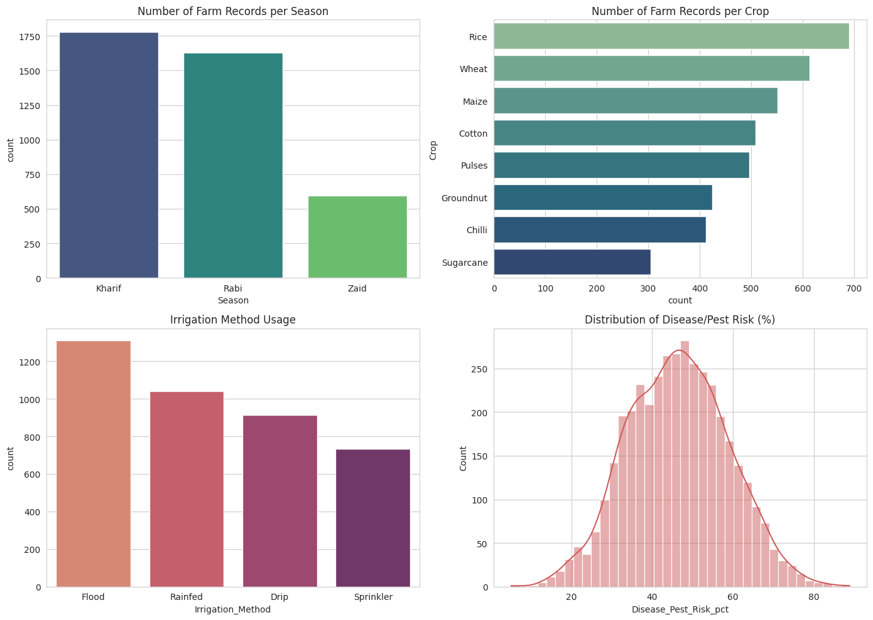
RESULTS
1. Number of Farm Records per Season
Kharif has the highest number of farm records.
Rabi has slightly fewer records, while Zaid has the lowest.
This shows that the dataset contains more observations for Kharif and Rabi seasons.
2. Number of Farm Records per Crop
Rice has the highest number of records.
Wheat and Maize also have a high number of observations.
Sugarcane has the lowest representation among the crops shown.
Flood irrigation is the most commonly used method.
Rainfed and Drip irrigation follow.
Sprinkler is the least used method in the dataset.
4. Distribution of Disease/Pest Risk
The distribution is concentrated mainly around 40–50% risk.
Most farms have a moderate disease/pest risk.
Very low and very high risk values occur less frequently.

Slide 7
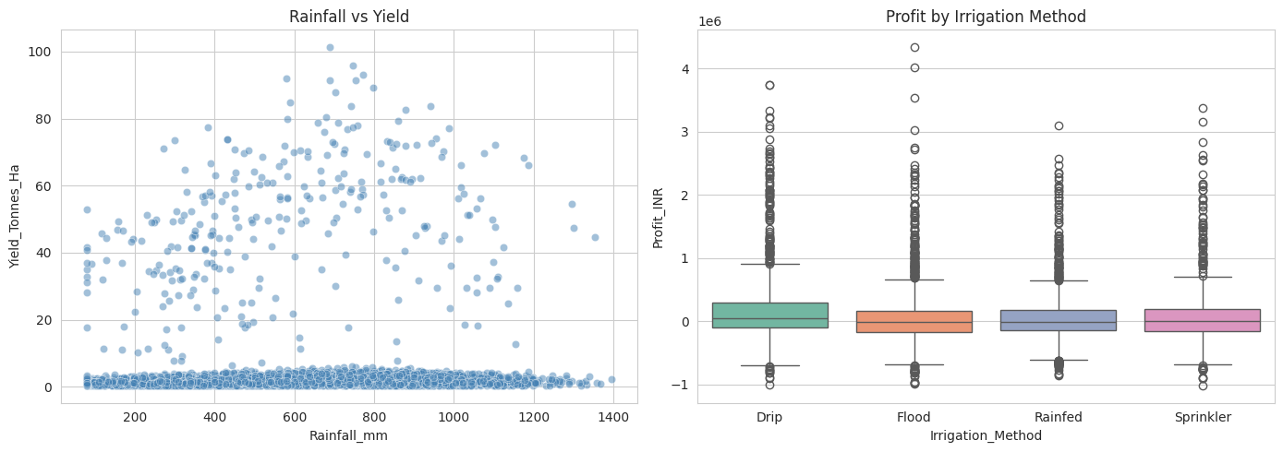
RESULTS
Conclusion -:
Rainfall vs Yield
“Higher rainfall generally supports higher crop yield, but the wide variation shows that yield depends on multiple agricultural factors.”
2. Profit by Irrigation Method
“Drip irrigation shows relatively better typical profitability, while all methods have significant variation due to differences in crop, costs, yield, and market conditions.”

Slide 8
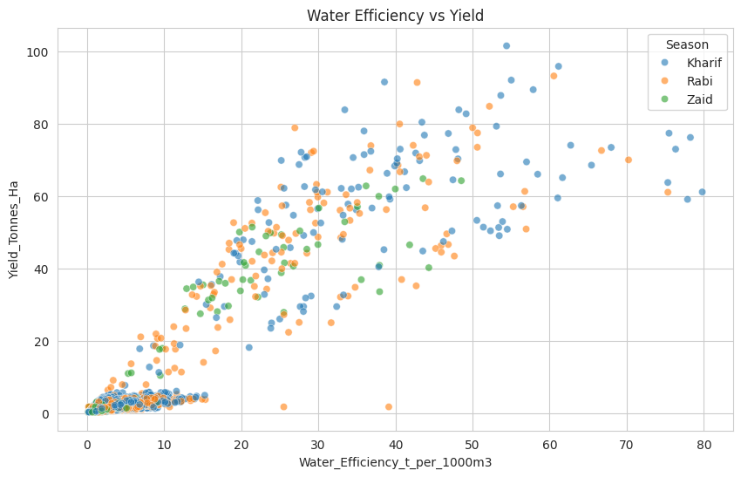
RESULTS
Conclusion -
  “The scatter plot indicates a generally positive relationship between water efficiency and crop yield, with Kharif showing the greatest variability and highest yield values, while Zaid observations are more concentrated in the middle range.”

Slide 9
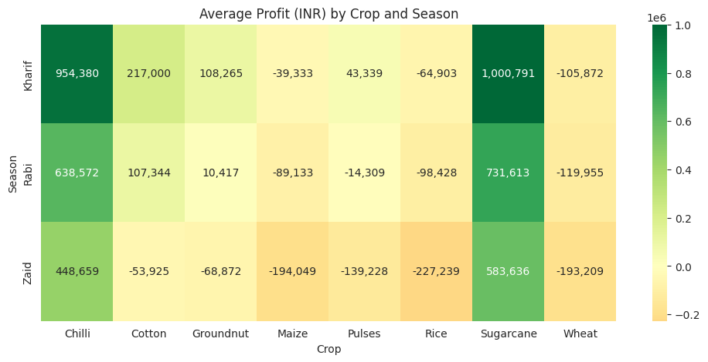
RESULTS
Conclusion :-
  “Sugarcane and Chilli are the most profitable crops, particularly during the Kharif season. Zaid shows the weakest profitability, with significant losses in crops such as Rice, Maize, Pulses and Wheat. The analysis suggests that crop and season selection has a strong impact on agricultural profitability.”

Slide 10
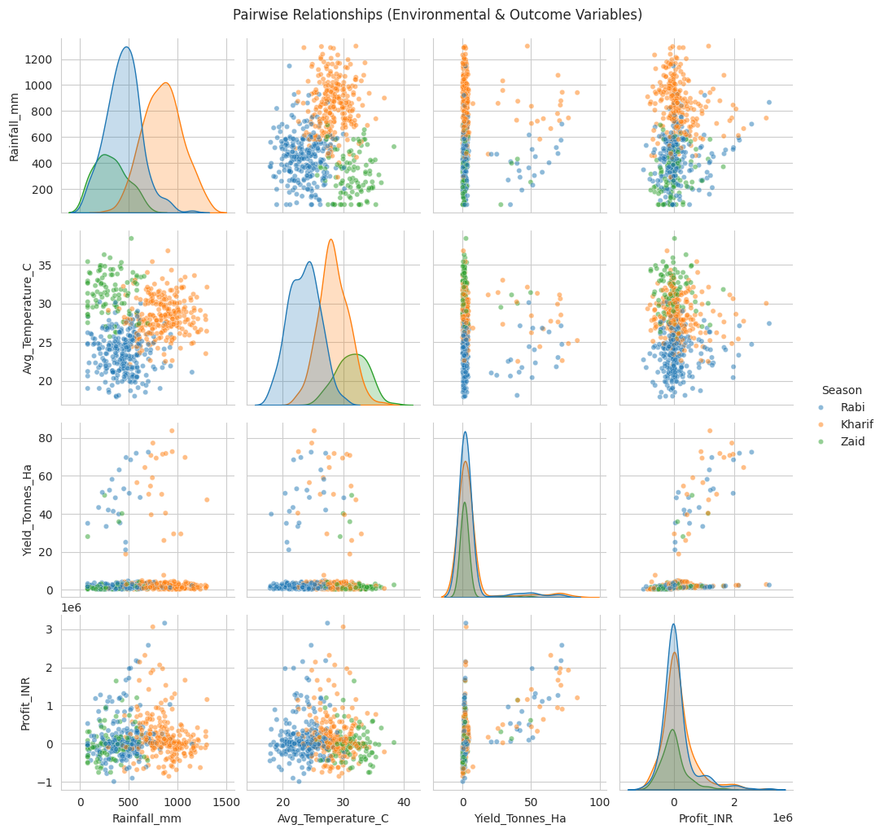
RESULTS
🌧️ Rainfall vs Temperature: Higher rainfall generally occurs at moderate temperatures (~25–30°C).
🌾 Yield: Most observations have low yield, but higher yields are associated with higher rainfall and temperature.
💰 Profit: Profit is mostly around zero, with some high-profit outliers.
📈 Yield vs Profit: Shows a clear positive relationship — higher yield tends to result in higher profit.
🟠 Kharif season: Generally has higher rainfall and temperature and some of the highest yields.
🔵 Rabi season: Generally has lower rainfall and temperature.
🟢 Zaid season: Falls mostly between Rabi and Kharif in temperature/rainfall.
Overall: Rainfall and temperature influence yield, and yield strongly influences profit.

Slide 11
Future scope
• Build machine-learning models to predict crop yield or farm profit.
• Add more years of data to study long-term seasonal trends.
• Develop an interactive dashboard for farmers and decision-makers.
• Include additional soil, weather, market and geographic variables.
• Use predictive insights for irrigation planning, crop selection and resource optimization.

Slide 12
GitHub Link
https://github.com/AnujaSatpute/Seasonal-Agriculture-Performance-Analysis

Slide 13

VOIS Course completion certificate -
Course name- Data Visualization

Slide 14
Thank you
.
.

