Slide 1


Slide 2
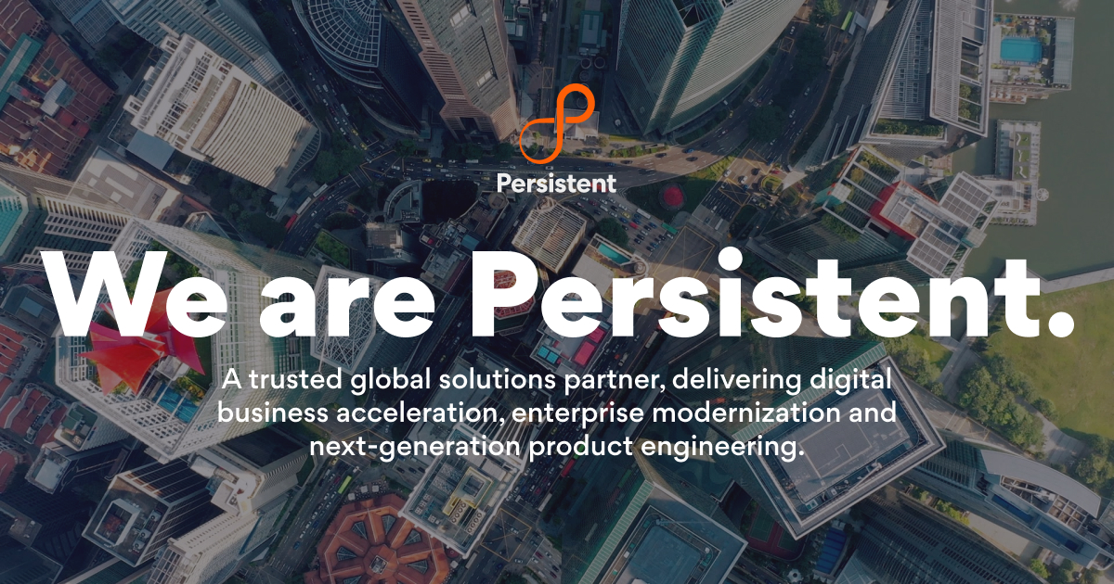
PERSISTENT PRESENTATION
Akshata Chavan
Amol Zambare
Aniruddha Dighe
Anuja Shinde
Arpit Naik

Slide 3
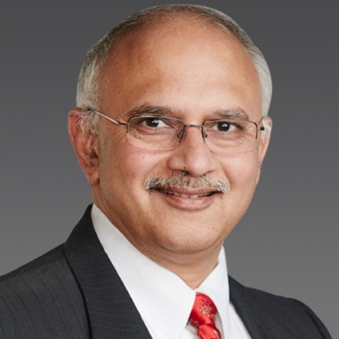
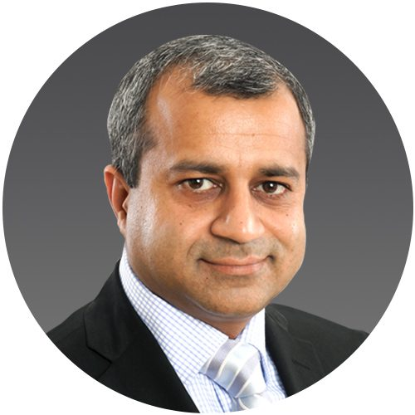
FOUNDER
Dr. Anand Deshpande
Dr. Anand Deshpande is the Founder, Chairman and Managing Director of persistent Systems since its inception and is responsible for the overall leadership , strategy and management of the Company.
Anand holds a B. Tech.(Hons.) in Computer Science and Engineering from Indian Institute of Technology (IIT) , Kharagpur and M.S. and Ph.D. in Computer Science from Indiana University, Bloomington, Indiana, USA .
Dr. Anand Deshpande
Founder, Chairman and Managing Director.
CEO
Sandeep Kalra
On 23 October 2020, Sandeep Karla became the CEO of Persistent. Sandeep Karla is the Chief Executive Officer of Persistent System and serves on the board as an Executive Director. He has completed his graduation from IIM Calcutta, and has spent about 16+ years with HCL Technologies where he held multiple leaderships positions , and also leading the Pharma vertical.
Sandeep Kalra
Executive Director and CEO

Slide 4
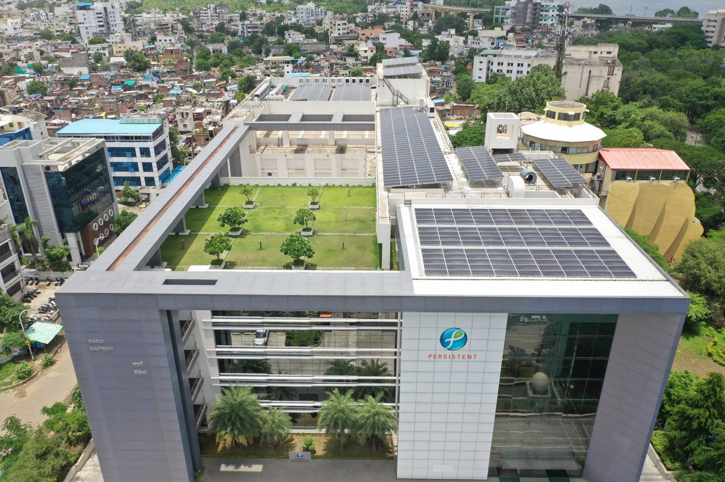
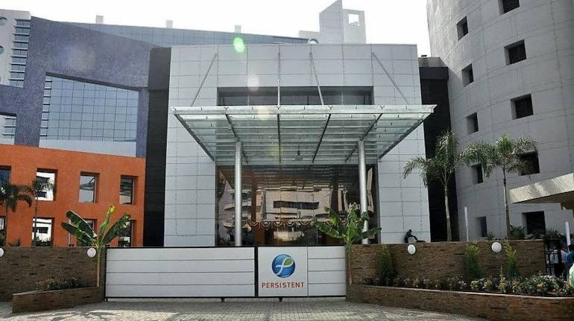
HISTORY
The Company was incorporated as Persistent Systems private Limited by Anand’s parents in Pune on May 30, 1990 while still he was in US.
They called it Persistent System because, they where working on system that are persistent, which is database.
In March that year, the Government of India had set up the first Software Technology Park (STP) in Pune, the brainchild of N. Vitthal, the then Secretary of Department of Electronics (DoE). The total area for the STP was 8,000 sq ft, and was given to 14 companies. It took Anand 6 to 8 months to get a spot in STP.
The company on September 17, 2007 with the name Persistent System Limited and a new certificate of incorporation was issued on September 28, 2007 from the RoC. The changes in registered office were for administrative reasons

Slide 5
REVENUE
1
$
$601.9M
2
12.9 % Y-O-Y Growth
3
Good growth in every quarter

Slide 6
Our Services
Persistent System specializes in Digital Business Strategy Services | Persistent Systems.
Digital Product Engineering-Software engineering services to architect, design, develop and manage your product lifecycle end-to-end, unlocking new levels of efficiency, innovation and growth
Data-Driven Business & Intelligence-Transform the way your business makes decisions. Explore our services and solutions designed to help you realize the full potential of your data so you can put it to work for you.
Identity, Access & Privacy-Get the support you need to develop & execute privacy-aware and identity-centric strategies through our secure, agile, and customer-obsessed journey.
Human-Centric Design Transforms Customer Support.

Slide 7
Awards
Company received the first prize from Government of Maharashtra ,small scale division for export performance.
Became one of the first companies in Asia to receivve an inevestment from Intel 64 LLC.
The company joins the Microsoft RFID partners council.
Persistent Systems wins Titanium Award at the Asset Triple Corporate Awadrs.
Recognized fifth time in a row as the Best Corporate University at the 2017 TISS LeapVault Awards.
Persistent Systems recognized for the fourth time under Training magazine’s Training Top 125 Award winners.
2011
1992
2005
2009
2011
2014
2019
2020
1998
2002
2005
2017
2000
2002
The product EnList Report Server wins CSI- Infosys Award.
Company won the NASSCOM innovation award
Persistent Systems partners with Dell to offer cloud-based instant disaster recovery service.
Persistent Systems receives 2019 Association of talent.
Recognised as a Microsoft Solution Provider.

Slide 8
Branches of persistent
Partners
1. Pune
2. Bangaluru
3. Hyderabad
4. Nagpur
5. Verna
6. Woodbridge township(US)
7. Sydney (Australia)
8. Koto city(Japan)
9. Singapore
10. London (UK)
Appian
AWS
DataStack
Google Cloud
IBM
Mambu
Microsoft
OutSystem
Red Hat
Sales Force

Slide 9
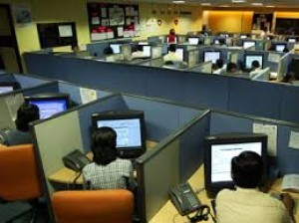
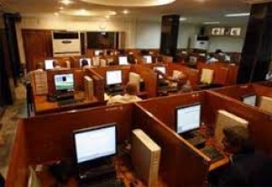
Employee
Starting in the year 1990, it took company to reach 9 years to have 100 employees.
In 2005, company had 1000 employees .
In 2011, company had 5000 employees.
In the recent times company is having 11000+ employees with 37 offices across 17 countries in 5 continents.
Company provides various facilities to its employees like gymnasium, food, cafeteria, health insurance.
Office Environment

Slide 10
Recruitment Process
Objective Round
Subjective Round
Coding Round
Computer Science
English Comprehension
Logical Ability
Automata Coding
Advance Coding Question
www.free-powerpoint-templates-design.com

Slide 11
Charity
Health
Cataract surgeries
Breast cancer screening
School health checkup program
Community Development
Roof top solar PV system on Nampally railway station,Hyderbad
Roof top solar PV system on pune railway station
Watershed projects
Education
School health program
Student sponsorship program
Kiran scholarship and mentoring program
1

Slide 12
Thank_You

