Slide 1
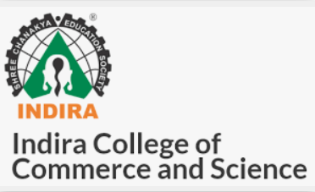
Digital Spaces -preserving your memories
03.Aishwarya
10.Anuja
31.Priyanka

Slide 2
Agenda
*Background
*Concept
*Summary of research
*Current problem
*Customer segment and eagerness
*Challenges
*Opportunities

Slide 3
Background
Life is collection of memories
- Hence a compelling need to capture , preserve and share memories
-Stories and sharing are integral in todays environment
-Many forms of devices exist and so is data stored in them
The problem
-Sharing and saving personal memories over internet has privacy and security concerns
The solution
-Provides a collection like “safe vault” where everything is under user control

Slide 4
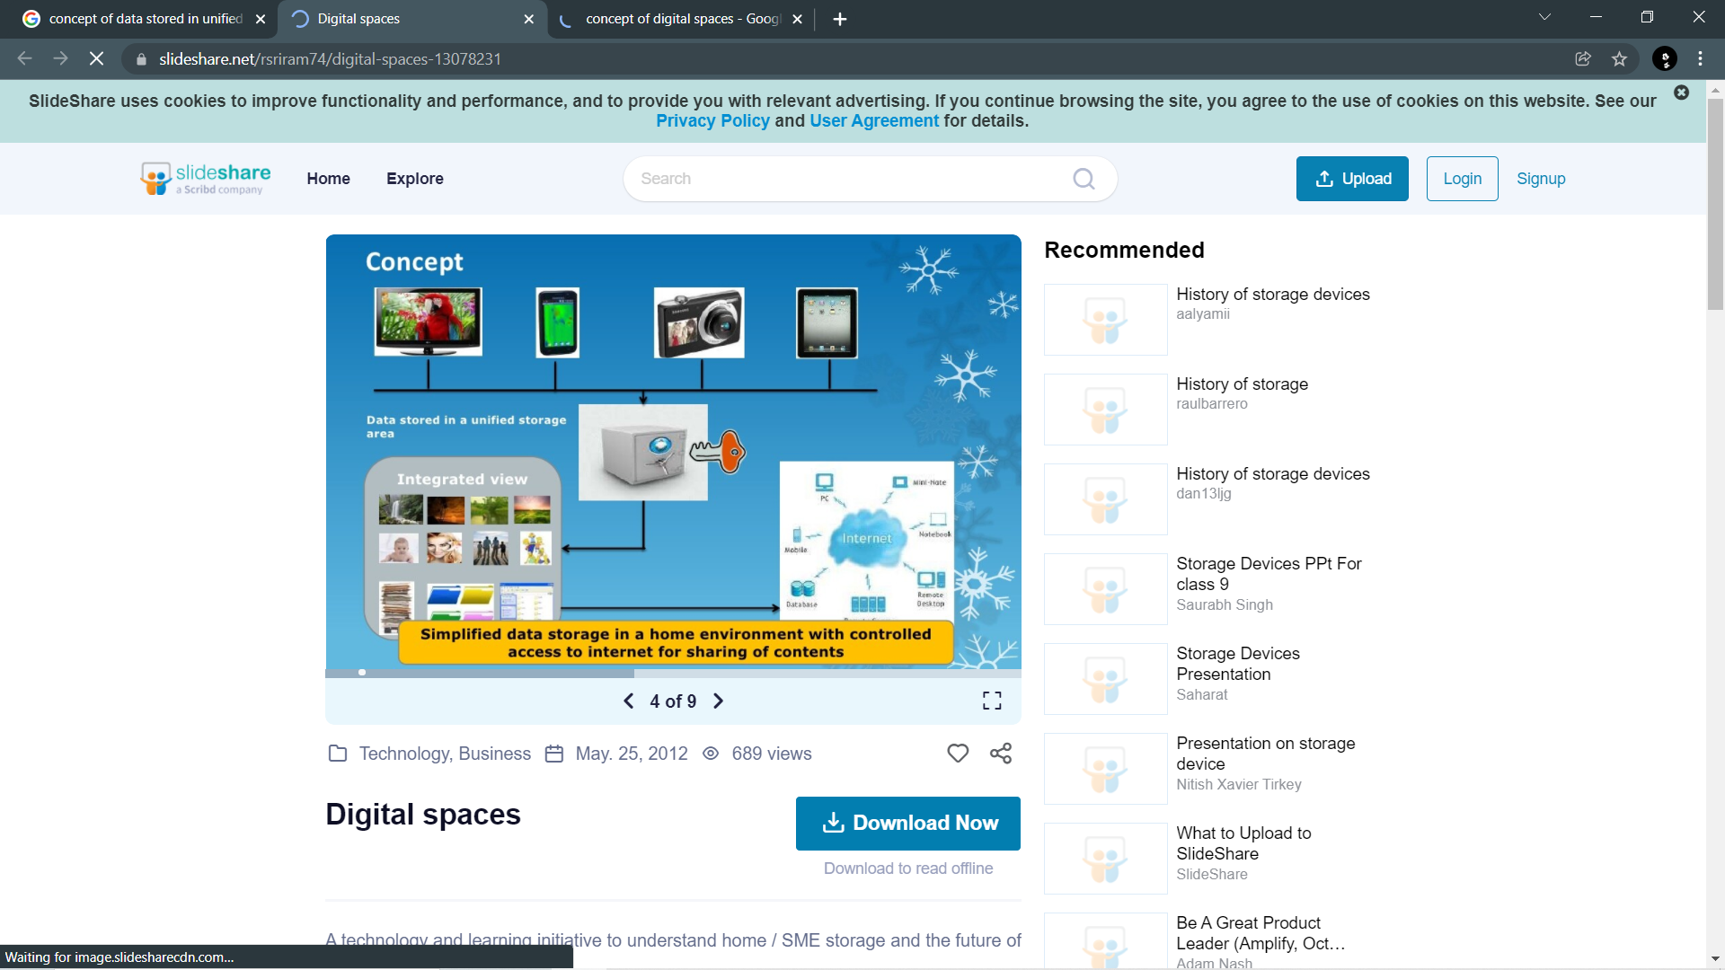
Concept

Slide 5
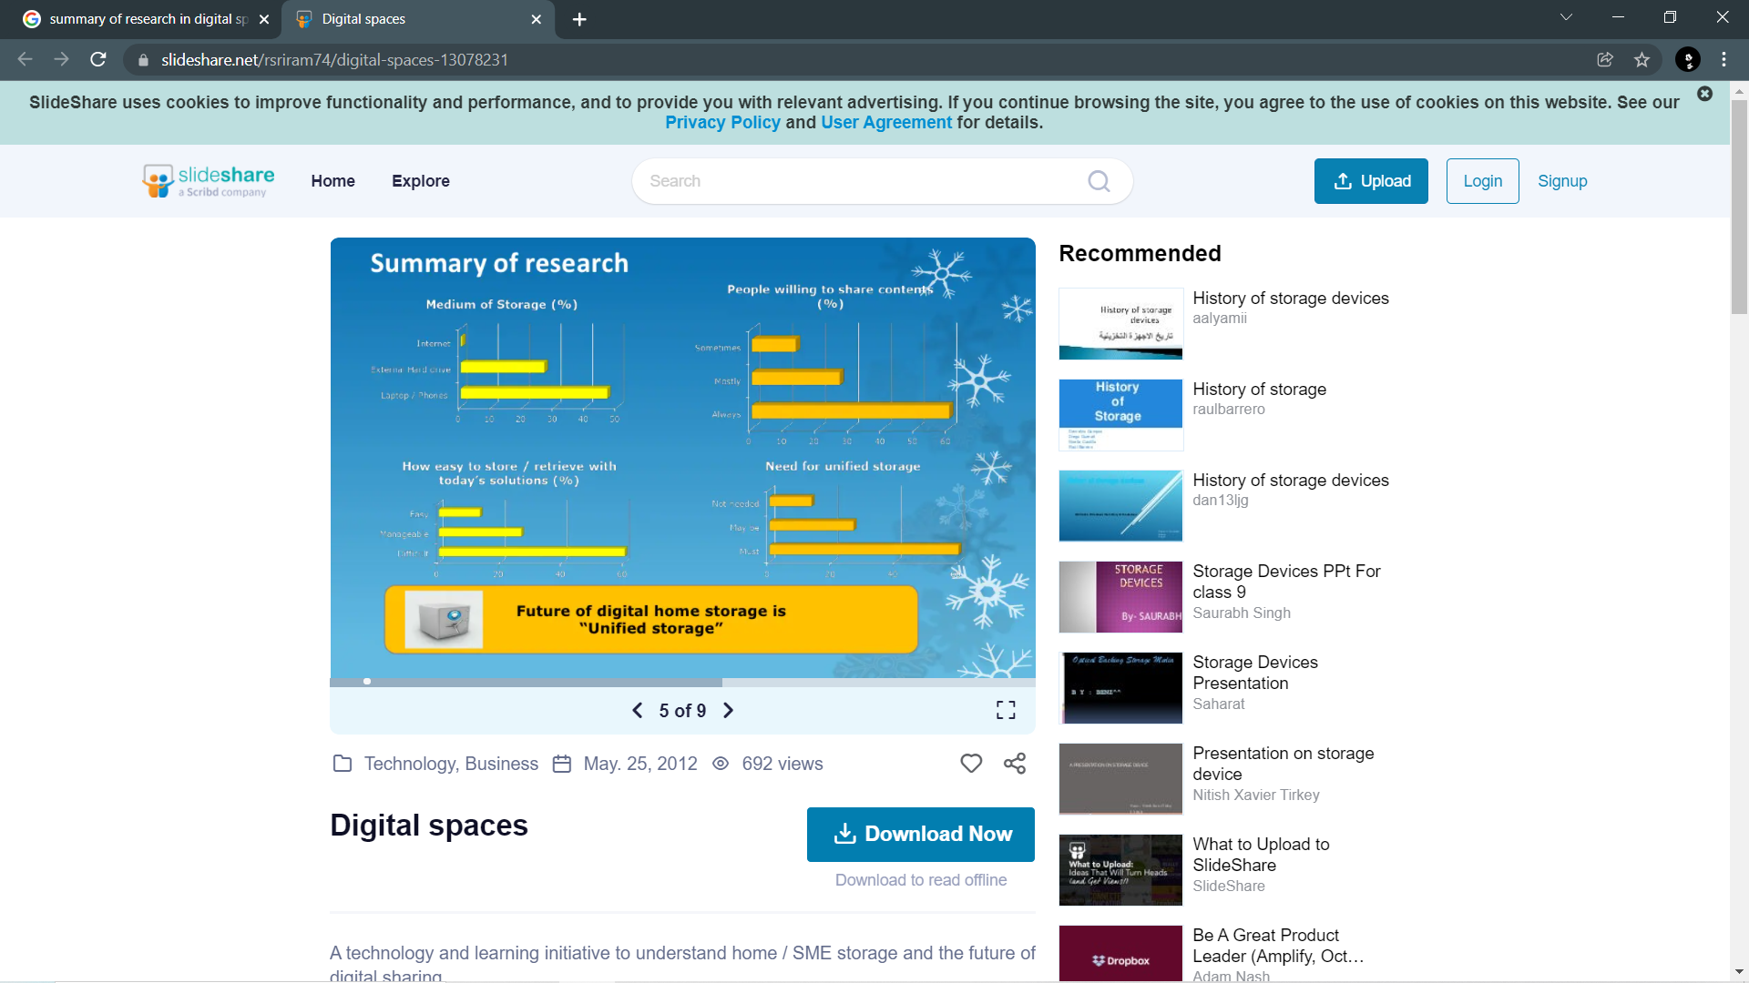
Summary of research

Slide 6
Current problem
 Heterogeneous devices without a common interface for storage
 Lack of unified approach to central storage area
 Sharing and preserving extremely cumbersome
 Solutions are tailored for one category of devices
 Example (apple family of devices)
 High level of technical depth required to configure devices
 Too many technologies( Bluetooth, wan, network, access, folders, always connected, etc)
The need: One click secure store and restore

Slide 7
Customer segment and eagerness
 Key Customer segments
 Home users
 Small and medium scale businesses
 Competition and existing products
 Different flavors of storage devices exist, however configuration and usage is painful
 Knowledge to setup, configure and use is difficult
 Lack of software eco system
 Digital spaces differentiation
 Hardware combined with extremely good software interface
 One click store and restore
 Customers willing to pay
 YES
 Price Point ($100 - $150)

Slide 8
Challenges
 Growth of heterogeneous devices and development of new operating systems and applications will create a hurdle for unified interface for simplified access
 Customer preferences change between private cloud Vs Public cloud, need support for both.
 A new device is unacceptable, the storage device should be integrated with existing hardware in the home (Example TV, setup box, Laptop, etc.)

Slide 9
Opportunities
 Growth of digital data provides opportunities for increased storage
 Growth of personal devices helps in data accumulation
 Customers recognizing the need for storage
 Diminishing value of print material and convergence to move to digital contents
 Home storage is a challenge given the different devices
 Cost is key – Need to get the cost right and provide good value proposition.

Slide 10
Thank you!

