Slide 1


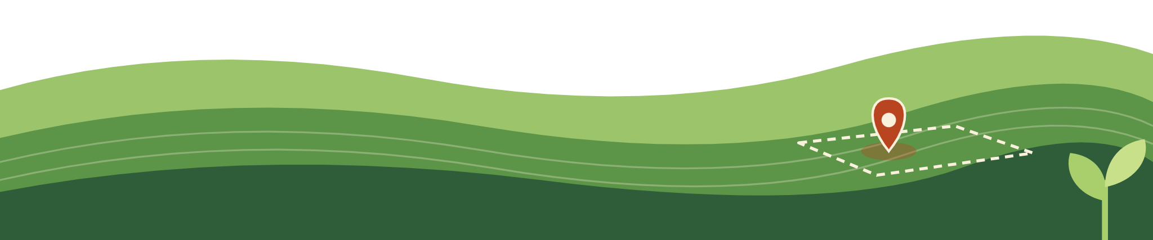
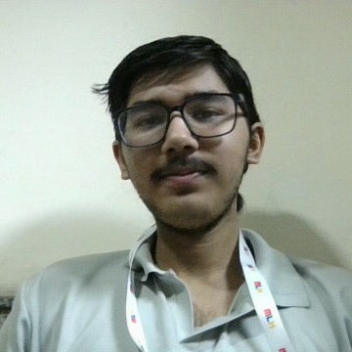



AI FARMING COMPANION
Kisaan
Bandhu
AI-powered Agricultural Disease Intelligence & Crop Surveillance Platform.
Scan crops
Weather-aware
Works offline
Notes:
Welcome. Kisaan Sathi is a farmer’s companion that covers the whole crop journey: protecting the crop in the field, then helping to store, transport and sell it. A Flutter app serves the farmer, and a web admin dashboard serves the region. The four chips along the bottom preview the story: scanning, weather-aware treatment, offline use and a fair-price sale.
1

Slide 2
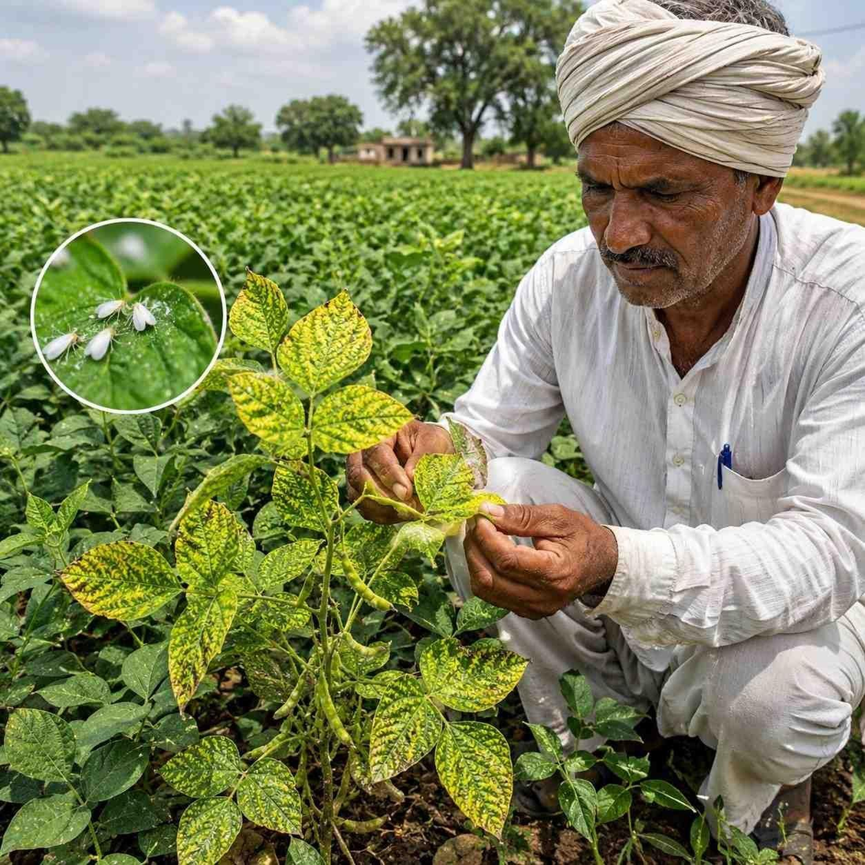



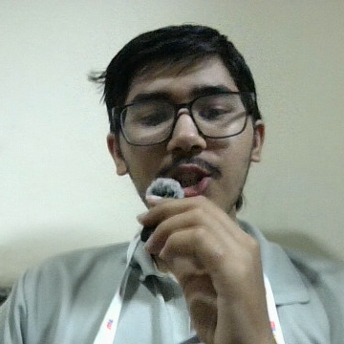
01 · THE CHALLENGE
The Problem faced by Farmers
Late detection
Disease and pests are often noticed only after they have spread across the field.
Unpredictable weather
Storms, hail and rain can weaken a treatment or damage a standing crop.
Lack of Connectivity
Digital agricultural services can become inaccessible in low-connectivity farming regions.
Kisaan Sathi · 02
Notes:
Farmers face three recurring problems: problems that spread before they are noticed, weather that undoes their work, and weak information when it is time to sell. Kisaan Sathi answers with a single agent that follows the whole journey. Green steps are crop care, gold steps are the post-harvest chain.
2

Slide 3

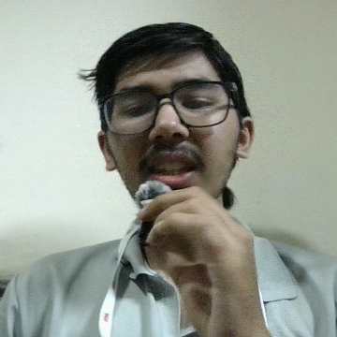
02 · THE EFFORT
Existing Gap
Existing approach
Limitation
  Disease detection apps
  Weather applications
  Agricultural helplines
  Government advisory systems
  Primarily focus on identifying crop diseases
  Provide forecasts not safeguarding measures
  Depend on expert availability
  Often operate separately from individual farm monitoring
Notes:
Farmers face three recurring problems: problems that spread before they are noticed, weather that undoes their work, and weak information when it is time to sell. Kisaan Sathi answers with a single agent that follows the whole journey. Green steps are crop care, gold steps are the post-harvest chain.
2

Slide 4
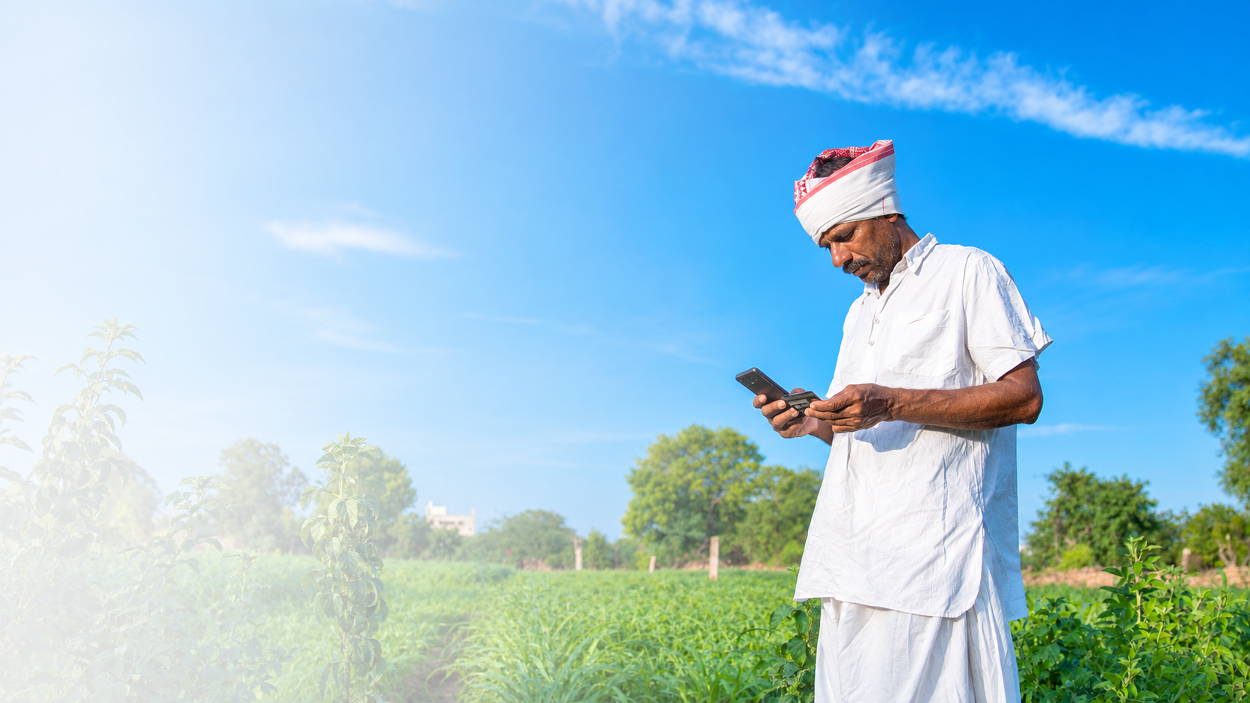

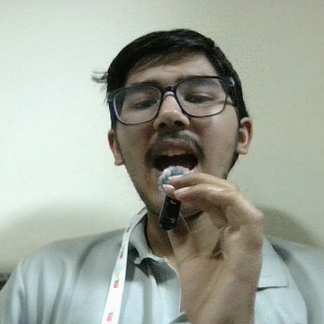
03 · OUR APPROACH
Introducing Our Solution
AI-powered Agricultural Disease Intelligence & Crop Surveillance Platform.
KisaanBandhu
Plant
Monitor
Treat
Capability
What it does
  Offline Edge Al
  Smart Field Monitoring
  Al Treatment Agent
  Persistent Follow-up
  Regional Intelligence
  Detects potential crop diseases and pests locally
  Maps crop health issues using GPS
  Provides RAG-powered, organic-first recommendations
  Tracks treatment progress and crop recovery
  Identifies potential outbreaks and coordinates alerts

Slide 5
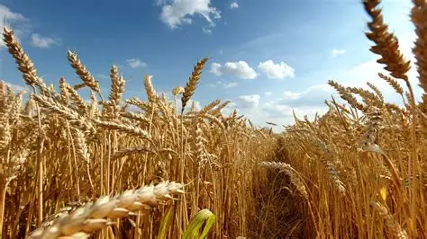


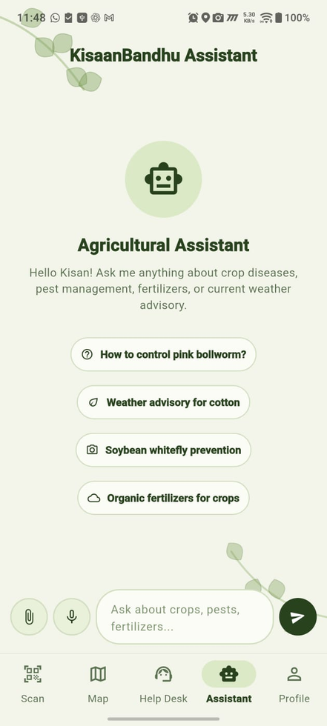


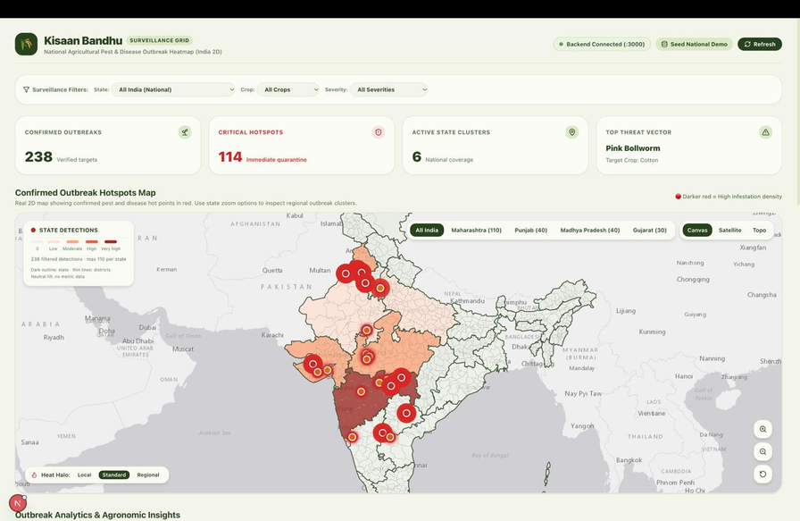
04 · UNIFIED AGRICULTURAL INTELLIGENCE ECOSYSTEM
System Components
Agricultural knowledge management
Emergency alert management
Outbreak monitoring
Multilingual farming assistant
AI treatment and follow-ups
GPS field boundary mapping
Offline disease detection
Regional disease heatmaps
Farm and crop registration

Slide 6

05 · THE SYSTEM
How KisaanBandhu Works
FARMER APP
ORGANISATION / NGO DASHBOARD
Edge-based Flutter app
Web dashboard
  Personal AI agent
  Offline disease detection
  Crop management
  Treatment and follow-ups
  Farmer alerts
  Regional heatmaps
  Disease outbreak monitoring
  Farmer data management
  Emergency alerts
One platform. Two interconnected applications.
Notes:
Two products, one agent. The farmer app runs on the phone with its own local model. The admin dashboard receives detection logs and sends alerts and prices back through the agent, which relays them to farmers.
3

Slide 7
Meko: Memory That Follows the Crop
Meko helps the agent retain each diseased-crop case and continue follow-ups beyond the first diagnosis.
From Detection to Recovery
Detect
Record
Remember
Follow up
Recover
Persistent crop case
How Meko supports the agent
Illustrative record retained by the agent
01
Retain context
Keep the detected crop issue and its history available.
Crop & field
Cotton : Field A
02
Recall at the right time
Use the stored case when the agent checks in again.
Detection
Suspected leaf disease + location
03
Continue follow-ups
Prompt progress checks and request updated observations.
Treatment
Recommended steps and application notes
Progress
Follow-up scans, observations and status
04
Track toward recovery
Compare updates with original case and treatment.
The goal: no crop case gets forgotten after diagnosis.
KISAAN SATHI / PERSISTENT AI FOLLOW-UP

Slide 8
Gemini + Our RAG: One Complete Answer
Our knowledge base grounds the response. Gemini turns that evidence into useful, contextual recommendations.
KisaanBandhu Intelligence
Why both matter
Farmer Query
RAG Retrieval
Gemini
RAG provides the domain knowledge.
Component
Role in the recommendation
Gemini interprets and connects that knowledge to the farmer's question.
Our RAG database
Retrieves relevant, curated crop and disease knowledge.
Gemini API
Reasons over the retrieved context and the farmer's situation.
Grounded knowledge
+
Context-aware reasoning
Combined output
Forms a clear answer with practical, crop-specific next steps.
A more complete recommendation.
Weather context
Can be considered alongside treatment
KISAAN SATHI / AI TREATMENT ENGINE

Slide 9
06 · THE DIFFERENCE
Existing Solution vs Our Approach
Capability
NPSS
Plantrix
Kisaan Sathi
  Disease Detection
  Internet Dependency
  Field Monitoring
  Treatment Guidance
  Follow-up
  Disease Monitoring
  Regional Intelligence
  Crop Lifecycle
  Al-powered detection through cloud APIs
  Requires internet for API-based inference
  Limited farm-level tracking
  General Al/API-based recommendations
  Lacks persistent disease case tracking
  Primarily individual, single-diagnosis based
  Limited visibility across individual farms
  Primarily focused on individual agricultural services
  On-device Edge Al using image-based diagnosis
  Offline disease detection on the device
  GPS-based field boundary and crop monitoring
  RAG + Gemini-powered, organic-first guidance
  Records detected diseases and maintains follow-up history
  Continuous farm-focused disease monitoring
  Geospatial heatmaps and potential outbreak detection
  Integrated support from planting to selling
  Can perform image based detection
  Depends on internet for proper functioning
  Does not include
  Requires user to manually input values
  Can fail to follow up with a proper cure
  Single diagnosis based
  Only by issued alerts
  Does not include
Our Core Differentiator
Individual Intelligence + Collective Intelligence
Notes:
Farmers face three recurring problems: problems that spread before they are noticed, weather that undoes their work, and weak information when it is time to sell. Kisaan Sathi answers with a single agent that follows the whole journey. Green steps are crop care, gold steps are the post-harvest chain.
2

Slide 10
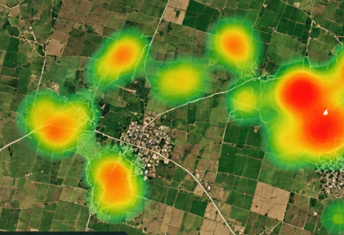



07 · ORGANISATION DASHBOARD
The Central Dashboard
Outbreak alerts
Heatmap spikes reveal an outbreak early, so neighbours are warned in time.
Storm and hail alerts
Admin pushes weather warnings; the agent tells every farmer in the area.
Harvest-season prices
Admin sets the right selling price, and the agent passes it on to farmers.
Low
High
: Red marks an outbreak zone
Notes:
When farmers reconnect, detection logs flow into the dashboard. The heatmap lets the admin see an outbreak forming across a region before it grows, and alert neighbouring farmers through the agent. The same channel carries storm and hail warnings, and during harvest season the admin publishes the correct price so farmers sell fairly.
7

Slide 11
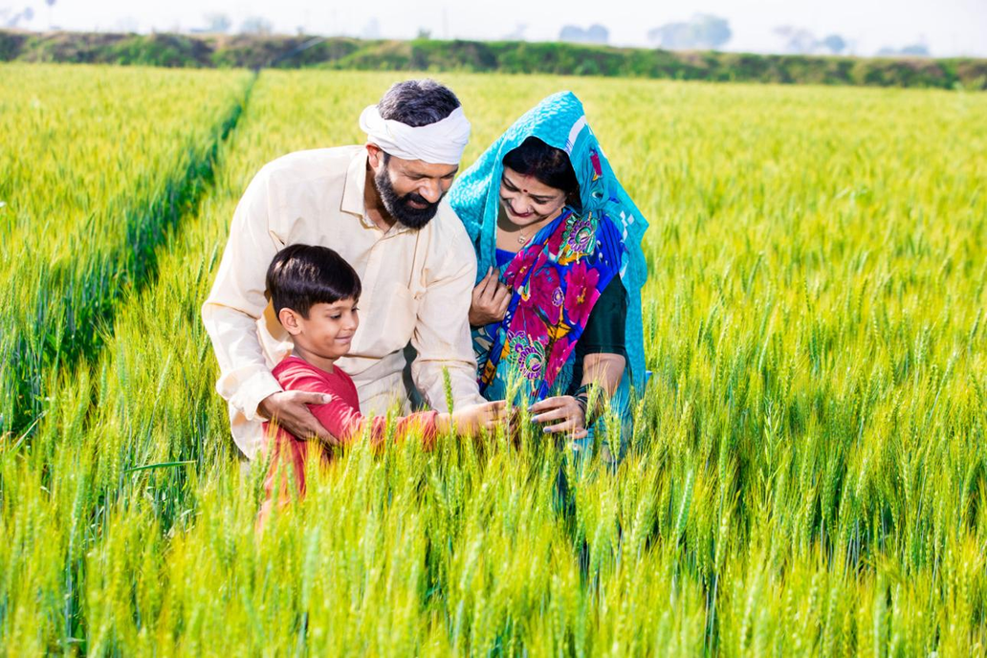
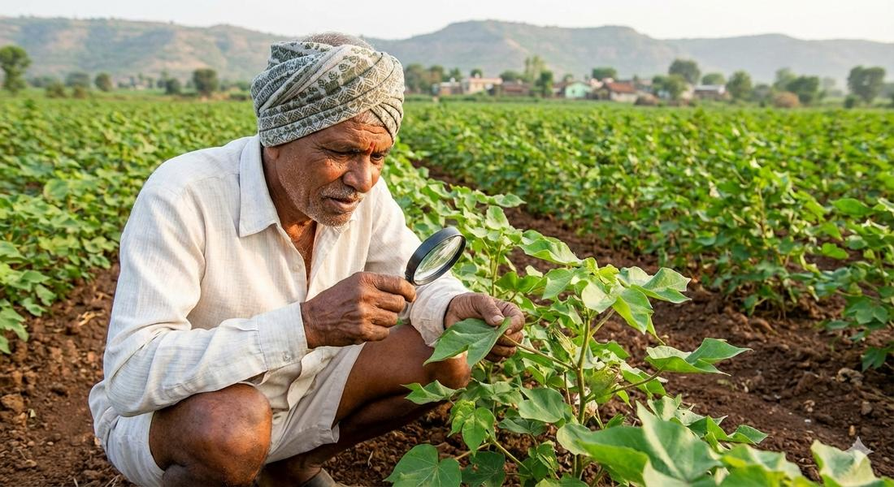
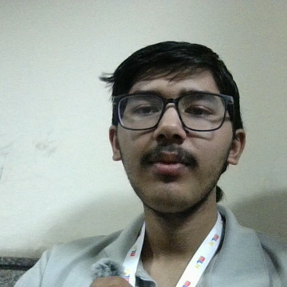
08 · SIGNIFICANCE
SOCIAL IMPACT
01. Empowering Small & Marginal Farmers
Making intelligent agricultural assistance accessible regardless of farm size.
02. Bridging the Digital Divide
Bringing offline-first AI technology to rural and low-connectivity communities.
03. Promoting Sustainable Agriculture
Encouraging responsible organic and biological crop protection practices.
04. Protecting Farmers' Livelihoods
Enabling early intervention and helping prevent avoidable crop losses.
Notes:
After planting, the farmer draws the field boundary once. Scanning happens with the phone’s own camera. Every detection is verified by the local model against our trained dataset before it is pinned on the field map as a geotag, red for disease and gold for pests.
4

Slide 12
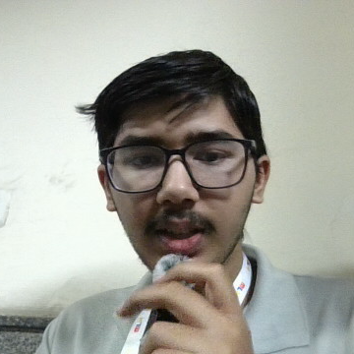
09 · FUTURE SCOPE
Expected Outcomes
1
Reduced Crop Losses
Early disease and pest identification to enable timely intervention
4
Sustainable Farming
Prioritize organic and biological crop protection practices.
Smarter Farming Decisions
Accessible, AI-powered and crop-specific agricultural guidance.
Greater Accessibility
Enable essential crop monitoring in low-connectivity regions.
2
5
Regional Disease Prevention
Identify potential disease clusters and enable community alerts.
Early Detections of Outbreaks
The disease information from farmers can help authorities recognize a outbreak in its early stage.
3
6
Notes:
Once a problem is confirmed, the agent retrieves the treatment from our own RAG database combined with the Gemini API. It always starts with organic options, checks the weather for anything that would weaken the cure, and only suggests chemicals when nothing organic will work. It keeps follow-up memory until the crop is cured, and can route the farmer to the nearest expert when it cannot identify the problem.
5

