Slide 1







Stack overflow developer Survey analysis 2019
Anuj Dangwal
04-12-2024

Slide 2



OUTLINE
Executive Summary
Introduction
Methodology
Results
Visualization – Charts
Dashboard
Discussion
Findings & Implications
Conclusion
Appendix

Slide 3

EXECUTIVE SUMMARY
Current technology usage
Top 10 Languages
Top 10 Databases
Platforms
Top 10 Web Frames
Future Technology Trends
Top 10 Languages desired for the next year
Top 10 Databases desired for the next year
Platforms desired for the next year
Top 10 Web Frames desired for the next year
Demographics
Respondent classified by gender
Respondent count for countries
Respondent count by gender and classsified by education level

Slide 4

INTRODUCTION
Top 10 programming languages in demand
Thetop database skills in demand
The popular IDEs
Correlation Between numerical data
Scraping internet web sites and accessing APIs to collect data

Slide 5

METHODOLOGY
Collecting Data using APIs
The GitHub Jobs API allows us to search, and view jobs with JSON over HTTP.
GitHub Jobs API allows anyone to query for the jobs based upon:
Technology like python, MySQL
City like New York, Bangalore
Collecting data using webscapping

Slide 6
RESULTS

Slide 7
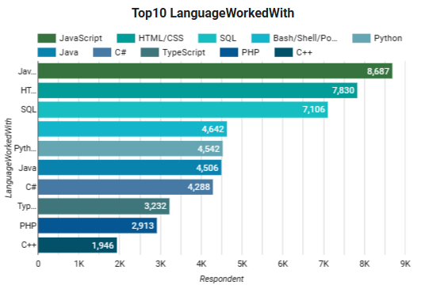
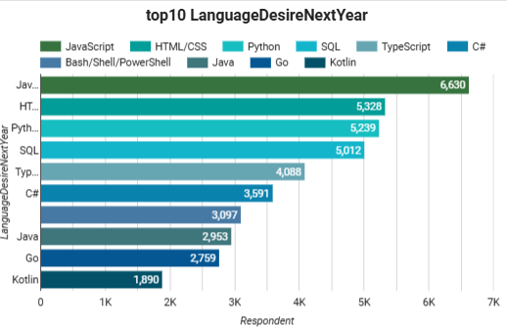
PROGRAMMING LANGUAGE TRENDS
Current Year
Next Year

Slide 8
PROGRAMMING LANGUAGE TRENDS - FINDINGS & IMPLICATIONS
Findings
JavaScript is the most popular language to use in current and also in future.
HTML/CSS is the second most popular language to use in current and also in future.
Python has the rising trend
Implications
JavaScript and HTML/CSS both have demand in current and future trend.
Python is the new thread for the near future and need to be focused on that.
Java, C#, C++ have lost their momentum. People are looking for other language apart from them.

Slide 9
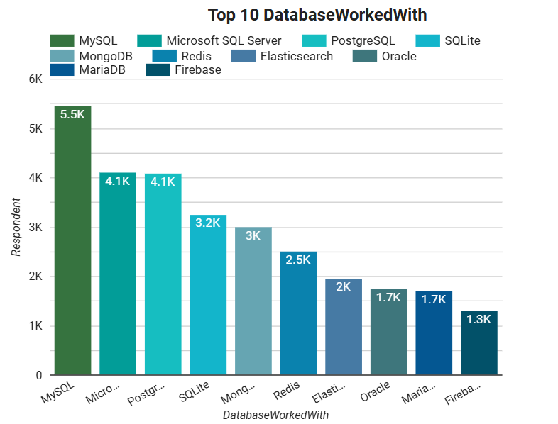
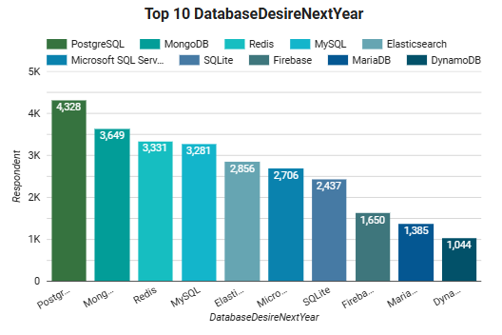
DATABASE TRENDS
Current Year
Next Year
< Bar chart of top 10 databases for the current year goes here >
< Bar chart of top 10 databases for the next year goes here.>

Slide 10
DATABASE TRENDS - FINDINGS & IMPLICATIONS
Findings
RDBMS has the dominant trend in current usage.
Now RDBMS have the dominant trend in future
Implications
People are highly intrested to learn non-relational databases.
It is clear that big data will become very popular in upcoming year

Slide 11

DASHBOARD
https://lookerstudio.google.com/s/uN3BUimIm8U

Slide 12
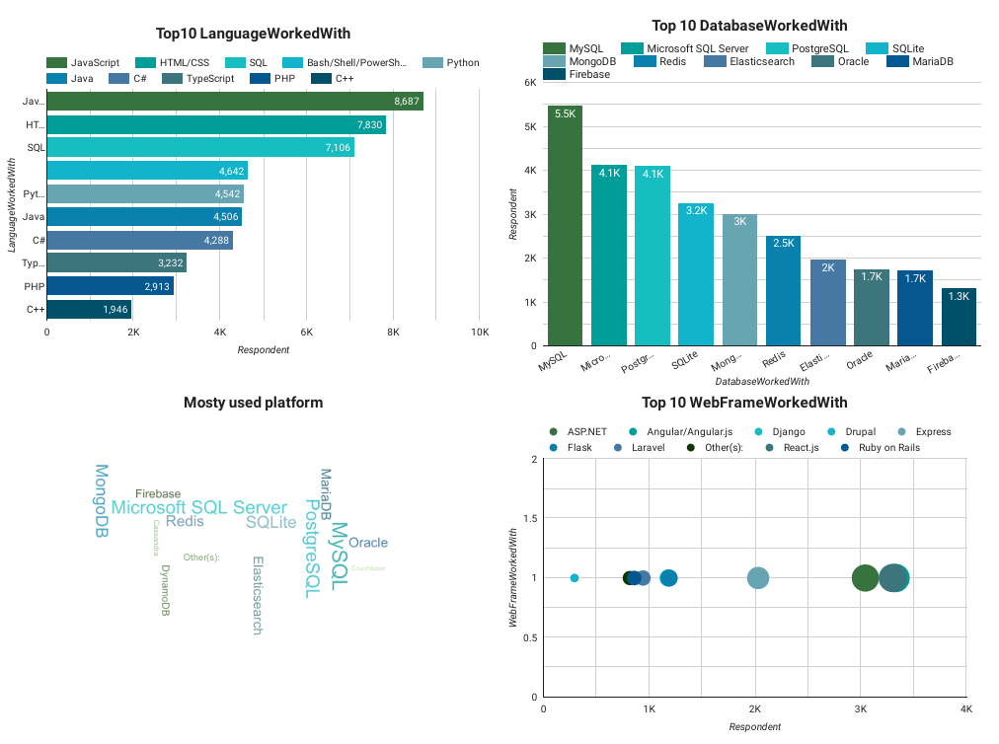
DASHBOARD TAB 1
Screenshot of dashboard tab 1 goes here

Slide 13
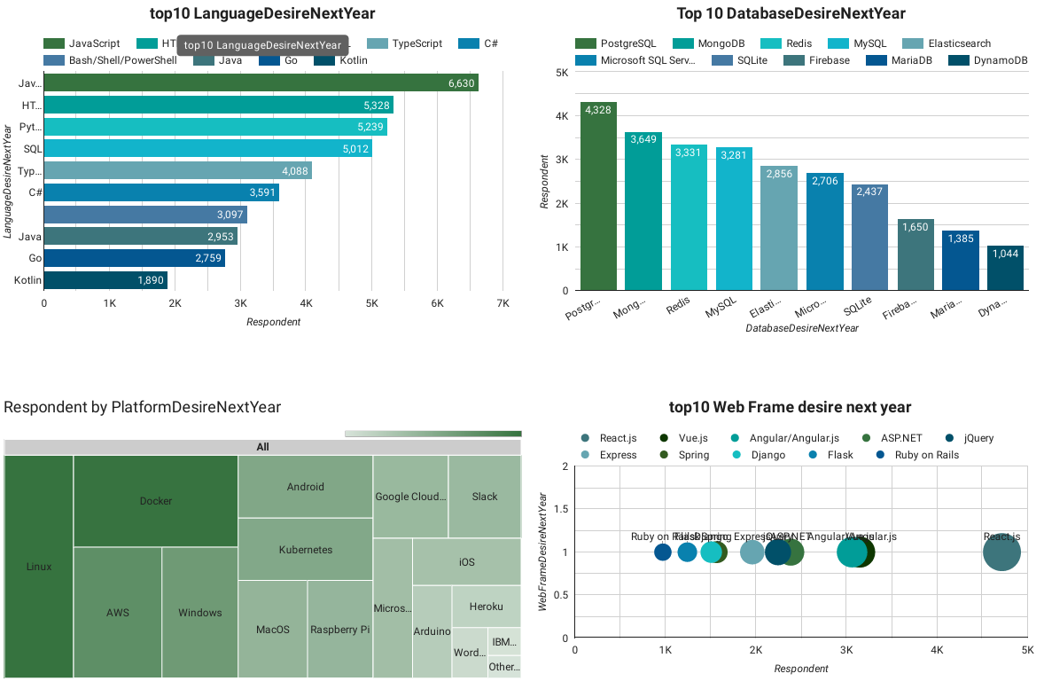
DASHBOARD TAB 2
Screenshot of dashboard tab 2 goes here

Slide 14
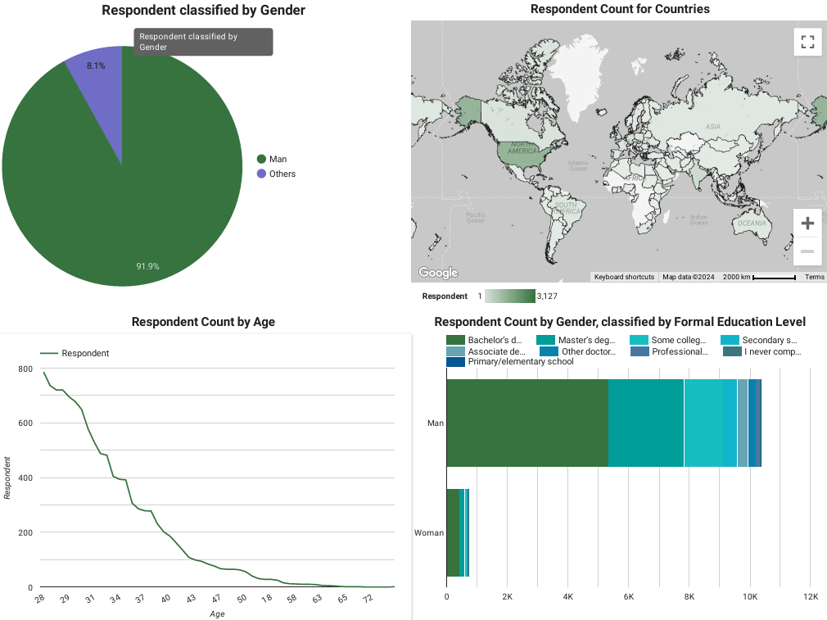
DASHBOARD TAB 3
Screenshot of dashboard tab 3 goes here

Slide 15
DISCUSSION
It is clear from previous study that, The upcoming future is for big data so the knowledge on big data along with advanced programming languages will make the differences.

Slide 16
OVERALL FINDINGS & IMPLICATIONS
Findings
The upcoming trend is for advanced programing languages
The upcoming trend for data base is non-relational database
Implications
People are looking for advanced programming languages along with easy learning.
People are looking for big data cause data is every where.

Slide 17

CONCLUSION
The top programming languages in demand.
The top database skills in demand.
The popular IDEs
Scraping internet websites and accessing APIs to collect data

