Slide 1

Cloudflare Zero Trust: Agent Onboarding & SWG Firewall Policies
Securing your workforce with Cloudflare's Zero Trust platform simplifies agent deployment. Robust firewall policies protect users and data, wherever they are located.
by Team - D

Slide 2


Cloudflare Zero Trust Overview
Cloudflare Zero Trust replaces legacy VPNs with a modern, Secure Access Service Edge (SASE). It verifies every user and device before granting application access. Integrating with identity providers like Okta, Azure AD, and Google Workspace, its global network spans 300+ cities in 100+ countries. This network blocks an average of 147 billion threats daily.
Replaces legacy VPNs with modern SASE.
Verifies every user and device.
Global network in 100+ countries.
Blocks billions of threats daily.

Slide 3
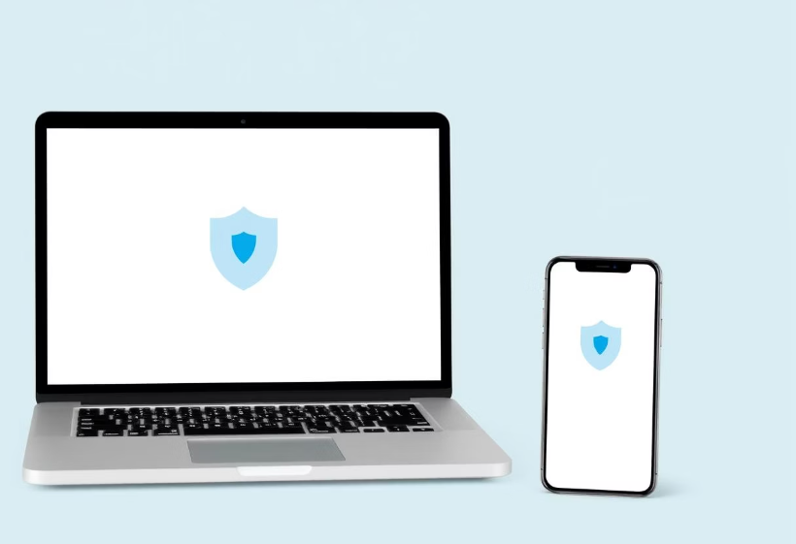
Zero Trust Agent: Deployment
Seamless Deployment
The lightweight Zero Trust agent supports macOS, Windows, Linux, iOS, and Android. It enforces device posture checks including OS version, disk encryption, and AV status. Integration with WARP ensures seamless operation. Silent deployment via MDM, like JAMF and Intune, is fully supported. Typical deployment takes less than 5 minutes per device, significantly streamlining IT operations.

Slide 4


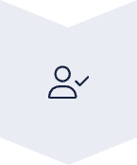


Agent Onboarding: Device Enrollment
Unique URL
Users enroll via a unique enrollment URL.
IdP Authentication
Authentication occurs with the configured identity provider.
Device Registration
Automatic device registration and posture assessment.
Reduced Tickets
Reduces IT support tickets by up to 75%.

Slide 5




SWG Firewall Policies: Overview
Cloudflare's Secure Web Gateway (SWG) protects users from web threats. It offers granular policies based on user, group, device, and destination. SWG supports URL filtering, content inspection, and threat intelligence. It integrates with Cloudflare's global threat intelligence database, blocking 99% of threats effectively.
Web Protection
Granular Controls
Global Intelligence
Shields users from online threats.
Policies based on identity and location.
Integrated threat intelligence.

Slide 6
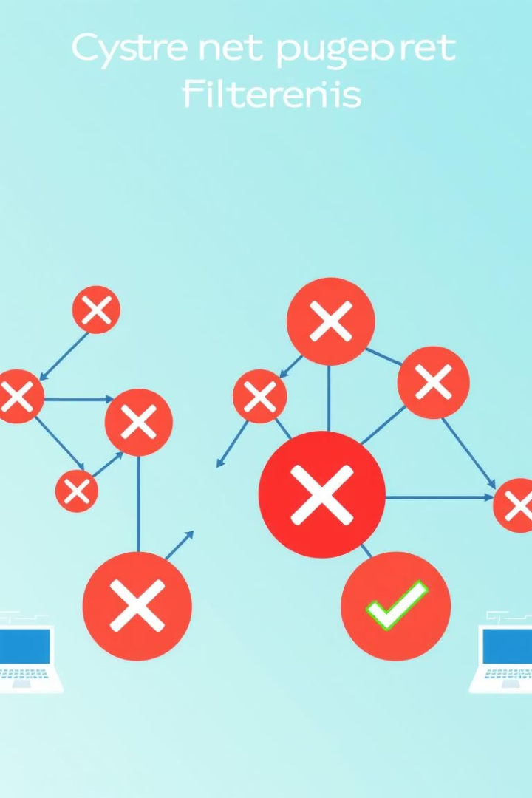
Firewall Policy Creation: Example
Block Social Media
Restrict social media for contractors.
Managed Device Access
Only managed devices access internal apps.
Inspect Outbound Data
Scan for sensitive data like credit cards.
Quarantine High-Risk Files
Isolate dangerous web downloads.
These policies reduce malware infections by up to 90%.

Slide 7

SWG Firewall Policy: Advanced Features
SWG firewall policies include Data Loss Prevention (DLP) to prevent sensitive data exfiltration. They integrate with third-party threat intelligence feeds for enhanced security. Custom block pages with company branding provide a tailored user experience. Real-time logging and reporting enable effective policy enforcement. Policy creation time is reduced by 50% compared to legacy firewalls.
50%
Faster Policy Creation
Compared to legacy firewalls.
99%
Threat Block Rate
Using global threat intelligence.

Slide 8
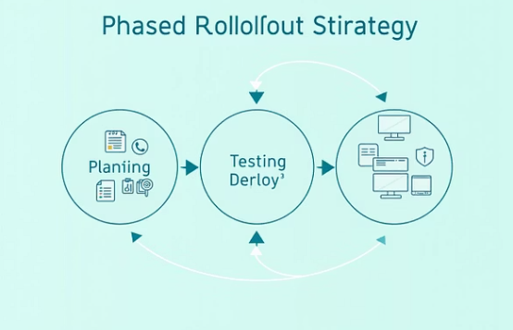
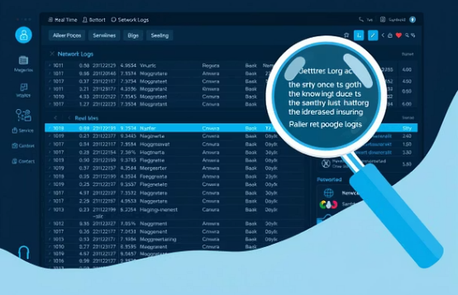

Best Practices & Conclusion
Begin with a phased rollout of the Zero Trust agent. Continuously monitor and adjust firewall policies as needed. Train users on new security protocols to ensure smooth adoption. Leverage Cloudflare's extensive support resources and documentation for assistance. Cloudflare blocks 10 million phishing attacks daily. Zero Trust adoption reduces breach risk by 80%, according to Gartner.

