Slide 1
Voucher Management System (VMS)
Supervisor Name
Members & Roles
Date
Department

Slide 2
Introduction
The Project Progress Of The Voucher Management System (VMS) Will Be Discussed With Key Stakeholders Such As The Marketing Team, Product Development Team, IT Department, And ERP.

Slide 3
Project Overview
Project Scope

Slide 4
Main Features and Benefits
Main features of VMS include,
Voucher Generation: Automated generation of unique voucher codes.
Voucher Redemption: Easy and secure voucher redemption process.
User Management: Role-based access control for different stakeholders.
Reporting and Analytics: Comprehensive reports on voucher usage and redemption.
Notification System: Alerts and notifications for voucher expiration and usage.
Integration with Existing Systems: Seamless integration with billing and CRM systems.

Slide 5
Main Features and Benefits
Benefits to the clients include,
Improved Efficiency: Reduces manual processing and human errors.
Enhanced Customer Experience: Simplifies the process of redeeming vouchers for customers.
Real-Time Insights: Provides real-time data on voucher usage and customer trends.
Cost Savings: Minimizes operational costs associated with voucher distribution.
Security: Ensures secure handling and redemption of vouchers.

Slide 6
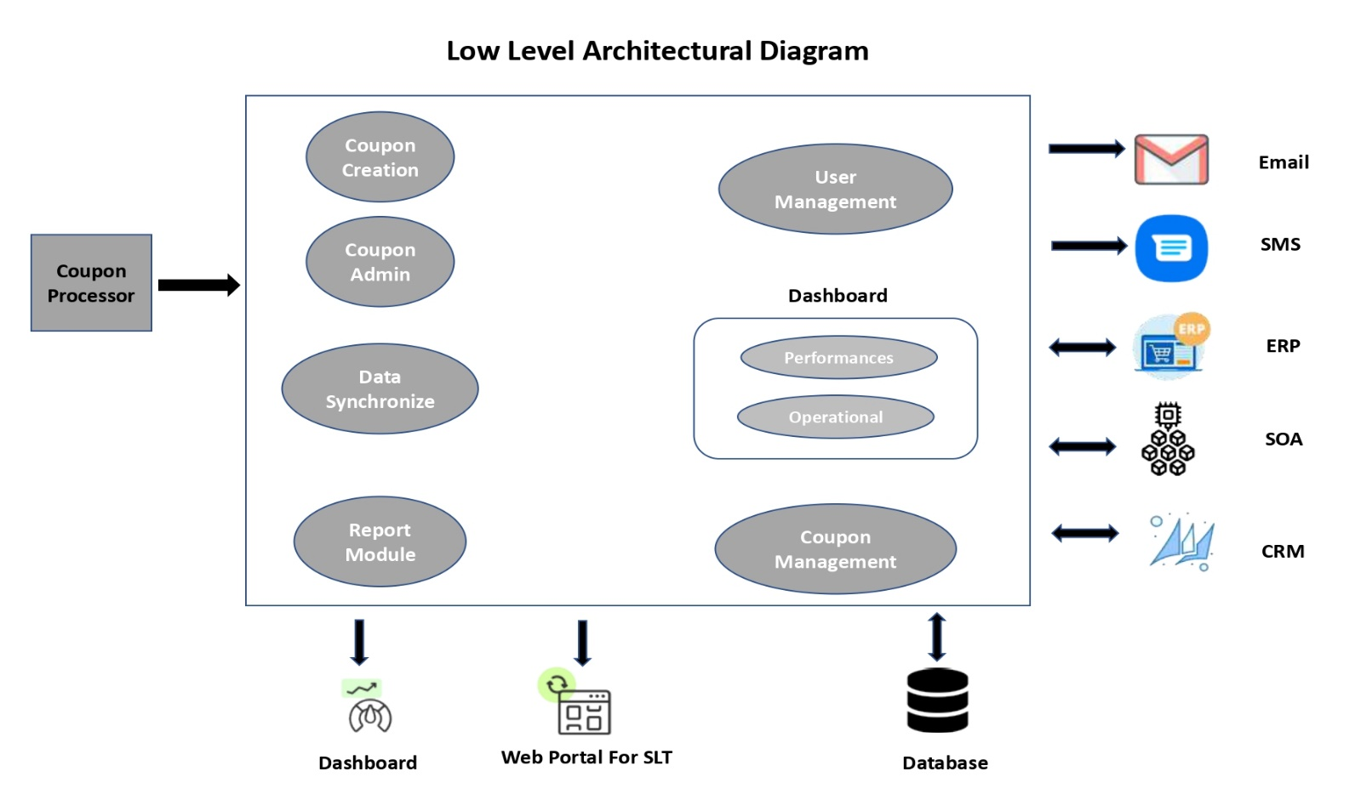
Technical Overview and Architecture
Architecture Diagram

Slide 7
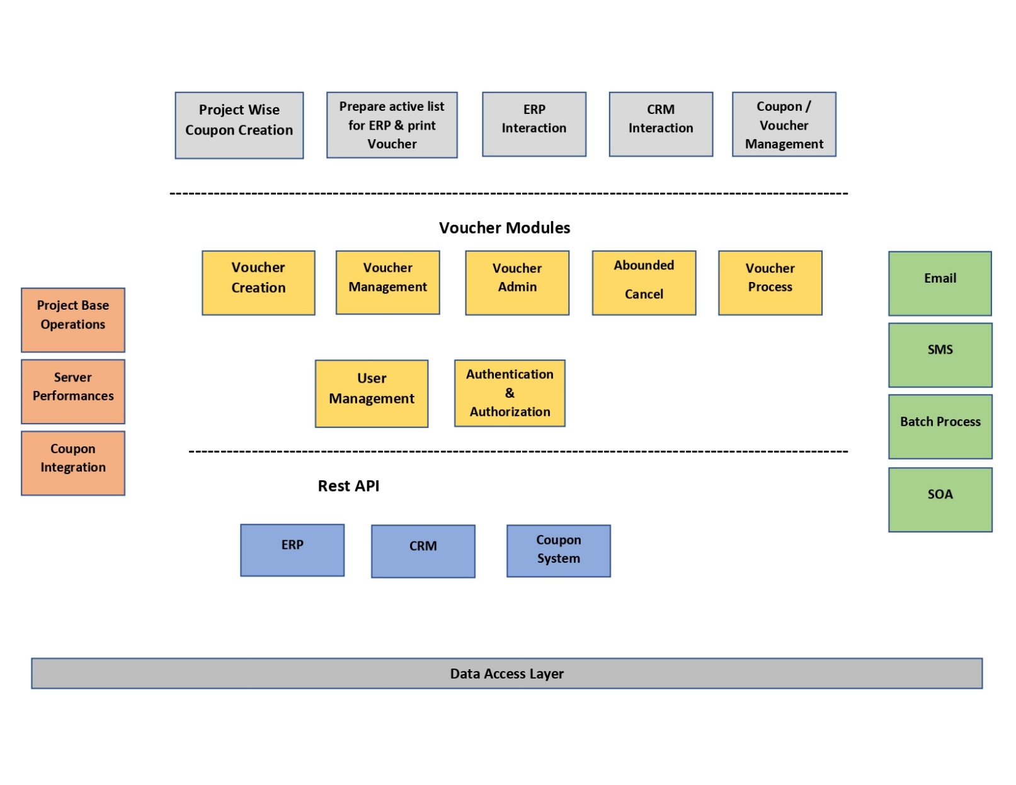
Technical Overview and Architecture

Slide 8
Technical Overview and Architecture
Technology Stack ,
Backend : PHP & Laravel
Frontend : Bootstrap , JS
Database : MySQL
Authentication : JWT (JSON Web Tokens)
Hosting :
API Documentation: Swagger
Version Control: Bit Bucket

Slide 9
Current Status and Milestones
Requirements gathering and analysis
System design and architecture planning
Development of core functionalities
Integration with CRM and billing systems
Initial testing and bug fixes

Slide 10
Current Status and Milestones
Upcoming Milestones
User Acceptance Testing (UAT) completion
Final bug fixes and optimizations
System go-live
Post-launch support and monitoring
Documentation and approval

Slide 11
Future Plan
Need relevant APIs from ERP to do the further development and implementation.

