Slide 1
Voucher Management System (VMS)
Supervisor Name
Members & Roles
Date
Department

Slide 2
Introduction
The purpose of the presentation is,
Present and discuss the project progress of the Voucher Management System (VMS) with the key stakeholders including the marketing team, user department , product development team, and IT department and
Gather feedback and give an awareness regarding the required resources to the future progress of the application.

Slide 3
Project Overview
Project Scope
The VMS project focuses on,
Managing and redeeming vouchers for not only FTTH new connections but also any product, and does not cover marketing strategies, customer feedback mechanisms, or non-technical aspects of voucher promotions.

Slide 4
Main Features and Benefits
Main features of VMS include,
Voucher Generation: Automated generation of unique voucher codes.
Voucher Redemption: Easy and secure voucher redemption process.
User Management: Role-based access control for different stakeholders.
Reporting and Analytics: Comprehensive reports on voucher usage and redemption.
Notification System: Alerts and notifications for voucher expiration and usage.
Integration with Existing Systems: Seamless integration with billing and CRM systems.

Slide 5
Main Features and Benefits
Benefits to the clients include,
Improved Efficiency: Reduces manual processing and human errors.
Enhanced Customer Experience: Simplifies the process of redeeming vouchers for customers.
Real-Time Insights: Provides real-time data on voucher usage and customer trends.
Cost Savings: Minimizes operational costs associated with voucher distribution.
Security: Ensures secure handling and redemption of vouchers.

Slide 6
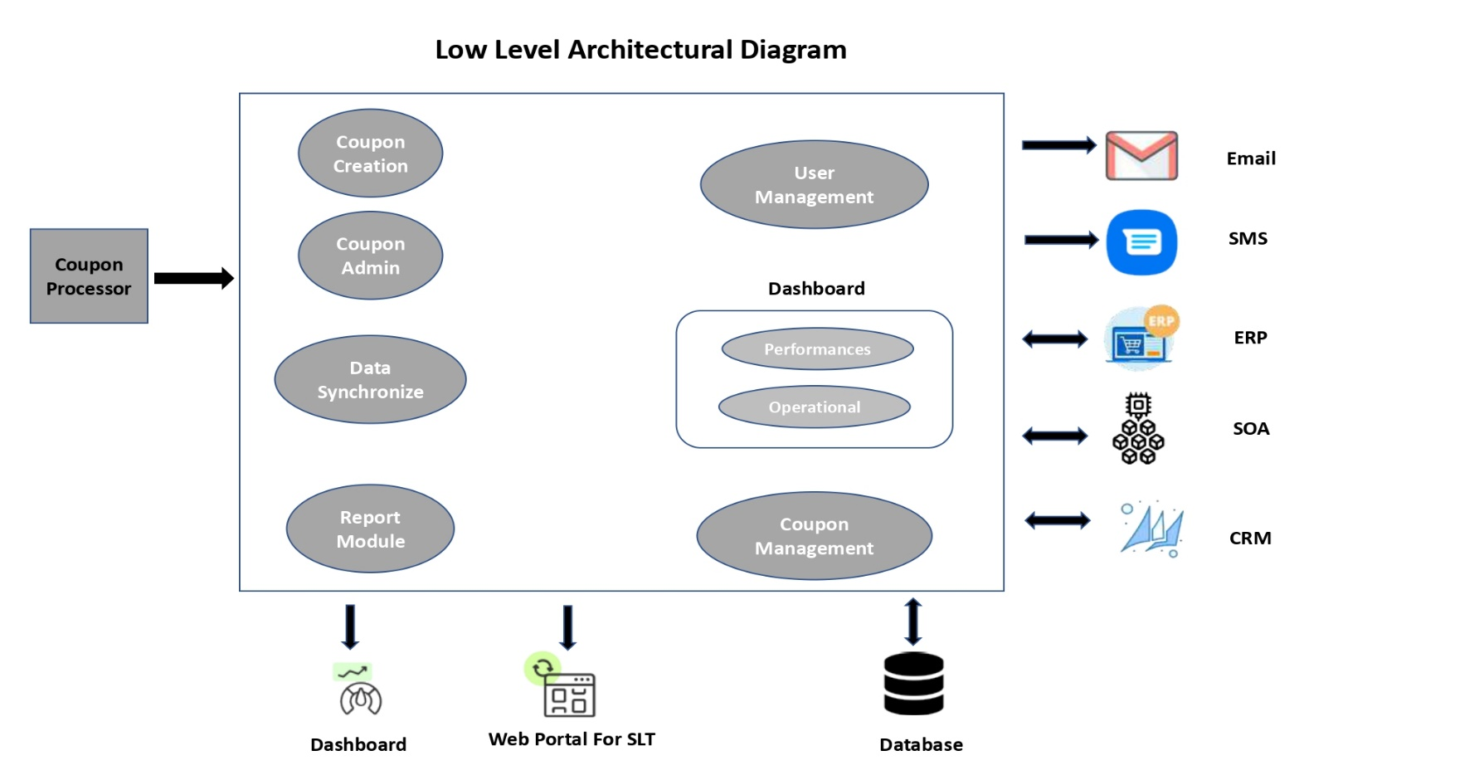
Technical Overview and Architecture
Architecture Diagram

Slide 7
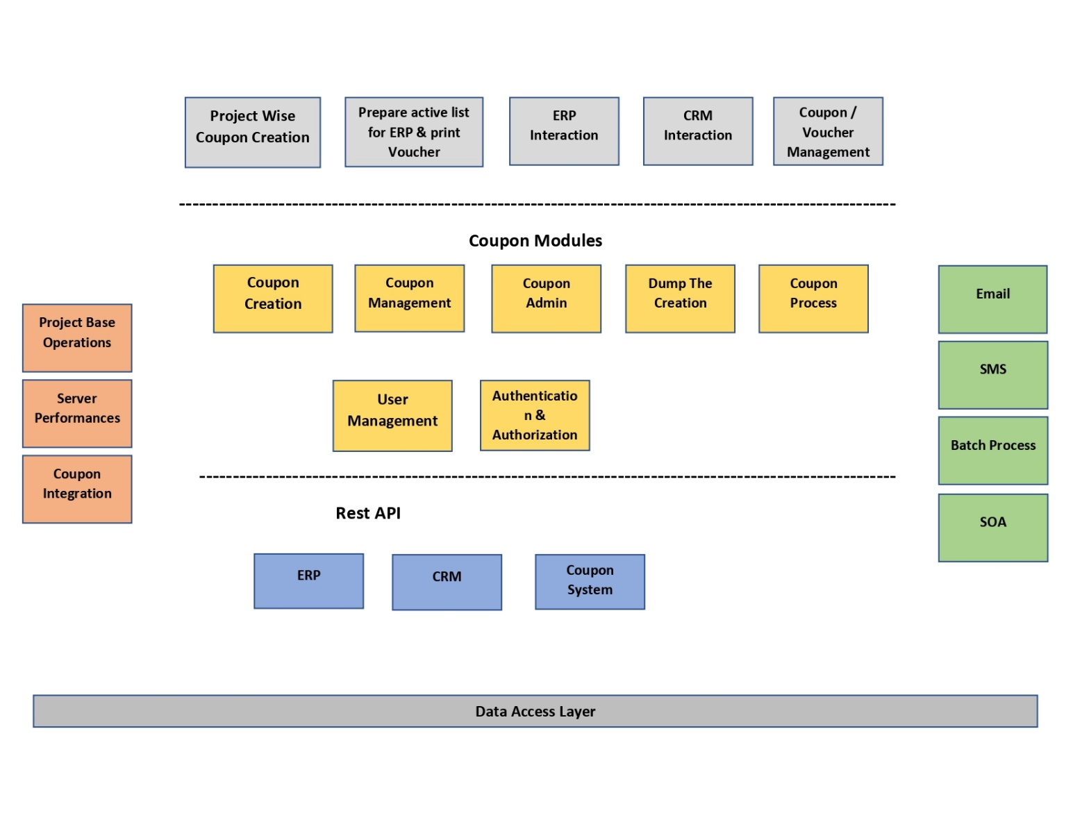
Technical Overview and Architecture

Slide 8
Technical Overview and Architecture
Technology Stack ,
Backend : language : PHP & framework : Laravel
Frontend : languages : HTML ,CSS & framework : Bootstrap
Database : MySQL
Authentication : JWT (JSON Web Tokens)
Hosting :
API Documentation: Swagger
Version Control: Bit Bucket

Slide 9
Current Status and Milestones
Progress of the application ,
The project is currently in the final testing phase. Integration with the existing billing system is complete, and user acceptance testing (UAT) is underway.
The FRD has received and reviewed
SRS is preparing by the business analysts.

Slide 10
Current Status and Milestones
Completed Milestones
Requirements gathering and analysis
System design and architecture planning
Development of core functionalities
Integration with CRM and billing systems
Initial testing and bug fixes

Slide 11
Current Status and Milestones
Upcoming Milestones
User Acceptance Testing (UAT) completion
Final bug fixes and optimizations
System go-live
Post-launch support and monitoring
Documentation and approval

Slide 12
Future Plan
Next steps,
Complete User Acceptance Testing (UAT) and address any issues identified.
Finalize the system go-live plan and execute it.
Provide training sessions for end-users.
Monitor system performance and provide ongoing support.

Slide 13
Future Plan
Actions required from client are,
Need relevant APIs from ERP to do the further development and implementation.
Review and approve UAT results.
Coordinate with IT for the system go-live.
Schedule training sessions for staff.
Provide feedback for continuous improvement.

Slide 14
Q&A

