Slide 1
Salary Prediction Using Ensemble Learning
Flask/IBM Cloud/github
Presented by: Anuj Mishra
GitHub: github.com/Anujunitian

Slide 2
Overview
- Predicts salary using ensemble ML models
- Used tools: Python, Google Colab, VS Code
- Flask used to host model as web app
- Final deployment available via browser interface

Slide 3
Technologies & Libraries
- Python
- Google Colab
- VS Code (Development IDE)
- Flask (Web Hosting)
- Scikit-learn, Pandas, NumPy, Matplotlib
- Joblib (Model Serialization)

Slide 4
Model & Approach
Ensemble Learning used:
- Random Forest
- Gradient Boosting
- Voting Regressor
Trained on structured employee data with features like:
- Age, Gender, Experience, Education, Job Title

Slide 5
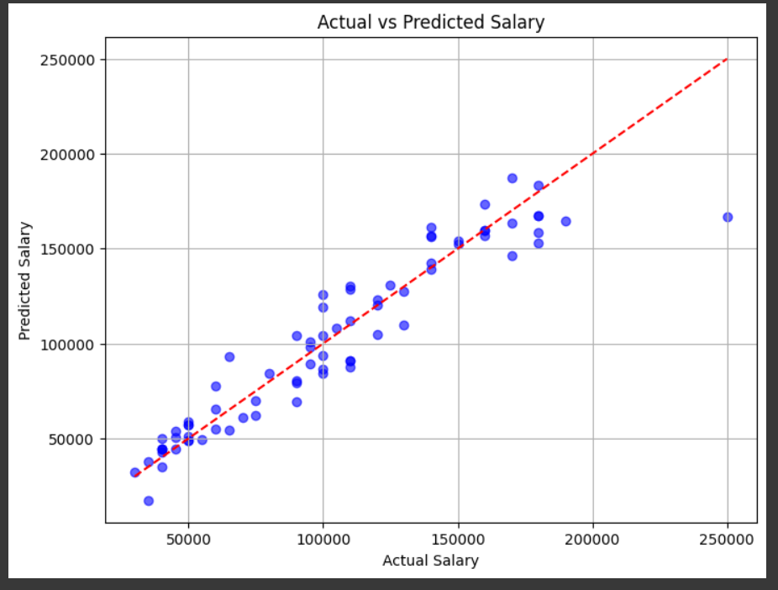
Model Performance: Actual vs Predicted
The scatter plot below shows a high correlation between actual and predicted salaries.

Slide 6
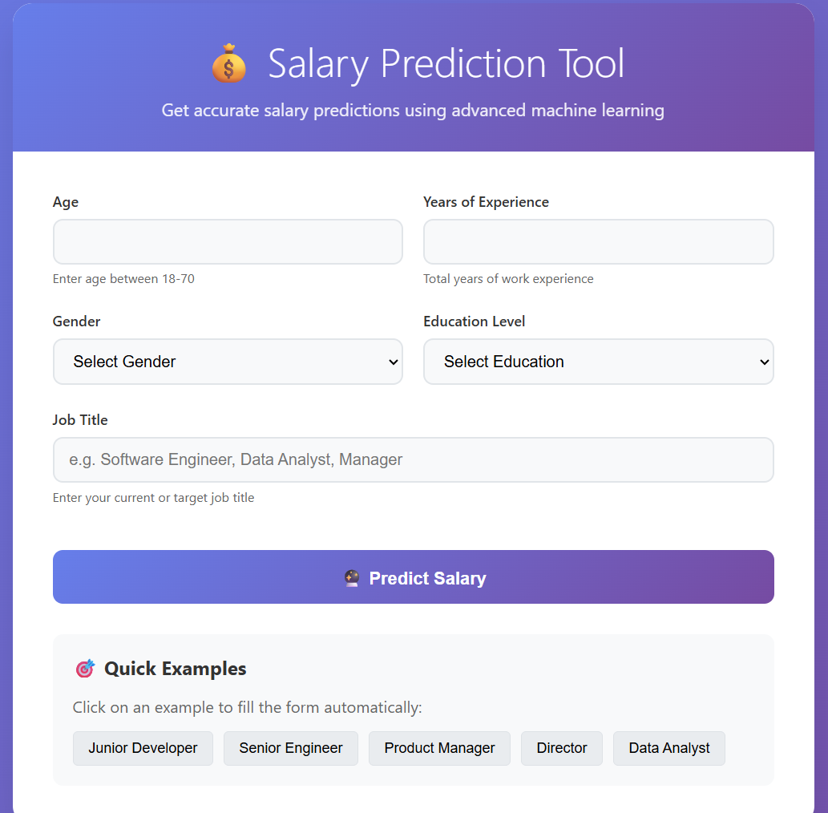
Browser-based Tool UI (Flask)
Users can input their details and get salary prediction directly on browser.

Slide 7
GitHub & Conclusion
GitHub Repo: https://github.com/Anujunitian/Salary-Prediction
Conclusion:
- Ensemble models provide robust and accurate salary predictions.
- Flask enables easy deployment and user interaction.
- Future improvements: Add real-time APIs, expand dataset.

