Slide 1
Bangalore Restaurants: What Drives Rating?
Analysis of 9,281 Zomato restaurants using Python, MySQL and Power BI
Data Analyst portfolio project

Slide 2
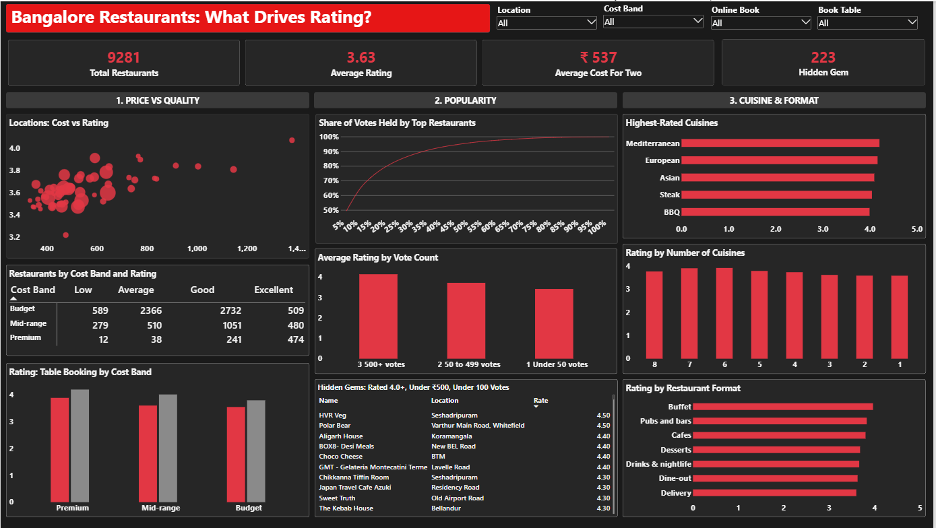
The dashboard at a glance

Slide 3
From 51,717 raw rows to 9,281 restaurants
51,717
12,499
9,281
raw rows, with many restaurants listed more than once
unique restaurants after removing repeats
restaurants with a valid rating and cost
Two gaps were fixed in Power Query: 37 missing restaurant types were set to "Unknown", and one ₹6,000 restaurant with no cost band was set to "Premium".

Slide 4
Premium restaurants rate higher
Average rating rises from 3.55 (Budget) to 4.10 (Premium)
Cost and rating move together, but only modestly (correlation about 0.33)
Table booking adds about 0.2 to 0.4 rating points in every cost band
Only about 10% of restaurants offer table booking

Slide 5
Popular restaurants rate higher
The top 10% of restaurants by votes hold about 65% of all votes
223 hidden gems are rated 4.0 or higher, cost ₹500 or less for two, and have under 100 votes
Good, cheap places are being overlooked by most diners

Slide 6
Cuisine and format
Highest-rated cuisines (50+ restaurants)
Average rating by restaurant format
Mediterranean, European and Asian cuisines rate highest, and they cost about ₹1,300 to ₹1,500 for two.

Slide 7
What to take away
Premium restaurants rate higher, but cost is only a modest guide to quality
Table booking goes with higher ratings in every cost band
A few popular restaurants hold most of the votes, so the hidden gems are easy to miss
Mediterranean, European and Asian cuisines rate highest, and restaurants with more cuisines rate slightly higher
Correlation is not causation, and cost for two is an estimate from the listing

