Slide 1
Airbnb New User Booking
MAY 29, 2020
By: Anu Kashyap

Slide 2
Agenda
Background & Objectives
Data Wrangling
Exploratory Data Analysis
Prediction Models
Recommendations
Lyft’s overall business objective

Slide 3
Background & Objectives
Background
Instacart operates an online grocery delivery and pick-up service. Orders are fulfilled and delivered by an Instacart personal shopper, who picks, packs, and delivers the order within the customer's designated time frame
Currently they use transactional data to develop models that predict which products a user will buy again, try for the first time, or add to their cart next during a session
Through a competition, Instacart is challenging the Kaggle community to use this anonymized data on customer orders over time to predict which previously purchased products will be in a user’s next order.
Problem Statement & Objective
Problem statement: In which country will a new guest book their first travel experience?
Objective:
The objective is to help Airbnb understand the following:
• Better forecast demand
• Share customized content with client
• Decrease the average time to first booking

Slide 4
Data Wrangling

Slide 5
Data Wrangling
Kaggle Data
The dataset for this competition is a relational set of files describing customers' orders over time. The dataset is anonymized and contains a sample of over 3 million grocery orders from more than 200,000 Instacart users. The datasets are:
aisles.csv: contains the aisle_id and aisle_name of a product
departments.csv: contains the department_id and department_name of a product
order_products__prior.csv: contains previous order contents for all customers. 'reordered' indicates that the customer has a previous order that contains the product
order_products__train.csv:
orders.csv: Contains information about which set (prior, train, test) an order belongs. Need to predict reordered items only for the test set orders. 'order_dow' is the day of week
products.csv: contains mapping between product, aisle and department
Data Wrangling
Concatenate train and test data so that data cleaning performed together
Drop ‘date_first_booking’ column which is entirely missing in test data
Replace unknown values in ‘gender’ and ‘f'irst_browser’ columns to NaN
‘Age’ column will only have values between 18-100 years, therefore, other values will be set to NaN
Date time data of 'time_first_active' and 'timestamp_first_active' to be split into day, month and year columns
Drop ‘date_account_created’ and ‘timestamp_first_active’ columns after completing step 5
Remove leading and trailing spaces from ‘language’ column
Data Source: https://www.kaggle.com/c/airbnb-recruiting-new-user-bookings/data

Slide 6
Exploratory Data Analysis

Slide 7
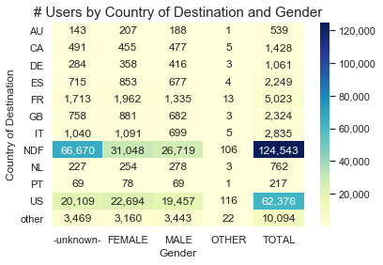
Destination country and gender
Each country has similar distribution of users in Male/Female categories
Using Chi-Square test, there’s a statistically significant association between country of destination and gender

Slide 8
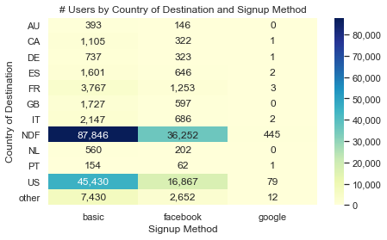
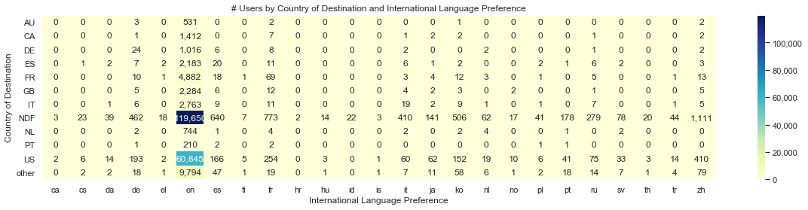
Destination country and signup method/language
‘English’ is the international language of preference for almost all users
Most users signup either through their own website or Facebook
Using Chi-Square test, there’s a statistically significant association between:
Country of destination and international language preference
Country of destination and signup method

Slide 9
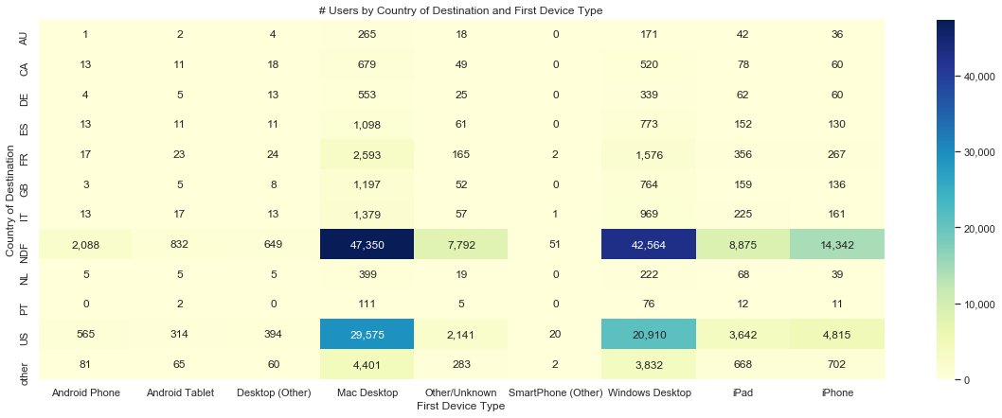
Destination country and first device type
Most users are either Mac Desktop users or Windows Desktop users
Using Chi-Square test, there’s a statistically significant association between country of destination and first device type

Slide 10
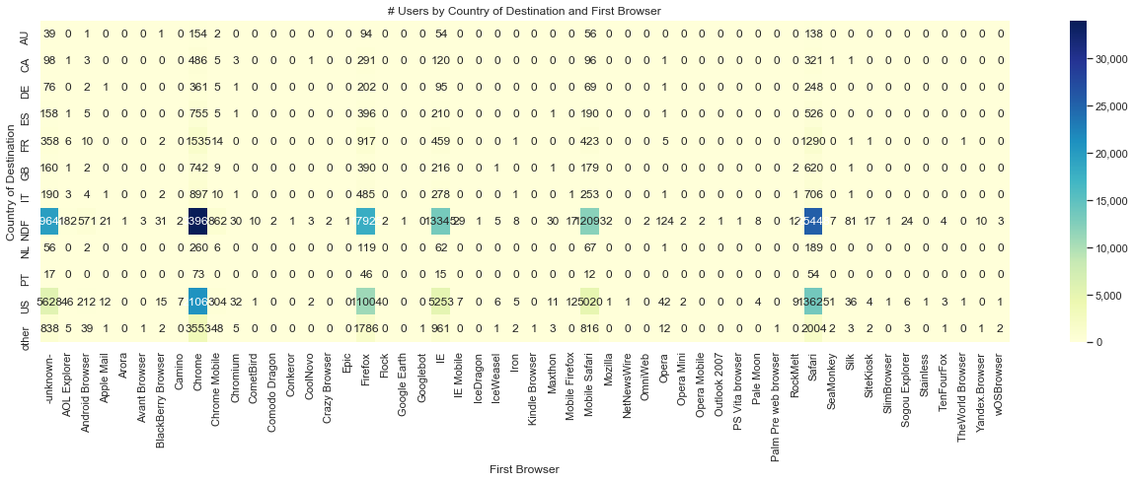
Destination country and first browser
Chrome, Firefox, IE, Safari and most popular first browsers used by user

Slide 11
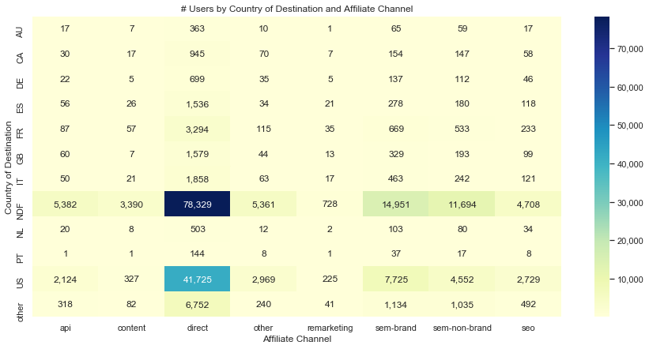
Destination country and affiliate channel
The most popular paid marketing channels are direct, sem-brand and sem-non-brand

Slide 12
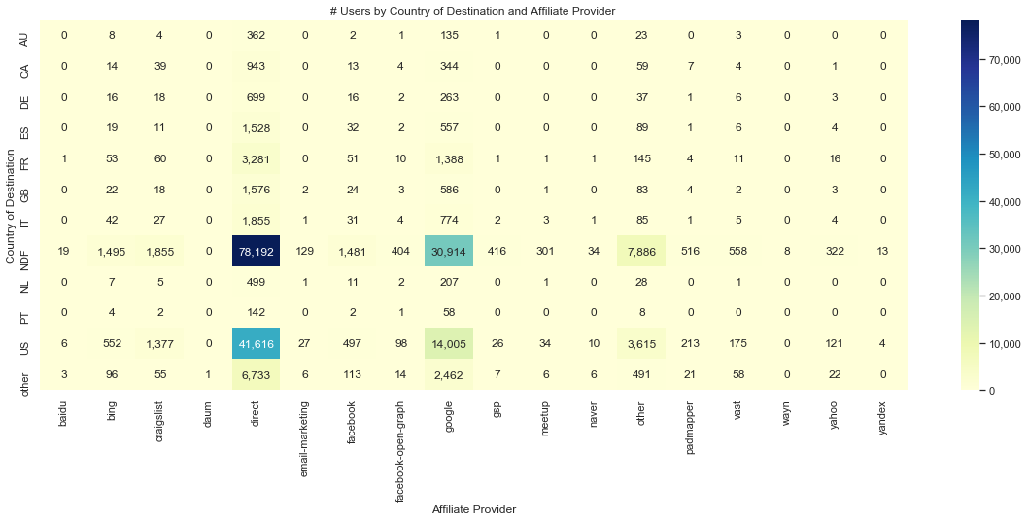
Destination country and affiliate provider
The most popular affiliate providers are direct and google

Slide 13
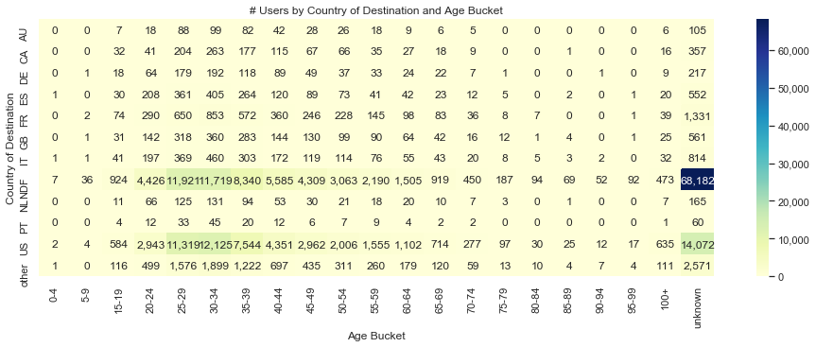
Destination country and age
Most users with destination country as US, are between ages 25-39 years

Slide 14
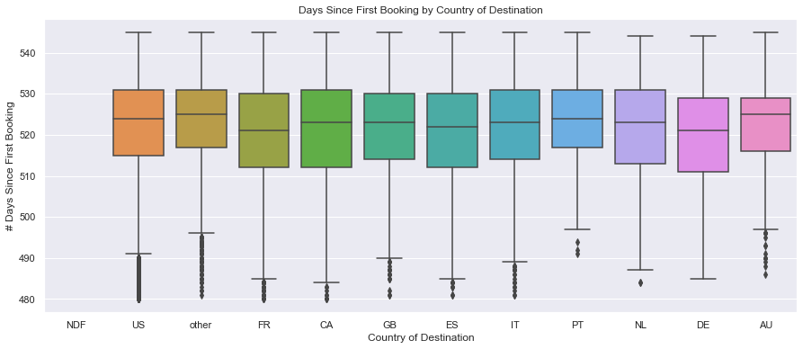
Destination country and days since first booking
As per the ANOVA test, The F-statistic= 38.9 and the p-value < 0.05 which indicates that there is a statistically significant association between country of destination and days since first booking but this test may not be very reliable because it may violate some of the assumptions of ANOVA

Slide 15
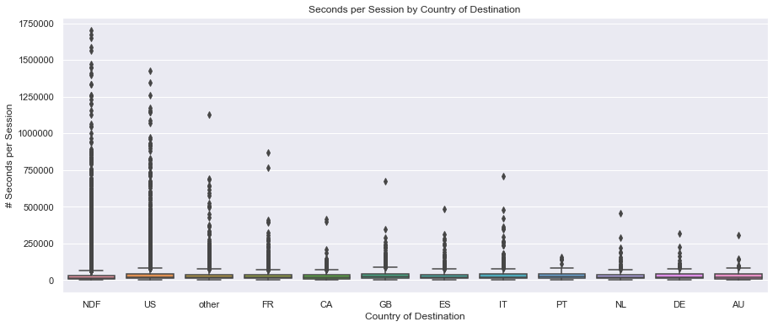
Destination country and seconds per session [TBD]
As per the ANOVA test, The F-statistic= 9.3 and the p-value < 0.05 which indicates that there is a statistically significant association between country of destination and seconds per session but this test may not be very reliable because it may violate some of the assumptions of ANOVA

Slide 16
Independent Variables
One hot encoding is used to convert categorical variables to dummy variables
# | Variable name | Description | Type
1 | gender | Gender of the user | categorical
2 | age | Age (in years) of the user | numeric
3 | signup_method | Signup method used by user e.g. basic, facebook or google | categorical
4 | Signup_flow | the page a user came to signup up from | categorical
5 | language | international language preference | categorical
6 | affiliate_channel | type of paid marketing | categorical
7 | affiliate_provider | where the marketing is e.g. google, craigslist, other | categorical
8 | first_affiliate_tracked | whats the first marketing the user interacted with before the signing up | categorical
9 | Signup_app | app through which the user signed up | categorical
10 | first_device_type | the first device type used by user e.g. phone, tablet, desktop | categorical
11 | first_browser | the first browser used by user | categorical
12 | dac_year, dac_month, dac_day | year, month and date when the account was created by user | numeric
13 | tfa_year, tfa_month, tfa_day | year, month and date when the user was first active | numeric
14 | cnt_action | # of actions by user | numeric
15 | cnt_uniq_action_type | # of unique action types by user | numeric
16 | cnt_uniq_dev_type | # of device types by user | numeric
17 | secs_per_session | average # of seconds elapsed per session by user | numeric

Slide 17
Comparison Between Prediction Models
XGBoost classification gives the highest accuracy on test and hold out set at 64.2% and 85.7% respectively
 | XGBoost Classification | Multi-Class Logistic Regression | Random Forest Classification
Dependent variable | Predicts destination country out of 12 countries | Predicts destination country out of 12 countries | Predicts destination country out of 12 countries
Hyperparameter Tuning Method | Gridsearch | Not applicable | Gridsearch
Optimal Hyperparameters | max_depth = 6 learning_rate = 0.1 n_estimators = 70 objective = 'multi:softprob' | penalty = ‘l2’ multi_class = ‘multinomial’ solver = ‘lbfgs’ C = 0.1 | criterion = ‘entropy’ max_depth = 15 max_features = ‘sqrt’ n_estimators = 150
Accuracy (Train set) | 65.4% | 58.4% | 68.5%
Accuracy (Test set) | 64.2% | 58.1% | 49.1%
Accuracy (Hold out set on Kaggle) | 85.7% | Not calculated | Not calculated

Slide 18
Variable Importance Using XGBoost Classification
Variable name | Importance | Description
gender | 14.7% | gender of the user
first_browser | 12.5% | the first browser used by user
signup_method | 12.1% | signup method used by user e.g. basic, facebook or google
age | 10.5% | age (in years) of the user
first_affiliate_tracked | 8.1% | whats the first marketing the user interacted with before the signing up
affiliate_channel | 8.0% | type of paid marketing
affiliate_provider | 7.1% | where the marketing is e.g. google, craigslist, other
tfa_year | 6.3% | year, month and date when the user was first active
first_device_type | 5.3% | the first device type used by user e.g. phone, tablet, desktop
cnt_uniq_action_type | 5.1% | # of unique action types by user
signup_app | 3.9% | app through which the user signed up
signup_flow | 1.6% | the page a user came to signup up from
dac_year | 1.2% | year when the account was created by user
tfa_month | 0.7% | month when the user was first active
secs_per_session | 0.6% | average # of seconds elapsed per session by user
cnt_uniq_dev_type | 0.6% | # of device types by user
cnt_action | 0.6% | # of actions by user
dac_month | 0.5% | month when the account was created by user
tfa_day | 0.4% | day of the month when the user was first active
dac_day | 0.4% | day of the month when the account was created by user

Slide 19
Recommendations
Key factor
Impact
Recommendations
1
Cancel fee
Cancellation fee of $5 is most effective in lowering the cancellation rate
Cancellation fee of $5 is most appropriate
TBD
2
ETA diff (mins)
Cancellation rate increases when the difference in ETA increases
High cancellation rate observed for 5% of the total rides when difference in ETA > 3 mins
Need to improve the method for determining pre book ETA
Cancellation fee can be waived when ETA diff > 3 mins
3
ETA to rider pre match (mins)
Cancellation rate increases when ETA to rider pre match increases
High cancellation rate observed for 8% of the total rides where ETA to rider pre match > 7 mins
Improve supply of drivers to reduce ETA to rider pre match
Cancellation fee can be waived when ETA to rider pre match > 7 mins
4
Ride type
Standard rides have a lower cancellation rate than shared rides
Cancellation fee can be waived in shared rides with high difference in ETA
Recommended cancellation policy
Cancellation fee = $5
But Lyft should consider waiving the cancellation fee in the following scenarios when the rider is not at fault, to improve customer retention:
Rides with difference between ETA post match and ETA pre match > 3 mins
Rides with ETA to rider pre match > 7 minutes
Notes:
Fault and not at fault

