Slide 1
Airbnb New User Booking
June, 2020
By: Anu Kashyap

Slide 2
Agenda
Background & Objectives
Data Wrangling
Exploratory Data Analysis
Prediction Models
Recommendations
Lyft’s overall business objective

Slide 3
Background & Objectives
Background
Airbnb is an American online marketplace company based in San Francisco, California, United States.
Airbnb offer arrangement for lodging, primarily homestays, or tourism experiences
Instead of waking to overlooked "Do not disturb" signs, Airbnb travelers find themselves rising with the birds in a whimsical treehouse, having their morning coffee on the deck of a houseboat, or cooking a shared regional breakfast with their hosts
New users on Airbnb can book a place to stay in 34,000+ cities across 190+ countries.
Problem Statement & Objective
Problem statement: In which country will a new guest book their first travel experience?
Objective:
The objective is to help Airbnb understand the following:
Better forecast demand
Share customized content with client
Decrease the average time to first booking

Slide 4
Data Wrangling

Slide 5
Data Wrangling
Kaggle Data
In this challenge, Kaggle has given a list of users along with their demographics, web session records, and some summary statistics.
All the users in this dataset are from the USA
There are 12 possible outcomes of the destination country: 'US', 'FR', 'CA', 'GB', 'ES', 'IT', 'PT', 'NL','DE', 'AU', 'NDF' (no destination found), and 'other’.
'NDF' is different from 'other' because 'other' means there was a booking, but it is to a country not included in the list, while 'NDF' means there wasn't a booking.
The training and test sets are split by dates. In the test set, we need predict all the new users with first activities after 7/1/2014
The sessions dataset, the data only dates back to 1/1/2014, while the ‘users’ dataset dates back to 2010
Data Wrangling
Concatenate train and test data so that data cleaning performed together
Drop ‘date_first_booking’ column which is entirely missing in test data
Replace unknown values in ‘gender’ and ‘f'irst_browser’ columns to NaN
‘Age’ column will only have values between 18-100 years, therefore, other values will be set to NaN
Date time data of 'time_first_active' and 'timestamp_first_active' to be split into day, month and year columns
Drop ‘date_account_created’ and ‘timestamp_first_active’ columns after completing step 5
Remove leading and trailing spaces from ‘language’ column
Data Source: https://www.kaggle.com/c/airbnb-recruiting-new-user-bookings/data

Slide 6
Exploratory Data Analysis

Slide 7
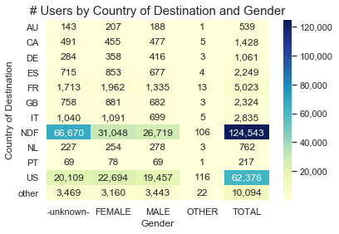
Destination Country & Gender
Each country has similar distribution of users in Male/Female categories
Using Chi-Square test, there’s a statistically significant association between country of destination and gender

Slide 8
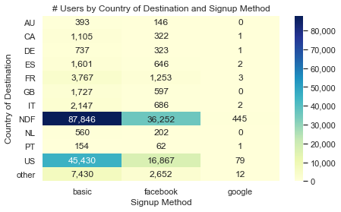
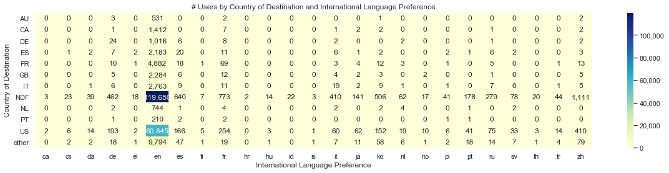
Destination Country & Signup Method/Language
‘English’ is the international language of preference for almost all users
Most users signup either through their own website or Facebook
Using Chi-Square test, there’s a statistically significant association between:
Country of destination and international language preference
Country of destination and signup method

Slide 9
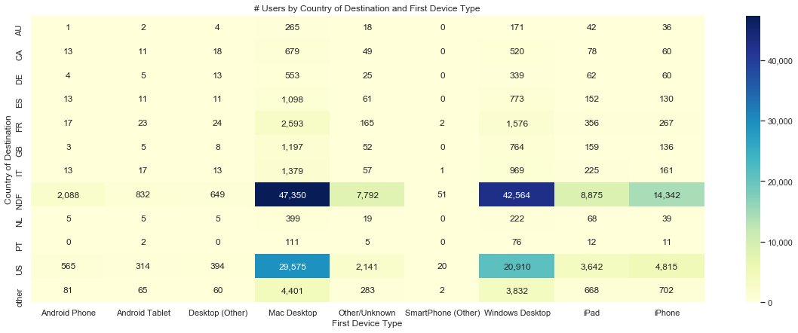
Destination Country & First Device Type
Most users are either Mac Desktop users or Windows Desktop users
Using Chi-Square test, there’s a statistically significant association between country of destination and first device type

Slide 10
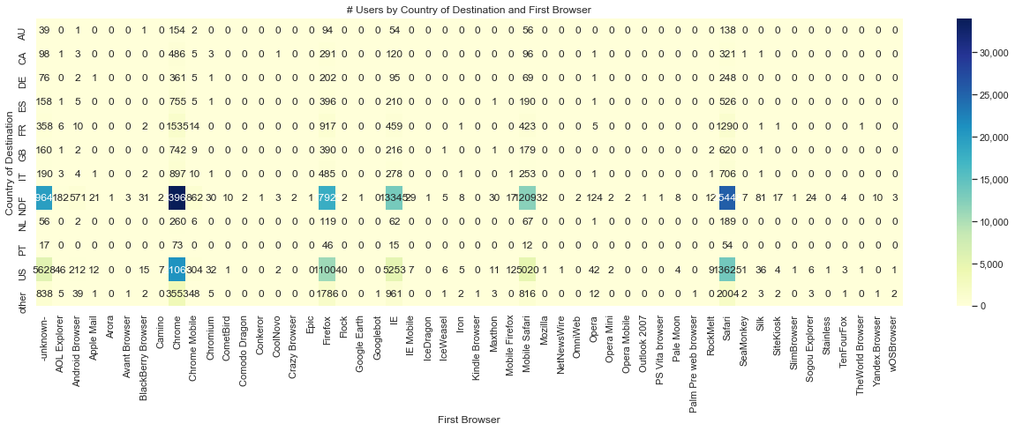
Destination Country & First Browser
Chrome, Firefox, IE, Safari and most popular first browsers used by user

Slide 11
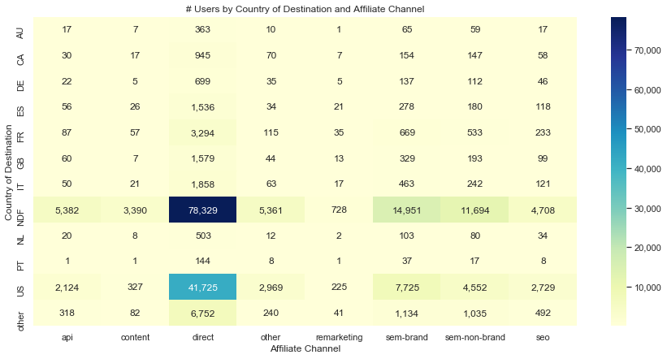
Destination Country & Affiliate Channel
The most popular paid marketing channels are direct, sem-brand and sem-non-brand

Slide 12
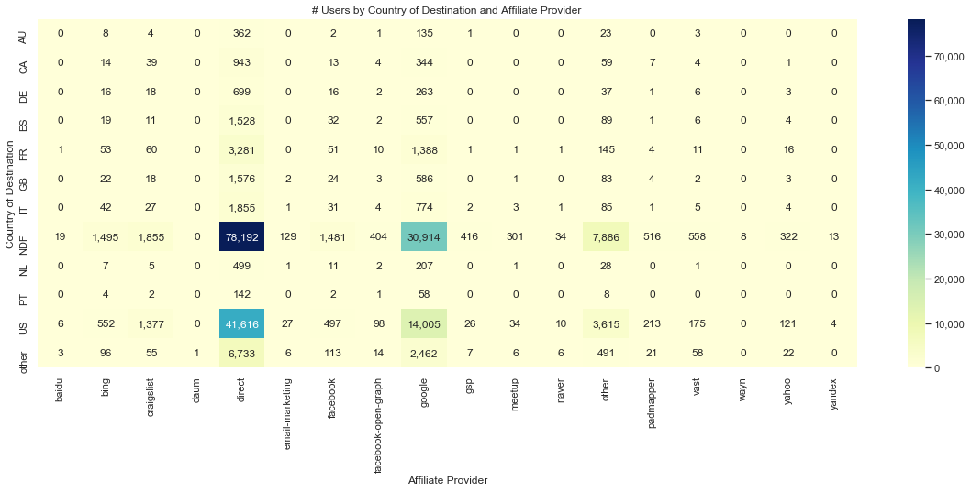
Destination Country & Affiliate Provider
The most popular affiliate providers are direct and google

Slide 13
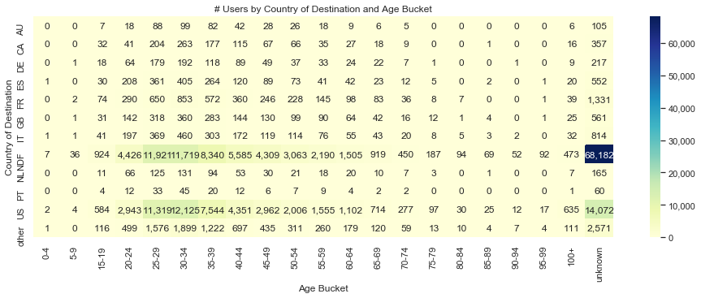
Destination Country & Age
Most users with destination country as US, are between ages 25-39 years

Slide 14
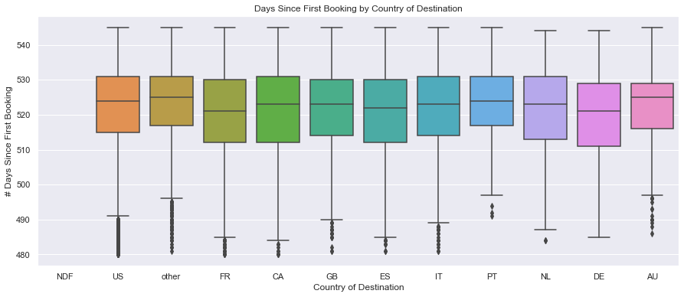
Destination Country & Days Since First Booking
As per the ANOVA test, The F-statistic= 38.9 and the p-value < 0.05 which indicates that there is a statistically significant association between country of destination and days since first booking but this test may not be very reliable because it may violate some of the assumptions of ANOVA
Note: The height of the box plot tells us how dispersed the data is

Slide 15
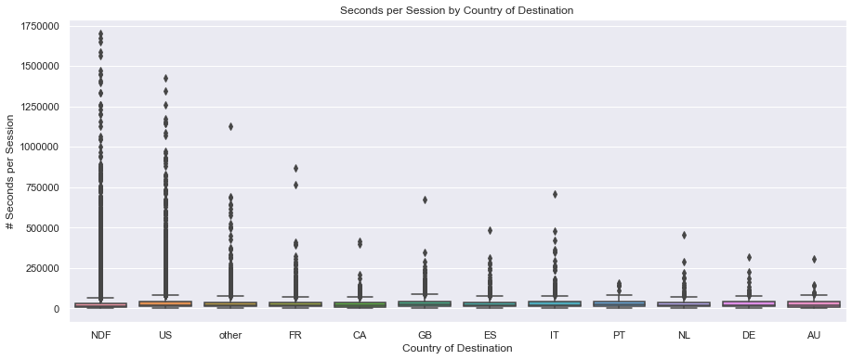
Destination Country & Seconds Per Session

Slide 16
Independent Variables
One hot encoding is used to convert categorical variables to dummy variables
# | Variable name | Description | Type
1 | gender | Gender of the user | categorical
2 | age | Age (in years) of the user | numeric
3 | signup_method | Signup method used by user e.g. basic, facebook or google | categorical
4 | Signup_flow | the page a user came to signup up from | categorical
5 | language | international language preference | categorical
6 | affiliate_channel | type of paid marketing | categorical
7 | affiliate_provider | where the marketing is e.g. google, craigslist, other | categorical
8 | first_affiliate_tracked | whats the first marketing the user interacted with before the signing up | categorical
9 | Signup_app | app through which the user signed up | categorical
10 | first_device_type | the first device type used by user e.g. phone, tablet, desktop | categorical
11 | first_browser | the first browser used by user | categorical
12 | dac_year, dac_month, dac_day | year, month and date when the account was created by user | numeric
13 | tfa_year, tfa_month, tfa_day | year, month and date when the user was first active | numeric
14 | cnt_action | # of actions by user | numeric
15 | cnt_uniq_action_type | # of unique action types by user | numeric
16 | cnt_uniq_dev_type | # of device types by user | numeric
17 | secs_per_session | average # of seconds elapsed per session by user | numeric

Slide 17
Comparison Between Prediction Models
XGBoost classification gives the highest accuracy on test and hold out set at 64.2% and 85.7% respectively
 | XGBoost Classification | Multi-Class Logistic Regression | Random Forest Classification
Dependent variable | Predicts destination country out of 12 countries | Predicts destination country out of 12 countries | Predicts destination country out of 12 countries
Hyperparameter Tuning Method | Gridsearch | Gridsearch | Gridsearch
Optimal Hyperparameters | max_depth = 6 learning_rate = 0.1 n_estimators = 70 objective = 'multi:softprob' | penalty = ‘l2’ multi_class = ‘multinomial’ solver = ‘lbfgs’ C = 0.1 | criterion = ‘entropy’ max_depth = 15 max_features = ‘sqrt’ n_estimators = 150
Accuracy (Train set) | 65.4% | 58.4% | 68.5%
Accuracy (Test set) | 64.2% | 58.1% | 49.1%
Accuracy (Hold out set on Kaggle) | 85.7% | Not calculated | Not calculated

Slide 18
Variable Importance Using XGBoost Classification
Variable name | Importance | Description
gender | 14.7% | gender of the user
first_browser | 12.5% | the first browser used by user
signup_method | 12.1% | signup method used by user e.g. basic, facebook or google
age | 10.5% | age (in years) of the user
first_affiliate_tracked | 8.1% | whats the first marketing the user interacted with before the signing up
affiliate_channel | 8.0% | type of paid marketing
affiliate_provider | 7.1% | where the marketing is e.g. google, craigslist, other
tfa_year | 6.3% | year, month and date when the user was first active
first_device_type | 5.3% | the first device type used by user e.g. phone, tablet, desktop
cnt_uniq_action_type | 5.1% | # of unique action types by user
signup_app | 3.9% | app through which the user signed up
signup_flow | 1.6% | the page a user came to signup up from
dac_year | 1.2% | year when the account was created by user
tfa_month | 0.7% | month when the user was first active
secs_per_session | 0.6% | average # of seconds elapsed per session by user
cnt_uniq_dev_type | 0.6% | # of device types by user
cnt_action | 0.6% | # of actions by user
dac_month | 0.5% | month when the account was created by user
tfa_day | 0.4% | day of the month when the user was first active
dac_day | 0.4% | day of the month when the account was created by user

Slide 19
Insights
Out of the three classification models used, XGBoost, Multi-class Logistic Regression, Random Forest, XGBoost classification model gives the best accuracy at 85.7% on the Kaggle hold out set
XGBoost hyperparameters were determined using Gridsearch and the best hyperparameters are:
max_depth = 6
learning_rate = 0.1
n_estimators = 70
objective = 'multi:softprob'
The top 5 variables as per the XGBoost variable importance are:
Gender (14.7%)
First_Browser (12.5%)
Signup_Method (12.1%)
Age (10.5%)
First_Affiliate_Tracked (8.1%)
Notes:
Fault and not at fault

