Slide 1
AI-Powered Video Summarization for Smart Learning
School of Computing
Dept of Networking and Communications
21CSE306P – Applied Generative AI Course Project
GENEVOE’ 26: Generative Evolution Expo Expo 2026
Convenors: Dr. Vaishnavi Moorthy & Dr. R. Swathy -Dept of NWC
Team & Batch No: 11 & 1
RA2411003010166 | ANUKOOL KASHYAP | CTECH
RA2411026010400 | ANANTH VIGNESH | CINTEL
RA2411028010108 | SK MD SAHID BABU | NWC
RA2411028010093 | KODALI SHASHANK | NWC

Slide 2
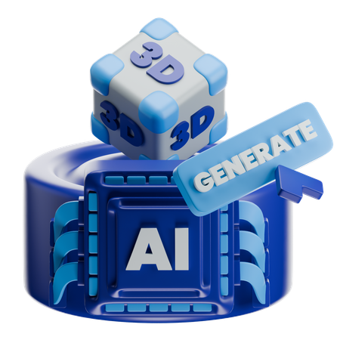
Problem Statement
A one-hour lecture cannot be searched, so revising it means watching it again. A course spreads one topic across many videos. General AI summarisers state facts the lecture never contained, so a student can neither trust the summary nor find the moment in the video where any claim was actually made.
Solution
Retrieval-Augmented Generation on the transcript
Course mode — one index across a whole playlist
Timestamp validation on every claim
Grounded refusal when the video does not cover it
Notes:
Only crisp an to the point to be mentioned…. Keywords may be made bold

Slide 3
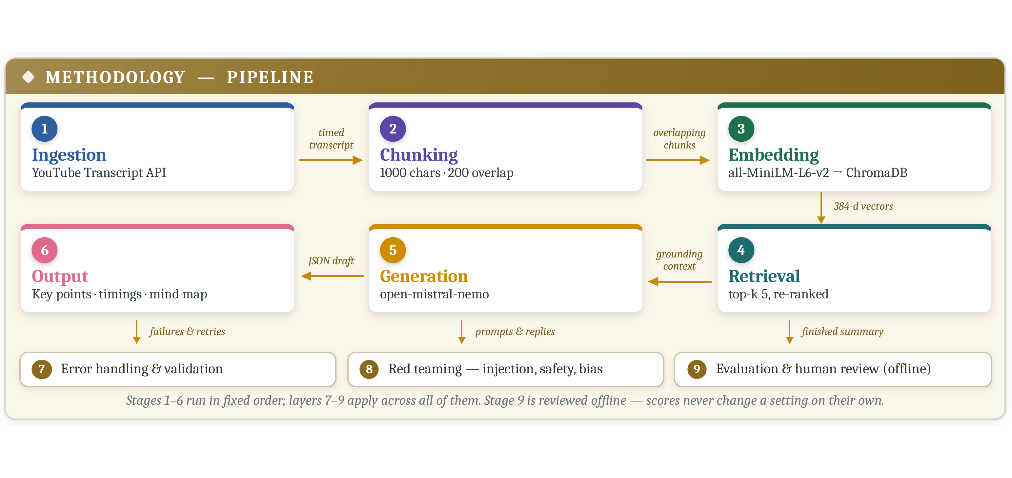
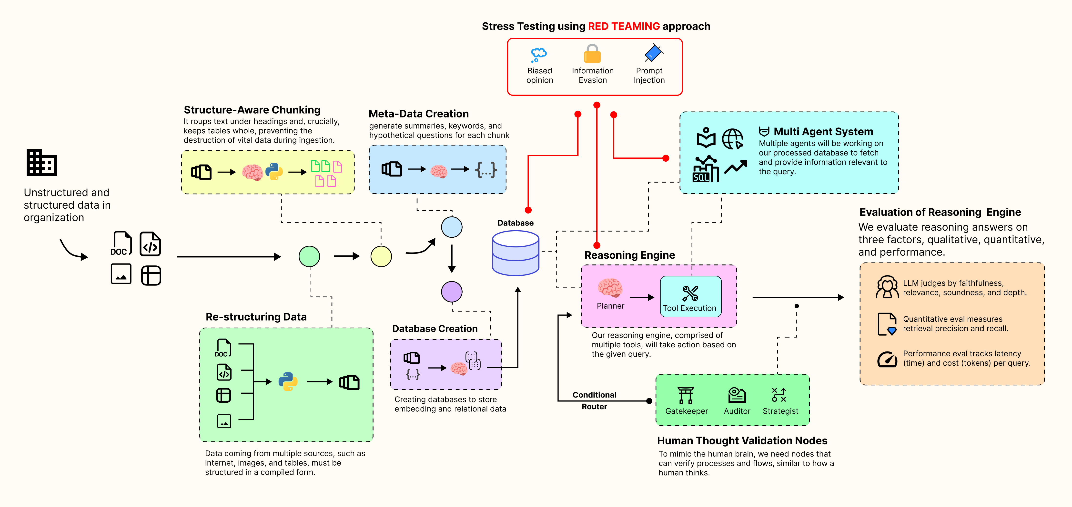
Pipeline Diagram
Notes:
Neatly first version of pipeline to be prepared demonstrating modules--strictly not generated from any LLM or google images to be incorporated. Number the steps accordingly…. DO NOT USE FLOWCHART symbols and logic in pipeline diagram (e.g. decision box, etc)----Remove Sample logo in your version
Avoid canva generated diagram

Slide 4
Industry Expert Comments
Pipeline diagram must show clearly numbered sequential steps — all nine blocks renumbered 1–9; stages 1–6 form the main flow, layers 7–9 marked as cross-cutting
Maintain one font and one template throughout — a single heading/body font pair and a common header, logo and numbering frame on every slide
Name the specific model used for summarisation — open-mistral-nemo (Mistral) fixed; embedding model and vector store also named on the pipeline

Slide 5
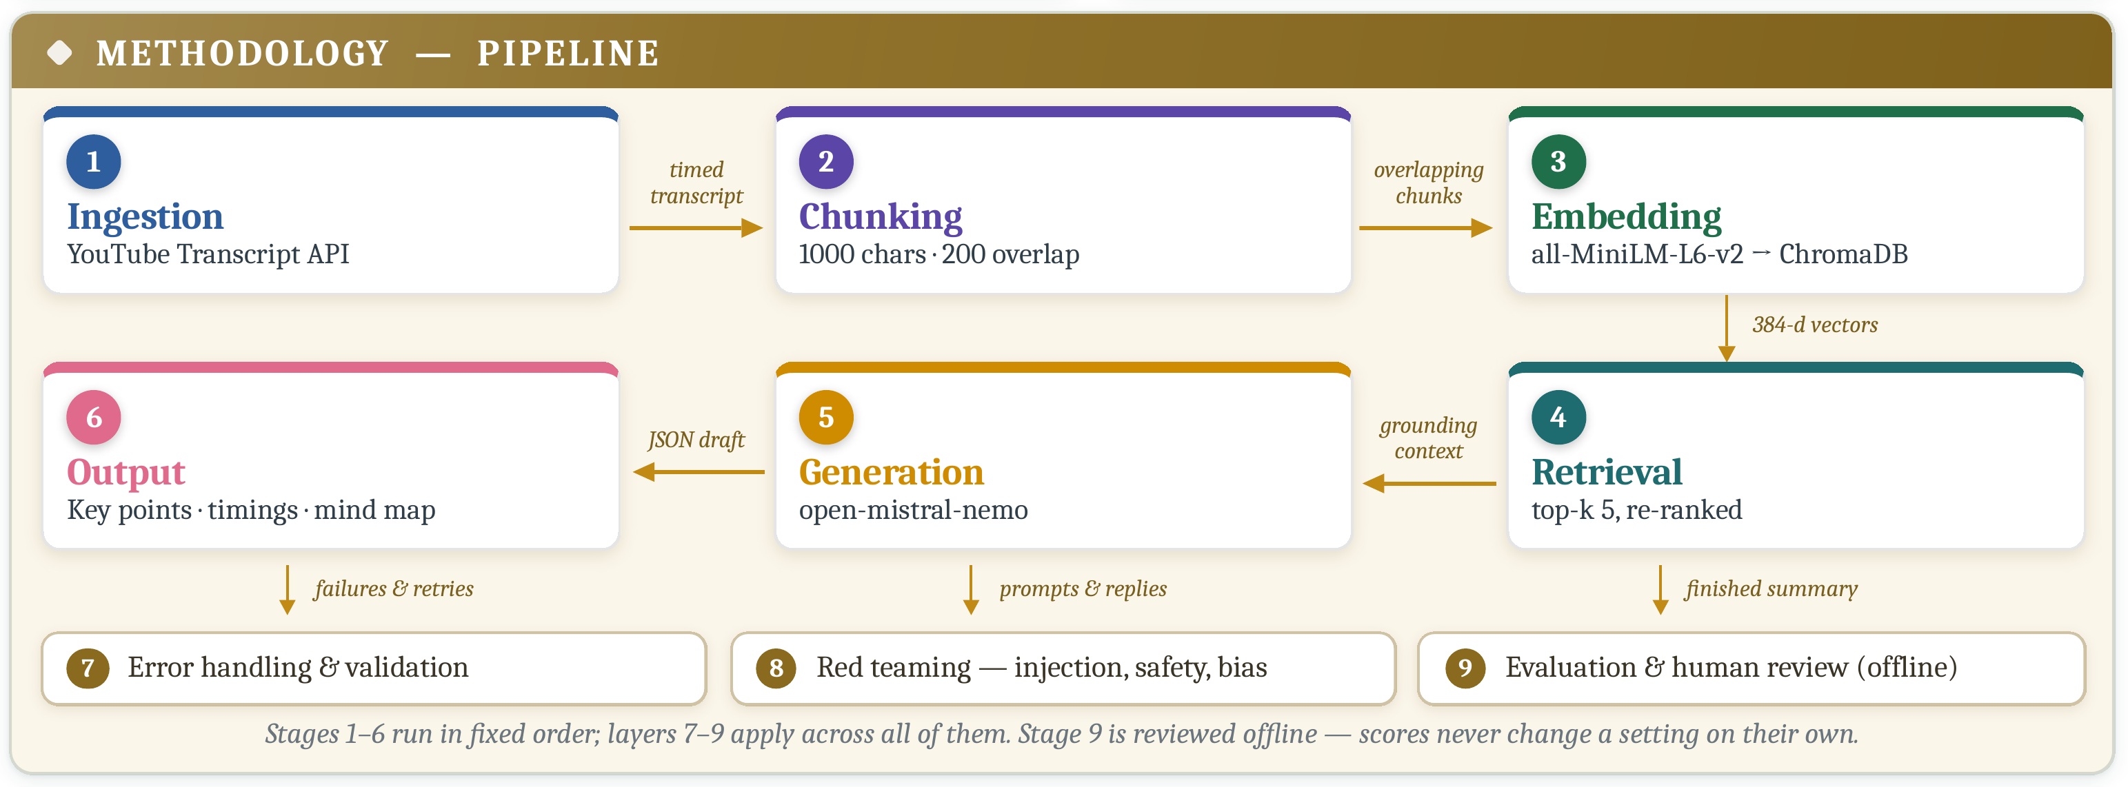


Generative AI Model
Fig. 1: Agentic AI Model Design – Pipeline/Workflow Diagram
Model Design (Strictly in max 4 bullet points)
Application: a YouTube video or playlist becomes a grounded summary, timeline and mind map
Novelty: course mode — one index across a playlist; answers cite video and timestamp
Target users: students revising recorded lectures and online courses
GenAI technique: Retrieval-Augmented Generation with prompt engineering
Technologies Used
Models: open-mistral-nemo, all-MiniLM-L6-v2
Frameworks: FastAPI, ChromaDB, sentence-transformers
Deployment tools: Uvicorn, Python 3.10, yt-dlp
Future Scope
Multilingual transcripts and translated summaries
Quiz and flashcard generation from the timeline
Reference-based ROUGE scoring on a labelled set
Shared course libraries for a whole class

Slide 6
Generative AI Implementation
Sl | Generative AI Architecture | Application/model name | Decision Making Strategies | Challenges/Limitation
1 | Retrieval-Augmented Generation (encoder + decoder) | all-MiniLM-L6-v2 → ChromaDB → open-mistral-nemo | Fixed six-stage order; top-5 chunks chosen by re-ranking (0.75 vector + 0.20 lexical + 0.05 position) | Quality is bounded by the transcript; auto-captions carry errors
2 | Prompt engineering layer | Role prompt, grounding constraint, JSON schema, few-shot exemplar | Model may answer only from the supplied context; JSON mode forces a parseable reply | Longer prompts raise the token cost of every call
3 | Validation and evaluation layer | Timestamp validator, red-team screens, ROUGE / faithfulness / relevance | Timestamps absent from the retrieved text are discarded; scores are reviewed offline by a person | Faithfulness is a lexical proxy, not entailment; ROUGE needs a reference

Slide 7
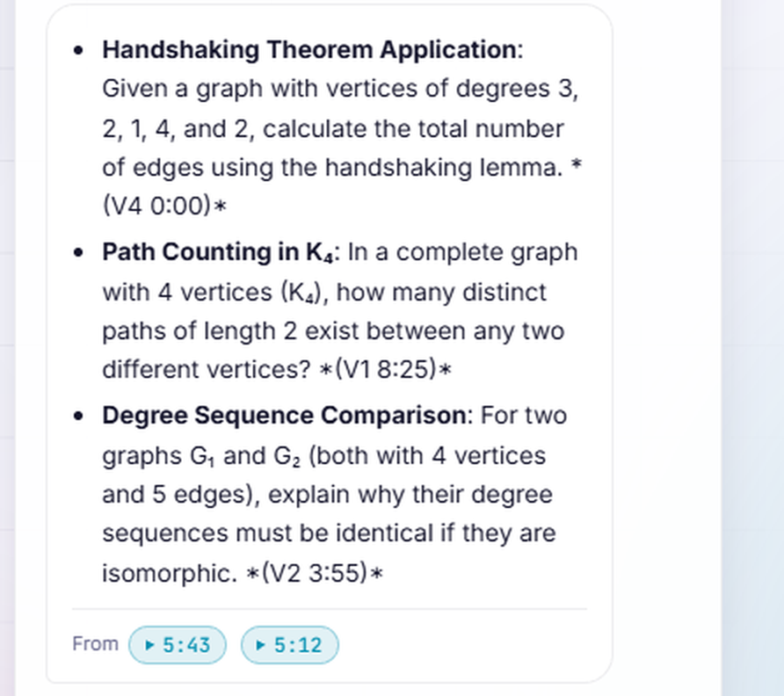
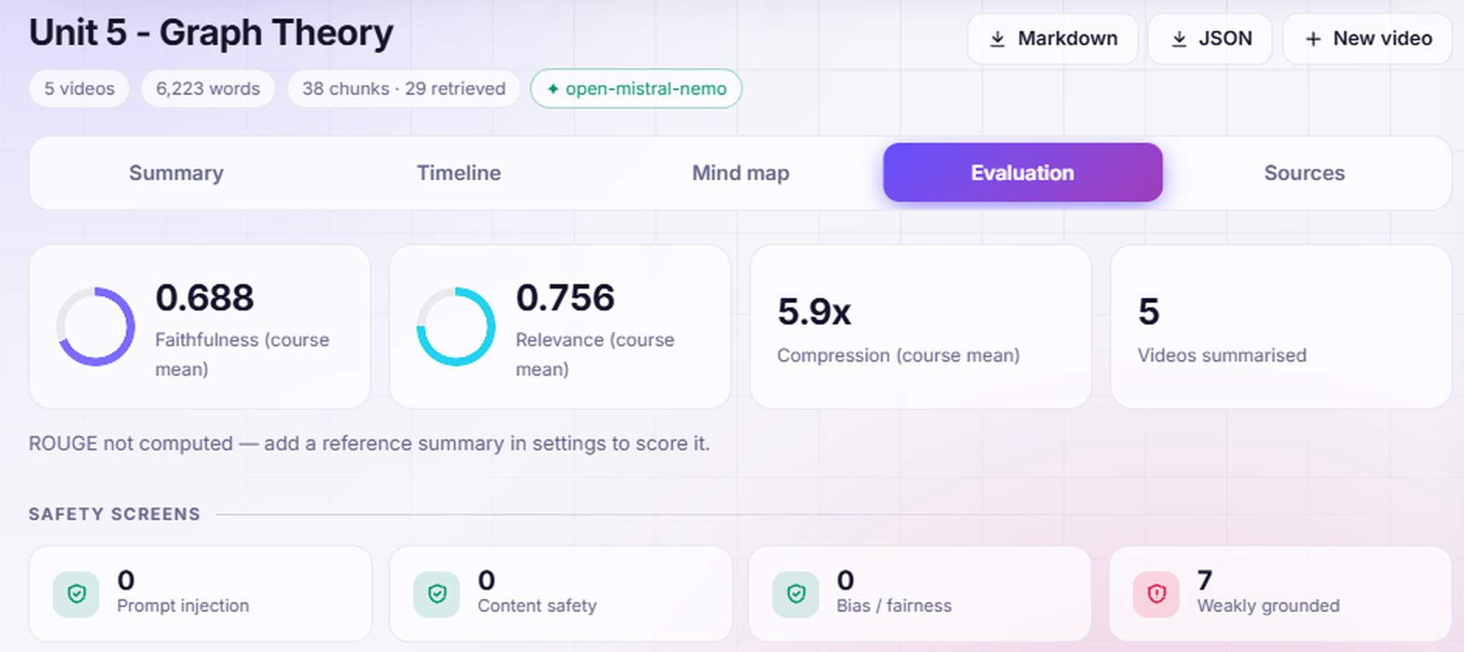


Video + Results
Demo Video
Link:
Fig. 3: Application Input
Fig. 2: Application Demo Video
Fig. 4: Application Output

