Slide 1

IBM University Engagement Project Submission
"The Smartest AI Fitness Buddy — Powered by IBM Granite & IBM watsonx.ai"

Slide 2

Project Tile – Fitness Buddy
Domain of Project – Healthcare & Fitness / Wellness
Student Name | Recent Passport Photo | Email ID | Mobile number [WhatsApp]
Anukrati Saini
anukratisaini@gmail.com
+91 88319917070

Slide 3
Problem Statement -
Problem Statement : Fitness Buddy
In today's fast-paced world, maintaining a healthy lifestyle has become increasingly difficult. Individuals struggle to establish consistent fitness routines due to a lack of personalised guidance, limited time, insufficient motivation, and difficulty accessing reliable fitness and wellness information. Existing fitness applications provide generic workout plans and rigid schedules that fail to consider a person's fitness level, lifestyle, daily routine, personal preferences, and evolving goals. Meanwhile, professional trainers face resource constraints that prevent them from offering continuous, one-on-one support at scale.
The Objective
Build an AI-powered Fitness Buddy that delivers personalised, adaptive, and motivating fitness and wellness guidance. The solution should:
  Personalised Workout Plans — Generate home workout routines based on fitness level, available equipment, time constraints, and individual goals.
  Nutrition Guidance — Suggest balanced daily meal plans, analyse food items, and recommend healthy food alternatives tailored to dietary needs.
  Contextual Explanations — Explain why a specific exercise or meal is suitable (e.g., "Why is this workout good for me?") using LLM-powered reasoning.
  Motivation & Habit Building — Deliver daily fitness inspiration, personalised motivational messages, and science-backed wellness tips to encourage consistency.
  Adaptive Recommendations — Dynamically adjust workout and wellness suggestions based on user feedback, progress, and changing schedules.
  Safe & Accessible Advice — Ensure all recommendations are appropriate for the user's fitness level, physical limitations, and health conditions.

Slide 4
Proposed Solution -
Proposed Solution: AI-Powered Fitness Buddy
The proposed solution is an intelligent, multi-feature AI Fitness Buddy built using Node.js, IBM watsonx.ai, and IBM Granite 4 (ibm/granite-4-h-small) to deliver personalised, real-time fitness and wellness guidance. The system addresses challenges in workout planning, nutrition tracking, and motivation through a conversational, adaptive architecture.
At its core, the solution uses IBM Granite's chat API to understand user inputs in natural language and generate context-aware responses. Carefully engineered prompts guide the model to act as a certified fitness coach, nutritionist, and wellness advisor simultaneously.
The system consists of four key feature agents:
Fitness Planning Agent : generates personalised home workout plans based on fitness level, equipment, time, and goals — and adapts them based on user feedback.
Nutrition Guidance Agent : creates daily meal plans, analyses individual food items, and recommends healthy food swaps tailored to the user's dietary needs and budget.
Motivation & Wellness Agent : delivers daily fitness inspiration, personalised motivational messages based on streak and mood, and science-backed tips on hydration, sleep, recovery, and stress.
Conversational AI Agent : supports multi-turn chat through IBM Granite, answering any fitness or nutrition question with contextual memory of the conversation.
The solution features a clean, responsive web interface (HTML/CSS/JS) with a chat panel, workout generator form, nutrition tabs, motivation section, and user profile — all served by an Express.js backend. Optional voice input is supported via IBM Watson Speech-to-Text or browser Web Speech API.
Overall, this solution delivers a full-stack, AI-powered personal fitness companion that motivates, guides, and adapts to users as they build healthier and more consistent lifestyles.

Slide 5
Technology Used
  IBM Granite 4 (ibm/granite-4-h-small) – Core LLM powering all AI features via IBM watsonx.ai chat API. Handles natural language understanding, reasoning, and personalised fitness response generation.
  IBM watsonx.ai – Cloud AI platform for deploying and calling IBM Granite models. Provides secure, scalable model inference via the official @ibm-cloud/watsonx-ai SDK with IAM authentication.
  IBM Cloud Lite – Free-tier IBM Cloud infrastructure providing API keys, IAM authentication, and watsonx.ai Runtime service to host and run Granite models at no cost.
  Node.js + Express.js – Backend server framework handling API routing, rate limiting, security headers (Helmet.js), and serving the web application.
  Vanilla HTML / CSS / JavaScript – Lightweight, framework-free frontend delivering a responsive single-page app with chat, workout, nutrition, motivation, and profile features.

Slide 6
Application Components Used
1) Chat Interface – Multi-turn conversational UI where users type or speak fitness questions. Sends messages to the backend, displays IBM Granite responses with typing indicators, and maintains session history.
2) IBM Granite AI Agent (graniteClient.js) – Core service wrapping the @ibm-cloud/watsonx-ai SDK. Authenticates using IamAuthenticator, calls ibm/granite-4-h-small via the textChat API, and returns responses to all features.
3) IBM Granite Model – ibm/granite-4-h-small (Granite 4) – IBM's latest model, fast and efficient for real-time personalised fitness coaching and recommendations.
4) Prompt Builder (promptBuilder.js) – Constructs structured prompts for each feature: workout plans, nutrition guidance, motivation, wellness tips, and Q&A — ensuring accurate, safe, personalised Granite responses.
5) Express.js REST API – Five route modules (chat, fitness, nutrition, motivation, speech) exposing dedicated endpoints that receive user inputs, call IBM Granite, and return structured JSON.
6) User Profile & LocalStorage – Persistent profile (age, weight, fitness level, goals, dietary restrictions) stored in browser localStorage and sent with each API call to personalise all responses.

Slide 7
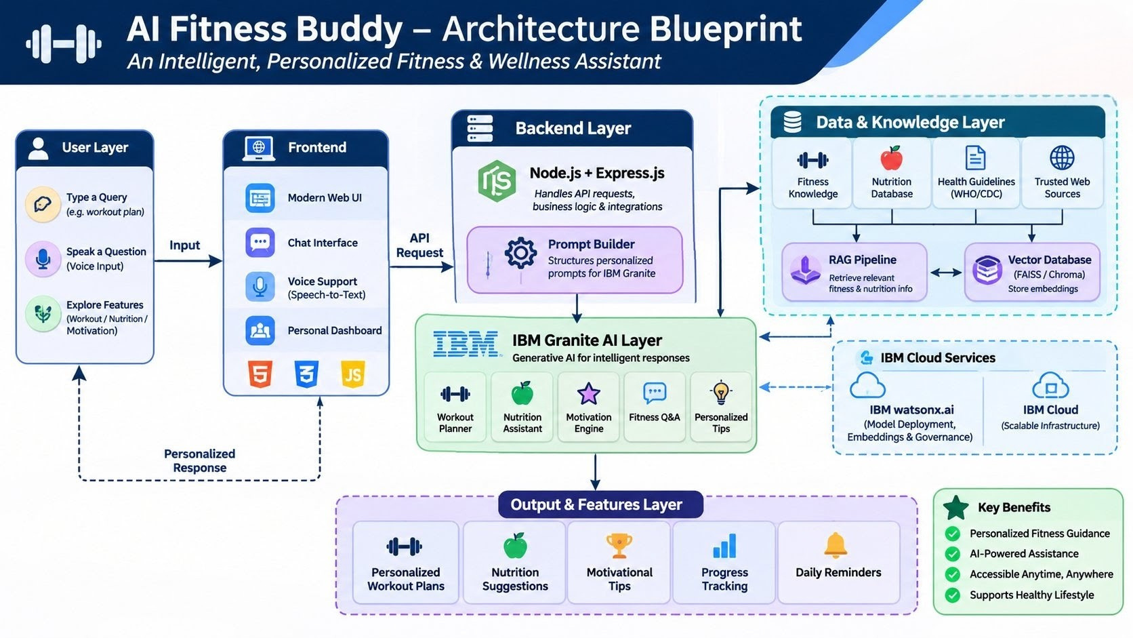

Slide 8

Role of Agentic AI in the Solution
Role of Agentic AI in The Smartest AI Fitness Buddy
Agentic AI enables the Fitness Buddy to function as an intelligent, autonomous coaching system rather than a simple chatbot. Using IBM watsonx.ai and IBM Granite 4, it coordinates multiple specialised feature agents to deliver personalised fitness and wellness guidance.
Each agent performs a specific role — generating workout plans, providing nutrition advice, delivering motivational messages, and answering fitness questions — while working collaboratively through a shared prompt engineering layer. This multi-agent approach ensures accurate, context-aware, and goal-driven results.
Agentic AI brings context awareness, understanding user details like fitness level, age, equipment, goals, and physical limitations to generate fully tailored recommendations. It supports real-time adaptation, adjusting workout plans and wellness tips based on user feedback and changing schedules.
The Conversational AI Agent maintains multi-turn session memory, enabling coherent, progressive coaching over time.
Overall, Agentic AI makes the Fitness Buddy proactive, personalised, and goal-driven — acting like a smart digital personal trainer and wellness coach that helps users build healthier, more consistent lifestyles.

Slide 9
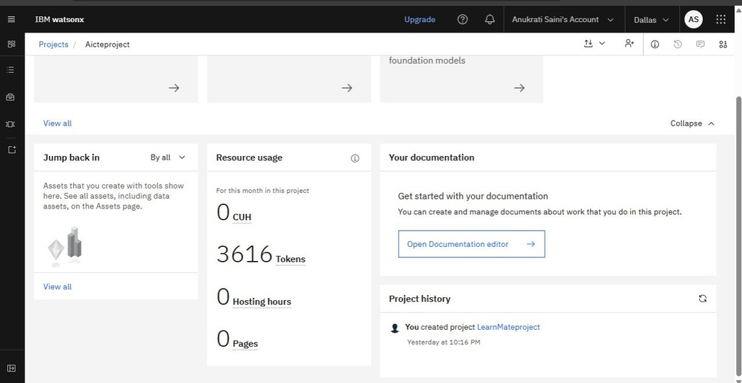
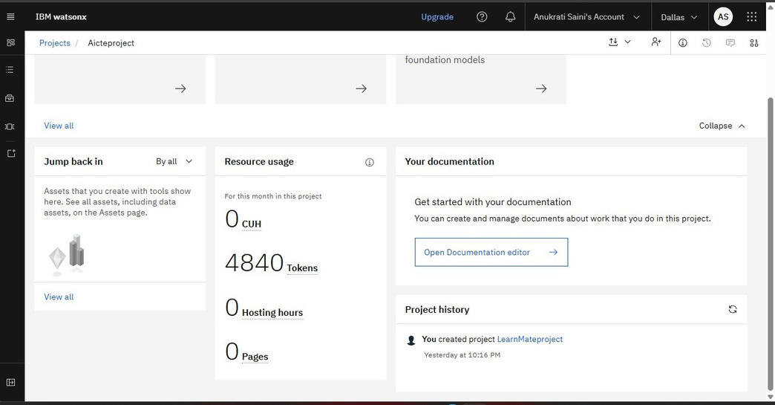
Token Usage
Before Prompt
After the Prompt
·
·
·

Slide 10
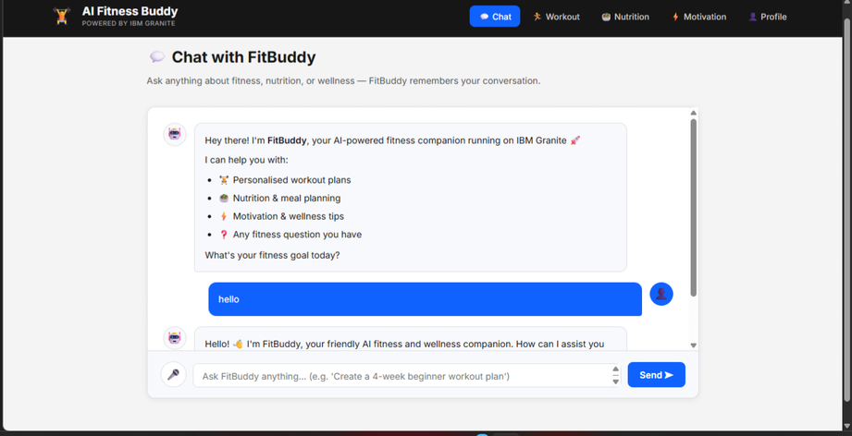
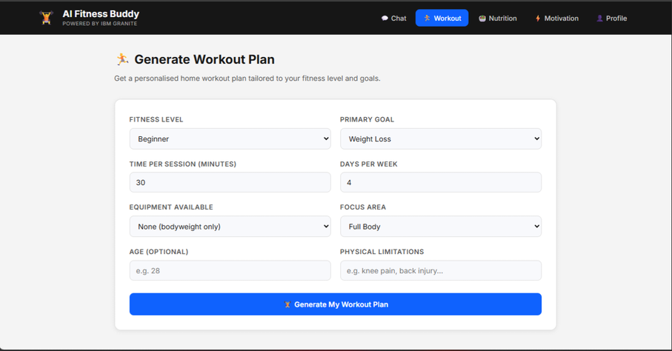
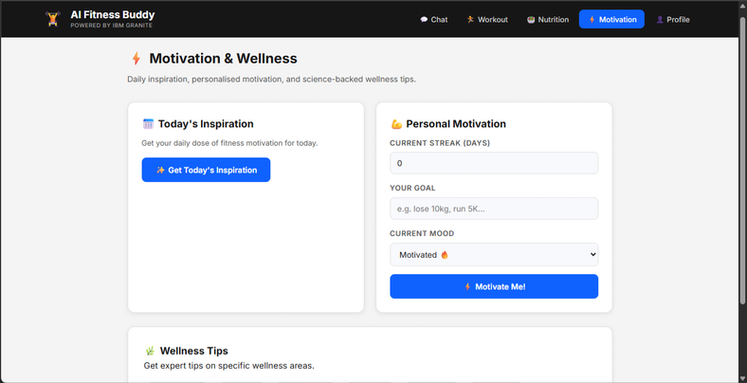
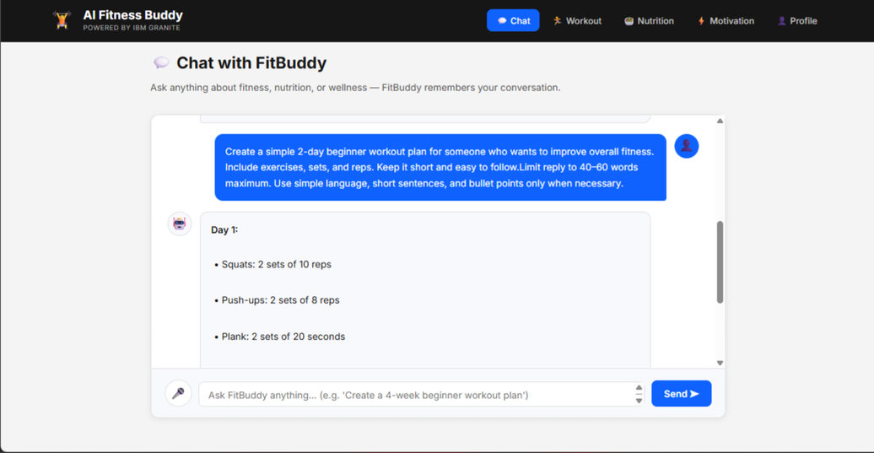
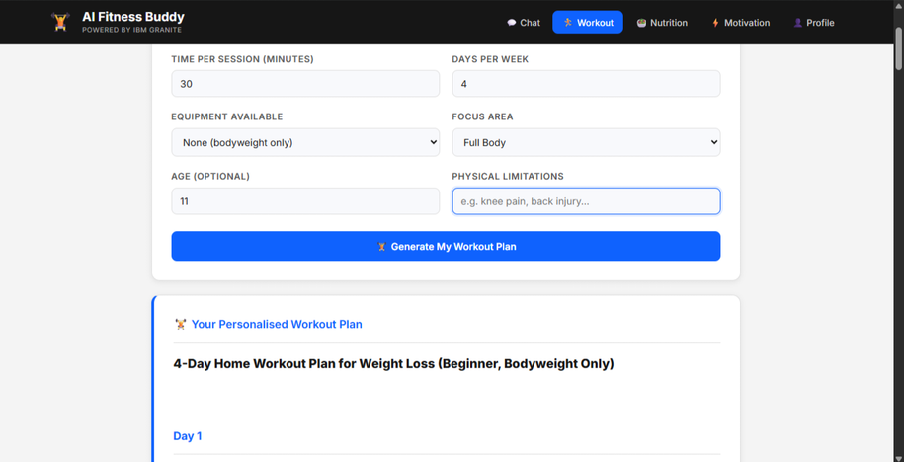
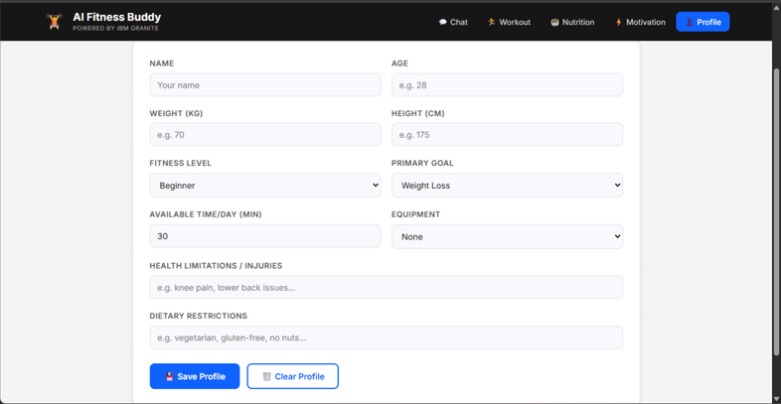
Project Output Screenshot

Slide 11
Novelty and Uniqueness
IBM Granite-Powered Intelligence
Integrates IBM Granite 4 (ibm/granite-4-h-small) through watsonx.ai to generate contextual, profile-aware fitness guidance.
Multi-Agent Fitness Assistance
Organizes the application into four specialized modules—Fitness, Nutrition, Motivation, and Chat—providing focused assistance across different wellness needs.
Personalized User Experience
Uses profile details such as fitness level, goals, available equipment, limitations, and dietary preferences to tailor recommendations.
Adaptive Workout Planning
Allows users to provide feedback on workout plans, enabling the AI to adjust future recommendations according to their preferences and progress.
Full-Stack and Extensible Design
Built with a Node.js and Express backend and a vanilla JavaScript frontend, making the application lightweight, understandable, and suitable for future enhancements.
Overall Impact
Smartest AI Fitness Buddy is designed as an interactive and personalized fitness companion that brings workout planning, nutrition guidance, motivation, and conversational assistance together in one application. Its AI-powered and feedback-driven approach makes it more adaptable than a static fitness recommendation system.

Slide 12
Git Hub Link
Project:AI Fitness Buddy – Powered by IBM Granite
GitHub Repository:
https://github.com/Anukratii/finalAIcteProject
Repository Contents:
- Complete project source code
- README and setup instructions
- Backend API and frontend files
- Project dependencies (`package.json`)
- Project problem statement (PDF)
- Final project presentation (PPTX)
Repository Visibility: Public
·
·

Slide 13
Future Scope
1. Integration with Wearables & Health Devices –
The system can be integrated with smartwatches and fitness trackers (e.g., Fitbit, Apple Watch) to collect real-time data such as steps, calories burned, heart rate, and sleep patterns, enabling more accurate, data-driven workout and recovery recommendations.
2. AI-Powered Voice Assistant & Multilingual Support –
Enhancing the system with a fully voice-enabled assistant and support for multiple languages will improve accessibility. Users can interact naturally in their preferred language, making the solution more inclusive globally.
3. Progress Tracking & Visualisation Dashboard –
A dedicated dashboard showing weekly workout completion, calorie trends, streak history, and fitness goal progress with charts — giving users clear visual feedback on their fitness journey.
4. Community & Social Features –
Peer challenges, shared workout plans, and leaderboards to increase motivation through community accountability and social fitness engagement.
·
·
·

Slide 14
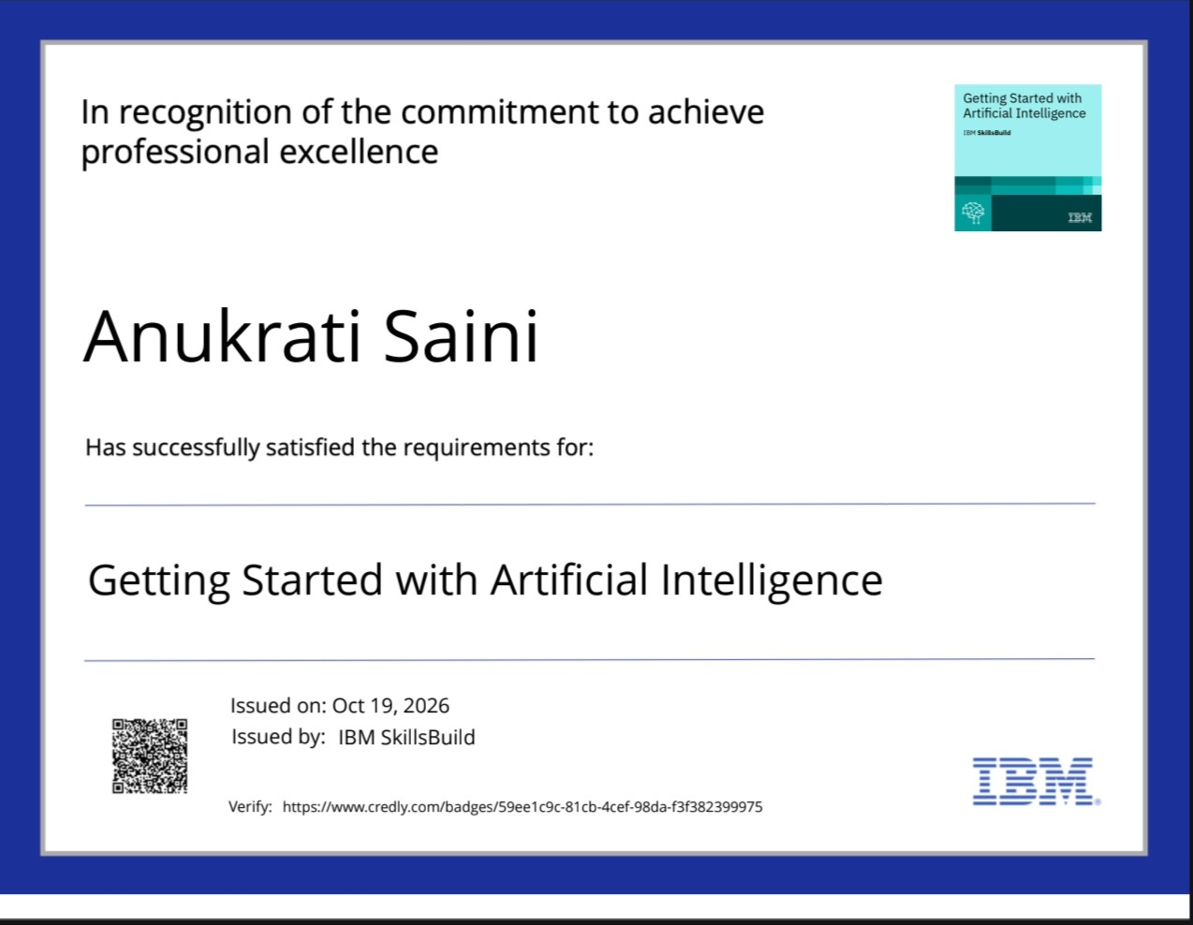
Certificates Earned:

Slide 15
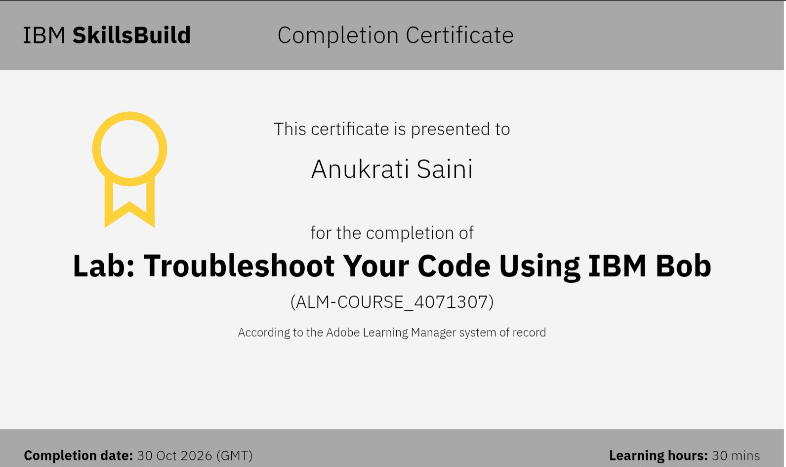
Certificates Earned:​
Add your IBM BOB Certificate

Slide 16


