Slide 1
ASE FINAL PROJECT
PHISHING WEBSITES DETECTION
PHISHING WEBSITES DETECTION
DELHI TECHNOLOGICAL UNIVERSITY
Team Members:
Pahul SIngh Kandra – 2K17/SE/075
Nitin – 2K17/SE/071

Slide 2
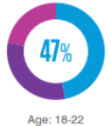
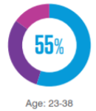
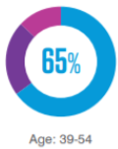
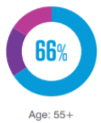
Steps that can be taken to avoid getting phished:
Phishing Websites
Creating awareness among users
Have a blacklist of phishing websites ready
Detect them in early appearance using Data
Mining techniques
It is a spoofed site which often appears as an exact replica of a legitimate site to the users, but it is actually a front which tricks users into providing sensitive information to a malicious cyber actor.

Slide 3

Important Statistics
UNDERLYING PROBLEMS
22% of breaches in 2019 involved phishing (DBIR 2020)
A New Phishing Site Launches Every 20 Seconds
While this is down 6.6% from the previous year, it’s still the “threat action variety” most likely to cause a breach.
2020 Mobile Threat Landscape Report says that every minute, three new phishing sites are designed to target users to pop up on the internet.
8
1
SSL: no longer an indicator of a safe site
Highest number of phishing attacks in the recent years
As reported by APWG, a whopping 77 percent of phishing sites examined in Q2 of 2020 used SSL. This is an increase of 3% in as many months.
According to Phishing Activity Trends Report for Q2 2020, the first half of the year saw around 1.5lacs reported phishing attacks.
2
7
94% of Coronavirus-Related Cyber Attacks in a 2-Week Period Were Phishing Attacks
85% of organisations have suffered from phishing attacks
95% of Coronavirus-related attacks were phishing attacks which included websites with “Corona” or “Covid” in their domains.
Another 86% experienced business email compromise (BEC) attempts.
3
6
51,000+ Coronavirus-Themed Domains Have Been Registered in 3 months
Phishing attacks- getting more sophisticated
4
5
This is up from their previous estimates of more than 4,000 such domains that were registered globally.
Users trust links to things like SharePoint
and OneDrive sites, attackers increasingly
use cloud file sharing services as part of
their schemes.

Slide 4

OUR
METHODOLOGY
We propose a Machine learning based approach to classifying websites into two classes: Safe or unsafe. Our mechanism only analyses the Uniform Resource Locator (URL) itself without accessing the content of Web sites. Thus, it eliminates the run-time latency and the possibility of exposing users to the browser based vulnerabilities. By employing learning algorithms, our scheme achieves better performance on generality and coverage compared with blacklisting service.
Lexical features are based on the observation that the URLs of many illegal sites look different, compared with legitimate sites. Analyzing lexical features enables us to capture the property for classification purposes.

Slide 5
PROJECT OVERVIEW
IMPORTANT DATA MINING STEPS
Defining Problem Statement
01
08
Hyper-parameter tuning
07
Performance Evaluation
Relevant Data Collection
02
06
Model Building
Exploratory Data Analysis
03
05
Feature Selection (Choice of Relevant features)
04
Pre-Processing

Slide 6
PROJECT OVERVIEW
IMPORTANT DATA MINING STEPS
Defining Problem Statement
01
08
Hyper-parameter tuning
07
Performance Evaluation
Relevant Data Collection
02
06
Model Building
Exploratory Data Analysis
03
05
Feature Selection (Choice of Relevant features)
04
Pre-Processing

Slide 7
OUR DATASET
age_of_domain
DNSRecord
web_traffic
Page_Rank
Google_Index
Links_pointing_to_page
Statistical_report
We found a dataset UCI phishing websites- well researched and benchmarked by the relevant community of researchers and the accompanying wiki highlights features and considerations by the author and it can be found here.
Redirect
on_mouseover
RightClick
popUpWindow
Iframe
Request_URL
URL_of_anchor
links_in_tags
SFH
abnormal_URL
submitting_to_email
Domain based features (7)
having_IP_address
URL_length
Shortening_service
having_at_symbol
double_slash_redirect
prefix_suffix
having_sub_domain
SSL_final_state
domain_registration_length
favicon
port
HTTPS_token
HTML and Javascript based features (5)
Abnormal based features (6)
Address Bar based Features (12)

Slide 8
PROJECT OVERVIEW
IMPORTANT DATA MINING STEPS
Defining Problem Statement
01
08
Hyper-parameter tuning
07
Performance Evaluation
Relevant Data Collection
02
06
Model Building
Exploratory Data Analysis
03
05
Feature Selection (Choice of Relevant features)
04
Pre-Processing

Slide 9
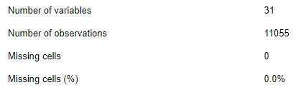
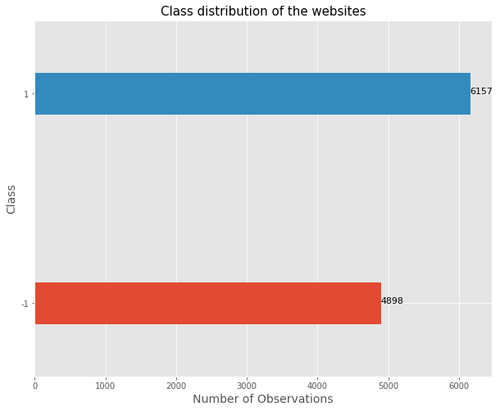
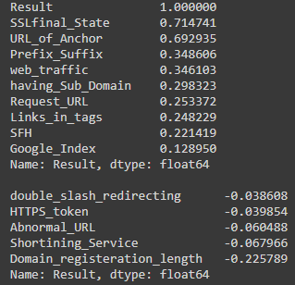

Data Exploration
General Analysis
Missing values
Nature of variables
Distribution of classes
Top 10 and least 5 correlated variable

Slide 10
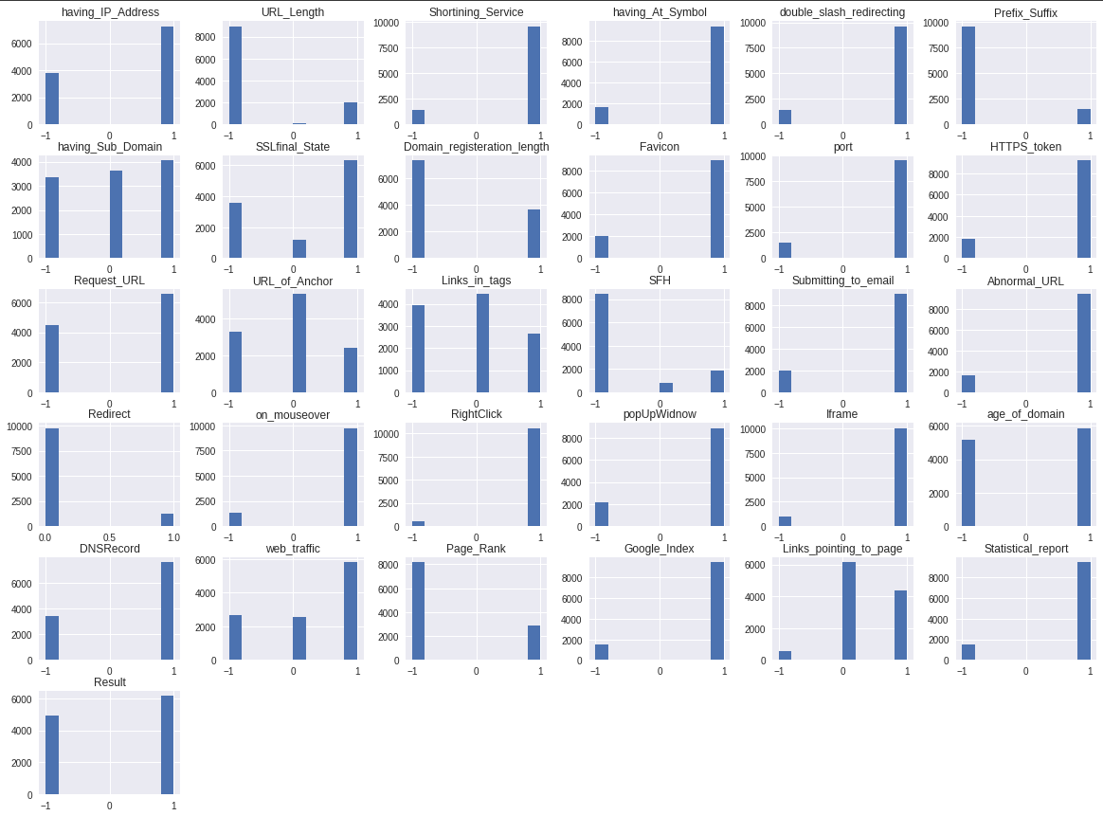
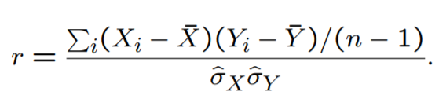
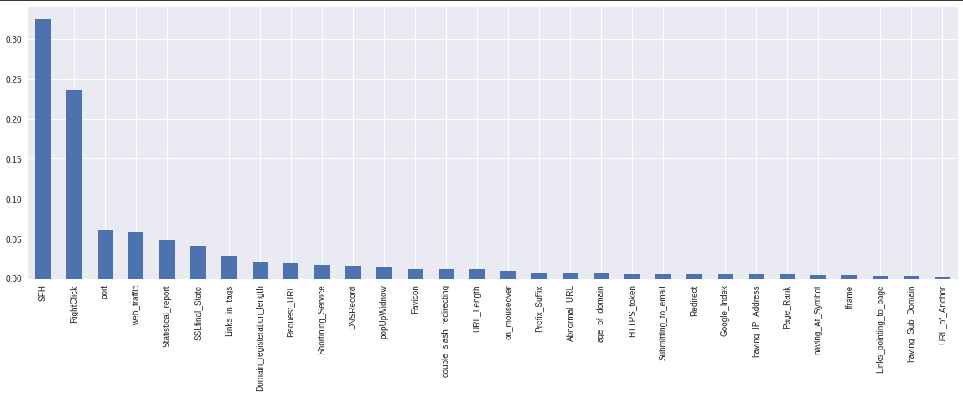
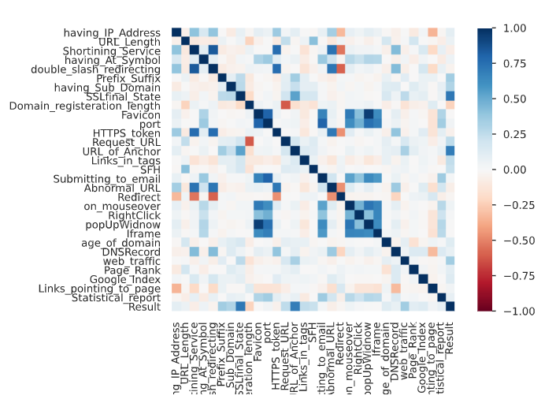
Correlation Matrix
Bi-variate analysis
Percentage of observations per label
Feature Importance

Slide 11
PROJECT OVERVIEW
IMPORTANT DATA MINING STEPS
Defining Problem Statement
01
08
Hyper-parameter tuning
07
Performance Evaluation
Relevant Data Collection
02
06
Model Building
Exploratory Data Analysis
03
05
Feature Selection (Choice of Relevant features)
04
Pre-Processing

Slide 12


Basic
Pre-processing
Handle missing values
There were no missing values found in the dataset
Handle categorical variables
Using LabelEncoder, categorical variables were handled.
Handle duplicate rows/columns
Duplicate rows and columns were deleted. Now, dataset contains 5949 rows

Slide 13


SFH
double_slash_redirecting
Feature
web_traffic
url_length
Selection
Statistical_report
on_mouseover
SSLfinal_State
abnormal_url
Domain _registration_length
https_token
popUpWindow
having_at_symbol
Links_in_tags
having_sub_domain
16 features
prefix_suffix
url_of_anchor

Slide 14
PROJECT OVERVIEW
IMPORTANT DATA MINING STEPS
Defining Problem Statement
01
08
Hyper-parameter tuning
07
Performance Evaluation
Relevant Data Collection
02
06
Model Building
Exploratory Data Analysis
03
05
Feature Selection (Choice of Relevant features)
04
Pre-Processing

Slide 15
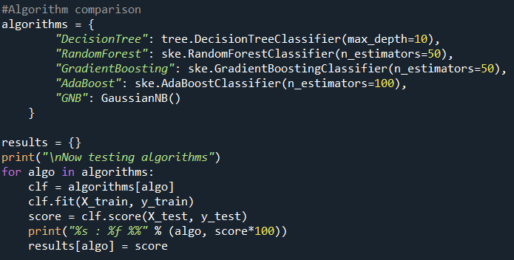
Model Building
COMPARISON BETWEEN VARIOUS ALGORITHMS
Decision Tree
Random Forest
Gradient Boosting
Gaussian Naive Bayes
AdaBoost

Slide 16
PROJECT OVERVIEW
IMPORTANT DATA MINING STEPS
Defining Problem Statement
01
08
Hyper-parameter tuning
07
Performance Evaluation
Relevant Data Collection
02
06
Model Building
Exploratory Data Analysis
03
05
Feature Selection (Choice of Relevant features)
04
Pre-Processing

Slide 17
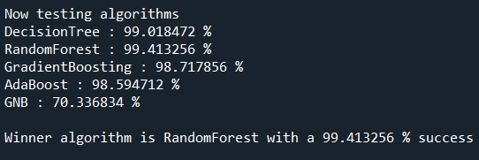
Performance Evaluation and Model Selection
99.0184%
99.4132%
98.7178%
98.5947%
70.3368%
Decision Tree
Random Forest
Gradient
Boosting
AdaBoost
Gaussian Naive Bayes

Slide 18
PROJECT OVERVIEW
IMPORTANT DATA MINING STEPS
Defining Problem Statement
01
08
Hyper-parameter tuning
07
Performance Evaluation
Relevant Data Collection
02
06
Model Building
Exploratory Data Analysis
03
05
Feature Selection (Choice of Relevant features)
04
Pre-Processing

Slide 19


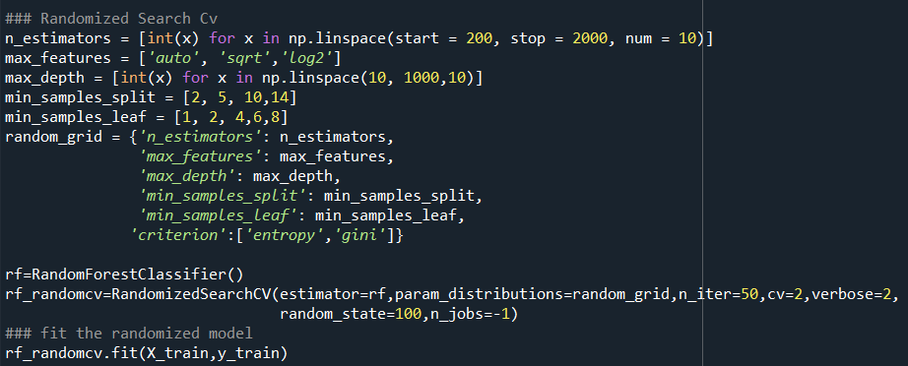
Hyper-parameter Tuning
criterion
Random Search
In Random Search, we create a grid of hyperparameters and train/test our model on just some random combination of these hyperparameters. Random search has proven to be particularly effective, especially if the search space is not cubic, i.e. if some hyper-parameters are given a much greater range of variation than others.
max_depth
max_features
min_samples_leaf
min_samples_split
n_estimators

Slide 20
WEBSITE DEMO

Slide 21
We successfully completed the detailed analysis on how an actual phishing websites detector works and operates. We presented a step by step procedure for this data mining project. In this report, we mentioned all our decisions and choices based on careful consideration of various factors relevant to our data. We reviewed various ways for exploratory data analysis, pre-processing, modelling as well as performance optimization methodologies. We also presented a user-friendly web application by which a user can easily detect a phishing website.
Conclusion

Slide 22
REFERENCES
Phishing URL Detection Using URL Ranking — Texas Tech University Scholars
Phishing Detection: Analysis of Visual Similarity Based Approaches
Detection of phishing websites using an efficient feature-based machine learning framework
Detecting Phishing Websites Using Machine Learning
Malicious web content detection using machine leaning - IEEE Conference Publication
(PDF) Swarm Intelligence Approaches for Parameter Setting of Deep Learning Neural Network: Case Study on Phishing Websites Classification
Detecting Phishing Websites using Neural Networks
Detecting phishing websites using machine learning | by Sayak Paul | Intel Software Innovators
Phishytics - Machine Learning for Detecting Phishing Websites - Securities
Detecting Phishing Websites using Machine Learning
(PDF) Predicting Phishing Websites based on Self-Structuring Neural Network
Phishing Websites Features
T Test (Student's T-Test): Definition and Examples

