Slide 1
DWDM
CASE STUDY
Presented By:
ANUKRITI
ANURAG MUDGIL
(DELHI TECHNOLOGICAL UNIVERSITY)

Slide 2
PROJECT OVERVIEW
IMPORTANT DATA MINING STEPS
Defining Problem Statement
01
08
Hyper-parameter tuning
07
Performance Evaluation
Relevant Data Collection
02
06
Model Building
Exploratory Data Analysis
03
05
Feature Selection (Choice of Relevant features)
04
Pre-Processing

Slide 3
Credit ScoreCard Models
TransRisk
FICO
Score
Vantage
Score
TransRisk
CreditXpert

Slide 4
Rise and Fall of Lehman Brothers
1850
1850-1870
1883-87
1899-1906
1984-94
Founded in the US State of Alabama by three brothers
Dry Goods Store
Cotton Business
New branch in NYC
Formation of NYSE in 1870
Member of Cotton Exchange
Member of NYSE
Underwrote its first public offering
Partnered with GS
Started entering financial markets
Continued their underwriting and became one of the largest
Acquired by Amex
and then spun off

Slide 5
FALL OF A COMPANY WHICH WAS CONSIDERED “TOO BIG TO FAIL”
1997
2000
2001-04
2006
15 Sept’ 2008
Brought Alt-A lender Aurora Loan Services
Acquired subprime mortgage lender BNC mortgage LLC
Started lending to many subprime borrowers
Price of real estate started declining
2003: $18.2 billion loan
2004: $40.2 billion
2006: started lending $50 billion per month as loan
158 year old company came to an end
Filed for bankruptcy

Slide 6


Seniority
Job
Our
Dataset
Home
Expenses
Financial Ratio
Savings
Time
Income
Used to measure the firm's ability to repay long-term debt
It is given by: Amount/Price.
Savings are important for calculating credit worthiness of a customer.
It is given by: (Income-(Expenses+Debt))/ (Amount/Time)
Mineria de Dades : It contains 4446 customer records and, the customer was given a Status- good/ bad depending upon 13 customer related attributes.
Apart from these, we also derived 2 other attributes from the existing ones:
Financial Ratio
Savings
Age
Assets
Martial
Debt
Records
Amount
Price
Finrat
Savings

Slide 7
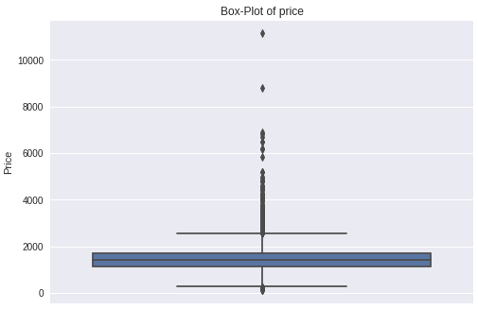
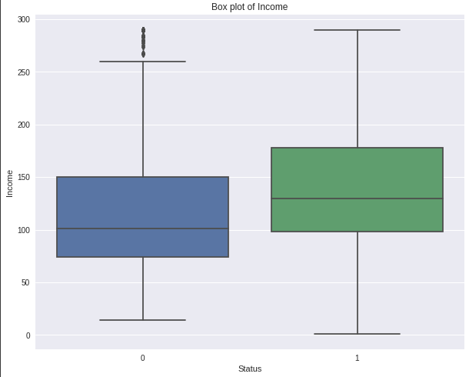
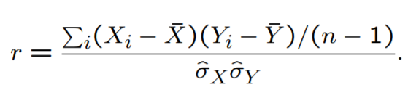
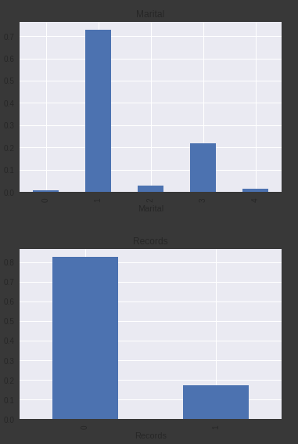
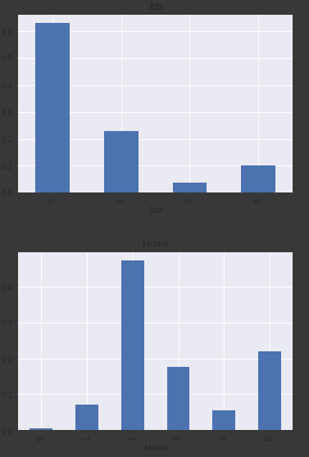

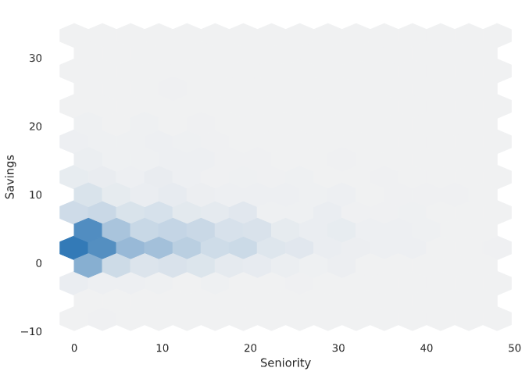
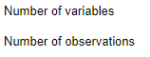

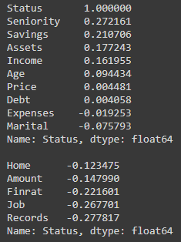
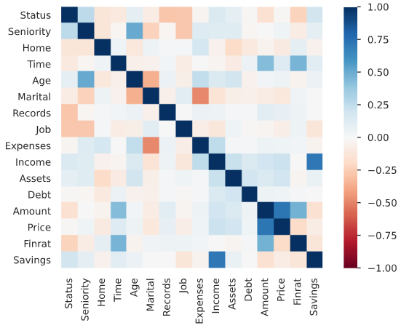



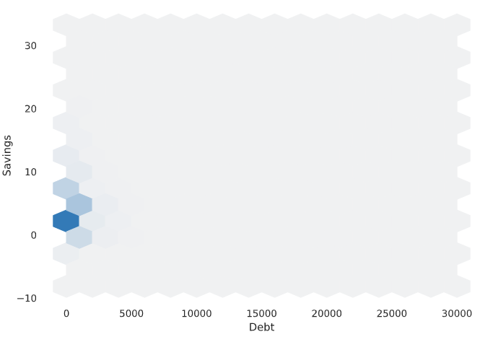
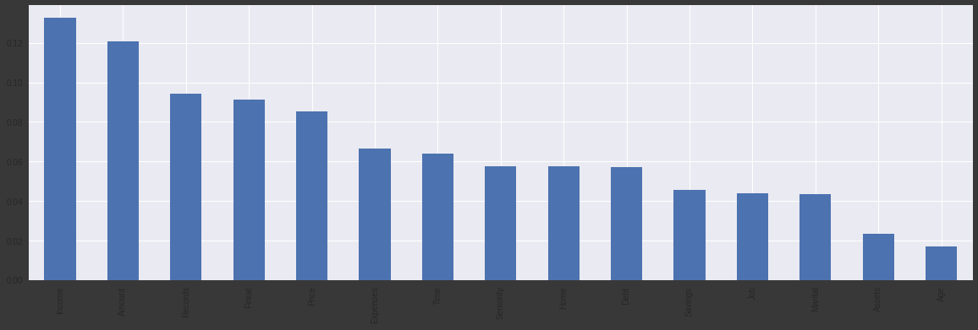


Exploratory Data Analysis
General observations
Checking missing values
Nature of variables
Distribution of classes
Studying useful variable interactions
Correlation Study
Percentage of observations per label
Outlier Analysis
Feature importance

Slide 8
Basic Pre-Processing
Data preprocessing is a data mining technique which is used to transform the raw data in a useful and efficient format.
Missing Values
Categorical Variables
Imbalanced Dataset
Handle outliers
Replaced by mean values of their columns
Measured skewness and performed capping
Used LabelEncoder
Used SMOTE technique

Slide 9
Feature Selection
[8 Features]
Top 4
INCOME
SENIORITY
RECORDS
HOME
FEATURE 1
FEATURE 2
FEATURE 3
FEATURE 4
Next 4
DEBT
SAVING
JOB
MARITAL
FEATURE 5
FEATURE 6
FEATURE 7
FEATURE 8

Slide 10

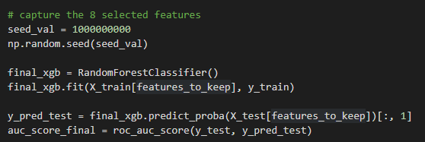

Model Selection
Random Forests are an ensemble learning method for classification, regression and other tasks that operate by constructing a multitude of decision trees at training time and outputting the class that is the mode of the classes or mean/average prediction of the individual trees.
Performance Metric
AUC (Area Under The Curve) of ROC curve tells how much model is capable of distinguishing between classes. Higher the AUC, better the model is at predicting

Slide 11
Hyper-Parameter Tuning and Performance Evaluation
colsample_bytree
Grid Search
GridSearchCV tries all the combinations of the values passed in the dictionary and evaluates the model for each combination using the Cross-Validation method. Hence after using this function we get accuracy/loss for every combination of hyperparameters and we can choose the one with the best performance.
grid search best score: -0.11429716133890302
Hyper Parameters final value after optimization: {'colsample_bytree': 0.3, 'gamma': 0.0, 'learning_rate': 0.2, 'max_depth': 5, 'n_estimators': 20000}
gamma
learning_rate
max_depth
n_estimators
FInal RMSE Score: 6.140317699900427e-05

Slide 12

CHALLENGES FACED
We successfully completed the detailed analysis on how to build a scorecard model for customers at bank. We presented a step by step procedure for this data mining project. In this report, we mentioned all our decisions and choices based on careful consideration of various factors relevant to our data. We reviewed various ways for exploratory data analysis, pre-processing, modelling as well as performance optimization methodologies. We also presented a user-friendly web application by which a user can easily be categorised as reliable or not and his customer credit score is generated.

Slide 13
Future Scope
We successfully completed the detailed analysis on how to build a scorecard model for customers at bank. We presented a step by step procedure for this data mining project. In this report, we mentioned all our decisions and choices based on careful consideration of various factors relevant to our data. We reviewed various ways for exploratory data analysis, pre-processing, modelling as well as performance optimization methodologies. We also presented a user-friendly web application by which a user can easily be categorised as reliable or not and his customer credit score is generated.

Slide 14
THANK YOU !

