Slide 1
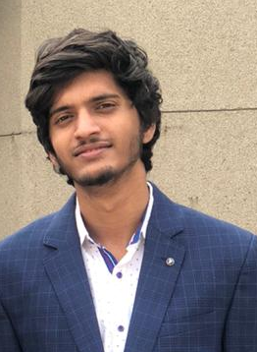


Citi Campus Innovation Challenge
Team Infersome
Presented By:
Ankit Priyarup
Anukriti
Gaurav Kumar

Slide 2
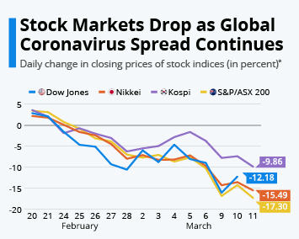
Problem Statement
The stock market is very unpredictable in nature any geopolitical changes - political news, economical news and influence of the social media can directly impact it
The most efficient way to solve this kind of issue is with the help of Machine Learning and Deep learning
Real time analysis using Time-Series forecasting and various news (tweets) stream

Slide 3
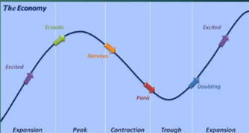
Problem Statement
A company's stock price reflects investor perception of its ability to earn and grow its profits in the future.
If shareholders are happy, and the company is doing well, as reflected by its share price, the management would likely remain and receive increases in compensation.
The prevention of a takeover is another reason that a corporation might be concerned with its stock price.
If a company's stock price is performing well along with the company, the company is likely to receive more favorable press from analysts and the media.

Slide 4
Challenges
Efficient Market Hypothesis states that the market is always at equilibrium.
Once we have a dataset, there is a fair amount of organizing and cleaning up to be done
Not all data is useful data, and the data that is useful may not be sufficient enough to make a claim

Slide 5
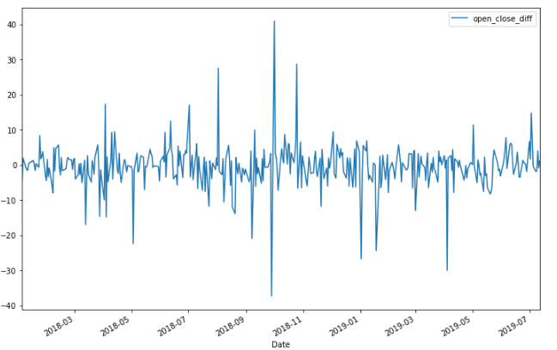
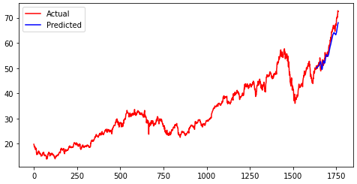
Data Collection
Two types of analysis:
Fundamental analysis (Data used: news articles using Finviz api, social media data data using twitter api)
Technical Analysis( Data used: historical stock prices using Yahoofinance api)

Slide 6
Pre-processing
Tweets and news cleaning: removal of twitter Return handles (RT @xxx:), remove twitter handles (@xxx), remove URL links (httpxxx), remove special characters, numbers, punctuations (except for #), stop word removal
Historical Data- Some records(data for some dates) not available: replaced NaN values by mean
Derived Features: Percent Price Change Within Period, Scaled Volume, SMA values, change in sentiment values
Sentiment Analysis performed using Vader & TextBlob Sentiment Intensity Analyzer

Slide 7
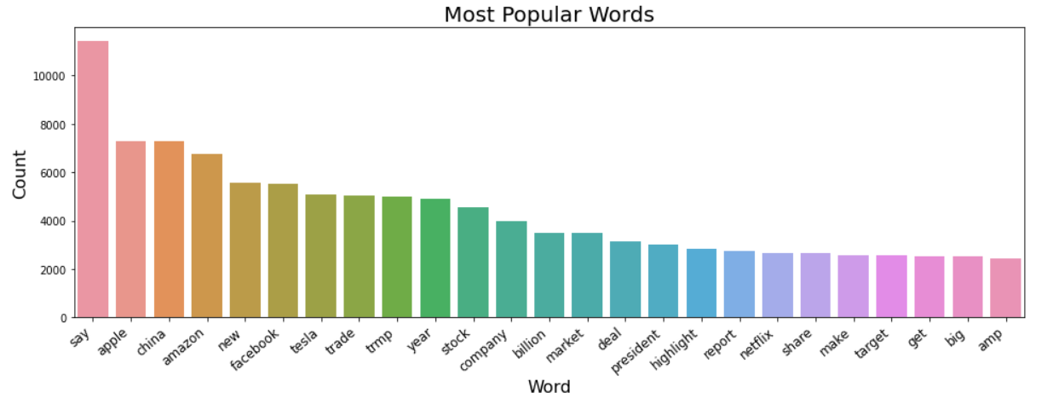
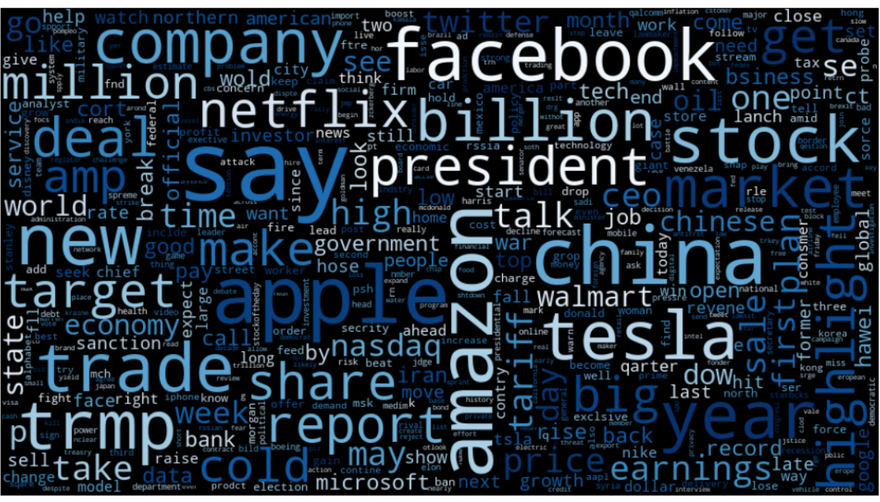
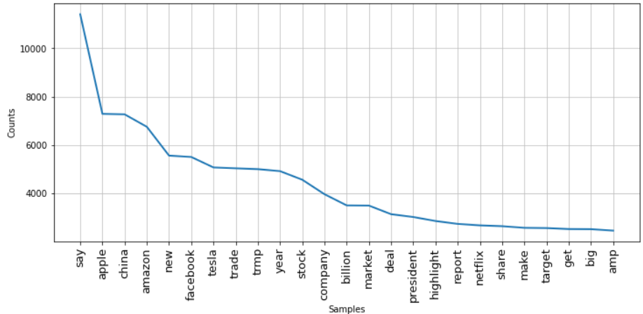

Slide 8
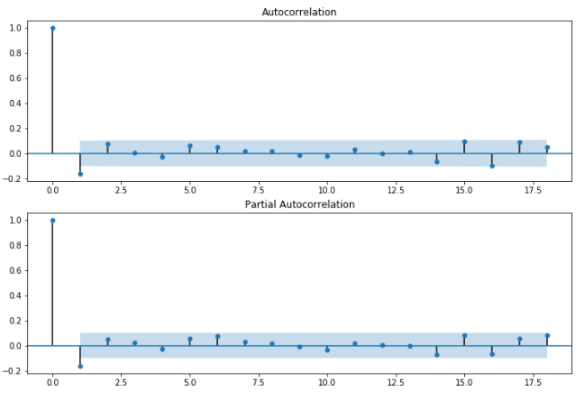

Slide 9
Final Feature Selection
Adj Close
Scaled Volume
Compound_y
Compound_x
Compound SMA(3) Headlines
Compound SMA(3) Twitter
change in sentiment headlines'
change in sentiment twitter

Slide 10
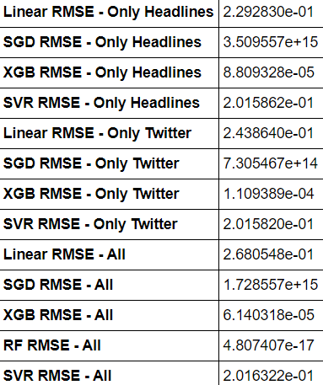
Model Selection and Analysis
Used Gradient Boosting ensemble technique
Models are fit using any arbitrary differentiable loss function and gradient descent optimization algorithm.

Slide 11
Hyperparameter Tuning
GridSearchCV tries all the combinations of the values passed in the dictionary and evaluates the model for each combination using the Cross-Validation method. Hence after using this function we get accuracy/loss for every combination of hyperparameters and we can choose the one with the best performance.
grid search best score: -0.11429716133890302
Hyper Parameters final value after optimization: {'colsample_bytree': 0.3, 'gamma': 0.0, 'learning_rate': 0.2, 'max_depth': 5, 'n_estimators': 20000}
FInal RMSE Score: 6.140317699900427e-05

Slide 12
Elastic Search
Backend
Node backend along with Elastic search, provides fast interaction and streaming data

Slide 13

Demo Angular Application

Slide 14
Technology Stack
Prediction Engine:
Libraries: numpy, pandas, itertools, bs4 (BeautifulSoup), sklearn (classifiers, metrics, model_selection), statsmodels.api, pickle, xgboost, matplotlib (visualization) etc.
Tools: Anaconda, WEKA
APIs: Tweepy API, Sntwitter, Finviz, Yfinance
Vader Sentiment Intensity Analyzer
Language: Python
GUI/DEMO:
Frontend:
Backend: Flask
Languages: Javascript, Python

Slide 15
Thank You!

