Slide 1
PERCEPTRON
Lecture-1
Intro to Machine Learning
Ayush C| Vasudev S

Slide 2
OBJECTIVES OF THE COURSE
Introduction to Machine Learning
Theoretical and Conceptual Foundation
Inducing the Thought Process of a Data Scientist
Ability to solve Real-World problems in industry and academia

Slide 3
COURSE LOGISTICS
Interactive Sessions
Piazza Online Classroom
After Class Doubts
Regular Take Home Assignments
Hackathons to implement your ideas
Online Code Submission and Leaderboard

Slide 4
MACHINE INTELLIGENCE

Slide 5
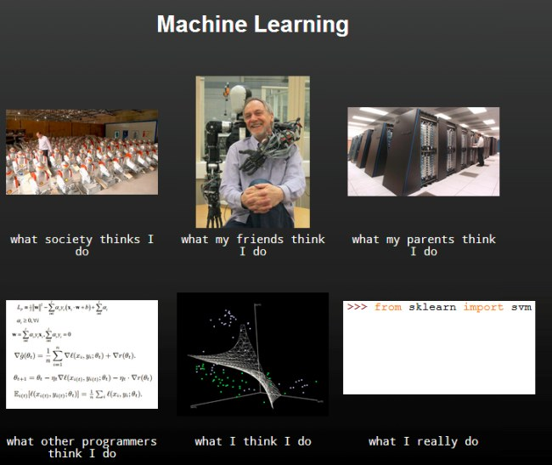
Notes:
1

Slide 6
WHAT IT IS

Slide 7
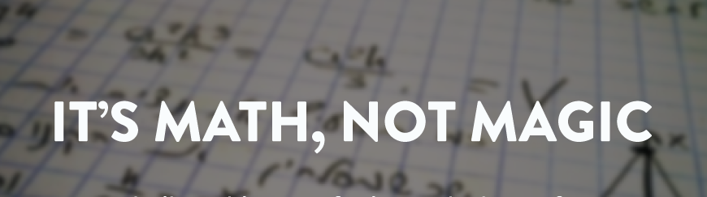
Notes:
1

Slide 8
RECAP: System of Linear Equations

Slide 9
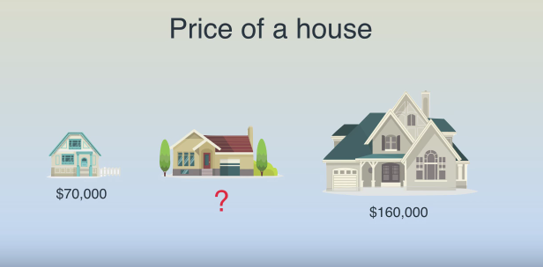
PROBLEM 1

Slide 10
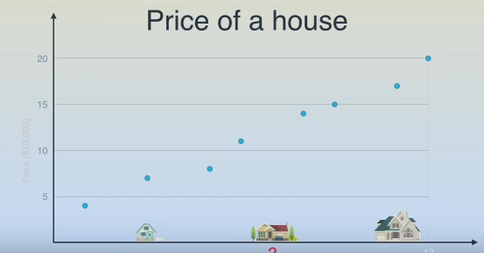

Slide 11
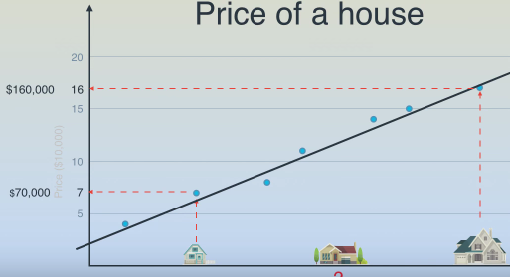
Make a Prediction : Fit a Line

Slide 12
FOOD FOR THOUGHT
1. Add another variable :- Repute of the Locality
2. Add another variable :- Lease/ Freehold
3. And another :p :- Year of Construction
Talk of : -
1. Problem Dimensionality
2. Nature of Curve to fit

Slide 13
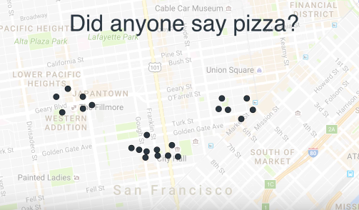
PROBLEM 2
Optimize Location of 3 pizza parlours

Slide 14
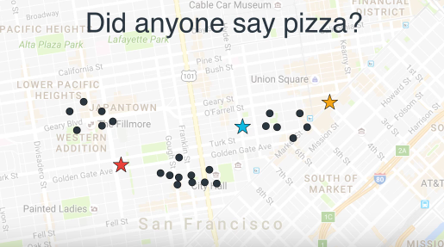
For the algorithm: Initialise to Random Locations

Slide 15
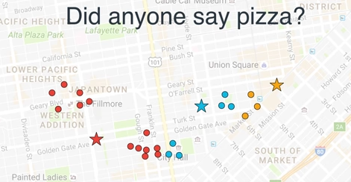

Slide 16
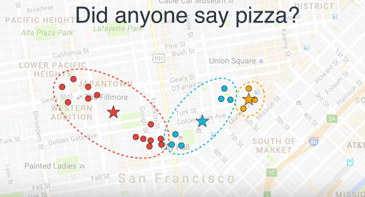

Slide 17
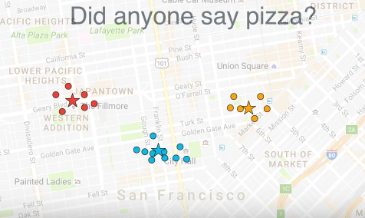
EVENTUALLY

Slide 18
Buzz Words
Supervised Learning, Unsupervised Learning, Reinforcement Learning
Classification/ Regression
Features
Training Data
Validation Data
Testing Data
For later!!
Overfitting, Underfitting
Weights
Notes:
1

Slide 19
WHICH OF THE ABOVE DISCUSSED PROBLEMS IS 1. SUPERVISED 2. UNSUPERVISED Justify!!

Slide 20
FORMAL DEFINITION
Machine learning is a subfield of artificial intelligence (AI) concerned with algorithms that allow computers to learn. What this means, in most cases, is that an algorithm is given a set of data and infers information about the properties of the data—and that information allows it to make predictions about other data that it might see in the future

Slide 21
DRIVING FACTORS !
Lots of Data
Ability to process it
Machine Learning Models are essentially Statistical Machines.
Notes:
1

Slide 22
SOME STATISTICS
Every minute up to 300 hours of video are uploaded to YouTube.
Average of 31.25 million messages and view 2.77 million videos every minute on Facebook.
More data has been created in the past two years than in the entire previous history of the human race.
At the moment less than 0.5% of all data is ever analyzed and used, just imagine the potential here.

Slide 23
THE INDUSTRY IS USING IT..
Google Page Ranking.
Netflix Suggestions.
Tinder, for you to “chill”
Tesla Self Driving Cars

Slide 24
THE POTENTIAL: FEW INTERESTING APPLICATIONS

Slide 25

Demystifying Prisma: Neural Art

Slide 26
The Mathematical Mozart

Slide 27
Image Captioning: Neural Story

Slide 28
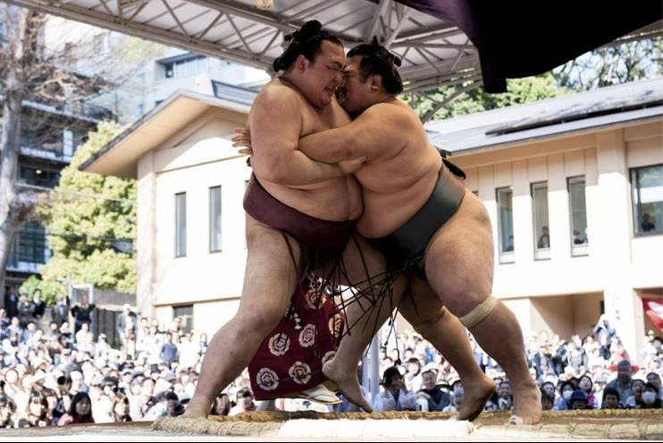

Slide 29
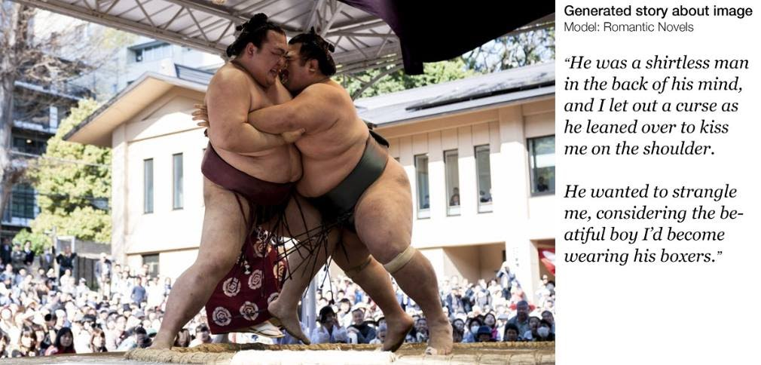

Slide 30
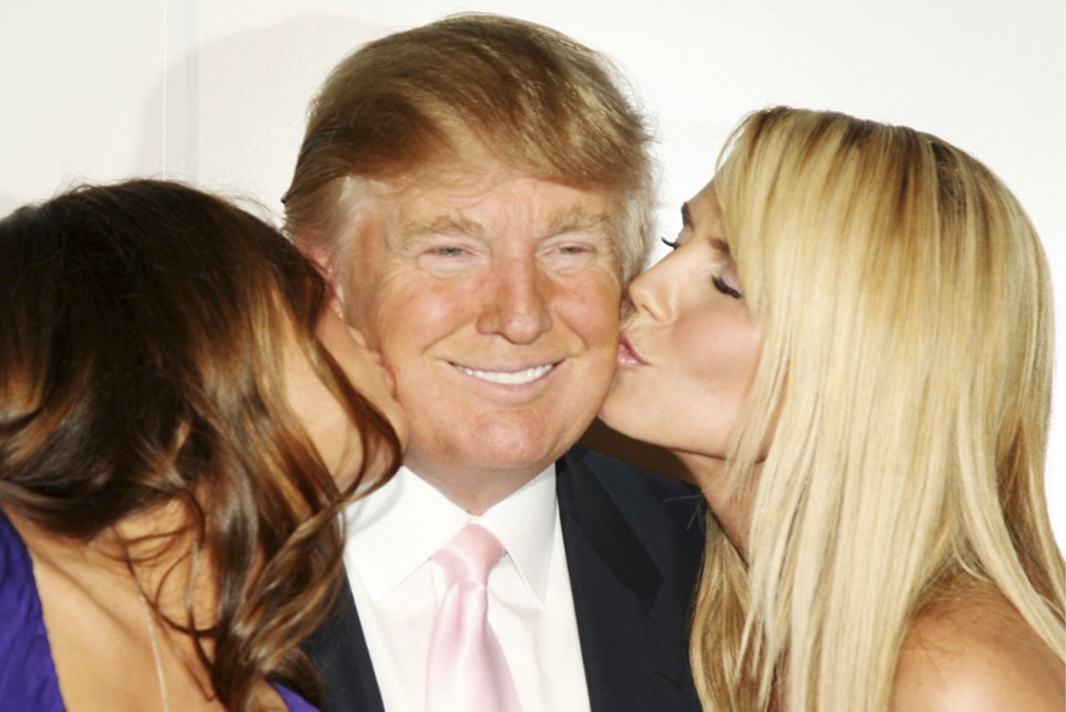

Slide 31
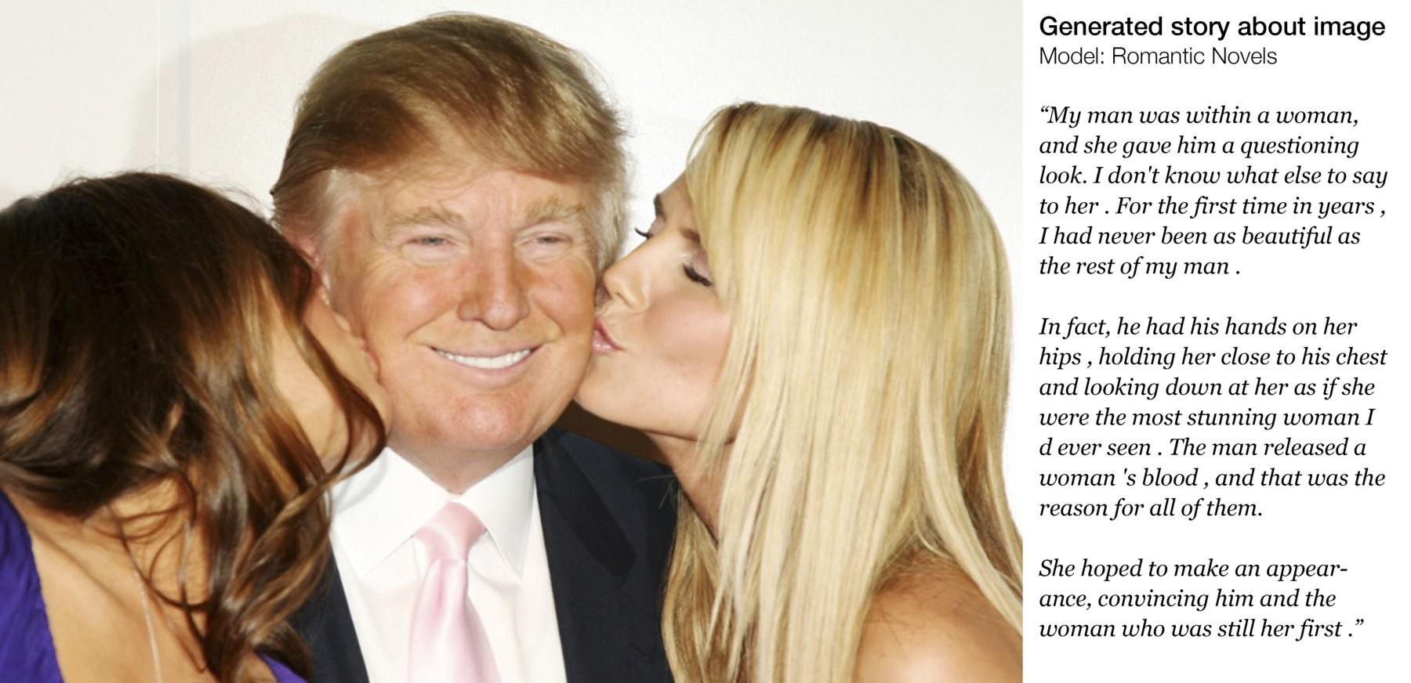

Slide 32
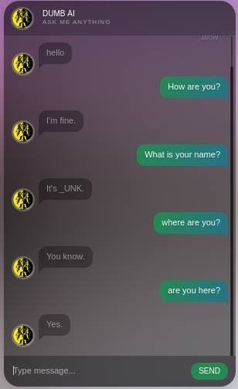
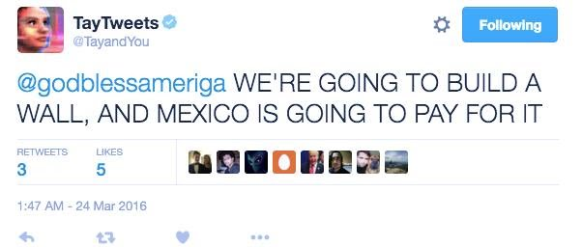
Conversational Engine

Slide 33
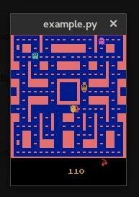
Pacman Champ: The Gamer

Slide 34
How easy do you think Lip Reading is ?
Lip-Reading AI
Human Accuracy : 20% to 60%
LipNet Accuracy : 93.4%

Slide 35
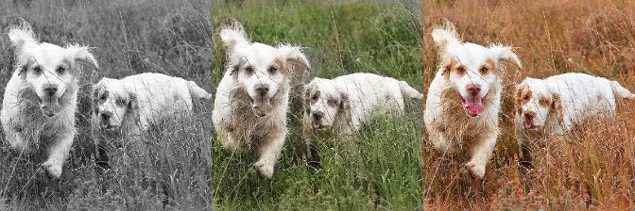
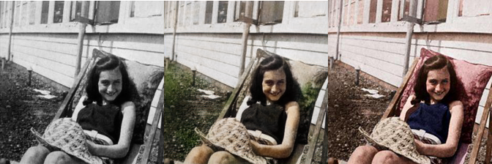
Colorizing the World:

Slide 36
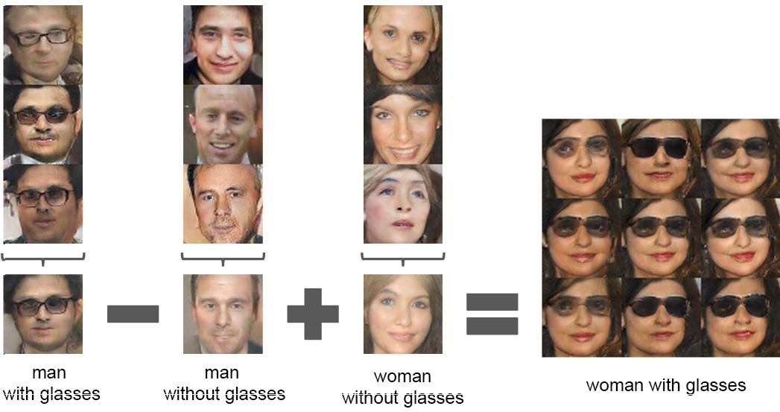
Playing with Words and Image
Notes:
1

Slide 37
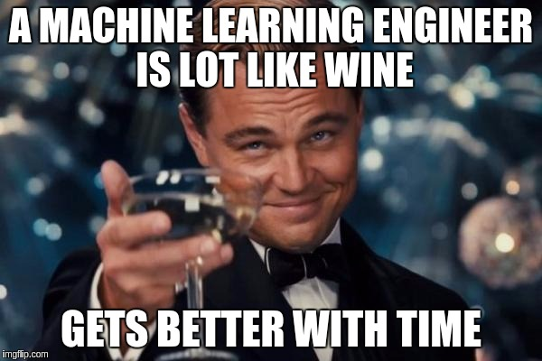
Notes:
<number>

Slide 38
DEVELOPER CHECKLIST
Python 2.7, Ipython , Jupyter
Numpy , Scipy
OpenCV
Matplotlib
Pandas
Theano , Tensorflow
And…..

Slide 39
Passion and
Perseverance !

Slide 40
INTRODUCTION TO PYTHON

Slide 41
Setting Up Jupyter Notebooks

Slide 42
Variable and Data Types

Slide 43
String, Lists and Dictionaries

Slide 44
Packages and Imports

Slide 45
Conditionals Loops and Functions

Slide 46
Object Oriented Paradigm

Slide 47
Python LIVE Assignment

Slide 48
File Handling

Slide 49
Statistical Computation with Python: Hands-on Session

Slide 50
Doubts and Queries?

Slide 51
Thank You!
Ayush C | Vasudev S

