Slide 1
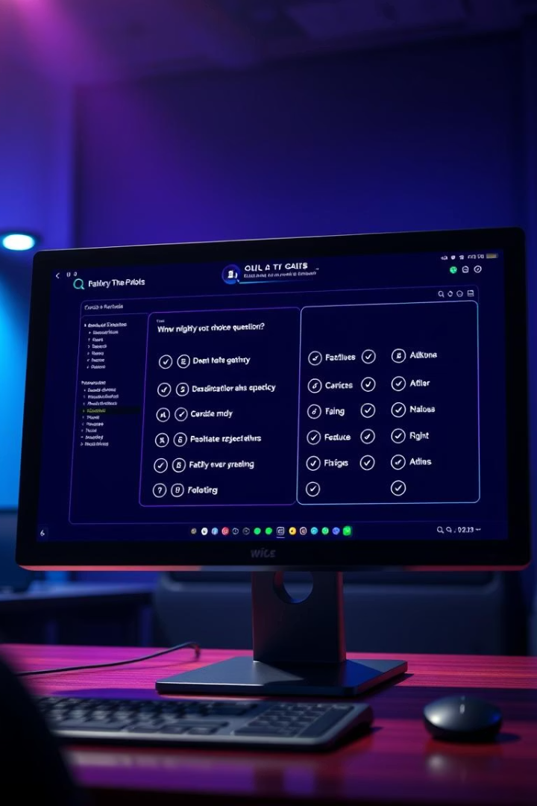
SmartQuiz: A Java-Based Quiz Application
This project presents an interactive Java desktop app for quizzes.
Presented By:-
Anukriti Chauhan
Ayush Gupta
Daksh Bhati
Taruna Singh.

Slide 2
Project Description & Tech Stack
Overview
Tech Stack
Java-based desktop app with multiple-choice quizzes and score tracking.
Programming Language: Java
GUI: Swing or JavaFX
Provides feedback for learning and assessment.
Database: Optional MySQL or file storage

Slide 3

Purpose and Learning Goals
Interactive Quiz Platform
Object-Oriented and GUI Learning
Engages users with real-time assessments and scoring.
Enhances skills in Java programming paradigms and UI design.
Simulating Real Applications
Builds familiarity with practical Java software development.

Slide 4






Project Workflow Visualized
User Registration/Login
Quiz Selection
Displaying Questions
User Submits Answers
Score Calculation
Display Results and Feedback

Slide 5
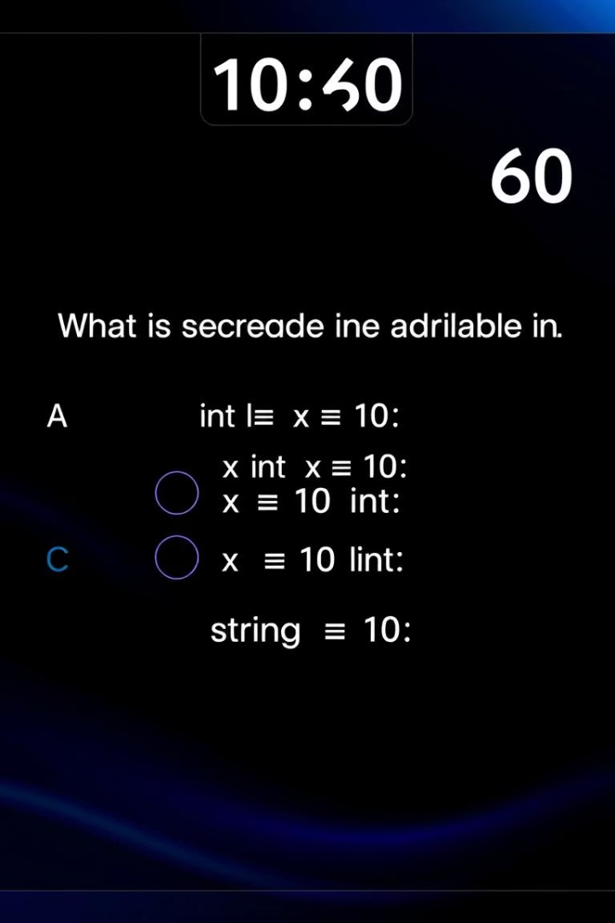
Expected Functional Results
Complete Java Application
Fully functional with GUI components and quiz logic.
Timed Multiple-Choice Quizzes
Support for question timers and selection.
Result Display
Final score shown with option for reviewing answers.
Data Storage (Optional)
Saving results locally or in a database.

Slide 6



GUI Components and Design Choices
Swing vs JavaFX
Swing offers robust, mature components; JavaFX provides modern UI effects.
User Interface
Designed for clarity, ease of use, and responsive layouts.

Slide 7

Project Challenges and Solutions
1
Managing State
2
GUI Updates
3
Data Handling
Handling user answers and score tracking efficiently.
Ensuring smooth, responsive question transitions.
Optional integration of database or file storage for persistence.

