Slide 1
HEALTHCARE SURVEY ANALYSIS RESULTS

Slide 2
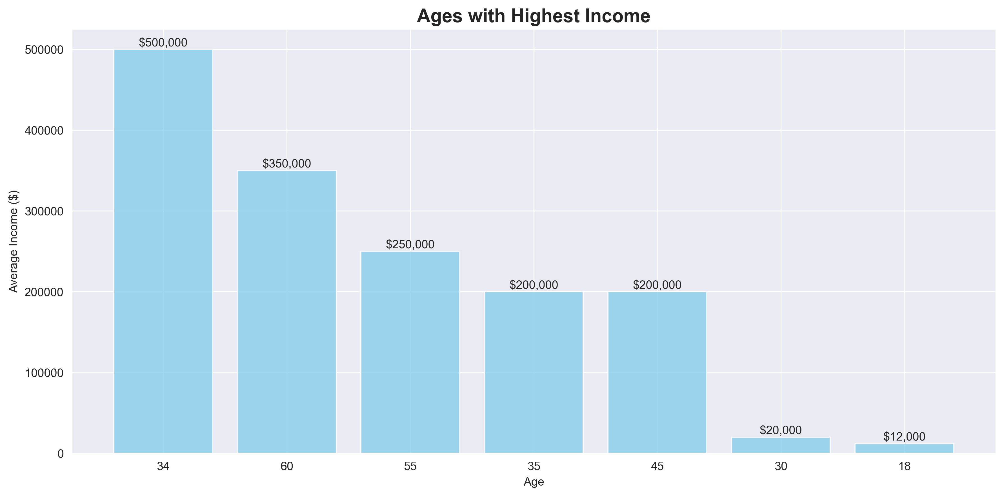

Slide 3
