Slide 1


INTERNSHIP PROJECT:
Supply Chain Risk and Sentiment Alert System
Presented by Anulipi Jana
KIIT, Bhubaneswar, Odisha
AJ

Slide 2
Introduction
I Completed the Internship Project at Infosys Springboard under the guidance of Rohitash Goyal, an expert mentor who teach, guide and monitor throughout the project.
An AI-Driven Supply Chain Disruption Predictor and Inventory Optimization System aims to provide businesses with a solution for predicting supply chain disruptions and optimizing inventory in real-time. The system leverages FastAPIs, advanced machine learning algorithms, NLP models and real-time data integration to proactively identify and manage disruptions in global supply chains. And forecasts potential disruptions, and suggests dynamic inventory adjustments based on predictive models.
Key Goals:
Monitor Global Supply Chain Data: The system will keep track of global news, supplier information, and transportation updates, using APIs (NewsApi, GoMaps, WeatherApi etc.)
Predict Potential Disruptions: The LLM Models (Bert, T5, MetaLLM) will identify and analysis possible risks and sentiment that could affect the supply chain.
Optimize Inventory Levels: Based on the predicted risks, the system will suggest adjustments to inventory levels to avoid shortages or excess stock. It will forecast these disruptions before they happen.
Send Real-Time Alerts and Dashboard deployment: Businesses will get instant notifications (via tools like Slack or email) about potential disruptions and what actions to take. This includes recommendations to reorder products or adjust inventory.

Slide 3
Need for a Modern Solution
Supply Chain Challenges
Why It Matters
Modern supply chains face constant pressure from unpredictable external factors like:
weather disruptions,
transportation delays
fluctuating market sentiments.
This inherent uncertainty poses significant risks and necessitates a shift towards more robust, data-driven strategies.
Users'’ need of a user-friendly platform which provide future prediction in 1 click.
The need for a sophisticated solution stems from the desire to: optimize inventory management, mitigate risks, enable better decision-making in complex supply chain networks. Real-time actionable insights are crucial to avoid costly delays and losses.
Real Cases
IBM partnered with Agrosmart to implement AI-powered weather prediction and crop monitoring systems.
Outcome: Decreased produce spoilage by 30% through smart rerouting to alternative storage or markets.
Fonterra implemented an AI-driven inventory optimization system that, forecasted demand by analyzing seasonal and market factors, Allocated storage by suggesting optimal warehouse locations, Reduced waste through expiry tracking and smart routing.
Outcome: 20% lower inventory costs and 15% better delivery times

Slide 4
A Framework for Actionable Insights
1
Milestone1: Setup & Data Collection
Install and Import all prerequisite libraries in Google Collab. Generate, Collect and modify data using Faker library and APIs.
2
Milestone2: Risk & Sentiment Analysis
Advanced AI models are employed to extract sentiment and risk from news articles , weather news, inventory levels, transportation status, lead times. Provide numerical values from 0 to 1 as Sentiment Factor and Risk Factor.
3
Milestone3: Predictive Action and Train Model
Using Sentiment and risk factors train model by RandomForestClassifier. Based on each cases as per their condition predict appropriate actions.
4
Milestone4: Alert Delivery
The system gathers comprehensive data from users, including information on inventory levels, transportation status, lead times, and external factors. The trained model predict real-time alerts and seamlessly delivered to Slack channels, providing a centralized platform for communication and immediate access to critical insights.
Product: Tomato 🍅

Slide 5
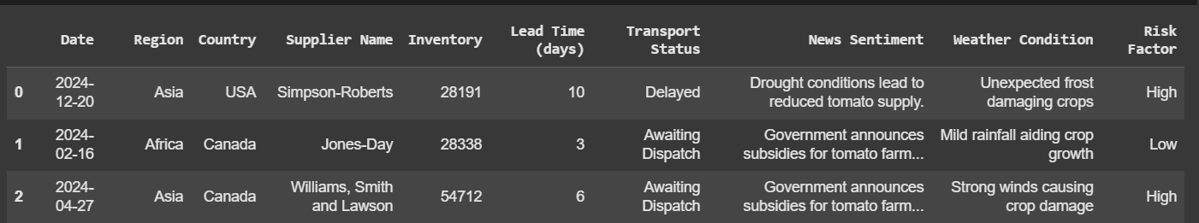
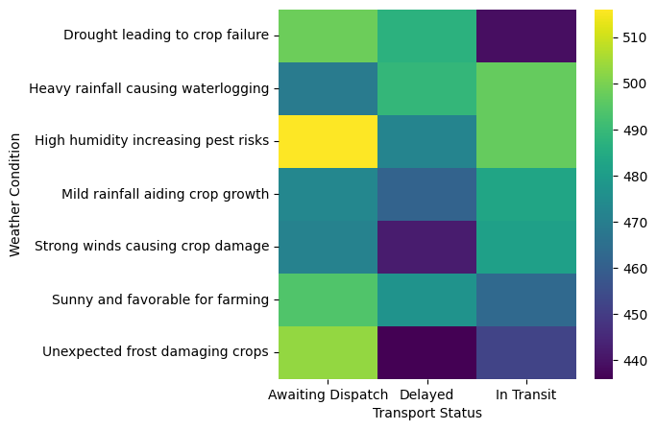
Dataset
Try to fetch data from Data Sources:
NewsApi
Kaggle
Chatgpt
IndiaGovt. Agriculture Dept.
Final dataset create using Faker library.

Slide 6
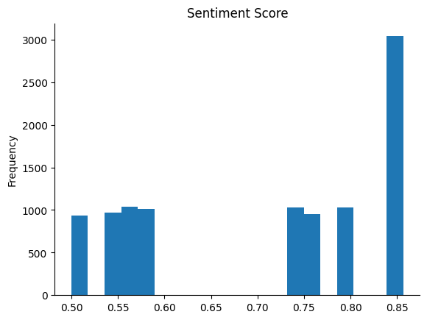
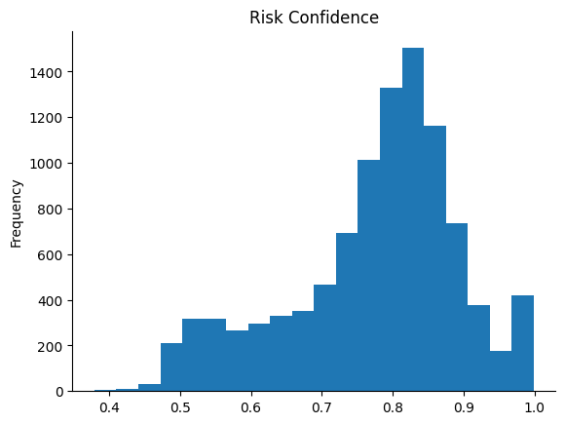
Risk & Sentiment Analysis
Model use for Analysis: cardiffnlp/twitter-roberta-base-sentiment, facebook/bart-large-mnli, yiyanghkust/finbert-tone

Slide 7
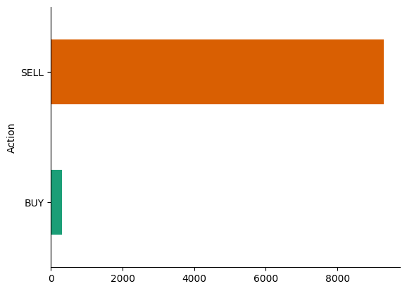
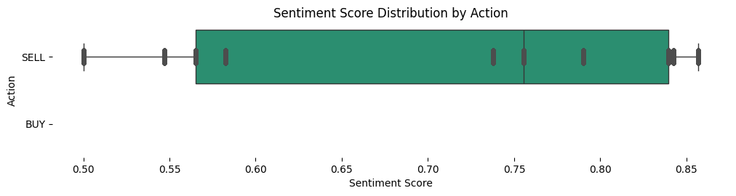
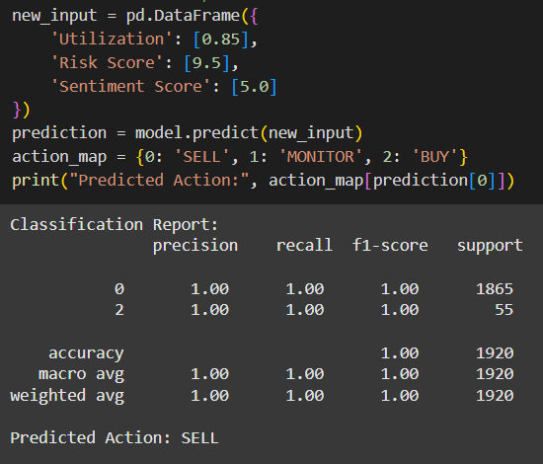
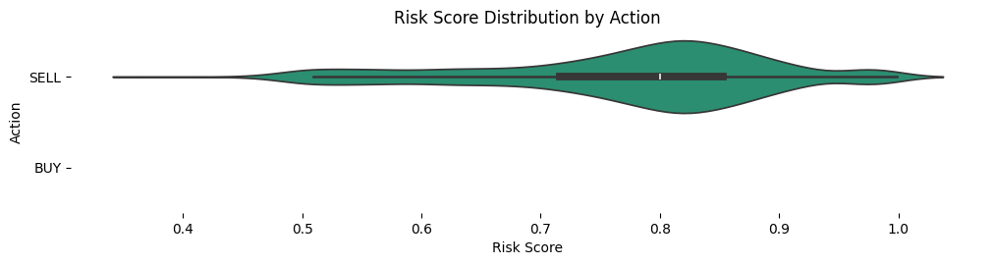
Predictive Action and Train model
Thresholds and conditions:
1. warehouse_capacity_threshold = 0.8 # 80% capacity considered high
2. risk_score_threshold = 9.0 # Risk Score above 9 is considered high
3. sentiment_score_threshold = 6.0 # Sentiment Score below 6 is considered negative

Slide 8
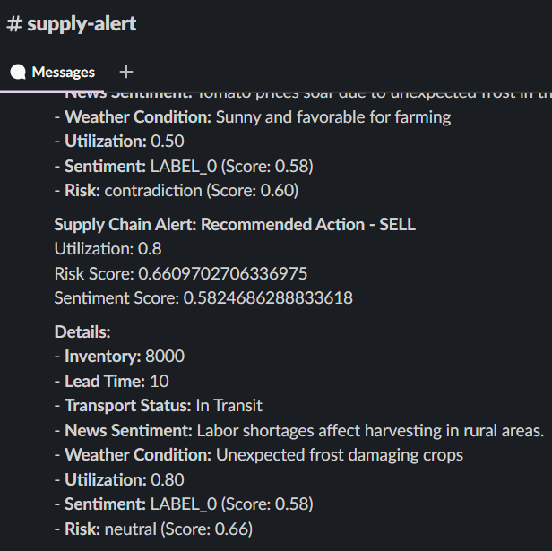
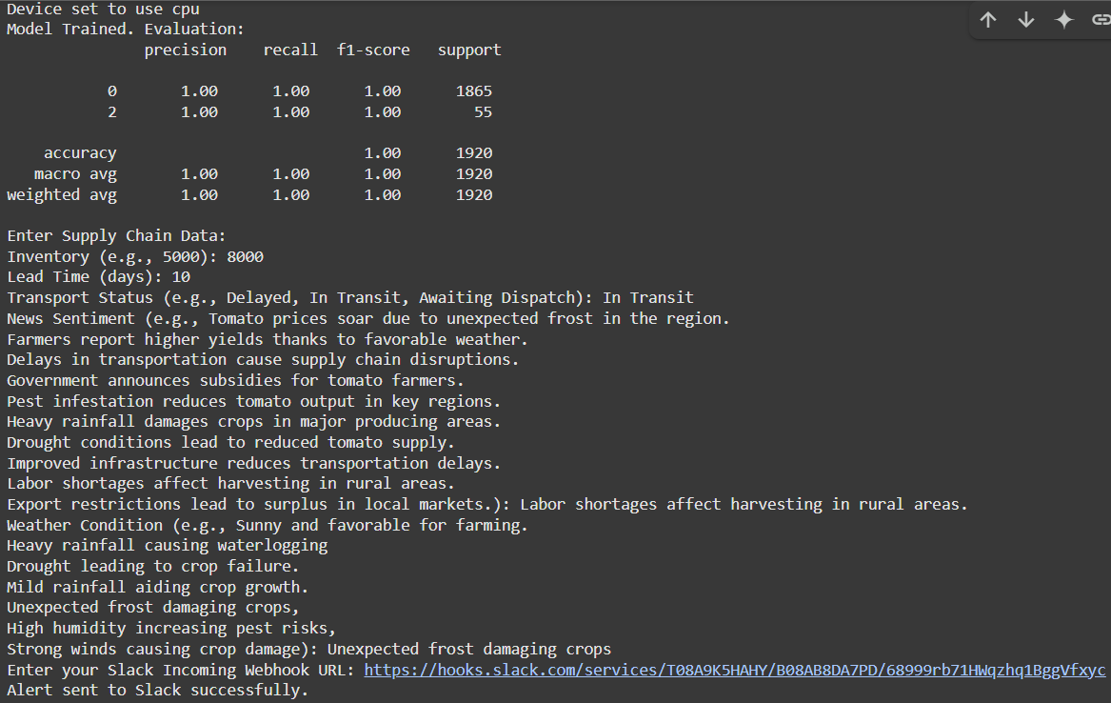
Send Alert in Slack
The system calculate Risk and Sentiment Factors by Risk and Sentiment Analysis. Trained model test the new case and predict suitable action.
Send that action with reasons (value of utilization, risk and Sentiment) to the user’s slack. Using the slack Webhook.
User give some input in the system.
Inputs: - Inventory, - Lead Time (days), - Transport Status, - News Sentiment, - Weather Condition, - Slack Incoming Webhook URL

Slide 9



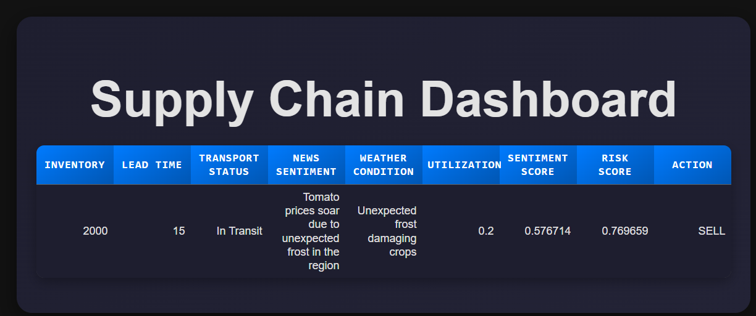


Future Possibilities
1
Real-time Data
Integrating real-time APIs for weather, transportation, and sentiment update, advance IOT sensors, tracker for monitoring and optimal result. It will enhance the system's responsiveness and accuracy, enabling more dynamic decision-making.
User Friendly Platforms
2
Developed comprehensive visual dashboards for detailed insights and easy interpretation of complex data, enhancing the usability. Expanding to support multi-language sentiment analysis. To reach in remote area.
Sustainable Supply Chains
3
AI-powered systems will enable recycling facilities in circular supply chains where food waste from supply chains could be converted into bioenergy or fertilizers.
4
Enterprise Integration
Integration with enterprise-level tools like SAP and Oracle will streamline data flow and provide a seamless experience for users within existing workflows.

Slide 10
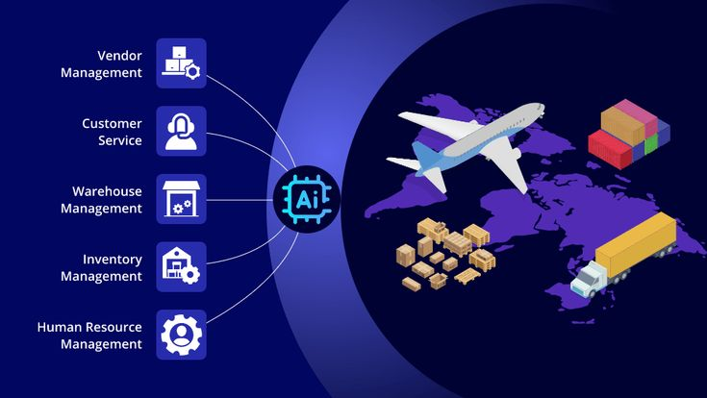
Conclusion
During the development of project: AI-Driven Supply Chain Disruption Predictor and Inventory Optimization System. I tackle real-world challenges like real time data collection, API resources, suitable model finding, disruptions and inefficiencies using predictive analytics and optimization, Visual representation.
This project sharpened my skills in AI, ML, LLM models, APIs, data analytics, and problem-solving, showcasing my ability to deliver impactful, scalable solutions. It’s a proud milestone, aligning with Infosys’ vision of driving digital excellence, and marks the beginning of my journey to build smarter and advanced AI-powered projects for the future.

Slide 11


Thank You
https://github.com/AnulipiJana/AI-Driven-Supply-Chain-Disruption-Predictor-and-Inventory-Optimization-System
LINK
https://app.slack.com/client/T08A9K5HAHY/C08A9K7QUFL

