Slide 1


The House of Tatas: Governance Challenge
Submitted By:
Anulipi Jana 21051974
Anurupa Saha 21051975
Submitted To:
Krutika Verma

Slide 2

Introduction to the Tata Group
The Tata Group is a renowned Indian multinational conglomerate with a rich history and diverse business interests. Founded in 1868 by Jamsetji Tata, the group has grown to encompass over 100 companies operating in numerous sectors, including technology, automobiles, steel, and consumer goods.
With a strong focus on innovation, social responsibility, and ethical business practices, the Tata Group has become a symbol of India's economic and industrial prowess. Its iconic brands, such as Tata Motors, Tata Steel, and Tata Consultancy Services, are recognized globally for their quality and innovation.

Slide 3
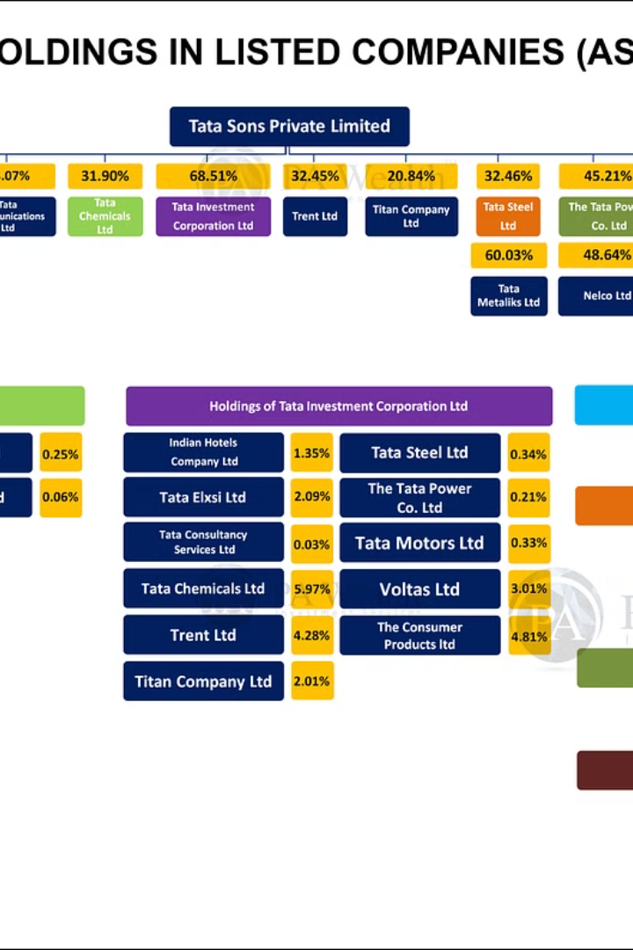
Tata's Unique Governance Structure
The Tata Group is known for its unique and complex governance structure, which sets it apart from traditional corporate models. The group is controlled by a network of philanthropic trusts that hold a majority stake, giving them significant influence over the conglomerate's strategic decisions.
This structure has enabled the Tatas to maintain a long-term, stakeholder-centric approach, prioritizing social responsibility alongside financial performance. However, it has also led to occasional tensions and power struggles within the group, as seen in the recent Mistry succession saga.

Slide 4
The Tata Trusts and their Influence
Charitable Legacy
1
The Tata Trusts, established by Jamsetji Tata, are some of India's oldest and largest philanthropic organizations, dedicated to supporting education, healthcare, and community development.
2
Controlling Stake
The Tata Trusts hold a controlling 66% stake in Tata Sons, the holding company of the Tata Group, giving them immense influence over the conglomerate's strategic decisions.
Autonomous Governance
3
The Tata Trusts operate autonomously from the Tata Group's management, with their own boards of trustees providing independent oversight and direction.

Slide 5
Controversies and Challenges in Tata's Governance
Allegations of mismanagement and nepotism in Tata Group's operations
Disputes between Tata Sons and its subsidiaries over strategic decisions
Criticism of the Tata Trusts' opaque decision-making and lack of accountability
Concerns over the Tata Group's complex ownership structure and control by a few family members
Lawsuits and regulatory investigations into alleged corporate governance failures at Tata companies

Slide 6

The Mistry Succession Saga
The succession of Tata Group's leadership became a contentious issue in 2016 when Cyrus Mistry was abruptly removed as the Chairman. This sparked a bitter power struggle between Mistry and the Tata Trusts, which held a majority stake in the conglomerate.
The Mistry camp alleged misgovernance and poor decision-making by the Tata board, while the Tatas countered that Mistry had failed to uphold the group's values and vision. The public feud highlighted deep divisions within the House of Tatas.

Slide 7
Ratan Tata's Return and Reforms
1
Ratan Tata's Temporary Return
2
Focus on Transparency
After Cyrus Mistry's ouster, Ratan Tata, the former chairman, briefly returned to the helm to provide stability and direction.
Ratan Tata initiated reforms to improve transparency and corporate governance, including strengthening the Tata Trusts' oversight role.
3
Restoring Trust
4
Paving the Way for a New Leader
Tata sought to repair relationships with key stakeholders and rebuild trust in the Tata brand after the divisive Mistry saga.
Ratan Tata's interim leadership laid the groundwork for the appointment of a new, permanent Tata Sons chairman.

Slide 8
Balancing Shareholder Interests and Social Responsibility
Shareholder Value
Social Responsibility
Ethical Dilemmas
Transparency & Accountability
Tata often faces difficult tradeoffs between maximizing profits and upholding its social mission. Navigating these dilemmas requires principled leadership and a nuanced understanding of stakeholder interests.
Tata's governance model must balance the need to deliver strong financial returns to shareholders with its deep commitment to social impact and public good.
As a conglomerate with diverse business interests, Tata must ensure its actions and policies benefit the communities it serves, protect the environment, and uplift the underprivileged.
Tata must maintain the highest standards of transparency and accountability to build trust with shareholders, customers, employees and the public at large.

Slide 9



Lessons and Implications for Corporate Governance
Transparency
1
Increase disclosure and accountability
Independence
2
Strengthen independent oversight
Stakeholder Focus
3
Balance shareholder and public interests
The Tata governance challenges highlight the critical need for robust corporate governance practices that prioritize transparency, independent oversight, and a balanced focus on all stakeholders. These lessons have far-reaching implications, calling for reforms to strengthen ethical decision-making, protect minority shareholders, and uphold a company's social responsibility. Implementing such governance best practices can help prevent future controversies and ensure long-term, sustainable success.

Slide 10
Lessons and Implications for Corporate Governance
Positive Resolution
Balancing Interests
Call to Action
A positive resolution to Tata's governance challenges can set a powerful example for ethical corporate practices and leadership succession planning.
Tata must continue to balance the needs of shareholders, stakeholders, and the public good through transparent, accountable governance.
Companies should strive for independent, diverse boards that uphold the highest standards of integrity, sustainability, and social responsibility.

Slide 11
Conclusion
The House of Tatas faces governance challenges pivotal to its enduring success. Upholding its esteemed legacy requires a steadfast commitment to transparency, accountability, and ethical leadership. By navigating these challenges with integrity and diligence, the organization can foster a culture of trust, innovation, and resilience. Embracing evolving governance standards and best practices is essential to maintain its reputation as a beacon of corporate governance excellence. By prioritizing transparency, accountability, and ethical leadership, the organization can uphold its legacy while fostering innovation and resilience in an ever-evolving business landscape. Through these efforts, The House of Tatas can continue to thrive and lead with integrity in the dynamic global business environment.

Slide 12
Reference
https://www.tatasustainability.com/Home/Governance
https://www.scribd.com/document/327276180/House-of-Tata
https://journalppw.com/index.php/jpsp/article/download/13666/8838/16585
https://blog.ipleaders.in/tata-sons-v-cyrus-misty-a-case-study-in-corporate-governance/
https://indiacorplaw.in/2017/09/tata-corporate-governance-episode-india-specific-issues-concerns.html

Slide 13

THANK YOU

