Slide 1
Professional Practices
“ANATOMY OF A SOFTWARE HOUSE”

Slide 2
Contents
• Anatomy
• Software house
• Anatomy of a typical software house
• Case study // any scenario

Slide 3
Anatomy is study of
– Structure
– Organization
– Internal working
– Hierarchy chart

Slide 4
Software House
“A software house is a company that primarily provides software products. These companies may specialize in business or consumer software or software-as-a-service (SaaS) products.
The common definition is that the company is mainly invested in developing and distributing software products”

Slide 5
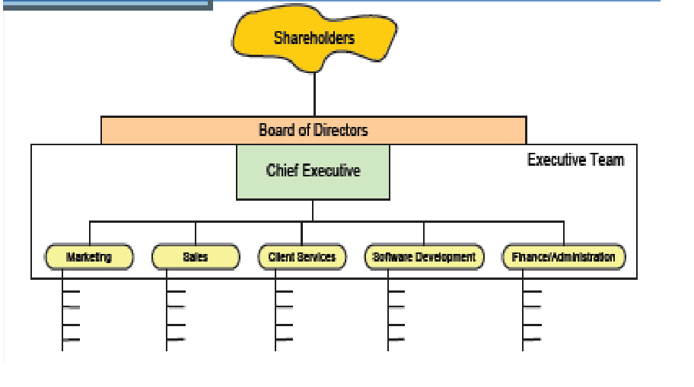
Anatomy of a software House
Notes:
shareholder: Directly or indirectly involved in your org.

Slide 6
Shareholders
• Owners of the company
• Elect the board of directors
• Vote on issues
• Same for private and public companies

Slide 7
Board of Directors
• Represent shareholders interests
• governing the organization by establishing broad policies and setting out strategic objectives
• selecting, appointing, supporting and reviewing the performance of the chief executive Officer
• terminating the chief executive Officer

Slide 8
Board of Directors
• ensuring the availability of adequate financial resources
• approving annual budgets
• accounting to the stakeholders for the organization's performance;
• setting the salaries, compensation and benefits of senior management;

Slide 9
Chief Executive Officer
• Appointed by the board
• Communicating, on behalf of the company, with shareholders, government entities, and the public
• Leading the development of the company’s short and long-term strategy
• Creating and implementing the company or organization’s vision and mission
• Evaluating the work of other executive leaders within the company

Slide 10
Executive Team
• Managed by CEO
• In charge of day to day functional areas
• Meet regularly to coordinate strategy, budget etc.
• manage the Group's business as a whole
• have extensive authorities within their individual areas of responsibility and have the duty to develop the company's operations in line with the targets set by the Board of Directors and the CEO.

Slide 11
Marketing
• create awareness of and develop the brand you're marketing
• communicate with target audiences and build and develop customer relationships
• organise and attend events such as conferences, seminars, receptions and exhibitions
• conduct market research, for example using customer questionnaires
Notes:
We are studying Anatomy of Software House

Slide 12
Sales
• Prepare and deliver appropriate presentations on products/ services
• Negotiate/close deals and handle complaints or objections

Slide 13
Client Services
• Develop and maintain existing client relationships.
• Interact and correspond with prospective clients.
• Ensure services are priced correctly for client
Notes:
prospective clients. :: whom you expect to become your clients in near future

Slide 14
Software Development
• Develop, manage and prepare best software development team.
• Guide, coach and mentor software development engineers.
• Provide project management and technical leadership for every aspect of software.
• Prepare lifecycle for different projects inclusive of research, development, design, evaluation, testing along with delivery to product management.
Notes:
Inclusive:including

Slide 15
Software Development
• Supervise architecture plus lead efforts to develop technical roadmap of all projects.
• Establish and stimulate software development standards and processes along with best practices for delivery of scalable and high quality software.
• Perform closely with Engineers, Developers and Product Management throughout organization to influence product development assisting or improving products.
Notes:
Encourage:stimulate

Slide 16
Finance and Admin
• Overall responsibility for all aspects of financial management and control.
• Effective financial reporting in a timely, accurate, relevant and informative manner.
• General administration duties.

