Slide 1

L3 GDB Macros By Anumeha Shah
Mentor
Shiv Kumar
Manager
Amit Nigam
What is GDB
GDB is a command line utility used for debugging purposes
Education
San Jose State University
Masters in Computer Science
About My Self
I like :
Hiking
Biking
Cooking
Traveling scenic places
What is L3 GDB Macros Project
The L3 GDB Macros project aims to automate the GDB debugging process
What is GDB Macros
GDB Macros are user defined GDB commands.
Contains sequence of GDB commands
These sequence of GDB commands can be executed based on extensive programming logic
How we achieve this
We are using GDB-Python APIs in Python scripts by capturing our engineers experience
Course Work
Algorithms
Computer Security
Machine Learning
Big Data
Career Interest
Software Developer
Programming is my passion
Besides programming, I am also interested in Security and Machine Learning

Slide 2


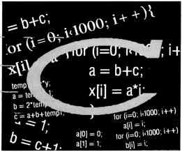
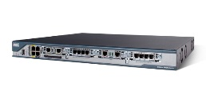

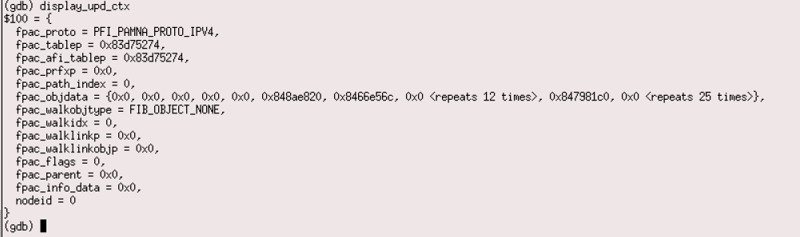
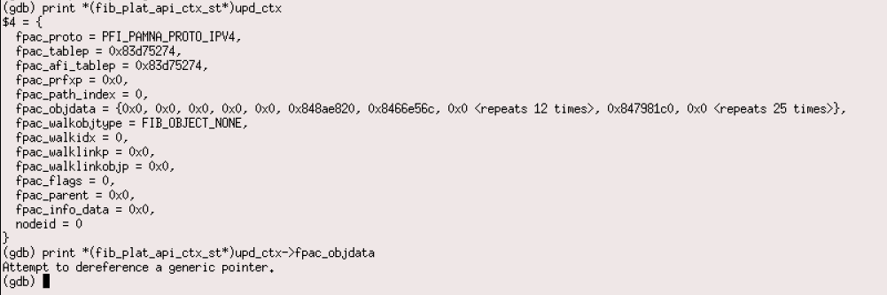
L3 GDB Macro Project Details
Result
Time Consuming
Complicated
Need to learn the context pointers
Requires extensive knowledge of code base
Intimidating for new user
Result
Speedy
Short Commands
Easy to use
No need to look in to the code to get right context pointers
Simplified
Captures User Experience
in the script
Just need to source the Python script using
Source gdb_fib_macro.py
0%
Router
50%
Get right context pointer
Intimidating for new user
Debug using GDB (command line utility) + GDB Macros
Generates Core File
Debug using GDB (command line utility)
Generates Core File
FIB PI HAL Gcplane Engine
FIB PI HAL Gcplane Engine
Short & easy to use commands
Long tedious command
prone to typing error
Single command for a complex process
Multiple commands to check one value
25%
50%
Result
Fast
Short Commands
Easy to use
No need to look in to the code to get the right context pointers thus saves 50% of time
Simplified
Result
Time Consuming
Complicated
Need to learn the context pointers
Requires extensive knowledge of code base
Intimidating for new user
Learning Experience
Debugging
GDB
Python
C
Modular programming
API Integration
Road Map
UT Tools
Audit Tools
To debug memory corruption
Validate various features

