Slide 1
Car Price Prediction

Slide 2
A Look at Data
DATA DICTONARY
1 | Car_ID | Unique id of each observation (Interger)
2 | Symboling | Its assigned insurance risk rating, A value of +3 indicates that the auto is risky, -3 that it is probably pretty safe.(Categorical)
3 | carCompany | Name of car company (Categorical)
4 | fueltype | Car fuel type i.e gas or diesel (Categorical)
5 | aspiration | Aspiration used in a car (Categorical)
6 | doornumber | Number of doors in a car (Categorical)
7 | carbody | body of car (Categorical)
8 | drivewheel | type of drive wheel (Categorical)
9 | enginelocation | Location of car engine (Categorical)
10 | wheelbase | Weelbase of car (Numeric)
11 | carlength | Length of car (Numeric)
12 | carwidth | Width of car (Numeric)
13 | carheight | height of car (Numeric)
14 | curbweight | The weight of a car without occupants or baggage. (Numeric)
15 | enginetype | Type of engine. (Categorical)
16 | cylindernumber | cylinder placed in the car (Categorical)
17 | enginesize | Size of car (Numeric)
18 | fuelsystem | Fuel system of car (Categorical)
19 | boreratio | Boreratio of car (Numeric)
20 | stroke | Stroke or volume inside the engine (Numeric)
21 | compressionratio | compression ratio of car (Numeric)
22 | horsepower | Horsepower (Numeric)
23 | peakrpm | car peak rpm (Numeric)
24 | citympg | Mileage in city (Numeric)
25 | highwaympg | Mileage on highway (Numeric)
26 | price(Dependent variable) | Price of car (Numeric)

Slide 3
Exploratory Data Analysis

Slide 4
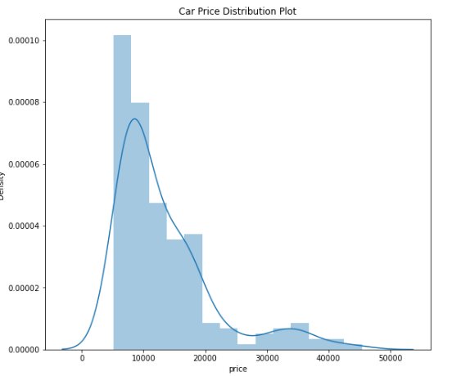
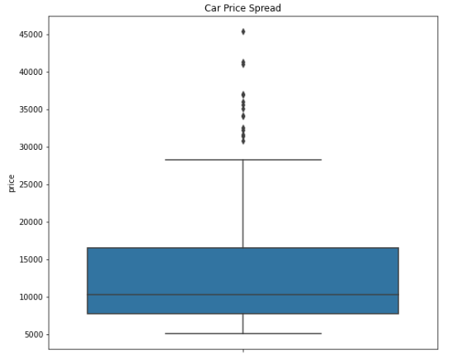
Target Variable - Price

Slide 5
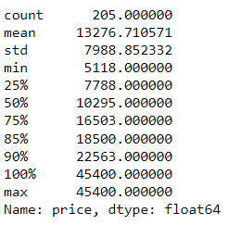
Right skewed
Most prices are low (below 15000)
Spread out from mean indicates high variance
85% are below 18500, remaining 15% are between 18500 and 45400

Slide 6
Visualizing categorical data
symboling
CompanyName
fueltype
aspiration
doornumber
carbody
drivewheel
enginelocation
enginetype
cylindernumber
fuelsystem

Slide 7
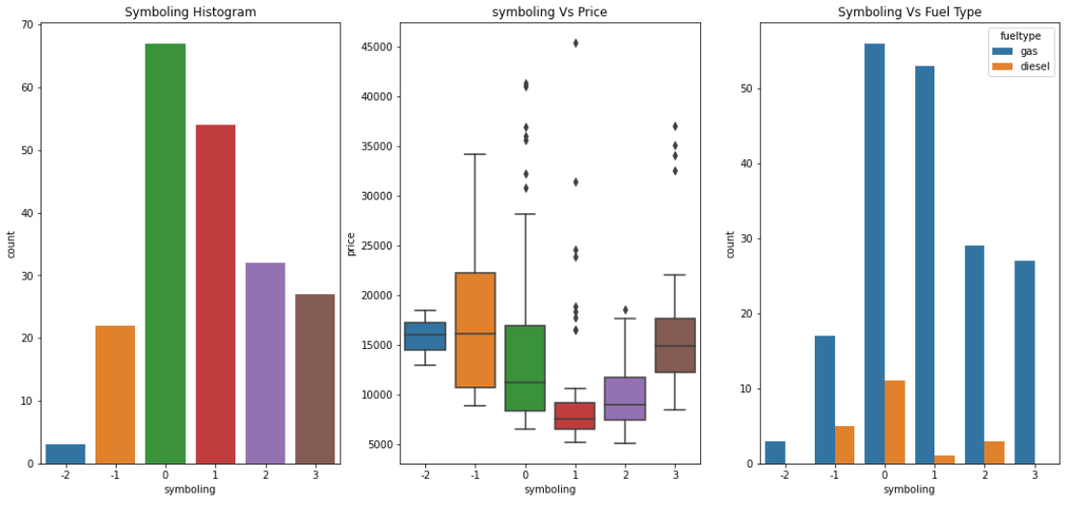
symboling
Insurance risk rate
-3 means safe
+3 means high risky
Symboling with 0 and 1 values are most sold
Cars with -1 are high priced (insurance risk rate is -1 means it is good
Dip in price at symboling 1
Symboling with 3 value has the price range similar to -2 value
Cars with all symboling mostly using gas as fuel

Slide 8
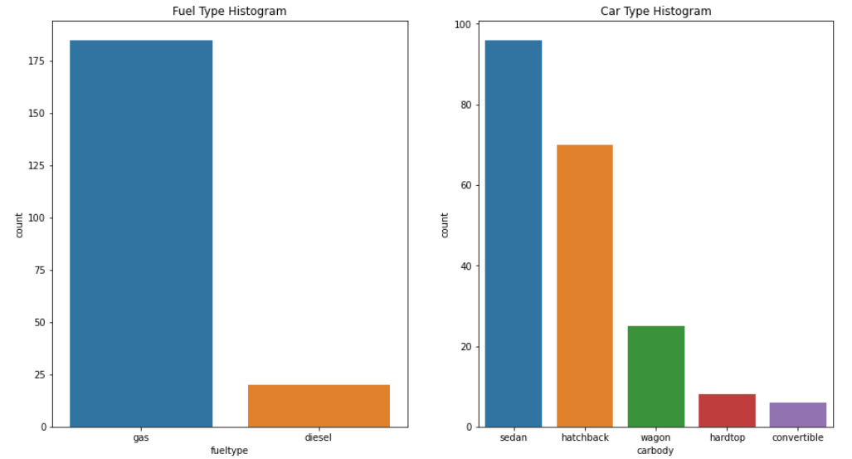
Fueltype and carbody
Gas fuelled cares are more than diesel
Sedan is the preferred car type

Slide 9
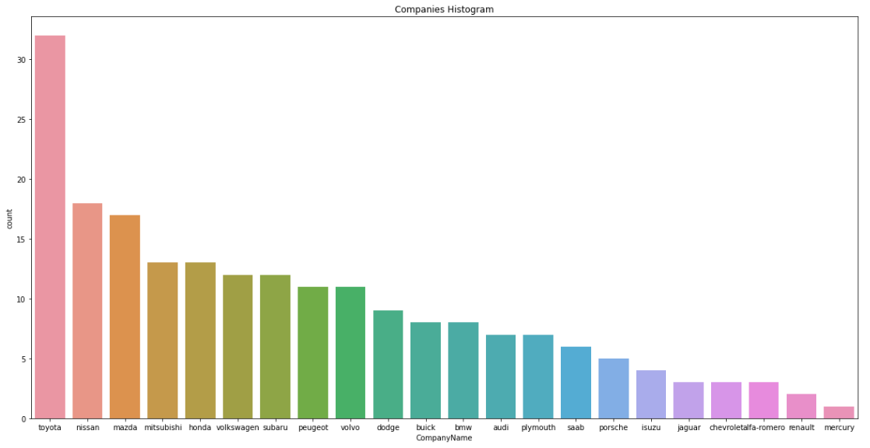
carcompany
Toyota seems to be favourite car

Slide 10
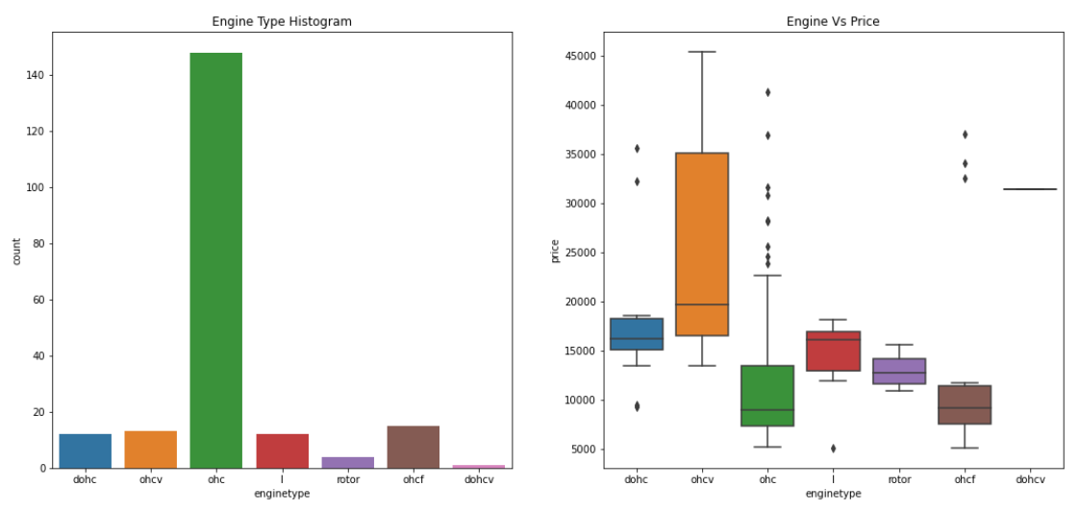
enginetype
Ohc engine is mostly used one and comparatively it has lower price range
Ohcv engine has the highest price range

Slide 11
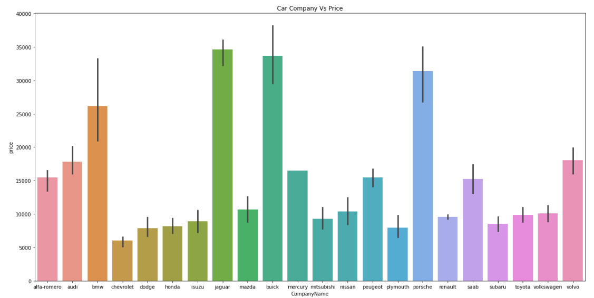
CAR COMPANY Vs PRICE
Jaguar and buick have higher price range

Slide 12
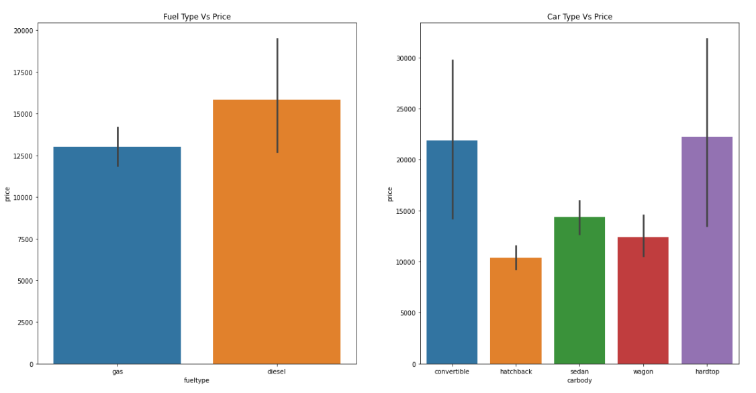
Fuel & car type Vs price
Diesel has highest price than gas
Hardtop and convertible car body have highest price range

Slide 13
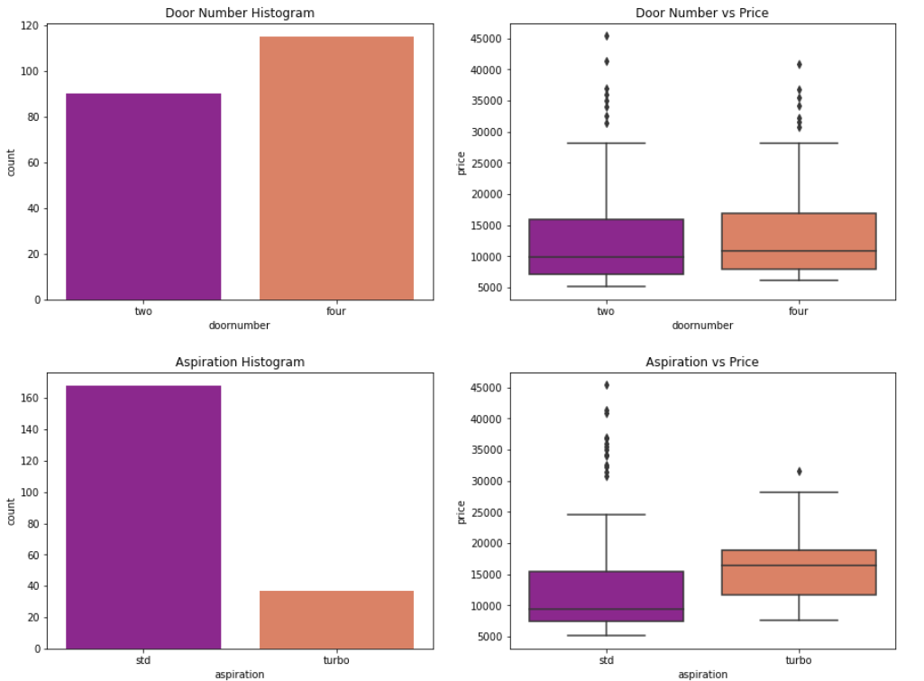
Other variables

Slide 14
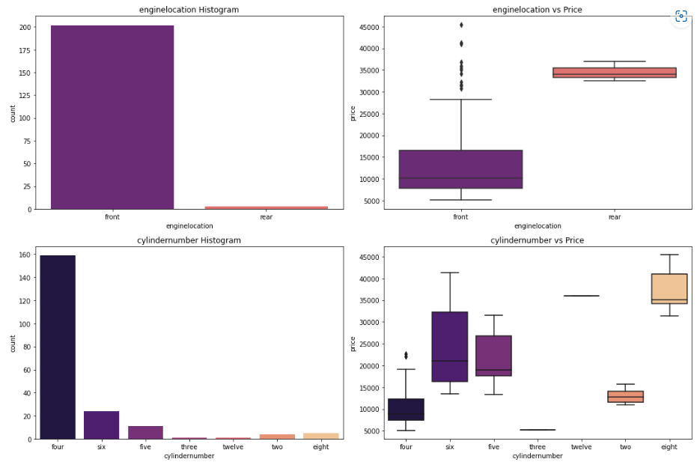

Slide 15
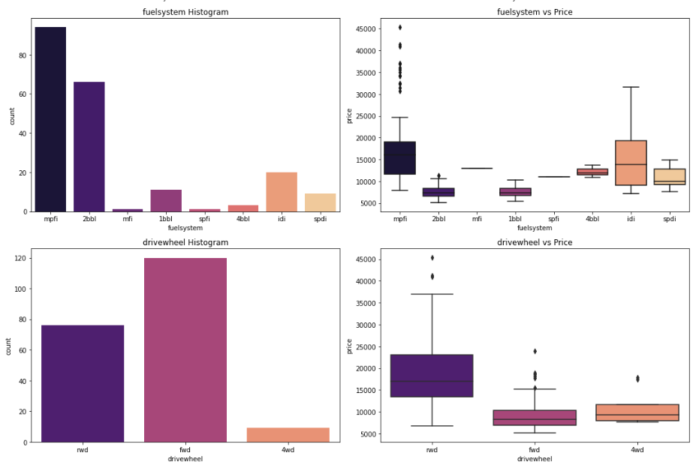

Slide 16
Inference:
Number of doors are not effecting the price
Aspiration with turbo has the highest price
Very few datapoints for enginelocation to make an inference
Most common number of cylinders are four, six and five
Eight cylinders have the highest price
Mpfi and 2bbl are most common type of fuel system
Mpfi and idi have the highest price range
There are few data in fuel system to derive any meaningful inference
Most high ranged cars seems to prefer rwd drivewheel

Slide 17
visualizing Numeric data
Car_ID
wheelbase
carlength
carwidth
carheight
carweight
enginesize
boreratio
stroke
compressionratio
horsepower
peakrpm
citympg
highwaympg (Independent variables)
price ( Dependent variable)

Slide 18
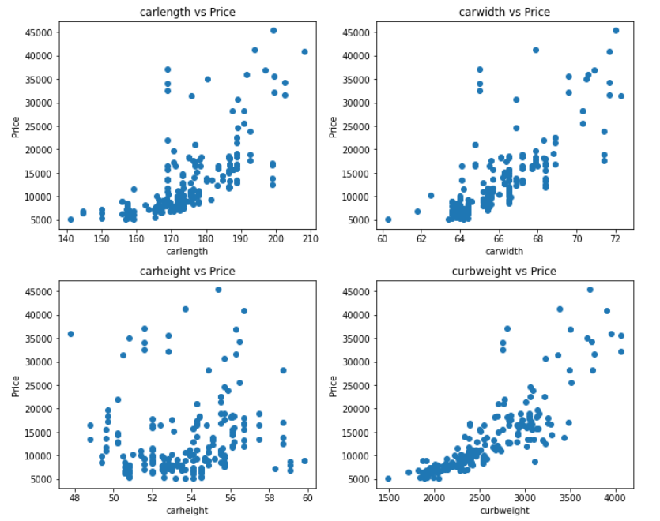

Slide 19
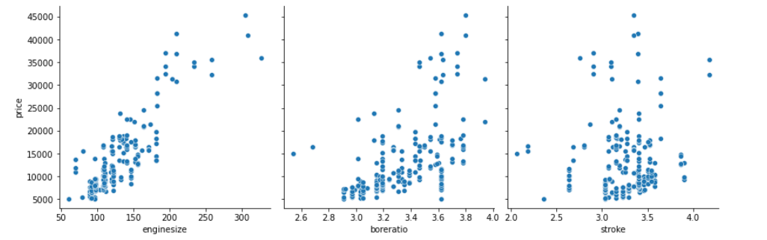
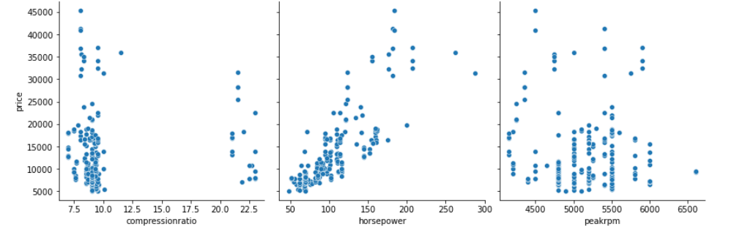
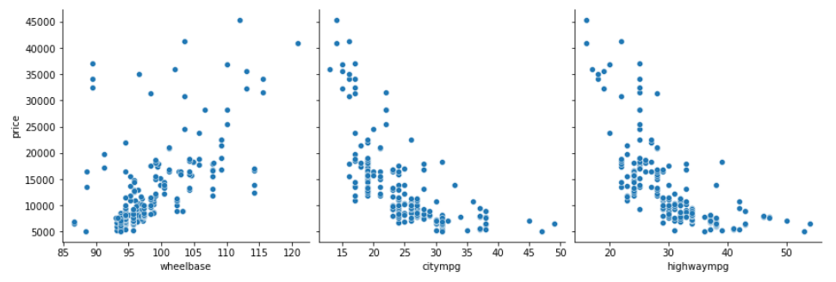

Slide 20
Positive correlation with price
Carlength
Carwidth
Carweight
Enginesize
Boreratio
Horsepower
wheelbase
Negative correlation with price
Citympg
highwaympg
No correlation
Carheight

Slide 21
Significant variables
Car Range
Engine Type
Fuel type
Car Body
Aspiration
Cylinder
Number
Drivewheel
Carweight
Car Length
Car width
Engine Size
Boreratio
Horse Power
Wheel base

