Slide 1
Covid-19 Analysis Dashboards

Slide 2
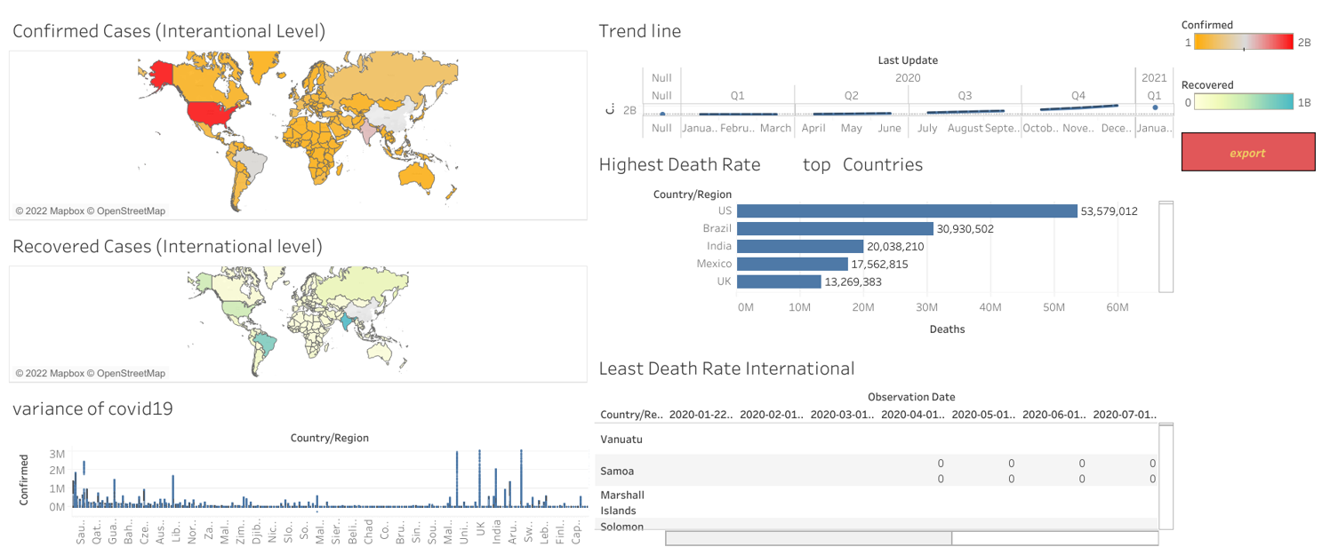
Covid-19 Analysis at International Level

Slide 3
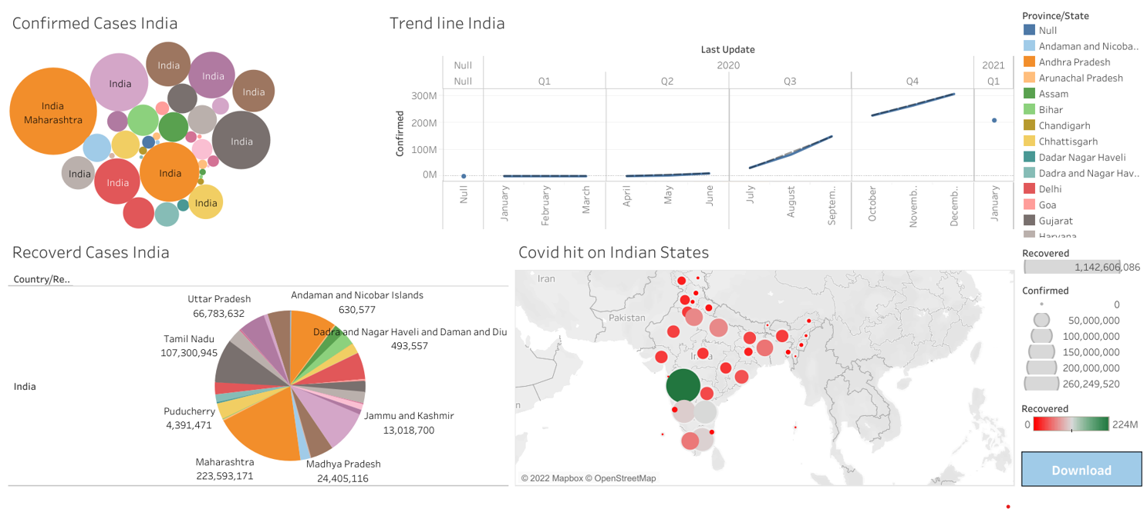
Covid-19 Analysis India

