Slide 1

School of Computer Science And Engineering Department of Artificial Intelligence and Machine Learning
Industrial Training (AI4170)
on
TITLE: Summer’24 SWE Intern @ PayPal
Presented By:
Student Name : Anuneet Rastogi
Enrollment: 219310251
Section:- 7D Aiml
Supervised By:
Supervisor Name : Ms. Simran Kaur
Designation: Assistant Professor (Aiml)

Slide 2

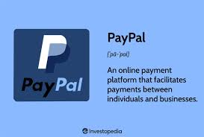
ABOUT PAYPAL
Global Online Payment System: PayPal is a widely used online payment system that allows users to make purchases, send money, and receive payments without sharing their financial information with third parties.
Security and Convenience: PayPal offers enhanced security features, such as encryption and fraud protection, making it a secure way to handle transactions. It also provides a convenient checkout process, often speeding up online purchases.
Digital Wallet: PayPal functions as a digital wallet, enabling users to store multiple payment methods, including credit cards, debit cards, and bank accounts, in one place. This makes managing finances and making payments easier.
Buy Now, Pay Later: PayPal offers a “buy now, pay later” option, allowing users to make purchases and pay for them over time. This feature provides flexibility for managing expenses.

Slide 3

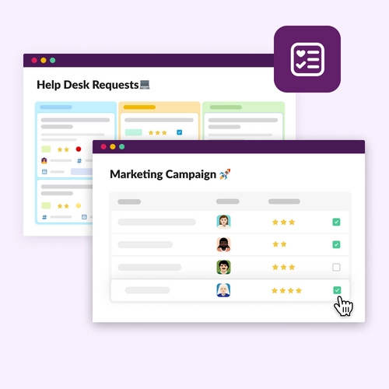
PROBLEM STATEMENT
Inefficiency in Problem Resolution: Developers and engineers often post their technical issues in dedicated Slack channels, leading to delays in problem resolution as team members must manually monitor and respond to each query.
Overload on Team Members: The responsibility of answering questions manually can overwhelm team members, especially during peak times or when multiple issues arise simultaneously, reducing overall productivity.
Delays in Getting Responses: Sometimes there are delays in getting responses to posted problems, which can hinder the progress of projects and cause frustration among team members.

Slide 4
PROPOSED SOLUTION
Flask-Based Service: Developed a service using Flask to handle the processing.
Slack API Integration: Utilized Slack APIs to extract data from various Slack channels.
Intent Detection: Implemented intent detection to understand the context and purpose of the extracted data.
Generative AI Processing: Processed the data using a generative AI model to produce output in JSON format.
Logic and API Calls: Passed the JSON output through a logic layer that determines the appropriate APIs to call based on the detected intent

Slide 5
CNSBOT AUTOMATION
“A GENERATIVE AI APPROACH
TO PROVIDE USER QUERY SOLUTION
BASED ON INTENT DETECTION”

Slide 6
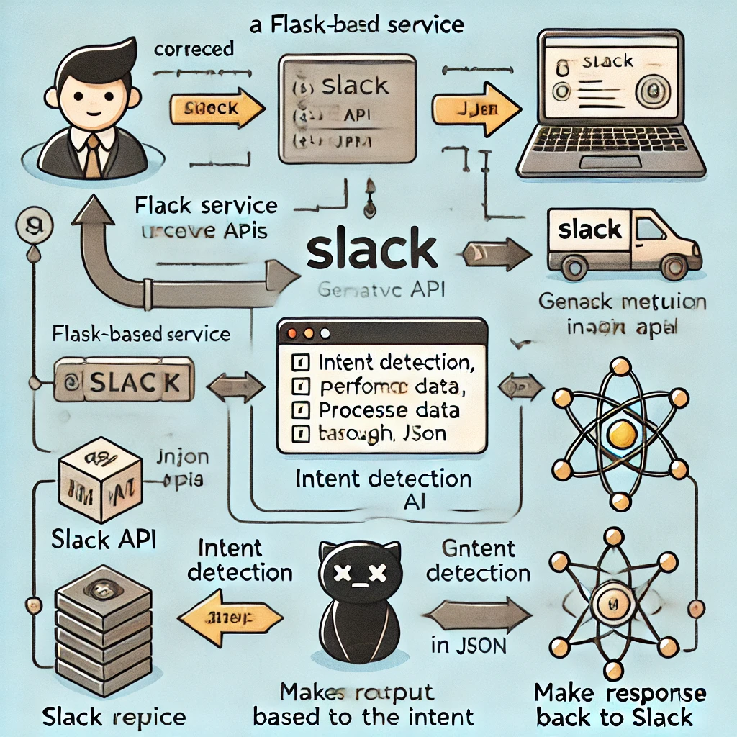
DESIGN/ DEVELOPMENT

Slide 7
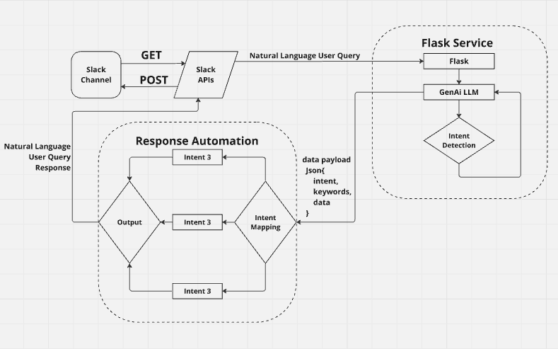
FLOWCHART

Slide 8
TIMELINE OF PROJECT
Week-> -----------------Tasks | 1 | 2 | 3 | 4 | 5 | 6 | 7 | 8 | 9 | 10 | 11 | 12
Research
Design
Development
Deployment

Slide 9
REFERENCES
Paypal Atlassian documentation (Confluence Pages)
Paypal Github
https://api.slack.com/
https://cloud.google.com/vertex-ai
https://console.cloud.google.com/
Youtube.com
https://flask.palletsprojects.com/
https://huggingface.co/
https://python.langchain.com/docs/introduction/
https://docs.llamaindex.ai/

Slide 10
Thank You

