Slide 1


SMART INDIA HACKATHON 2025
TITLE PAGE
Problem Statement ID – 25020
Problem Statement Title- Development of indigenous contactless Integrated Track Monitoring Systems (ITMS) for Track Recording on Indian Railways
Theme- Smart Automation
PS Category- Hardware
Team ID: 83795
Team Name: - LOCO RUNNERS

Slide 2
IDEA TITLE: Indigenous Smart Track Monitoring System for Indian Railways
LOCO RUNNERS
Proposed Solution: Indian Railways still depends on costly imported Track Recording Cars (TRCs) and manual inspections, which are expensive, rigid, and lack proper traceability of track components.
Our idea is a low-cost, indigenous, GPS-independent Integrated Track Monitoring System (ITMS) that ensures:
Continuous and contactless monitoring of track health.
Unique identification and lifecycle traceability of each sleeper and fitting.
Automated fault detection with proactive accident prevention.
Scalability, modular design, and weather-resilient operation at a fraction of TRC cost.
Hardware
Prototype TRC built using ESP32-CAM and MPU6050 sensors to capture vibration and ride-quality data.
Each sleeper/fitting identified using RFID/UHF tags or a frequency/resonance-based prototype (modified version) for precise mapping and traceability.
Object detection module to sense obstacles (e.g., rocks in landslide zones) so that a pilot train can reverse automatically and prevent derailments.
Indian TRC can made withy low cost no needs to add unnecessary sensors.
Software
Automatically data sent to central database for real-time analysis.
Detects sleeper-level faults with exact location & fitting details, no need for GPS.
Abnormal vibration → frequency shift, resonance mapping gives sleeper info.
This solves RFID issues (rain, weather) → ensures durable traceability.
Automated, accurate, and supports early maintenance & accident prevention.

Slide 3
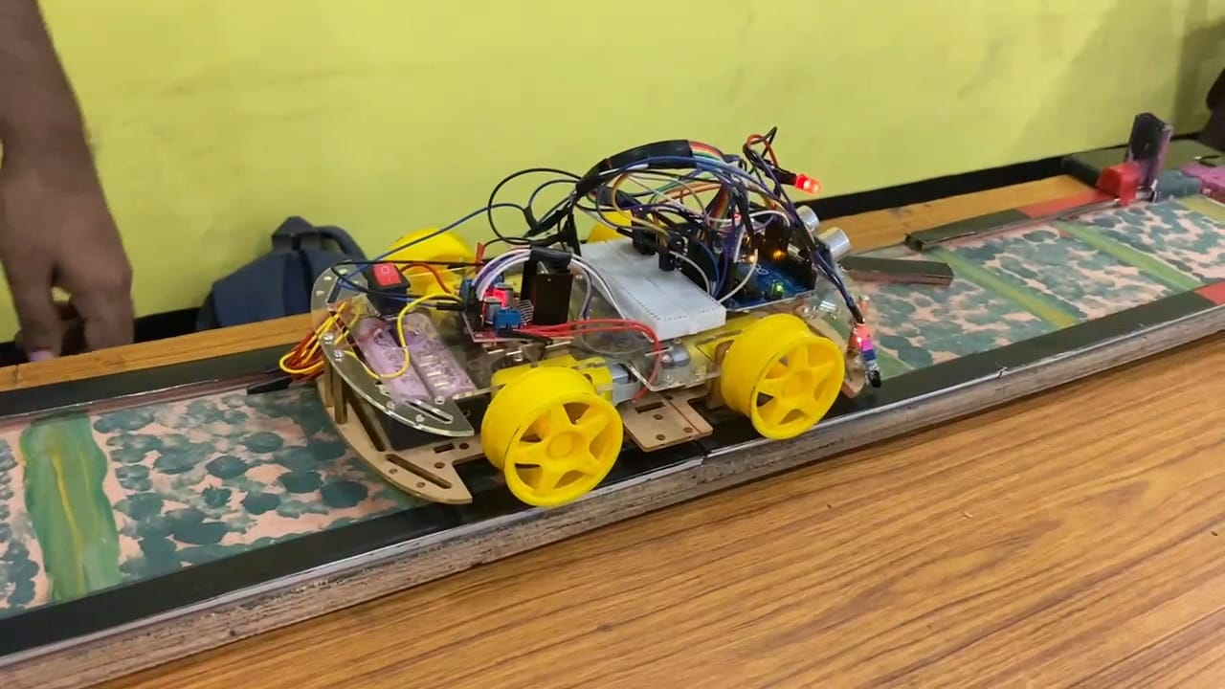
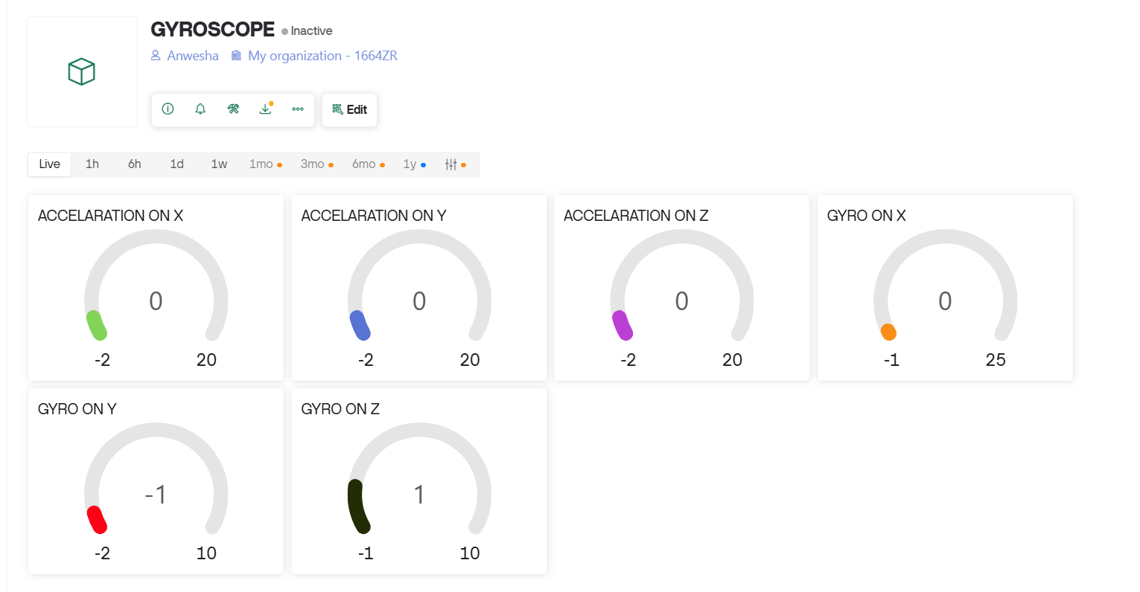
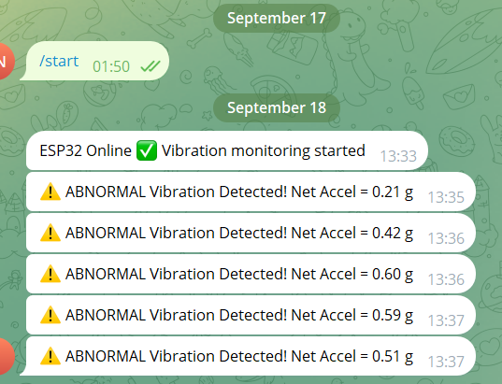
TECHNICAL APPROACH
LOCO RUNNERS
Hardware Layer:
Sensors & Measurement: ESP32-CAM + MPU6050 for vibration and ride quality
Track ID: Laser/RFID/UHF tags on sleepers and data monitoring
Obstacle Detection: Optical module for debris and obstacles
Data Acquisition: High-speed sampling every 25 cm, 0–200 km/h
Video Recording: Rear-window synchronized visual validation
Software Layer:
Onboard Processing: Noise filtering and track condition extraction
Standards: EN 13848 Parts 1 & 2, RDSO TM/IM/448:2023
Database: Chainage-mapped outputs for visualization and fault traceability
Automation: Real-time, contactless monitoring with exportable, secure reports
This layered approach ensures accurate, reliable, and fully indigenous monitoring, reducing reliance on foreign TRC systems while improving preventive maintenance.

Slide 4

FEASIBILITY AND VIABILITY
LOCO RUNNERS
Feasibility: Low-cost hardware + open-source software;
scalable, standards-compliant design.
Challenges: Harsh environment, large data, durability,
integration,adoption resistance.
Strategies:
✔ Sensor fusion for reliability
✔ Edge computing to reduce data load
✔ Ruggedized hardware for durability
✔ Modular software design
✔ Phased rollout & training
WE WILL MAKE IT RFID CUM RESONANCE BASED PROTOTYPE TO FACE ENVIROMENTAL CHALLANGES

Slide 5
IMPACT AND BENEFITS
LOCO RUNNERS
MARKET SIZE
COST COMPARISON
Indian Railways: 68,000+ km track with 1.3M+ sleepers/km; high reliance on costly imported TRCs creates demand for low-cost domestic solutions.
Global Railways: 1.3M+ route-km worldwide, growing need for automated monitoring.
Opportunity: Large domestic and international market for affordable, scalable, modular track monitoring systems.
Imported TRCs: ₹15–20 Cr/unit, high maintenance, non-customizable
Manual Inspection: Low initial cost, error-prone, high labor cost
Proposed ITMS: Prototype <₹10,000; full train deployment ₹2–3 L, modular, easy to maintain
Impact: >95% cost savings, faster deployment, full traceability
Benefits :
Affordable, real-time rail safety
Cuts inspection costs by over 90%
Automated fault & obstacle detection, prevents derailments, enhances passenger safety
Ensures traceability of track components and track geometry measurement
Extends track and asset life
Promotes self-reliant Indian Railways
No tension for wheater chalanges

Slide 6
RESEARCH AND REFERENCES
LOCO RUNNERS
Recording Cars (TRCs) in Indian Railways – IRICE
Vibration & ride-quality monitoring with MPU6050 – Hackster.io
RFID/UHF tagging for track components – Intellistride
Optical/obstacle detection in railways – ScienceDirect
Indian Railways safety standards & preventive maintenance

