Slide 1
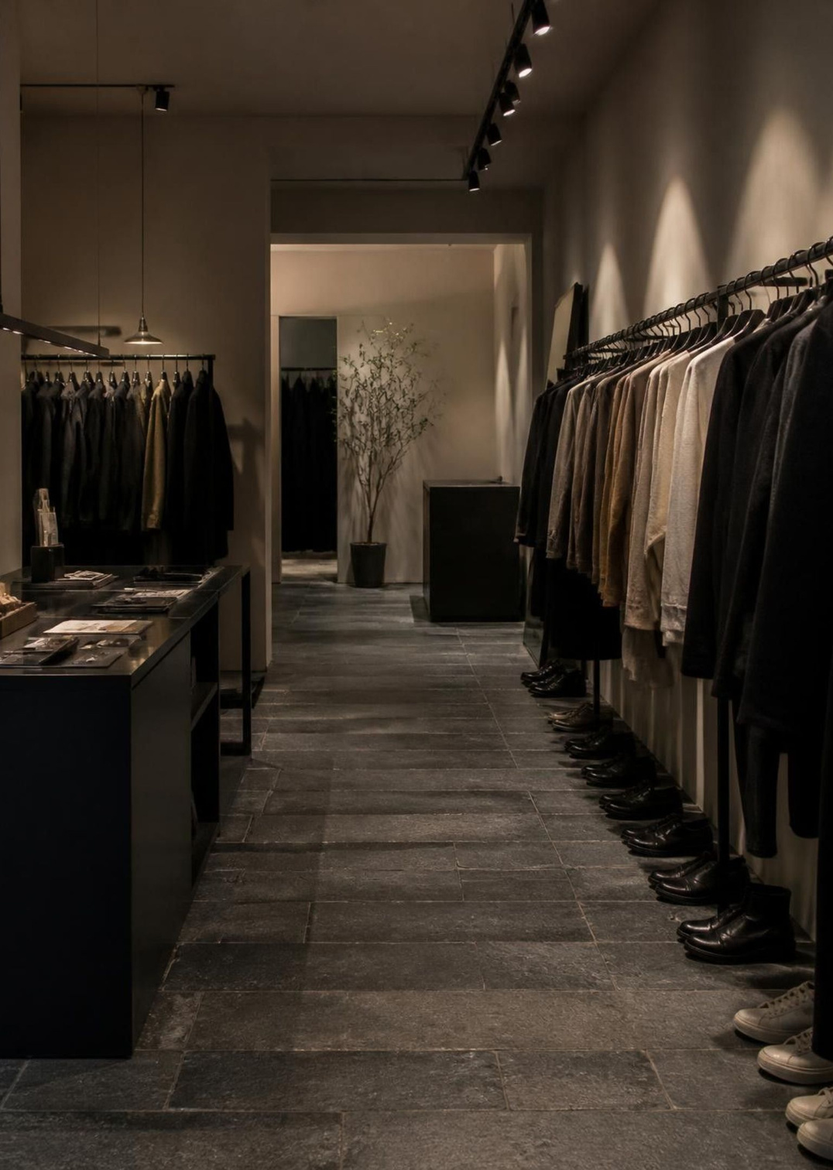
Customer shopping data can turn retail uncertainty into action.
Transaction Evidence & Decision Framework
3,900 purchases analyzed across product, promo, and retention signals
Notes:
Open by framing the core premise: retail data is only valuable when it resolves commercial uncertainty into specific operational decisions.
1

Slide 2

  DATASET BASELINE
3,900 purchases reveal a broad but measurable customer base
3,900 purchases
Across 18 columns and four product categories.
Core question
Which factors drive engagement, conversion, and repeat purchasing?
Signals available
Demographics, product, discount, review, shipping, payment, subscription, and purchase history.
Notes:
Establish the foundation: this 3,900-purchase dataset captures every major touchpoint from category interest to payment and shipping preference.
2

Slide 3
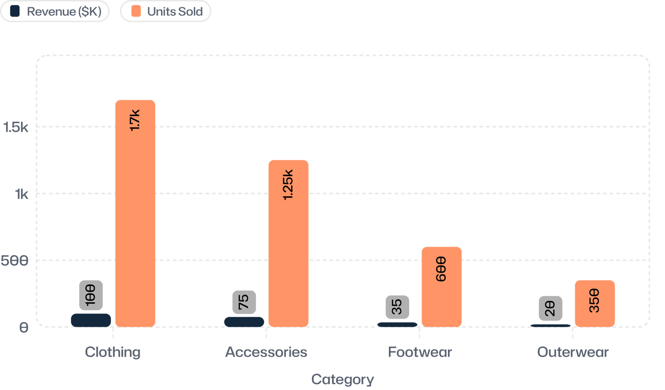
  PORTFOLIO MIX
Clothing leads the portfolio, with accessories close behind
76%
of total revenue is concentrated in Clothing ($100K) and Accessories ($75K).
Strategic implication: protect the core clothing volume while deploying accessories as immediate basket-extenders at checkout.
Notes:
Point to the primary volume drivers: Clothing and Accessories account for 2,950 of the 3,900 unit sales. Accessories serve as the prime cross-sell partner.
3

Slide 4
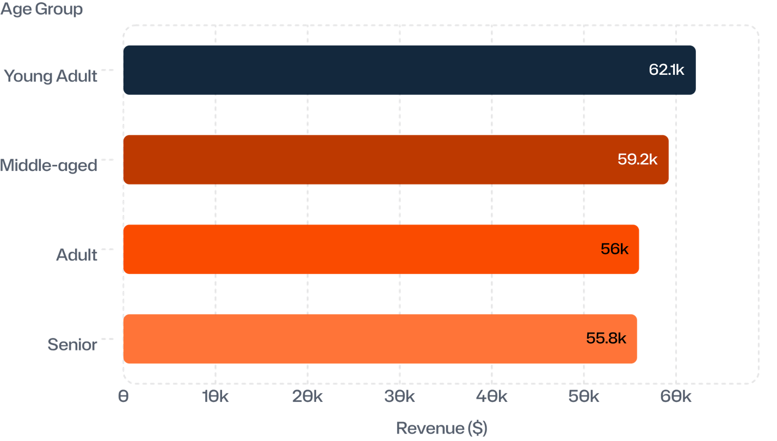
  DEMOGRAPHIC BREAKDOWN
Young adults are the strongest revenue segment
Broad engagement
Revenue is distributed across all four age groups, spanning $55.7K to $62.1K.
Young Adult lead
Shoppers under 30 form the leading single cohort at $62,143 total spend.
Action required
Tailor creative and bundle messaging by life stage instead of relying on a generic broad-market pitch.
Notes:
Emphasize that while Young Adults lead, every cohort contributes at least $55K. The mandate is segmentation and relevant creative, not abandoning older shoppers.
4

Slide 5
  PROMOTIONAL PRICING
Discounts can drive volume without eliminating higher-value orders
Top Discount-Dependent Products
Product | Discounted
Hat | 50.00%
Sneakers | 49.66%
Coat | 49.07%
Sweater | 48.17%
Pants | 47.37%
839
customers still spent above the average purchase amount.
Move from blanket discounting to product- and segment-specific offers.
Notes:
Nearly half of sales in top categories carry promotions, yet 839 customers maintain above-average spend. Replace margin-draining sitewide sales with item-level triggers.
5

Slide 6
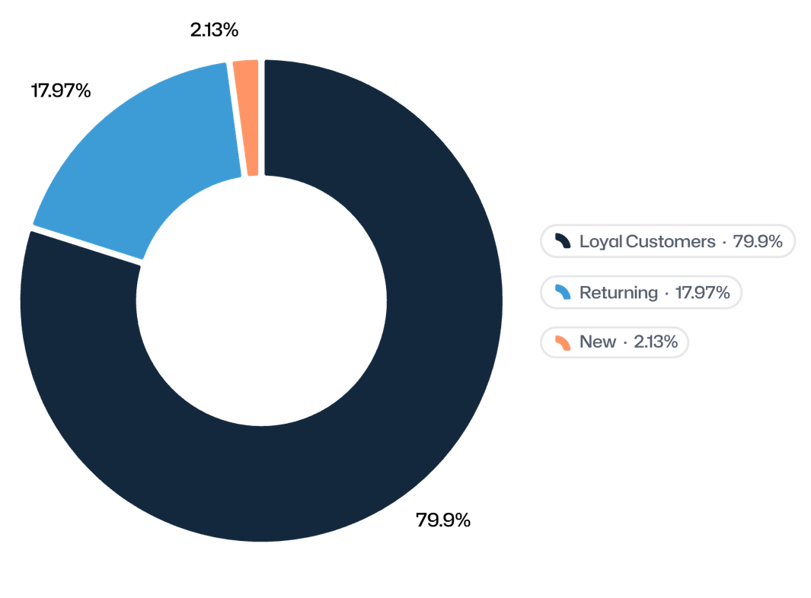
  RETENTION & MEMBERSHIP
Loyalty is large, but subscriptions are not yet converting it
CUSTOMER BASE
3,116 Loyal buyers
Over 79% of all accounts show proven repeat purchasing behavior.
PROGRAM PENETRATION
27% Subscribed vs 73% Non
Subscription revenue sits at $62,645 against $170,436 from non-subscribers.
COMMERCIAL GAP
Convert habitual repeat activity into structured recurring membership value.
Notes:
The business enjoys strong organic loyalty with 3,116 repeat shoppers, but leaves recurring value on the table: only 27% are subscribed, leaving $170K non-member revenue untapped.
6

Slide 7
  MERCHANDISE STRATEGY
Product proof points can anchor campaigns
Top-Rated Products
Top Category Sellers
Deploy high satisfaction scores in acquisition ads to lower trust barriers.
Feature proven volume leaders across landing pages and hero displays.
Item | Avg Rating
Gloves | 3.86 / 5.0
Sandals | 3.84 / 5.0
Boots | 3.82 / 5.0
Hat | 3.80 / 5.0
Skirt | 3.78 / 5.0
Category | Best Seller
Accessories | Jewelry
Clothing | Blouse
Footwear | Sandals
Outerwear | Jacket
Campaign positioning: attract with rating proof; convert with proven category volume.
Notes:
Pair high customer satisfaction with high-velocity SKU distribution: Gloves and Sandals lead in reviews; Jewelry, Blouse, Sandals, and Jacket drive category conversion.
7

Slide 8
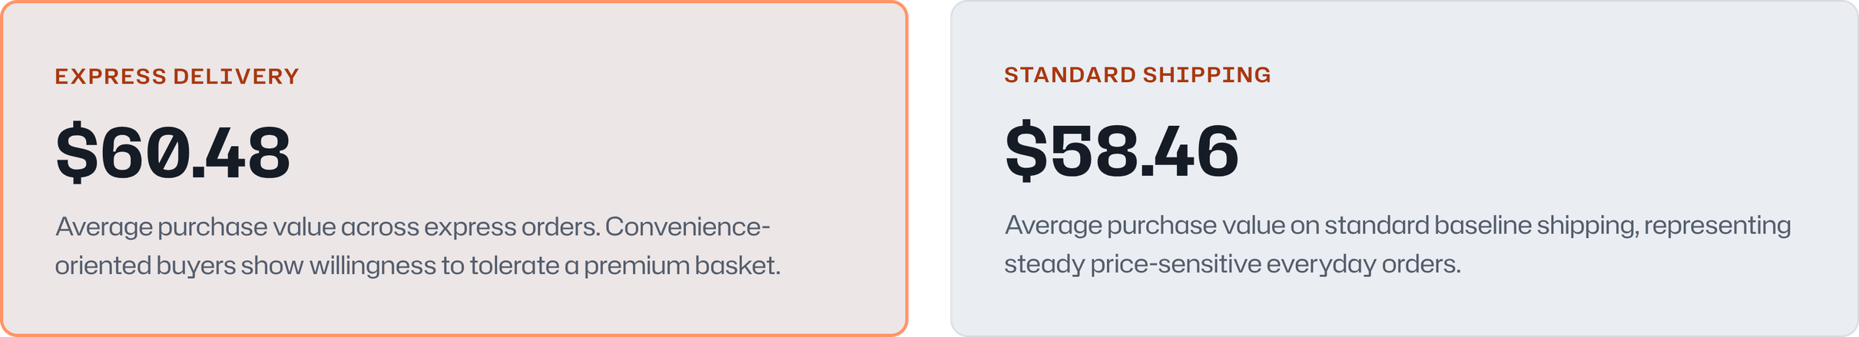
  FULFILLMENT ECONOMICS
Shipping preference creates a small but useful value signal
Behavioral interpretation
Operational test
Shoppers prioritizing speed order slightly higher baskets ($2.02 higher on average).
Test express-shipping threshold bundles and priority checkout without assuming direct causation.
Notes:
A $2.02 delta separates express from standard orders ($60.48 vs $58.46). Treat this as a correlation signal to test tier thresholds, not guaranteed causation.
8

Slide 9
  ACTION BLUEPRINT
Build the decision system around three connected moves
01
02
03
01
02
03
Acquire
Convert
Retain
Target age groups and product interests using category-specific creative rather than generic broadcast marketing.
Deploy top-rated proof items, selective item discounts, and expedited delivery options to reduce friction.
Reward the 3,116 repeat buyers and convert high loyalty into concrete, recurring subscription benefits.
Notes:
The three stages form a closed operational loop: targeted acquisition leads to friction-free conversion, which feeds recurring subscriber loyalty.
9

Slide 10

  OPERATIONAL CADENCE
Make the dashboard a recurring operating rhythm
Track weekly
Category revenue, discount rate, review rating, repeat purchase, and subscription conversion.
Use the stack
Python for cleaning and feature engineering, SQL for transaction analysis, Power BI for stakeholder visibility.
Next test
Compare targeted discount and subscription offers by segment and product.
Notes:
Conclude with execution: weekly KPI tracking across Python, SQL, and Power BI ensures that insights directly drive commercial experiments.
10

Slide 11


