Slide 1

TechUnited Turtle
Feasibility Analysis:
Functionalities of the football robots
24/02/22

Slide 2
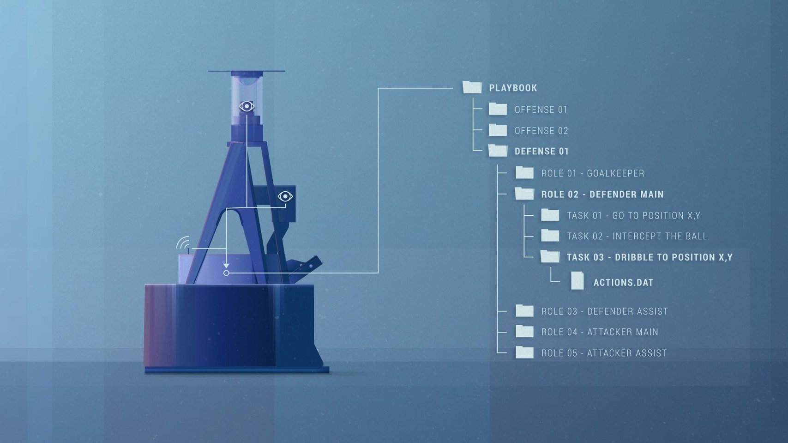
Mirror lens
OmniVision
camera
Kinect camera
IMU???
rear
front
Wheels encoders
Source: https://www.tue.nl/nieuws/features/voetbalrobots/

Slide 3
Turtle3 Software
Motion
Vision
Worldmodel
These processes communicate with each other through a real-time database (RTDB)

Slide 4

Vision
environment perception
using omni-vision images and provides the location of the ball, obstacles and the robot itself.
Image Processing
Tracking
Filtering
Estimation
Pose of obstacles for strategy
Pose of obstacles for worldmodel
Ball detection

Slide 5
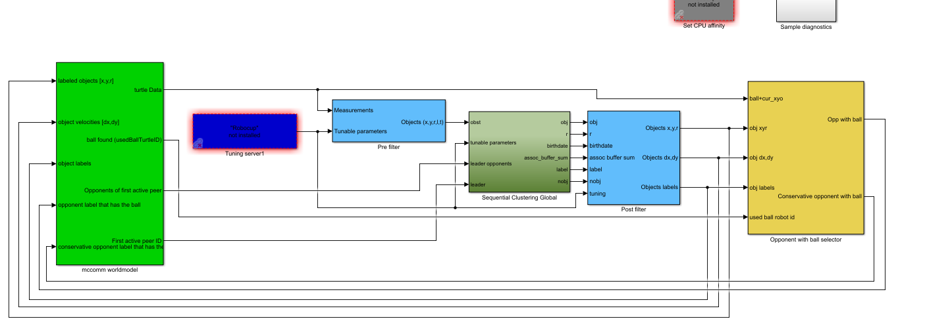
Worldmodel
Combines:
the ball
Obstacles
robot position information
provided by vision with data acquired from other team members => unified representation of the world

Slide 6
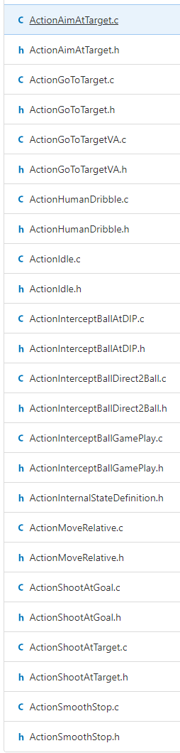
Strategy
Is the highest level.
Defines Actions executed by Roles deployed on the turtle.
ActionShootatGoal:
Checks for obstacles at goal area: measures distance of robot to obstacle and angle of obstacle with respect to robot.
RoleAssigner:
Looks for the robots to which the role fits the best (by looking at min distance to travel from the robot to a desired position)

Slide 7
Simulation
To be checked

Slide 8
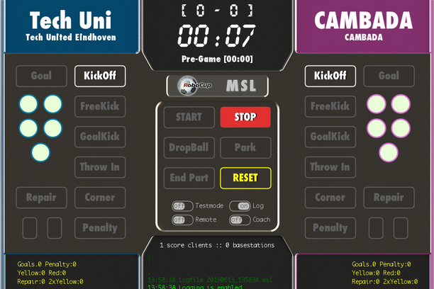
Human Referee and RefBox
“The only person intervening during a game of robot soccer is the referee. He has access to a program called 'RefBox'. This translates the referee's commands to the robots. At the beginning of the game, the referee signal the kick-off by clicking on the START button. Once a team has scored, he clicks on the GOAL button. The referee's button also gives the signal when a free kick can be taken, or when a robot can throw in the ball. In addition, the referee gives red and yellow cards by pressing a button. At the end of the game, the referee blows the whistle (although the robots do not hear that sound) and presses the button, causing the robots to stop playing.”

Slide 9
Useful links:
https://www.tue.nl/en/news-and-events/features/soccer-robots/
http://roboticopenplatform.org/wiki/TURTLE
https://gitlab.tue.nl/tech-united-eindhoven/Turtle3/-/tree/master/
https://www.techunited.nl/uploads/Voetbalrobots/Kwalificatie/[Tech%20United]%20TDP2018.pdf
https://msl.robocup.org/

