Slide 1
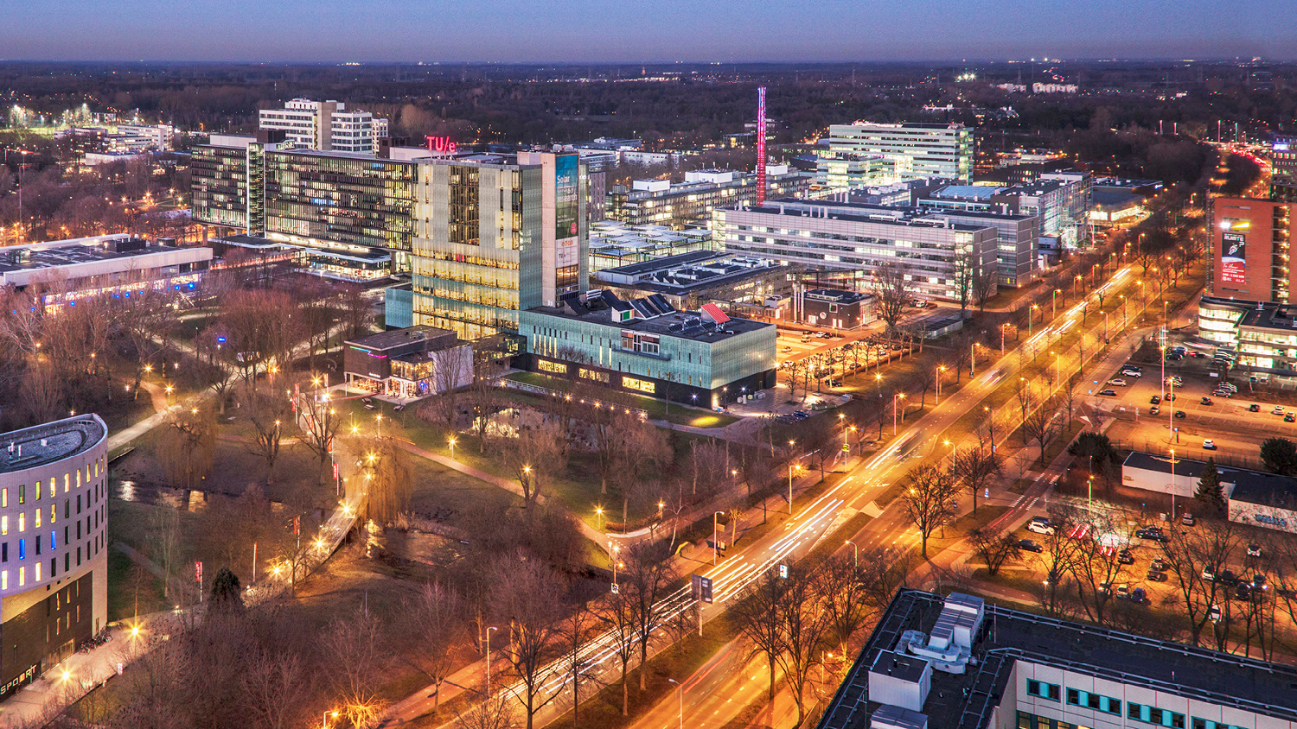
Stakeholder Analysis, Concerns and Functional Decomposition
Tuesday, 22 February 2022
Anup, Software Architect, PDEng Trainee MSD 2022
Department, Sub department or Capacity Group

Slide 2
Stakeholder and Proiritization
Erjen
Design Team(us)
2
Title of the presentation - by tab Insert -> Header text and Footer text

Slide 3
Erjen’s Prioritized Concerns
5 mins match 2 vs 2
Positive feedback from human referee
Log and show evidence for violation for rule violations
Build on previous work
Structured Software delivery
Documentation
Individual learning goals

Slide 4
Rene’s Prioritized concerns
5 mins match 2 vs 2
Positive feedback from human referee
Log and show evidence for violation for rule violations

Slide 5
Human Referee’s Prioritized concerns
Loose his/ her job.
To be assisted in rules that are difficult to interpret
Log and show evidence for violation for rule violations
Communication with AutoRef.

Slide 6
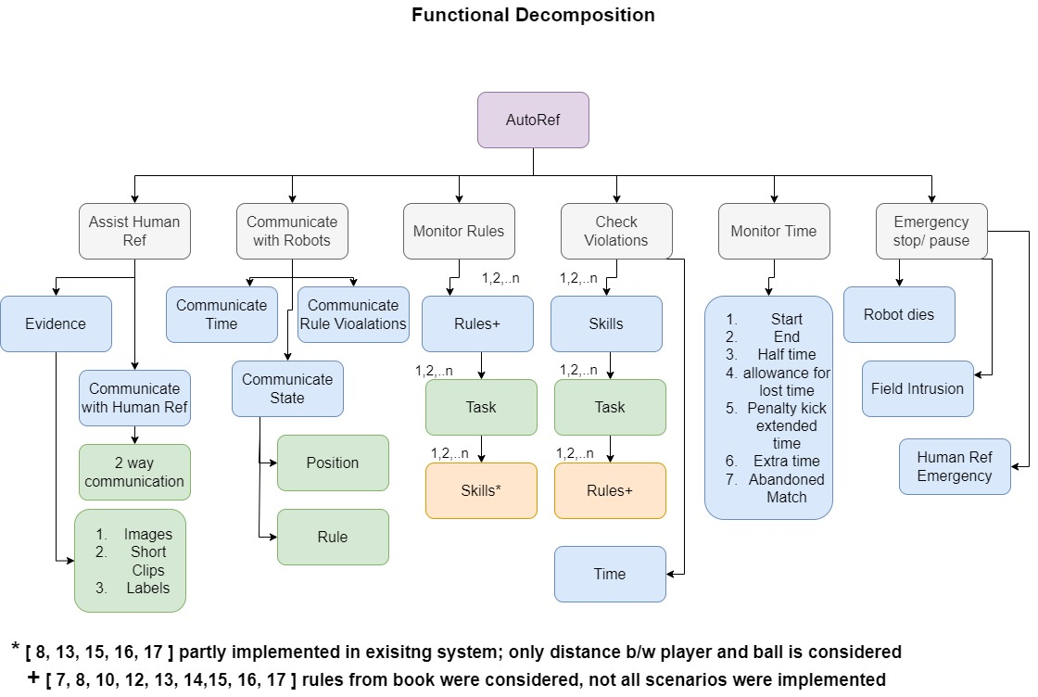

Slide 7
Questions?

