Slide 1
Git

Slide 2
What is version control
Version control is a system that records changes to a file or set of files over time so that you can recall specific versions later
Any type of file on a computer can be placed under version control.
A VCS allows you to: revert files back to a previous state, revert the entire project back to a previous state, review changes made over time, see who last modified something that might be causing a problem, who introduced an issue and when

Slide 3
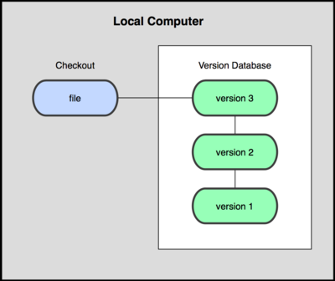
Local version control

Slide 4
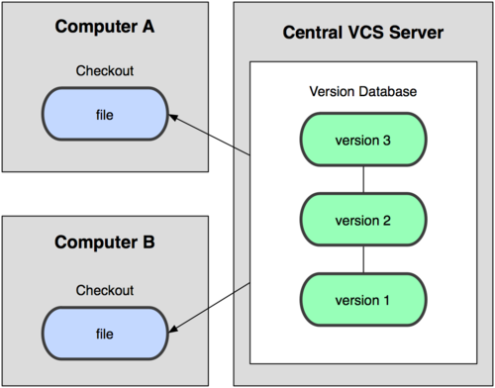
Centralized version control

Slide 5
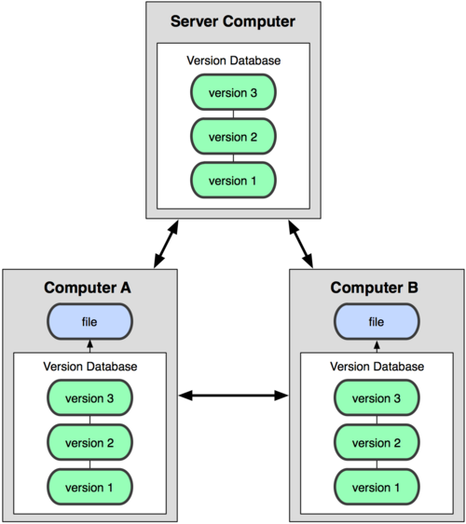
Distributed version control system
Git is a Distributed version control system

Slide 6
Goals of git
Speed
Simple design
Strong support for non-linear development (thousands of parallel branches)
Fully distributed
Able to handle large projects like the Linux kernel efficiently (speed and data size)

Slide 7
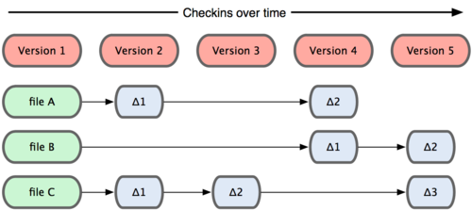
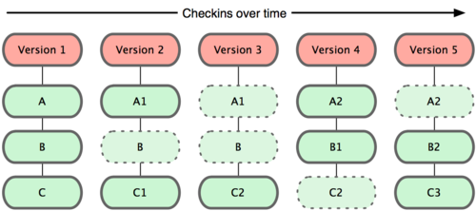
Data View git vs other
Others
git

Slide 8
Git
Almost every operation is local.
Git has integrity – Everything is check summed.
Three states
1) Committed
2) Modified
3) Staged

Slide 9

3 sections of git
3 states lead us to 3
sections of git
viz., git directory, working
directory and
staging area.

Slide 10
3 Sections of git
Working directory - The working directory is a single checkout of one version of the project. These files are pulled out of the compressed database in the Git directory and placed on disk for you to use or modify.
Staging area - The staging area is a simple file, generally contained in your Git directory, that stores information about what will go into your next commit
Git directory - The Git directory is where Git stores the metadata and object database for your project. This is the most important part of Git, and it is what is copied when you clone a repository from another computer.

Slide 11
Work flow
The basic Git work flow goes something like this:
1) You modify files in your working directory.
2) You stage the files, adding snapshots of them to your staging area.
3) You do a commit, which takes the files as they are in the staging area and stores that snapshot permanently to your Git directory.

Slide 12
Using the git
Creating the .git directory with git init
Checking the status
Tracking the files
Ignoring files
Committing the changes
Skipping the staging area
Removing the files
Renaming and moving

Slide 13
Using the git
Git log
Undoing the commit with amend
Un-modifying the modified file

Slide 14
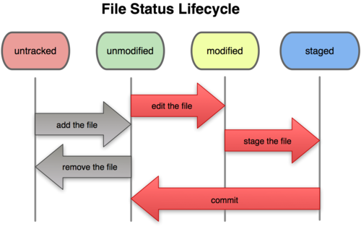
File status life cycle

Slide 15
Working with remotes
Showing your remotes
Fetching data from Internet just brings it to your computer, it does not merge it with the work you have done regarding the same project.`

Slide 16
Git Branches

