Slide 1
SLAAC
Stateless address auto configuration

Slide 2
SLAAC (Cont..)
Security Considerations
Stateless address auto configuration allows a host to connect to a network, configure an address, and start communicating with other nodes without ever registering or authenticating itself with the local site.
.

Slide 3
SLAAC (Cont..)
allows auto generation of address without the control of network administrator.
It contradicts the need to identify criminal
breaks unique identification of user connecting to services.
Prevents tracking of user based on ipv6 address
breaks cyber laws of many countries(user device relation)

Slide 4
DAD
Duplicate address detection & SLAAC

Slide 5
Steps
1)Wait for advertisement
2)Generate local-link address
3)Advertise
4)if no problem continue
else wait for manual configuration

Slide 6
Security consideration
The use of stateless address auto configuration and Duplicate Address Detection opens up the possibility of several denial-of-service attacks. For example, any node can respond to Neighbor Solicitations for a tentative address, causing the other node to reject the address as a duplicate

Slide 7
Problem
1) intentionally reply to solicitation message
2) inactive host (rebooting)
3) failing needs manual configuration

Slide 8
First Hop Security
Problem during configuration itself

Slide 9
Secure Network Discovery (SEND)
Advantages:
Solves auto configuration
Solves problems in network discovery protocol
Infrastructure independent
Currently available for linux (under testing)

Slide 10
SEND(Cont..)
Disadvantages:
Reqd. public key infrastructure (acc. To X.509)
Certification for each client.(installation & re-issue on expiration)
Not supported by Mac & Windows

Slide 11
SEND(Cont..)
Disadvantages:
Reqd. public key infrastructure (acc. To X.509)
Certification for each client.(installation & re-issue on expiration)
Not supported by Mac & Windows
Patented by CISCO.

Slide 12
DHCPv6
Problem during configuration itself

Slide 13
Effect of ipv6 on software development

Slide 14
Ipv6 effect
Effects on –
1)server
2) application
3) mobile services
4) security services and devices( like firewall and antivirus)
5) intranet
6) public website

Slide 15
Approaches
1) separate logic for ipv4 and ipv6
-leaves ipv6 code untouched
-but more complex due to race conditions
2) Combined logic for ipv4 & ipv6
-recode

Slide 16
Ipv6 effect
For govt. related work ipv6 is compulsory

Slide 17
Tool to guide changes to be made in ipv4 code reqd. for ipv6
Eg- Ipv6 finder for c/c++
It identifies the section of code which needs modification.

Slide 18
Firewall

Slide 19
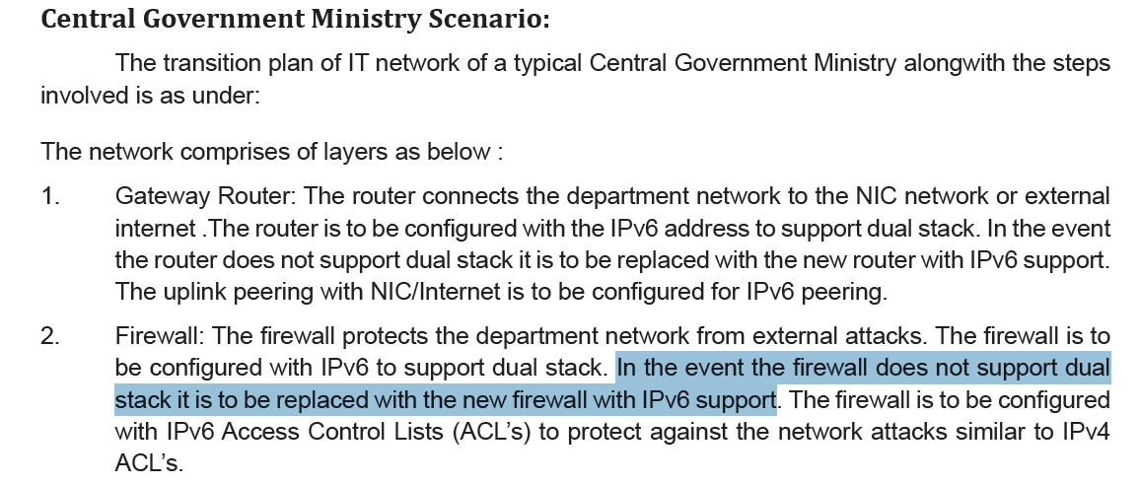
Firewall

Slide 20
Happy Eyeballing

