Slide 1
Microservices
Overview
Maven Project structure
Customer Microservice
Postgres Database Setup
Fraud Detection Microservice
Intercommunication between microservices
Eureka Service
Load Balancer
Feign Clients
Notification Microservice
Sleuth – distributed Tracing
Zipkin Dashboard
API Gateway
Async Communication
Kafka Implementation
Maven build
JIB plugin for creating docker images
Docker registry
Run all images in containers
Deploy on Kubernetes

Slide 2
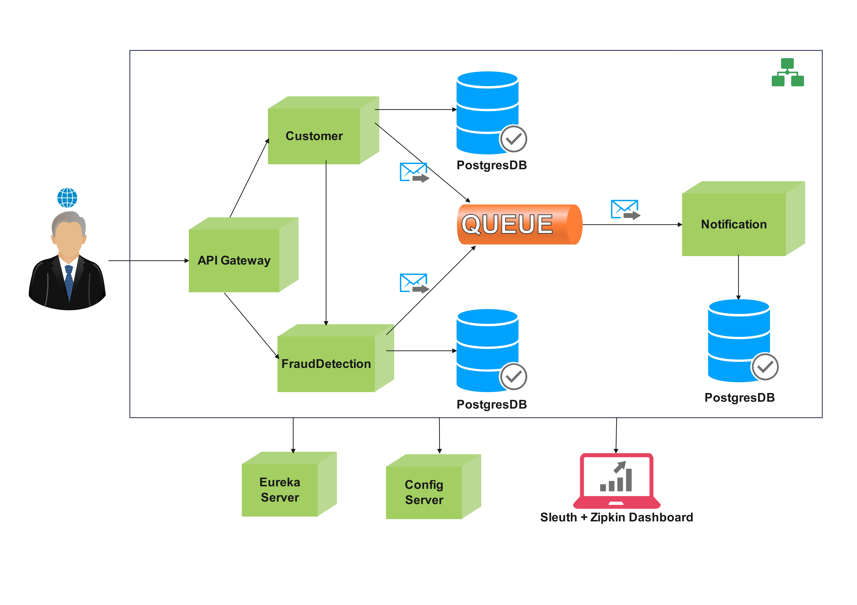
Architecture

