Slide 1
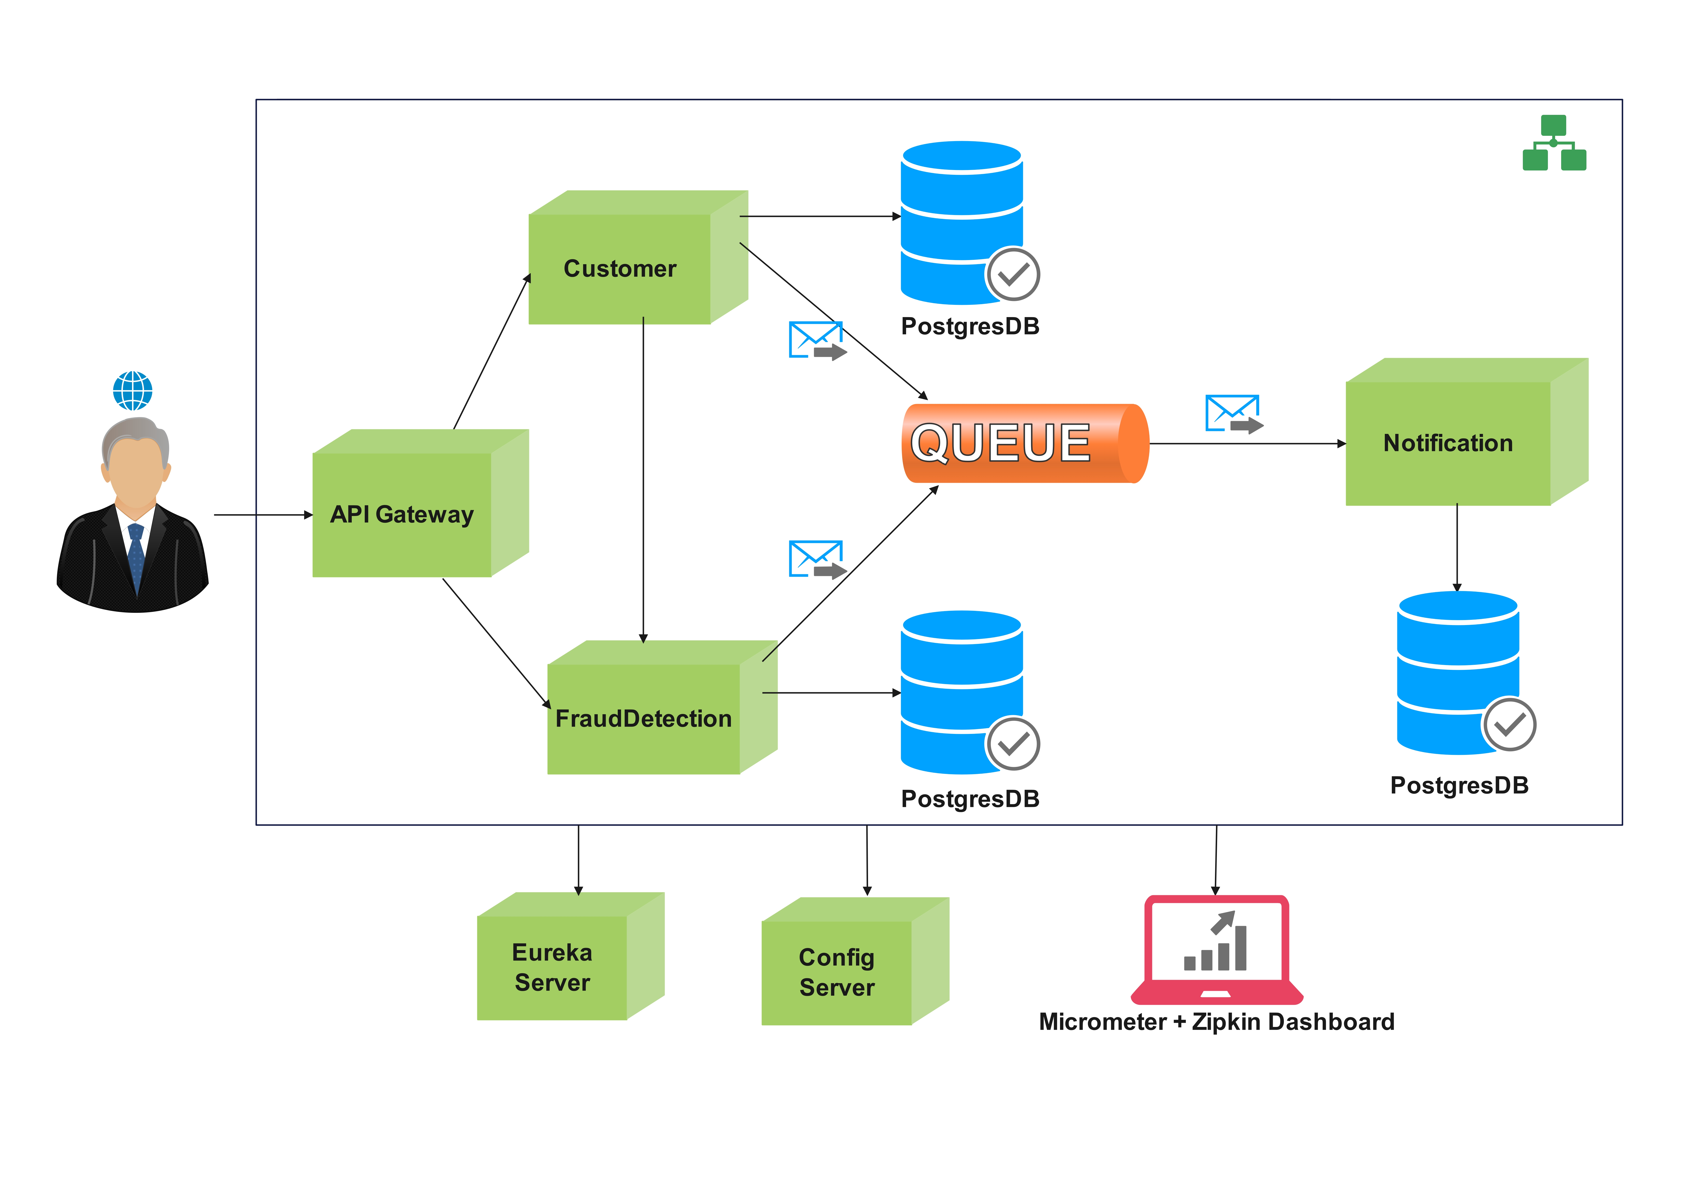
Architecture

Slide 2
Microservices
Overview
Architecture
Maven Project structure
Postgres Database Setup
Customer Microservice
Fraud Detection Microservice
Intercommunication between microservices
Eureka Service
Load Balancer
Feign Clients
Notification Microservice
Micrometer – distributed Tracing & Logging
Zipkin Dashboard – Monitoring latency , performance
API Gateway – Rate Limiter, Load balancing, Routing
Async Communication
Kafka Implementation
Maven build
Maven JIB plugin for creating docker images
Docker registry
Run all images in containers
Deploy on Kubernetes
Frameworks used:
Spring boot 3
Spring cloud
Spring data JPA
Tools used:
IntelliJ – Editor
Postgres – Database
pgAdmin – DB Editor
Maven - build tool
Docker - Containerization
Zipkin - Monitoring
Kafka – Async communication
Kubernetes - Orchestration

Slide 3
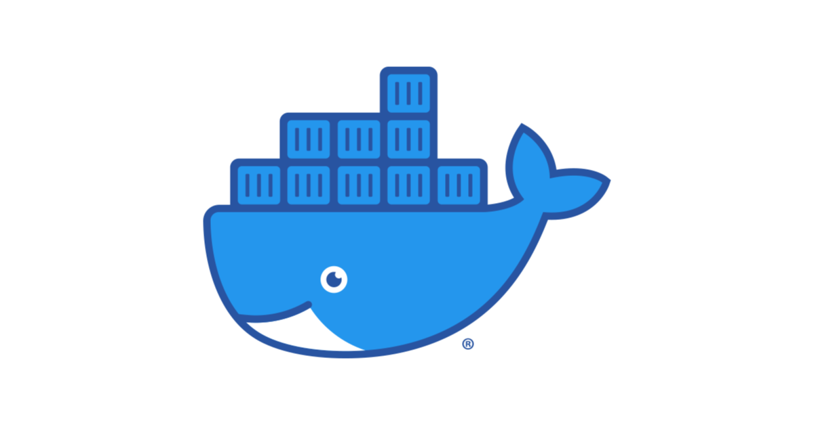
What is docker?
Platform for building , running & shipping applications
Developers can easily build and deploy their application which runs in a container
Local development is same across all environments
CI/CD workflows

