Slide 1
Implementation of DevOps in the Open-Source Projects
Anup Jacob

Slide 2
Background
Open-Source: Distributed under a license that provides users the right to use, study, alter, and distribute - the program and its source code to anyone and for any purpose.
Increase in competition and demand for implementing frequent changes in SDLC life cycle.
The DevOps process ensures the product developed complies to professional standards and helps in anticipating any problems.
Best practices implementation via Continuous Integration, Continuous Delivery, Continuous Testing, Continuous Monitoring, and Improvements.

Slide 3
Problem
Problem statement:
Challenges faced by the open-source projects in public repositories due to lack of implementation of DevOps, coding standards and best practices.
Research question:
Do Open-Source projects follow DevOps methodologies and best practices?
Aims:
To identify current practices used in the different open-source software development process.
Establish how best practices can be easily implemented in open-source projects.

Slide 4
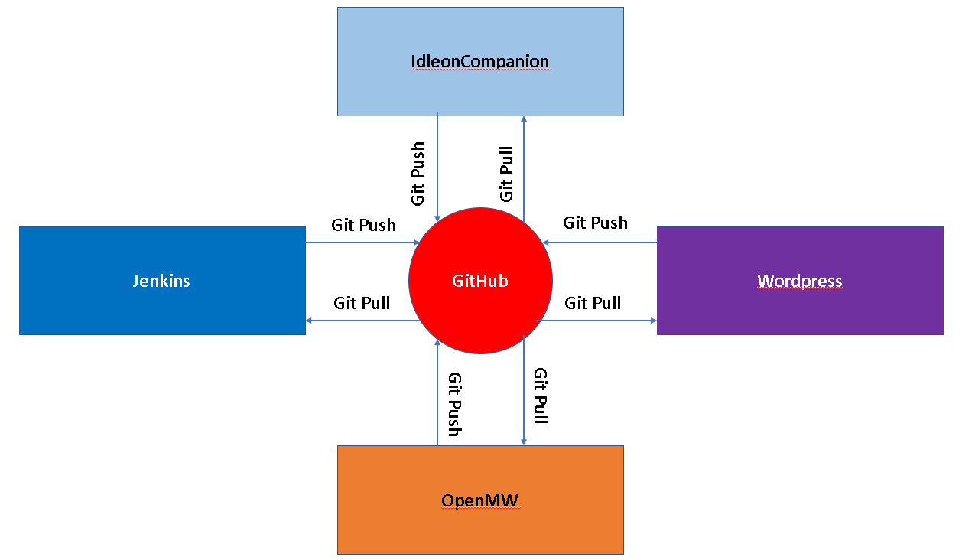
Research Methodology
Data Collection Strategy:
Direct Observation
Direct feedback from developers
External feedback from experts
Chosen open-source projects:
Jenkins
Wordpress
IdleonCompanion
OpenMW

Slide 5
Live Demo
POWER BI LINKS:
GITHUB URL: https://github.com/AnupJacob/Dissertation-Artefacts/raw/main/Dissertation.pbix
OR
ONLINE SERVICES URL: https://app.powerbi.com/links/9i57JfHL8s?ctid=47855545-00bb-4800-a65f-e79104ec0fc4&pbi_source=linkShare&bookmarkGuid=5ee30439-c141-4690-987d-6be90aa53bb1
MICROSOFT EXCEL LINK (GITHUB):
URL: https://github.com/AnupJacob/Dissertation-Artefacts/raw/main/Artefact_AnupJacob_L00163455_DevOps%202022.xlsx

Slide 6
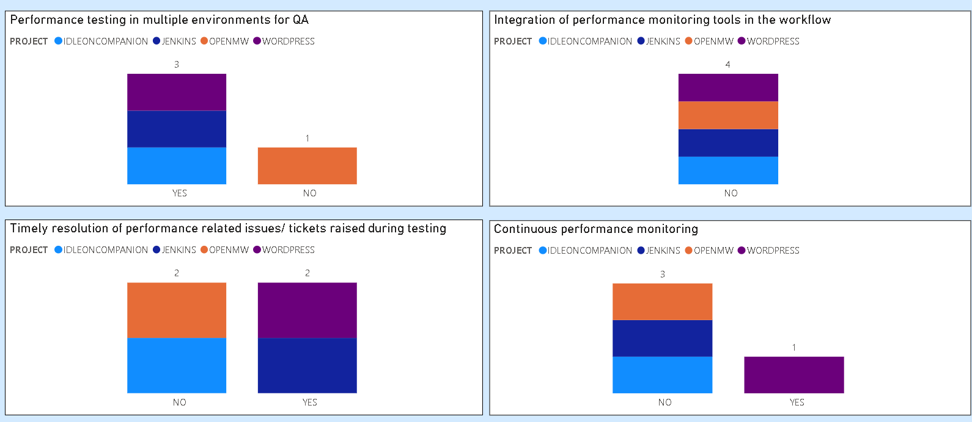
Results and Analysis
Figure: Graphs showing the approach to performance by the four open-source projects for four of the analyzed factors

Slide 7
Conclusions
Ensure proper code reviews before deployment
Use of a reliable issue tracking tool
Integration of third-party apps in the repository if possible
Prioritizing the resolution of the existing issues along with adding new features

Slide 8
Recommendations
Importance to the future society
Identify the gaps in both the team and the development process.
Discovering and sharing knowledge of project based custom best practices to other projects.
Future research
Identify other ways to analyse the effect of socio-psychological aspects on the development process of each projects even though initial try by email resulted in failure.

