Slide 1
Topic Modelling
Navnath Satre,
Vaibhav Bhasker Bansode
Sandeep Khandelwal
Anup Meshram,
Daroga Ajahar Madar
Mentored By Mrs. Bhanu Priya

Slide 2
What is Topic Modelling?
Topic modelling, in the context of Natural Language Processing, is described as a method of uncovering hidden structure in a collection of texts.
Topic modelling is a form of unsupervised learning that identifies hidden relationships in data.
Topic modelling works in an exploratory manner, looking for the themes (or topics) that lie within a set of text data. There is no prior knowledge about the themes required in order for topic modelling to work.

Slide 3
Types of Topic Modelling
Topic modelling is an ‘unsupervised’ machine learning technique, in other words, one that doesn’t require training.
Topic classification is a ‘supervised’ machine learning technique, one that needs training before being able to automatically analyse texts.

Slide 4
Techniques for Topic Modelling
Latent Semantic Analysis (LSA) (Latent Semantic Indexing)
Probabilistic Latent Semantic Analysis (pLSA)
Latent Dirichlet Analysis (LDA)
Non-Negative Metric Function
Correlated Topic Model (CTM)

Slide 5
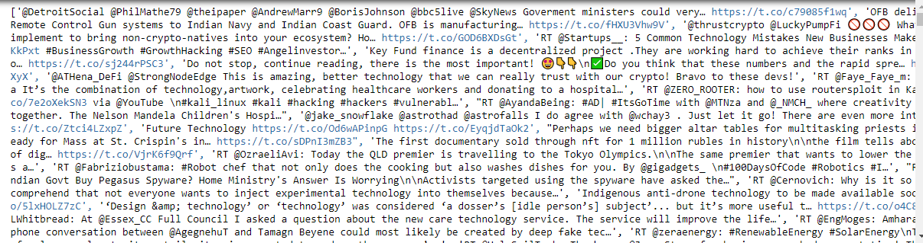
Collecting Data
Extraction of the textual data from web source of "Twitter“.
Fetching the data from twitter using API and Access tokens.

Slide 6
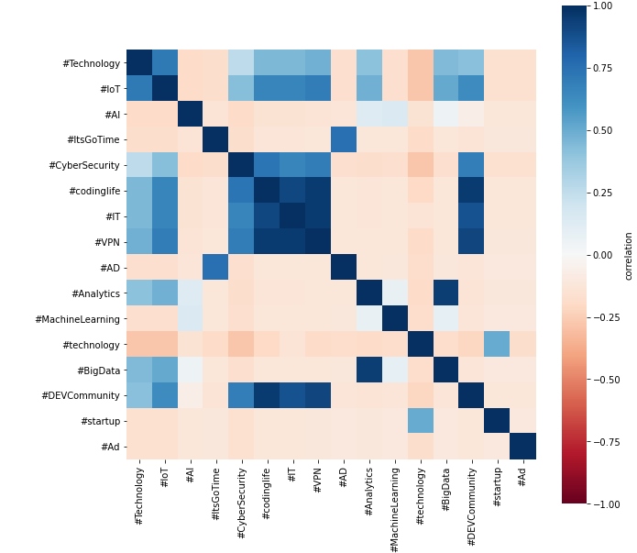
Hashtags & Relationship

Slide 7
Data Cleaning & Pre-Processing
Text Preprocessing
Steps to preprocess text data:
Convert the text into lowercase
Split text into words
Remove the stop loss words
Remove the Punctuation, any symbols and special characters
Normalize the word (I'll be using Lemmatization for normalization)

Slide 8
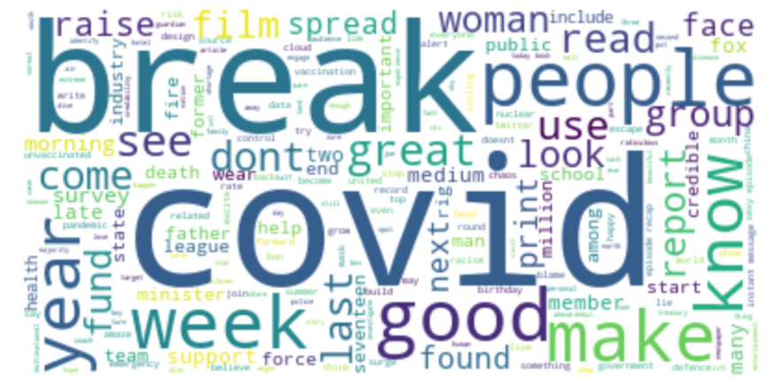
Word Cloud

Slide 9
Model Building
Implementation of LDA
Input Parameter :- Corpus ,Document-term matrix , vocabulary using both TF-IDF and Count Vectorizer
Using GridSearchCV we had tune the model and find the hyper-parameters.

Slide 10
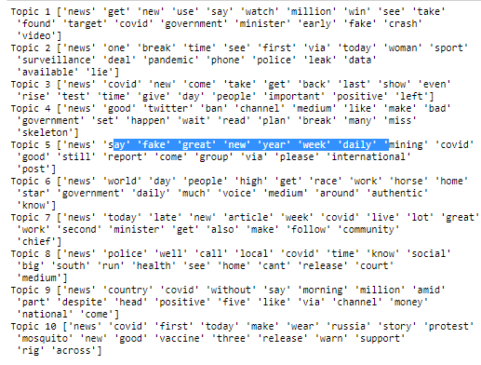
Final Output

Slide 11
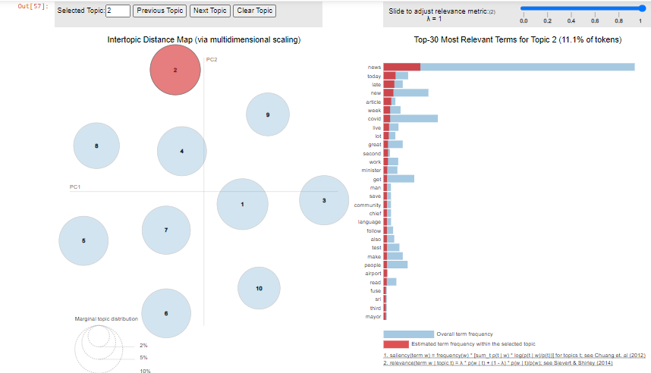
Visualization

Slide 12
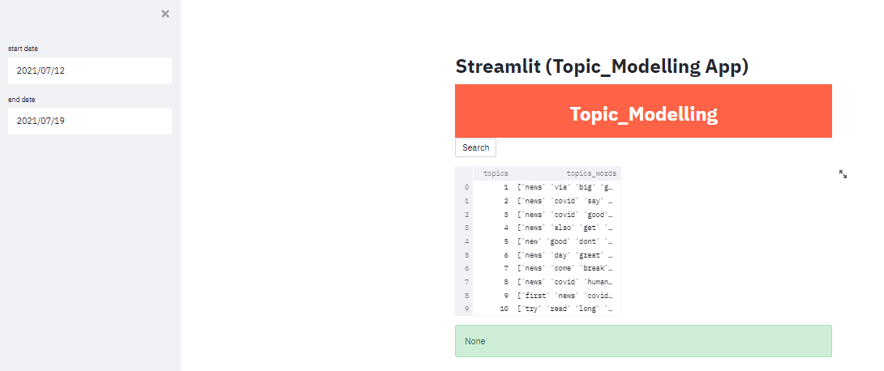
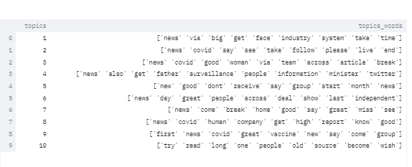
Deployment

Slide 13
Challenges faced?
Extraction of Data
Model Selection
To increase the Model Accuracy
How did you overcome?
By using Twitter Developer Account
Did research and finalise LDA
We tuned hyperparameters

Slide 14
Thank You

