Slide 1
REAL TIME MARKET SENTIMENT ANALYZER
Anup Rawka

Slide 2
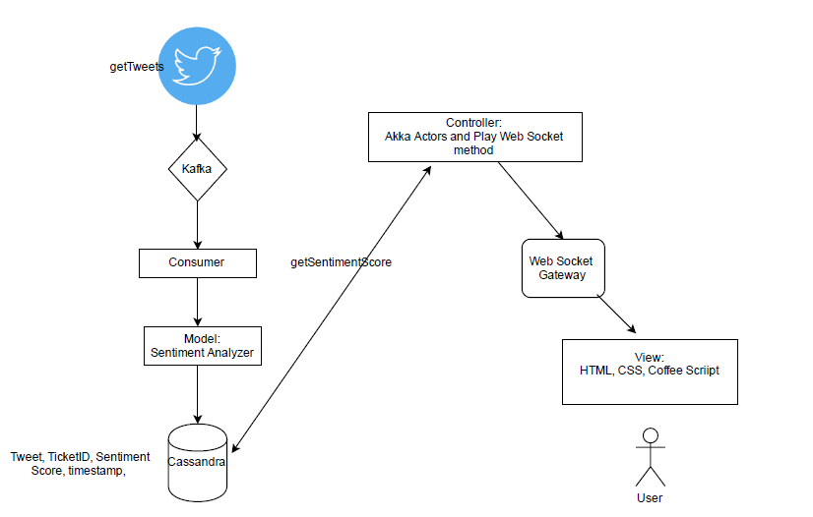
Architecture Diagram

Slide 3
Technologies Used:
Client Side:
HTML, Coffee Script, Web Sockets.
2) Server Side:
Scala, Akka (Makes the application reactive), Kafka, Play Framework (used to push data in real time from Server to client), Stanford Open NLP.
3) Data Storage:
Cassandra.
GitHub: https://github.com/AnupRawka/MarketSentiments

Slide 4
Project Description:
MARKET SENTIMENT ANALYZER- A real-time and historical sentiment analyzer service for Twitter Finance.
(Technologies: Play Framework –Reactive Web application using Akka Actors, Kafka, Cassandra, Natural Language Processing, Scala, SBT, HTML5, JavaScript, CSS)
The application analyzes real time relevant tweets for Major Stock Indices, Bonds, Commodities and Currencies and assigns a sentiment score using standard Stanford Core NLP library.
Sentiments and corresponding tweets are sent to Kafka queue which are then sent to Cassandra.
Akka actors are used to continuously get the sentiments from Cassandra.
Play is used as the Web Application framework; it uses Akka Actors to communicate new Quotes to the client.

Slide 5
Project Application:
There are various factors that are currently used to predict financial forecasting like Technological Advances, State of Economy and Industry, etc.
Market Sentiment Analyzer can provide real time sentiments analysis of twitter Users across the world and will provide one more factor for forecasting.
Users sentiments can provide the idea about their expectations and speculations about particular stock/commodity.

