Slide 1


Contact Management System
Group Member Name: Registration No: Symbol No:
1) Anup Shrestha 058-3-2-02784-2019 325126
2) Rahul Neupane 058-3-2-02801-2019 325143
3) Rojan Pant 058-3-2-02804-2019 325146
4) Subash Danuwar 058-3-2-02813-2019 325155

Slide 2
INTRODUCTION
A “Contact management system” is a program that enables users to easily store and find contact information such as Name, Phone numbers, Addresses and Email addresses.
This program can be associated to different devices.

Slide 3
OBJECTIVES
It manages all the information about contacts.
It helps to streamline administrative tasks and reduce overhead by providing a single, unified view of each contact’s processes.

Slide 4
PARAMETER INVOLVED
Functions
Switch
File Handling
Class
Goto Statements

Slide 5
FEATURES
Adding a new contact.
Listing of all contacts.
Searching for a contact.
Editing a contact.
Deleting a contact.

Slide 6
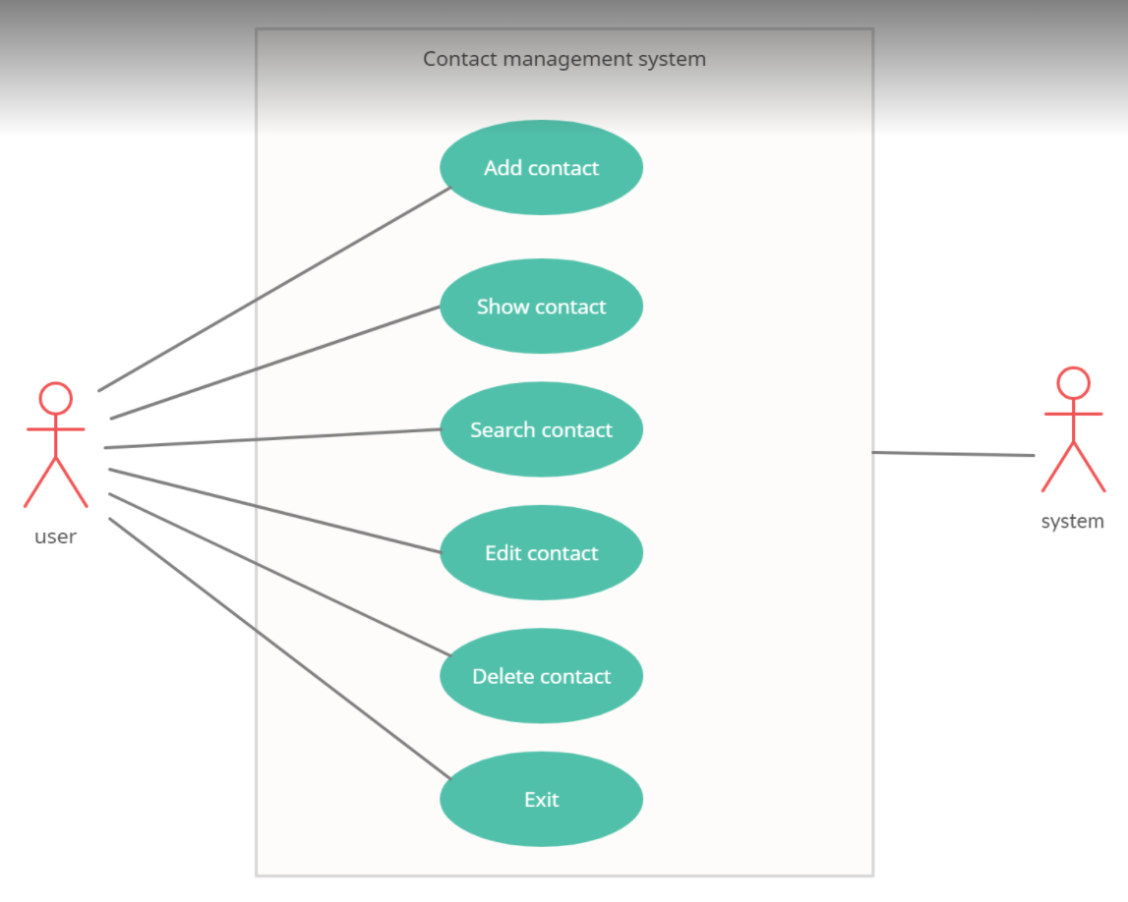
USE CASE DIAGRAM

Slide 7
ADVANTAGES
Storing customer’s information.
Maintaining customer’s record.
Save time with the search and filter option.
Customer complaint records.

Slide 8
SCOPE AND LIMITATIONS
SCOPE:-
For Sales Management.
For Marketing.
For Customer’s Service.
LIMITATIONS:-
Hardware or Software requirements.
Software subscription or purchase fees.
Reporting features.

Slide 9
SYSTEM REQUIREMENTS
Hardware:
RAM: 256 MB
Hard Disk: 200MB or above free space available
Processor: Intel Pentium III or higher
SOFTWARE:
OS: Windows 7 or Higher
Applications: Dev C++ or other C++ compiler.

Slide 10
ALGORITHM
Step 1: Start.
Step 2: Shows Main menu.
Step 3: For condition of menu program further shows option as:
Add contacts
Show available contacts
Search contact
Edit contact
Delete contact
Exit
Step 4: The program provides functions to run on the basis of option chosen by user.
Step 5: If user chooses option 6, user is asked for confirmation.
Then if chosen to exit go to step 6.
Else go to step 2.
Step 6: Stop.

Slide 11
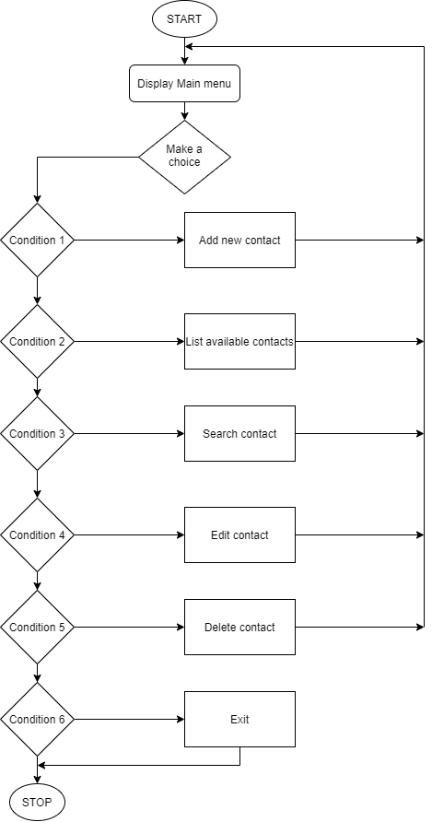
FLOWCHART

Slide 12
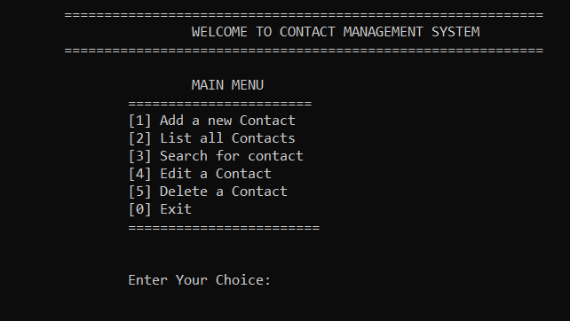
MAIN MENU

Slide 13
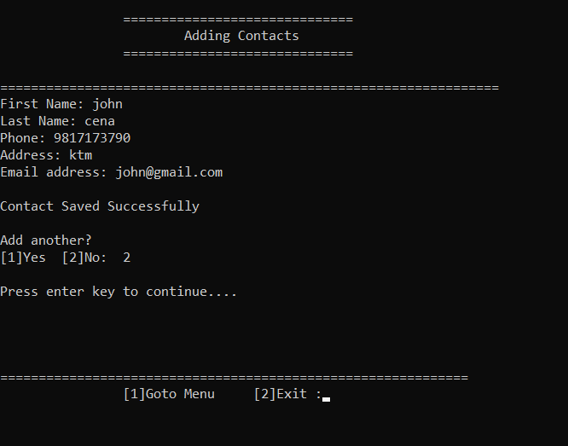
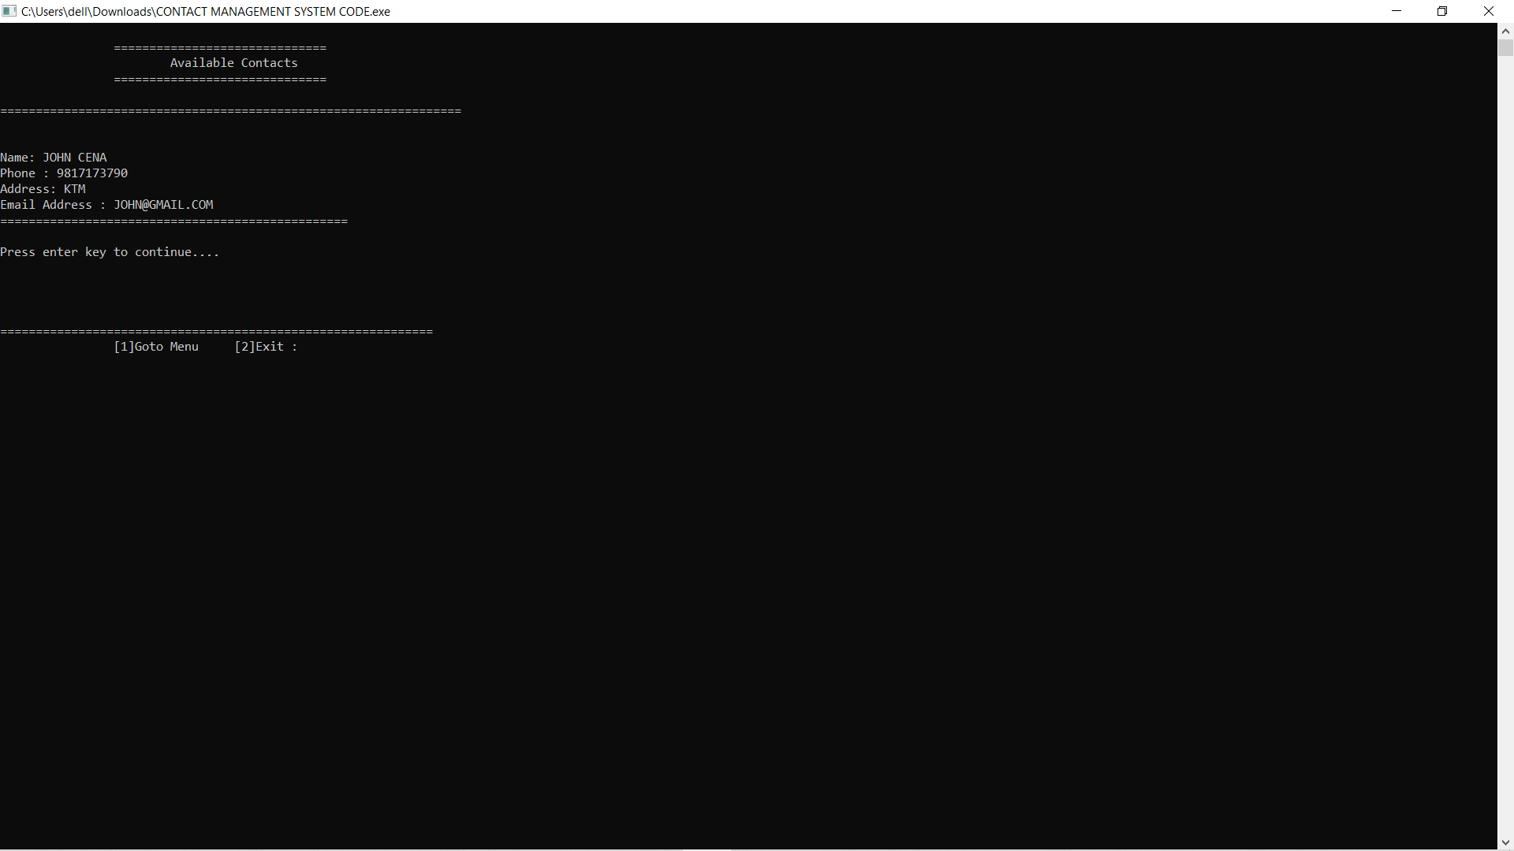
ADDING CONTACT

Slide 14
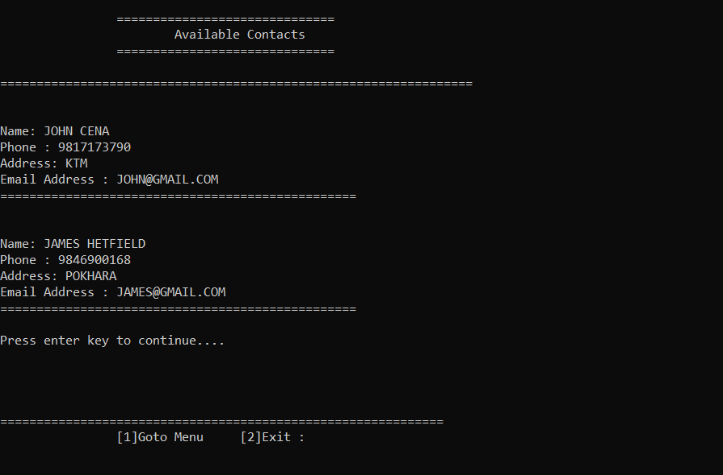
LISTING CONTACT

Slide 15


SEARCHING CONTACT

Slide 16
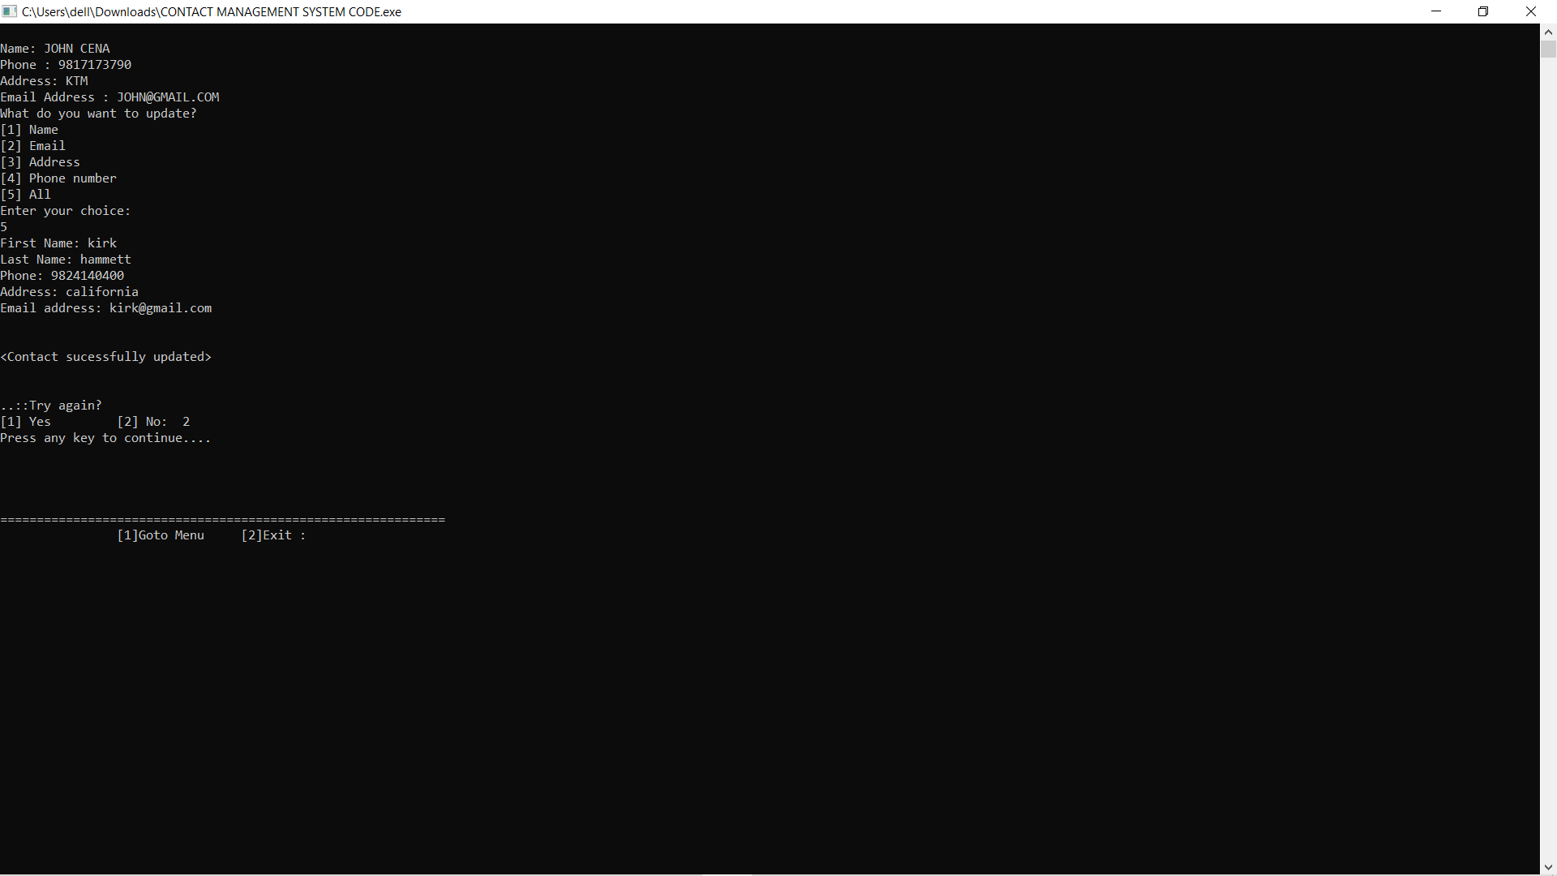

EDITING CONTACT

Slide 17
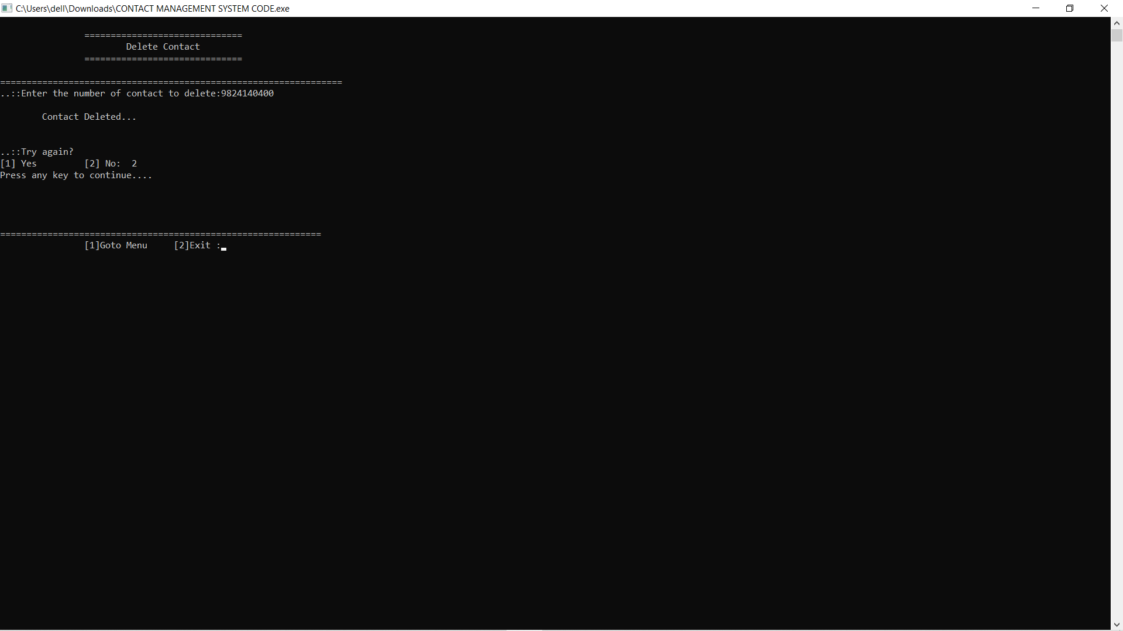
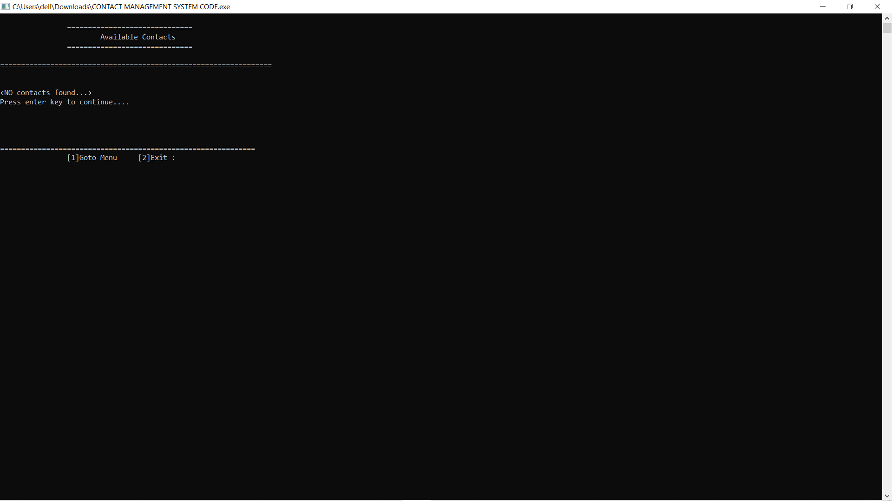
DELETING CONTACT

Slide 18
FUTURE ENHANCEMENT
High Value-Add versus transactional.
Increasing Multi-channel interaction.
Increasing Automation.

Slide 19
CONCLUSION

Slide 20
REFERENCES
www.w3schools.com
www.sites.google.com/site/completelearning.com
www.cprogramming.com
Special Thanks:-
KIST COLLEGE OF INFORMATION AND TECHNOLOGY
BIT CO-ORDINATOR MR. DEEPAK KHADKA
BIT LECTURER MR. PRAWESH DHUNGANA

Slide 21
THANK YOU!!!!!!

