Slide 1
Cognitive Processes
PSY 334
Chapter 8 – Problem Solving

Slide 2
Procedural Knowledge
Declarative knowledge – knowledge about facts and things
Procedural knowledge – knowledge about how to perform various cognitive activities.
To a cognitive psychologist all cognitive activities are fundamentally problem-solving in nature.
  Sultan and the bananas

Slide 3
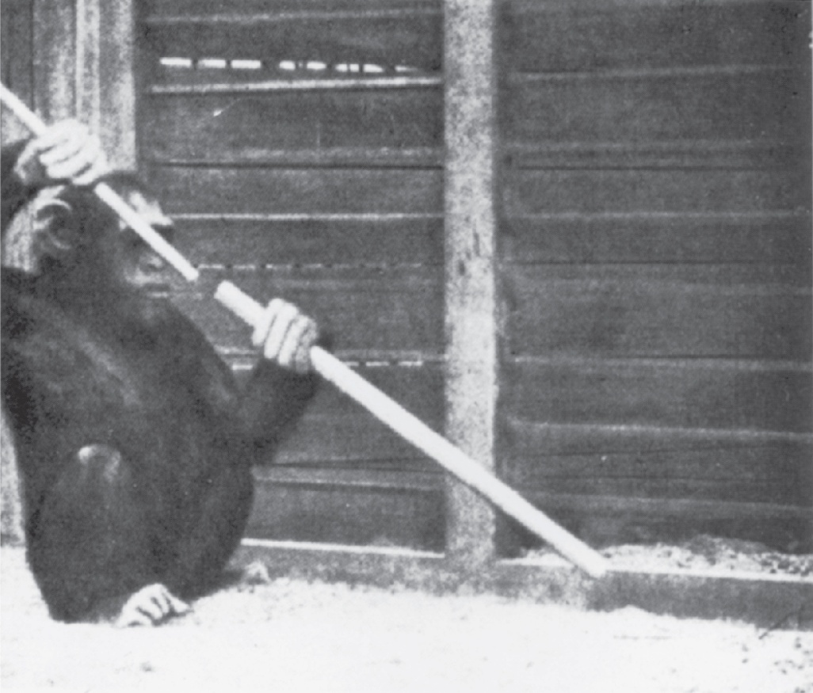
Sultan and the Bananas

Slide 4
Elements of Problem Solving
Goal directedness – behavior is organized toward a goal.
Subgoal decomposition – the original goal can be broken into subtasks or subgoals.
Operator application – the solution to the overall problem is a sequence of known operators (actions to change the situation).

Slide 5
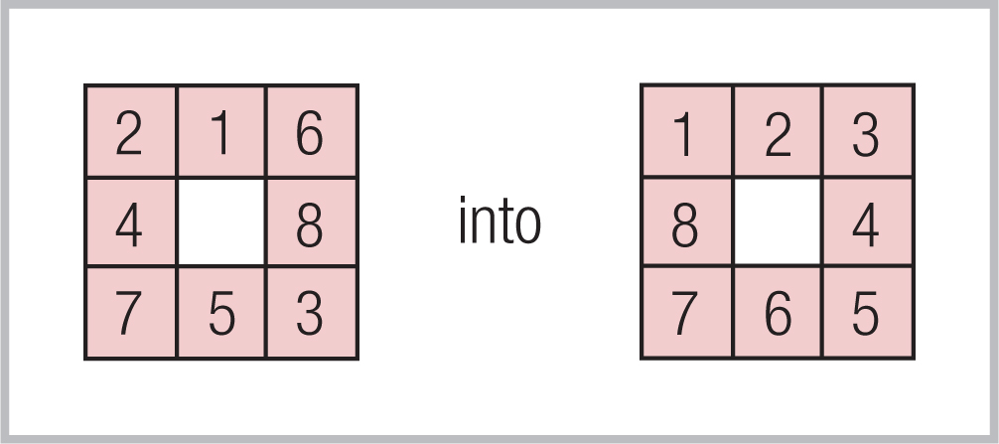
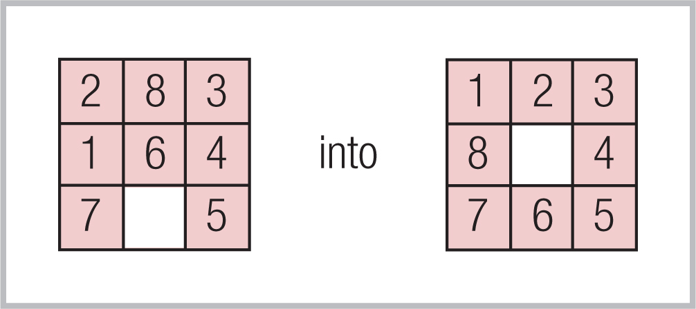
A Sample Problem

Slide 6
The Problem Space
Problem space – the various states of the problem.
State – a representation of the problem in some degree of solution.
  Initial state – the initial (starting) situation.
  Goal state – the desired ending situation.
  Intermediate states – states on the way to the goal.

Slide 7
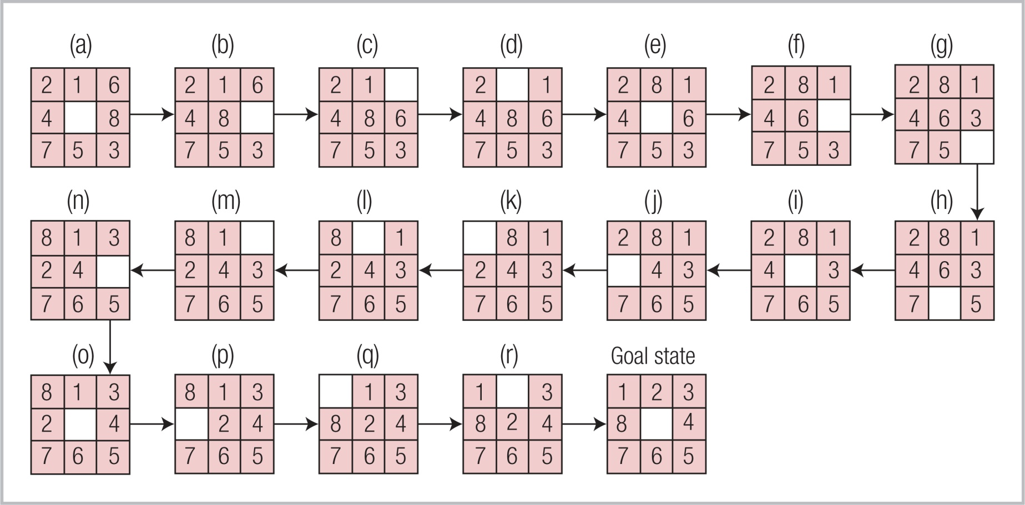
Steps in Solution (States)

Slide 8
Search
Operator – an action that will transform the current problem state into another problem state.
The problem space is a maze of states.
Operators provide paths through the maze – ways of moving through states.
Problem solving is a search for the appropriate path through the maze.
  Search trees – describe possible paths.

Slide 9
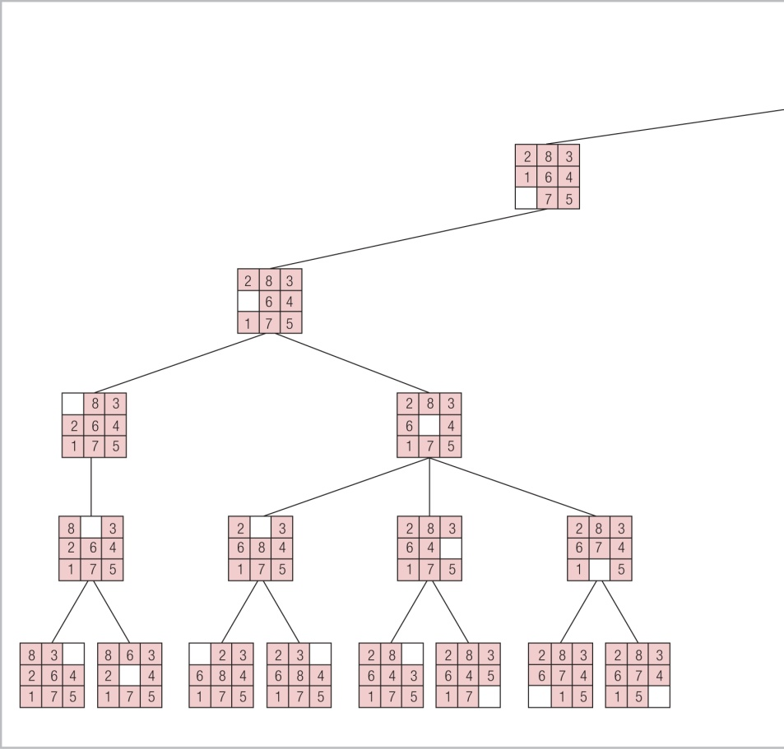
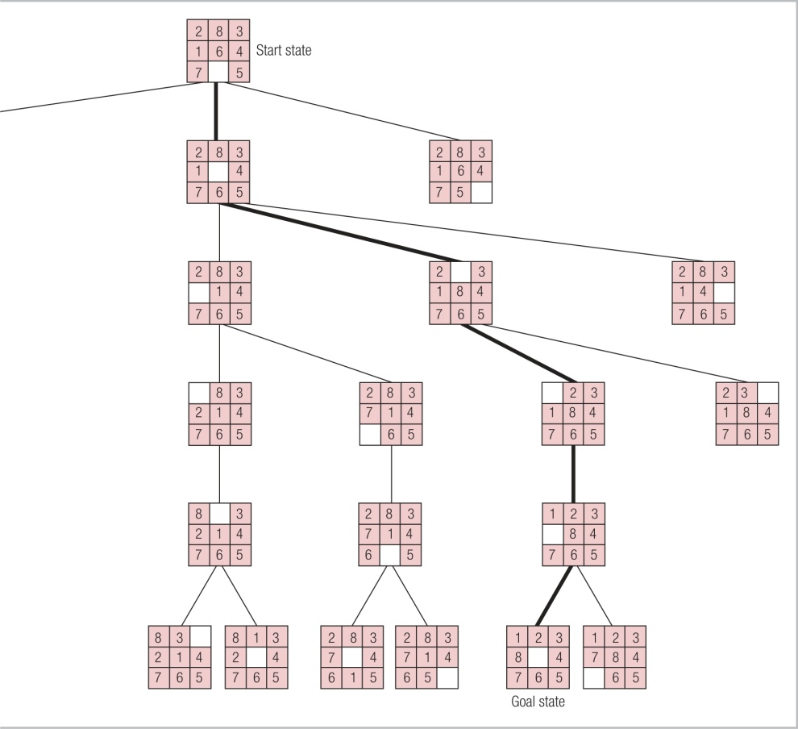
Search Path

Slide 10
Acquisition of Operators
How do we learn ways of transforming problem states (operators)?
  Discovery – trial and error, exploration.
  Instruction – depends on language.
  Observation and imitation – monkey see, monkey do.
Examples are chances for observation:
  13% solved with instruction, 28% with an example, 40% with both.

Slide 11
Analogy and Imitation
Analogy – the solution for one problem is mapped into a solution for another.
  The elements from one situation correspond to the elements of the other.
Tumor radiation example.

Slide 12
Problems Using Analogy
Thinking is needing to use it correctly.
  Geometry example – student must recognize which parts can be mapped and which are unique to the situation.
People do not notice when an analogy is possible – don’t recognize the similarities.
Similarities frequently exist in the deep structure, not the superficial details.
  Proximity is a cue in textbooks.

Slide 13
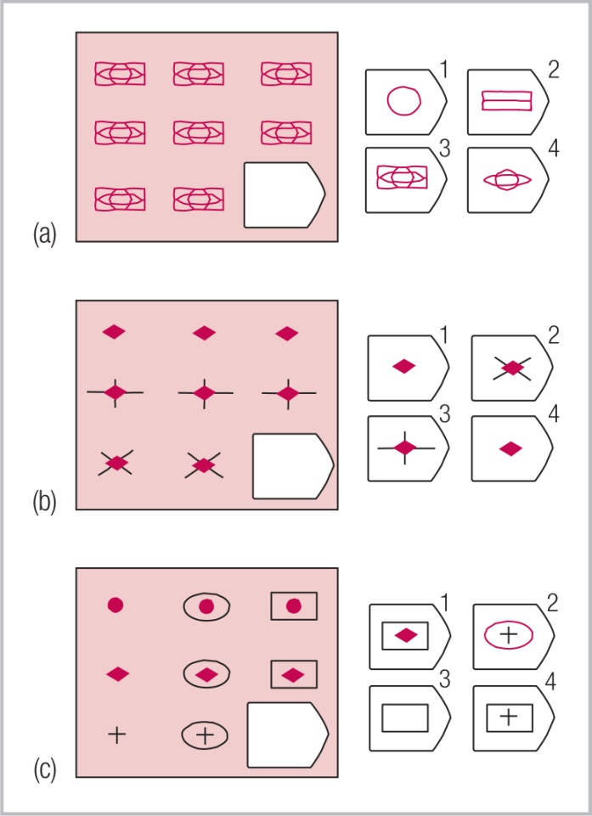
Imaging Studies of Analogy
Stimuli used by Cristoff. Only (c) involves analogical reasoning.
Children under age 5, primates and patients with frontal lobe damage cannot do (c).

Slide 14
Production Systems
Production rules – rules for solving a problem.
A production rule consists of:
  Goal
  Application tests
  An action
Typically written as if-then statements.
  Condition – the “if” part, goal and tests.
  Action – the “then” part, actions to do.

Slide 15
Features of Production Rules
Conditionality –a condition describes when a rule applies and specifies action.
Modularity – overall problem-solving is broken down into one production rule per operator.
Goal factoring – each production rule is relevant to a particular goal (or subgoal).
Abstractness – rules apply to a defined class of situations.

Slide 16
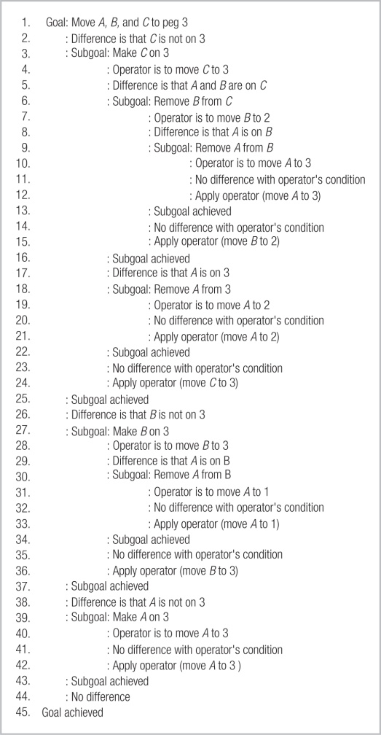
Sample Production Rules

Slide 17
Operator Selection
How do we know what action to take to solve a problem?
Three criteria for operator selection:
  Backup avoidance – don’t do anything that would undo the existing state.
  Difference reduction – do whatever helps most to reduce the distance to the goal.
  Means-end analysis – figure out what is needed to reach goal and make that a goal

Slide 18
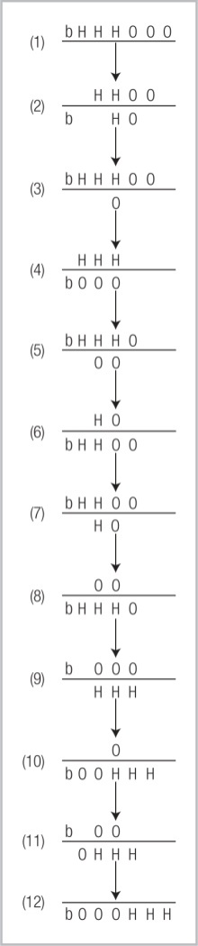
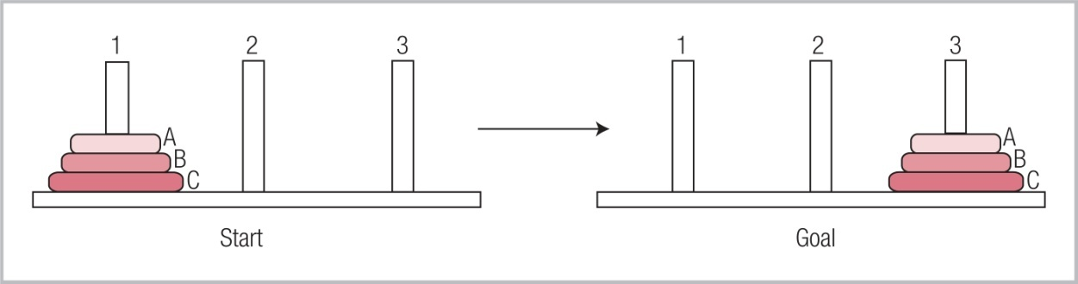
Backup Avoidance
Tower of Hanoi
To solve each of these problems one must backup but most people will not do this and so have difficulty.
Hobbits & Orcs

Slide 19
Difference Reduction
Select the operator that will produce a state that is closer to the goal state.
  Or the one that produces a state that looks more similar to the goal state.
Also called “hill climbing”.
Only considers whether next step is an improvement, not overall plan.
Sometimes the solution requires going against similarity – hobbits & orcs.

Slide 20
Means-End Analysis
Newell & Simon – General Problem Solver (GPS).
  A more sophisticated version of difference reduction.
  What do you need, what have you got, how can you get what you need?
  Focus is on enabling blocked operators, not abandoning them.
  Larger goals broken into subgoals.
GPS solution to Tower of Hanoi problem.

Slide 21
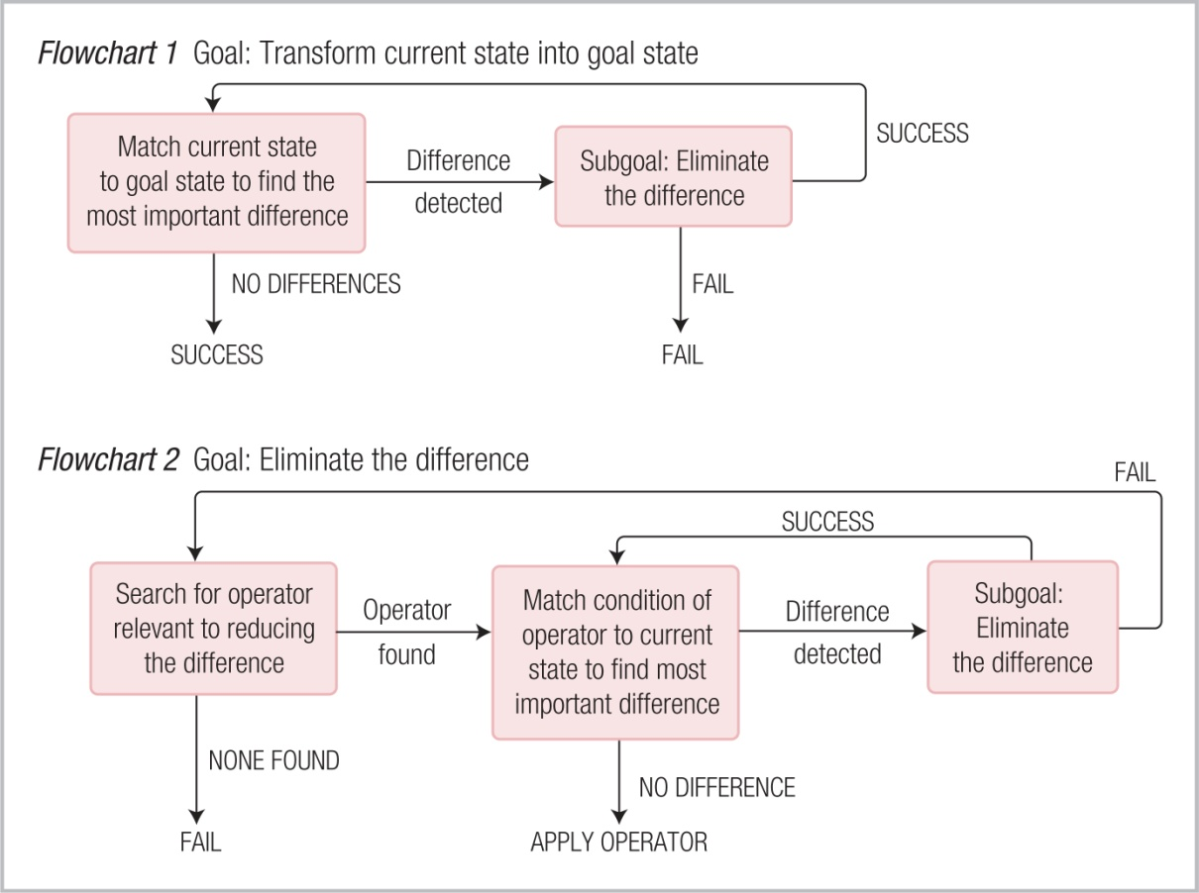
General Problem Solver

Slide 22
Prefrontal Cortex and Goals
Sophisticated problem-solving requires that goals and subgoals be kept in working memory.
  Prefrontal cortex holds information in working memory.
With damage to prefrontal cortex, Tower of Hanoi moves other than hill climbing are difficult.
Prefrontal activation is higher in novel problem solving.

Slide 23
Problem Representation
Finding the solution may depend upon how the problem is represented:
  Checkerboard problem solution depends on seeing that each domino must cover one white and one black square.
Failures of transfer – students do not see that material already learned is applicable to the current situation.
  Word problems in physics & algebra.

Slide 24
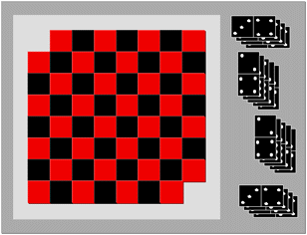
Checkerboard Problem

Slide 25
Functional Fixedness
Solution to a problem may depend on representing objects in the environment in novel ways.
Functional-fixedness – subjects are fixed on an object’s conventional function.
  Two-string problem.
  Candle-holder problem.

Slide 26
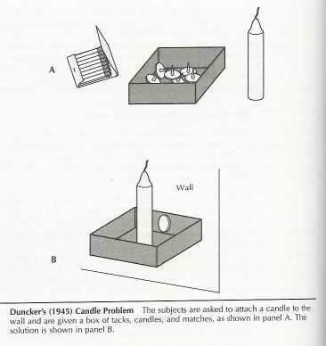
Duncker’s Candle Problem

Slide 27
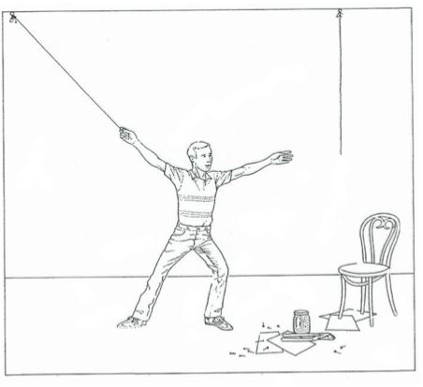
Two-String Problem

Slide 28
“Everywhere” Displays
Images projected by a computer onto objects in the environment.
Sometimes the conventional function of the object onto which a display is projected prevents seeing the display.
  Sometimes the display prevents seeing the object.
  Disappearing milk, disappearing message.

Slide 29
Set Effects
Set effect – when previous experience biases a subject toward a particular operator.
  Can prevent finding the solution to a new problem.

Slide 30
Luchins Water Jug Problem
Addition solution: 2A + C
Subtraction solution: B – A – 2C
New addition problems were solved quicker and subtraction problems were solved more slowly after experience.
Problem | Capacity of Jug A | Capacity of Jug B | Capacity of Jug C | Desired Quantity
1 | 5 cups | 40 cups | 18 cups | 28 cups
2 | 21 cups | 127 cups | 3 cups | 100 cups

Slide 31
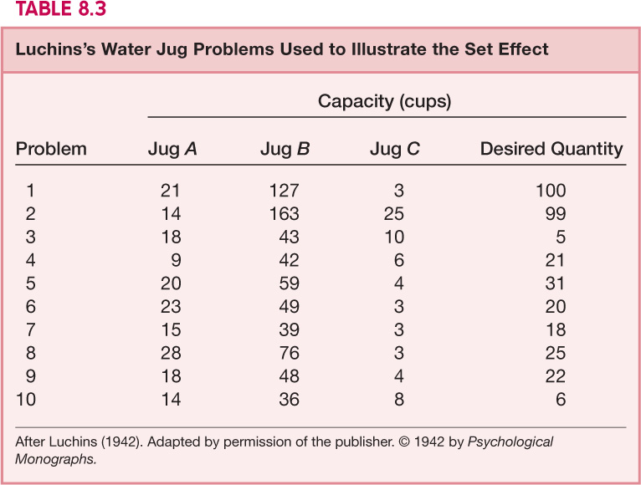
Luchin’s Water Jug Problem

Slide 32
Einstellung Effect
Mechanization of thought – a set effect in which subjects get used to using a particular solution strategy.
  After using B – 2C – A, subjects cannot find the easier solution A – C to problem 8.
  64% of whole setup group failed 8 & 79% used less efficient solution to 9 & 10.
  1 % of controls used B-2C-A & 95% solved question 8;

Slide 33
Incubation Effects
Problems depending upon insight tend to benefit from interruption.
  Delay may break set effects.
Problems depending on a set of steps or procedures do not benefit from interruption.
  Subjects forget their plan and must review what was previously done.

Slide 34
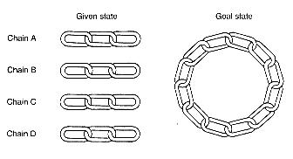
Chain & Links Problem

Slide 35
Insight
There is no magical “aha” moment where everything falls into place, even though it feels that way.
  People let go of poor ways of solving the problem during incubation.
Subjects do not know when they are close to a solution, so it seems like insight – but they were working all along.

