Slide 1

FORWARD DEPLOYED ENGINEERING
From AI demo
to production outcome
FDE Masterclass | Rohit Jindal | Scaler | 25 July 2026
LLMs · RAG · Agents · Case Studies · 90-day Roadmap
Notes:
Open calmly. Do not start with your bio. Start with the role and the promise: this session is about moving AI from demo to production.

Slide 2
Today’s agenda
A 2-hour path from role clarity to interview-ready systems
0:00–0:38
Why the FDE role exists, what it owns, and how the operating loop works
0:38–1:04
LLMs visually, then RAG visually, with demo language you can reuse
1:08–1:31
Two case studies: enterprise RAG and invoice agent
1:31–2:00
Practice tool, 90-day roadmap, structured learning, close
Two promises
Familiarity, not fake mastery.
Resource pack at the end.
Rohit Jindal | FDE Masterclass | Scaler
Notes:
Set expectations: we will not master every LLM topic in two hours. We will learn enough visually to understand diagrams, failure points, and interview conversations.

Slide 3
WHY THIS ROLE EXISTS
Most AI projects fail after the demo, not before it.
729%
Compliance
Scattered docs
growth signal: companies need people who can ship AI into real workflows
Traceability
Latency
Integration
Adoption
The gap is around the model: data, permissions, workflow, rollout, trust.
Rohit Jindal | FDE Masterclass | Scaler
Notes:
Open the section with the 729% number, then explain the bank demo that does not go live. Land this: almost nobody says the model was not smart enough. The failure is around the model.

Slide 4
The production gap
Different people stop at different points. The FDE owns the outcome.
Consultant
Recommendation deck
Software engineer
Waits for clean spec
Data scientist
Better notebook model
FDE
Integrated system people use
Chat prompt for class
One word: what usually kills an AI project after the demo?
Rohit Jindal | FDE Masterclass | Scaler
Notes:
Ask chat: data, accuracy, integration, trust, cost. Read three answers. Then land: the FDE fixes the messy gap between demo and daily production use.

Slide 5
A longer corridor, not a closed door
Why my examples come from real deployment pressure
1
2
3
4
Civil engineering
Applied AI & DS
Teaching
FDE lens
Concrete, structures, soil
Target, Mastercard, State Street
Simplifying messy systems
Model + users + risk + production
A model inside a notebook is not a business solution.
Rohit Jindal | FDE Masterclass | Scaler
Notes:
Tell the personal story briefly. Civil engineering is deliberate because many learners are transitioning. Promise to explain technical ideas twice: human language first, then one level deeper.

Slide 6
What does “Forward Deployed Engineer” mean?
Each word matters
FORWARD
Close to the customer, user, and messy workflow.
DEPLOYED
Inside real environments with real data, permissions, latency, and incidents.
ENGINEER
Builds, tests, deploys, documents, monitors, and owns the system.
One-line definition
A customer-facing software engineer who owns the journey from an unclear business problem to a working production system.
Rohit Jindal | FDE Masterclass | Scaler
Notes:
Break the title word by word. Ask learners to repeat the one-line definition mentally.

Slide 7
What an FDE actually does
The job is a loop of decisions, not a list of tools
Discover
Show me how you do this today.
Define success
Which number should move?
Design
What architecture fits your constraints?
Build + integrate
Connect docs, DBs, APIs, auth, UI.
Evaluate + deploy
Tests, guardrails, monitoring, rollout.
Generalise
Turn repeat patterns into product.
The rare skill: making a good decision when the requirement is incomplete and the clock is running.
Rohit Jindal | FDE Masterclass | Scaler
Notes:
Read the six job sentences as if speaking in a real meeting. Emphasize that the value is judgment under ambiguity.

Slide 8
A bad Monday in the life of an FDE
The model is often not the problem
9:00
10:00
11:00
1:30
3:00
4:30
Incident call
Trace retrieval logs
Fix permission filter
Staging tests
Gradual rollout
Incident note
A metadata filter was skipped. The LLM answered from documents it should never have seen.
Rohit Jindal | FDE Masterclass | Scaler
Notes:
Narrate this as an incident story. The learning: most AI failures are retrieval, permission, integration, or product failures.

Slide 9
How FDE differs from adjacent roles
Read the JD, not just the title
Role
Centre of gravity
Output
Software Engineer
Reusable product/platform
Software for many customers
ML / AI Engineer
Models, pipelines, evaluation
Reliable AI capability
Solutions Engineer
Pre-sales demos/design
Proposal or demo
Consultant
Diagnosis and process
Roadmap
FDE
Customer outcome end-to-end
Integrated system people use
Signal to look for: discovery + delivery + rollout + adoption.
Rohit Jindal | FDE Masterclass | Scaler
Notes:
Caveat: titles are inconsistent. The signal is whether the role owns discovery, delivery, rollout, and adoption.

Slide 10
The FDE operating loop
Launch is not the end; feedback starts there
Discover
Define success
Prototype
Integrate
Evaluate
Deploy
Observe
Generalise
One question per step is most of the job.
What is the user trying to do? What measurable change proves this was worth building? What breaks in real use?
Rohit Jindal | FDE Masterclass | Scaler
Notes:
Walk through the loop with one question per step. Use the public-sector knowledge assistant example if time allows.

Slide 11
Prototype thinking vs FDE thinking
The shift that separates demo-builders from production owners
Prototype
FDE
Can the LLM answer?
Can the right user get the right answer from a permitted source?
Answer looks good
Passes evals and cites evidence
Runs on my laptop
Deployable, observable, secure, fast enough
We used a vector DB
Retrieval and caching fit user behaviour
Demo is done
Feedback loop has started
Rohit Jindal | FDE Masterclass | Scaler
Notes:
Move learners from “I built an AI feature” to “I changed a workflow and can prove it.”

Slide 12
LLM intuition: next token prediction
Ask the class before revealing the mechanism
The customer returned the product because it was ____
The whole mechanism
Pick one likely next piece of text, attach it, then repeat. Fluency is the result of doing this extremely well.
damaged
48%
defective
25%
late
14%
wrong
8%
expensive
5%
Rohit Jindal | FDE Masterclass | Scaler
Notes:
Ask everyone to type one word. Then explain the ranked list of likely next words.

Slide 13
Inside the LLM: five stages
Plain English first, one level deeper second
1
2
3
4
5
Tokenise
Represent
Attend
Transform
Predict
Cut text into pieces
Turn pieces into numbers
Decide which words matter
Refine over many layers
Score the next token
Hallucination = plausible continuation without enough grounding.
Rohit Jindal | FDE Masterclass | Scaler
Notes:
Explain attention as every word deciding which earlier words explain it. Then land the limitation: an LLM is not a database.

Slide 14
The first fix for a confident wrong answer
Grounding beats randomness tweaks
Company leave policy answer is confident but wrong. What do you fix first?
A Raise temperature
Not the first fix.
B Use bigger model
Not the first fix.
C Give verified document
Correct: ground the answer in evidence.
Temperature changes randomness. It does not make the answer true.
Rohit Jindal | FDE Masterclass | Scaler
Notes:
Run this as a quiz. Answer is C. The word grounding leads directly into RAG.

Slide 15

RAG = open-book exam
We find the relevant pages first. The model answers from evidence, not memory.
Closed book: model guesses from memory
Open book: retrieve → answer → cite
Rohit Jindal | FDE Masterclass | Scaler
Notes:
Use the closed-book versus open-book line. This is the simplest way to explain RAG to any stakeholder.

Slide 16
RAG is two systems, not one
Offline preparation + online answering
Offline: prepare knowledge
Online: answer question
Connect
Parse
Chunk
Embed
Index
Version
Auth
Rewrite
Filter
Retrieve
Rerank
Generate
Cite
Embeddings
A location on a map of meaning. “Car” and “vehicle” are near; “car” and “carrot” are not.
Debugging lesson
Only one box is the model. When “AI is wrong,” first find which box broke.
Rohit Jindal | FDE Masterclass | Scaler
Notes:
Walk the two halves. Emphasize that you should never hide retrieval in a demo; show the chunks before the answer.

Slide 17
What “good RAG” really means
A checklist for demos, interviews, and production reviews
Evidence
Right chunks are retrieved
Faithfulness
Answer stays inside evidence
Sources
Citations are visible and correct
Refusal
Abstains when evidence is missing
Permissions
Filters before content reaches model
Latency + cost
Survive real usage
Freshness
Updates and deletes propagate
RAG does not make an LLM truthful. It builds a system that retrieves evidence, constrains the answer, and makes failure measurable.
Rohit Jindal | FDE Masterclass | Scaler
Notes:
Ask where the pipeline can fail: parsing, chunking, retrieval, filtering, reranking, prompting, generation, citation, interface.

Slide 18
Four-minute break
Come back with one use case and one failure mode
In chat before you go:
One AI use case + one way it could fail in production
Your current role if you are transitioning into this field
Testing · support · mechanical · civil · teaching · sales · fresher · non-tech
Rohit Jindal | FDE Masterclass | Scaler
Notes:
After the break, read some current roles aloud. Transition is possible, but it comes from building one real system and closing the engineering gap.

Slide 19
Case Study 1: Enterprise RAG design
Financial services policy assistant
500k
5k
strict
<5s
must cite
internal documents
employees
access controls
target latency
every answer
Clarify before architecture
Who uses it and what decision follows?
How are permissions represented today?
How fresh must answers be?
What does “citation” mean exactly?
Which mistakes are unacceptable?
Rohit Jindal | FDE Masterclass | Scaler
Notes:
This is the first solved case study. Make the point: the best first system design answer is usually a good question.

Slide 20
Enterprise RAG architecture
Permission-aware retrieval before generation
Sources
SharePoint
DBs
Scans
Ingestion
OCR
cleaning
versioning
Indexes
Vector
keyword
metadata
Query service
auth
filters
routing
Retrieval
hybrid
rerank
LLM
grounded
answer
Citations
source
spans
Identity + permissions sit underneath retrieval. Evaluation + observability run across everything.
Rohit Jindal | FDE Masterclass | Scaler
Notes:
Explain left-to-right. Stress that permissions are not a post-processing step. They happen before or during retrieval.

Slide 21
Enterprise RAG trade-offs
Never answer with a tool name alone
Chunking
Fixed → semantic / parent-child
Retrieval
Vector only → hybrid
Vector store
Managed → self-hosted
Model
One premium → routing
Caching
None → permission-aware
Rollout
Big bang → staged pilot
Weak: “Use Qdrant.” Strong: “I need self-hosting, metadata filters, and deployment control; Qdrant is one candidate.”
Rohit Jindal | FDE Masterclass | Scaler
Notes:
Say the Qdrant line. Senior system design is not a diagram of tools; it is decisions justified by constraints.

Slide 22
Enterprise RAG debugging + metrics
Diagnose before touching the model
Wrong answer
Correct chunk never retrieved
Contradiction
Correct chunk retrieved
Bad citation
Claim not supported
Data leak
Restricted doc visible
Stale answer
Old policy retrieved
Slow P95
Trace every stage
Metrics to say out loud
Context recall and precision
Faithfulness, citation accuracy, abstention quality
Self-service success rate and time saved
P50/P95 latency, permission violations, cost per successful task
Rohit Jindal | FDE Masterclass | Scaler
Notes:
This slide is for the detailed case explanation. Keep the rule: debug the pipeline stage by stage before changing the model.

Slide 23
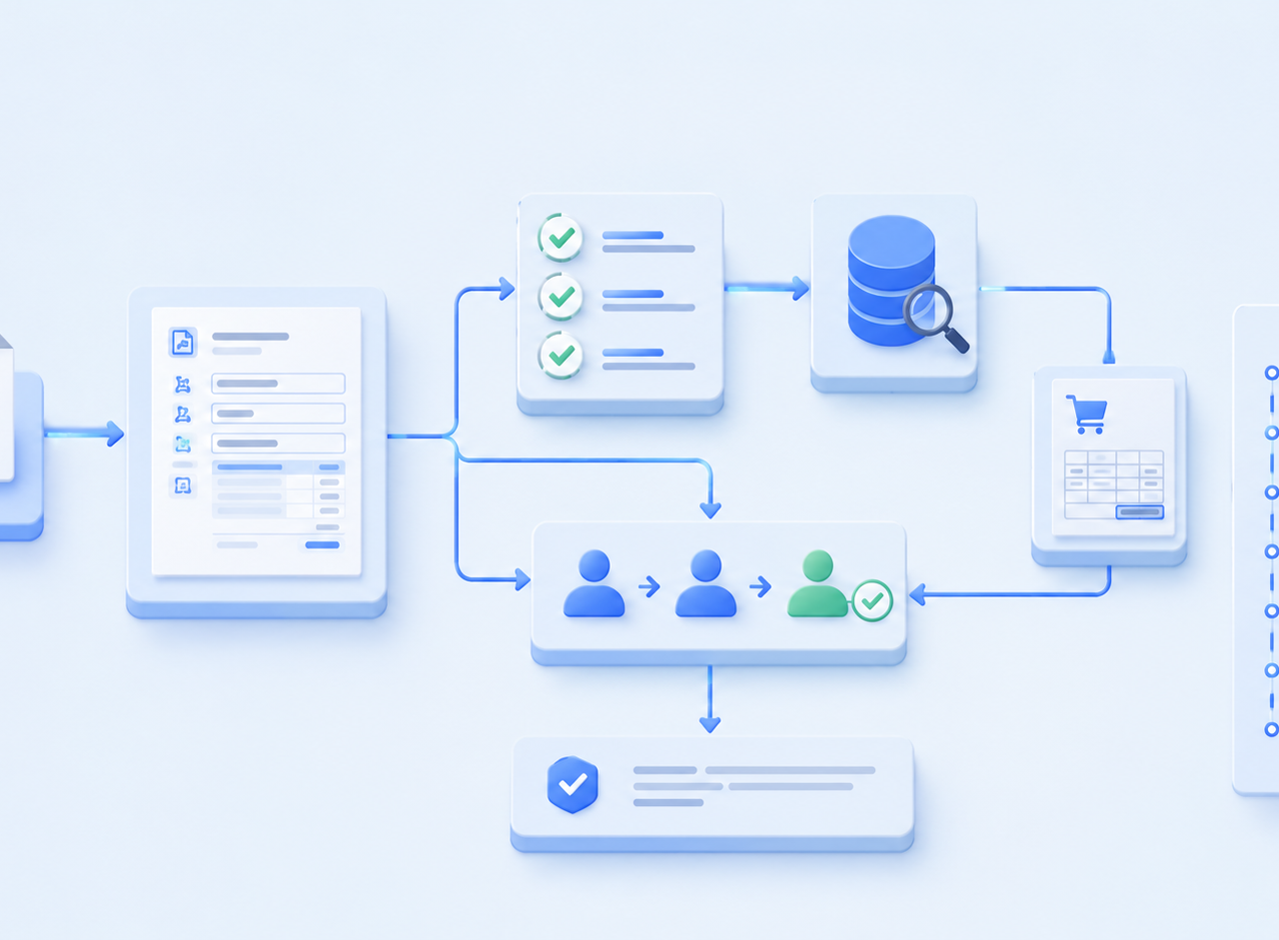
Case Study 2: Invoice agent
Extraction + tools + rules + human review
The case
Invoices must be matched to PO, checked against policy, screened for duplicates, and routed for approval or review.
Pattern answer
It is all three in different places: structured extraction, RAG for policy, and a controlled tool-using agent.
Rohit Jindal | FDE Masterclass | Scaler
Notes:
Ask: Is this RAG, extraction, or an agent? The honest answer is all three appear, but the core is structured extraction plus tools plus rules.

Slide 24
Invoice workflow
The model helps read and explain; rules decide
Intake
OCR / parse
JSON extraction
Validate schema
PO + vendor tools
Rules + policy
Decision
Human review / audit
Auto-approve only low-risk, high-confidence cases. Everything ambiguous goes to a person.
Rohit Jindal | FDE Masterclass | Scaler
Notes:
Walk the seven-stage pipeline. Emphasize original file storage, strict schema, trusted tool lookup, deterministic rules, and audit trail.

Slide 25
Where the LLM must not decide
A small arithmetic example that saves the whole design
Invoice: ₹1,04,000
PO: ₹1,00,000
Policy tolerance: 2%
Code calculates: 4% variance
Result: human exception review
The LLM can explain the exception. It must not be the source of truth for thresholds, math, or payment action.
Rohit Jindal | FDE Masterclass | Scaler
Notes:
Ask this as a question first. Then answer: no, absolutely not. Code calculates variance; the LLM can explain.

Slide 26
Safe agent loop
A model inside a controlled system, not a free-running bot
Goal
Decide
Call tool
Observe
Validate
Continue / stop / human
Typed function schemas
Least privilege and read-only first
Timeouts, retries, idempotency keys
Approval gates for irreversible actions
Audit log for every tool call
Rohit Jindal | FDE Masterclass | Scaler
Notes:
Explain agent loop. Add guardrails: confidence thresholds, cross-check totals, never repeated payment, safe pending state.

Slide 27
Internal FDE practice tool
Knowledge disappears unless you use it under pressure
Practice the actual motion:
Messy, under-specified business problem
Ask clarifying questions
Choose an architecture
Defend trade-offs under pushback
Live demo script
Show what happens when you skip clarifying questions. Then ask about scale, security, and success metric first.
30 minutes a day for two weeks builds fluency because you have said the arguments out loud fifty times.
Rohit Jindal | FDE Masterclass | Scaler
Notes:
Switch to the internal tool. Narrate as you click. The key message is active practice, not passive watching.

Slide 28
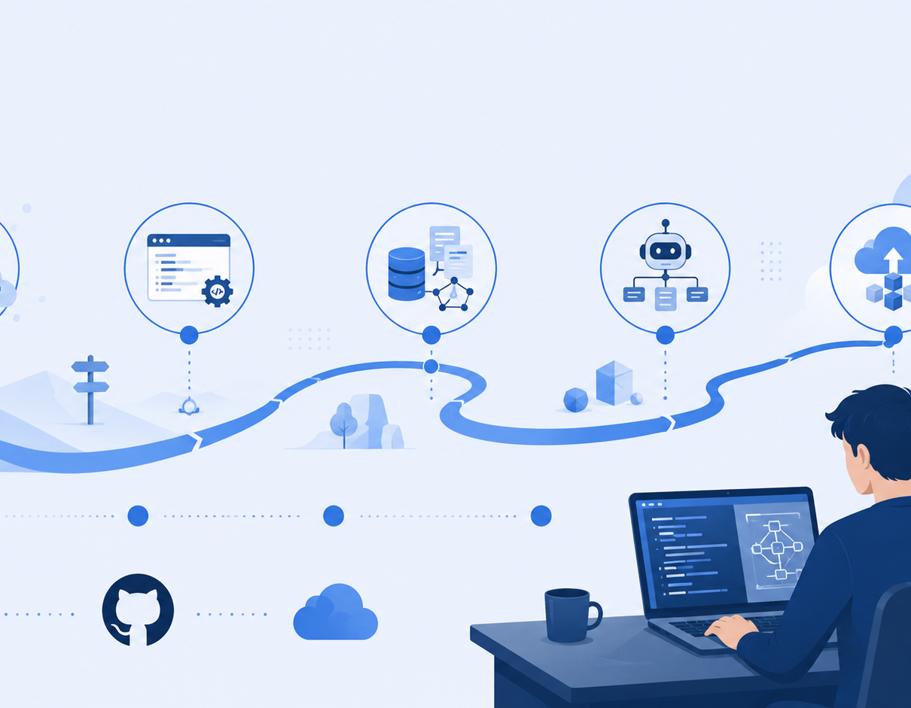
Your 90-day roadmap
Four pillars. Three out of four keeps people stuck.
Software engineering
Python, APIs, SQL, Git, testing
Applied AI
LLMs, RAG, extraction, tool calling, evals
Production systems
Docker, auth, logging, queues, cost
Customer problem-solving
Discovery, scoping, trade-offs, demos
Rohit Jindal | FDE Masterclass | Scaler
Notes:
Emphasize: do not learn fifty frameworks. Learn fundamentals and build one project deeply enough to defend every decision.

Slide 29
12-week build plan
By the end, you should have proof, not only notes
Weeks 1–2
Python, APIs, SQL, Git, testing
Weeks 3–4
Basic RAG with visible retrieval + citations
Weeks 5–6
Hybrid retrieval, filters, 30–50 eval questions
Weeks 7–8
Agent calling two real tools with typed schemas
Weeks 9–10
FastAPI, Docker, auth, logging, latency/cost
Weeks 11–12
Capstone, demo video, README, mock interviews
Beginner → resume/course RAG. Intermediate → policy assistant. Advanced → invoice/support agent.
Rohit Jindal | FDE Masterclass | Scaler
Notes:
Give the three project order: beginner RAG, intermediate policy assistant, advanced invoice or support operations agent.

Slide 30
Portfolio proof + interview answer skeleton
A strong portfolio shows judgment
Problem + user workflow
Constraint + success metric
Architecture diagram
Tools chosen and rejected
Evaluation results
Failure modes and fixes
Deployment + cost notes
3-minute demo video
Context → Constraint → Options → Decision → Trade-off → Metric → Failure mode
Use this skeleton whenever an interview question feels too open-ended.
Rohit Jindal | FDE Masterclass | Scaler
Notes:
This is the answer structure learners can reuse in project deep dives, system design, and customer scenario rounds.

Slide 31
Where structured learning fits
Sequence, accountability, feedback, interview practice
Structure
Projects
Feedback
Community
Interview readiness
Ask any programme three questions:
Which production-style projects will I ship?
Who reviews my work?
How is interview readiness measured?
Rohit Jindal | FDE Masterclass | Scaler
Notes:
Be balanced. Free learning is possible. Structure should solve sequence, accountability, feedback, and practice.

Slide 32
Tonight’s action
Create one GitHub repository. In the README, write four lines:
User
Problem
Success metric
Seven-day version
Do not wait to feel ready. Build one small system, put it in front of one real user, study what fails, and improve it.
Rohit Jindal | FDE Masterclass | Scaler
Notes:
End slowly on this sentence. Then transition to Q&A buckets: role/career, technical architecture, project ideas.

Slide 33
Q&A buckets
Start your question with the bucket so more people can be helped
Role & career
Transition, background, role expectations
Technical architecture
LLMs, RAG, agents, deployment
Project ideas
What to build, scope, proof
Keep answers diagnostic: what is known, what depends on the company, and how to verify.
Rohit Jindal | FDE Masterclass | Scaler
Notes:
Use 60–90 second answers unless it helps the whole room. Personal profile questions get a next action, not a full career consultation.

