Slide 1
Reliance
Industries Limited
GROWTH IS LIFE
Presented by:- Anupam Kumar Thakur

Slide 2
History
Dhirajlal Hirachand Ambani, popularly known as Dhirubhai Ambani (28 December 1932 – 6 July 2002) was an Indian business tycoon who founded Reliance Industries in Bombay.
The company was co-founded by Dhirubhai Ambani and Champaklal Damani in 1960's as Reliance Commercial Corporation. In 1965, the partnership ended and Dhirubhai continued the polyester business of the firm.
In 1966 a company named as Reliance Textiles Engineers Pvt. Ltd. Was incorporated in Maharashtra (Mumbai).
It established a synthetic fabrics mill in the same year at Naroda in Gujarat.[
It got renamed in as Reliance Industries on May 08, 1973.
Headquarter of Reliance Industries is in Maharashtra (Mumbai).

Slide 3
History continue……
We all know about “Vimal” . In 1975, the company expanded its business into textiles, with "Vimal" becoming its major brand in later years.
During the year of 1985-1992, the company expanded its capacity of producing polyester yarn by over 145,000 tonnes per annum.
In 1995/96, the company entered the telecom industry through a joint venture with NYNEX, USA and promoted Reliance Telecom Private Limited in India.
In 1998/99, RIL introduced packaged LPG in 15 kg cylinders under the brand name Reliance Gas.
The years 1998–2000 saw the construction of the Integrated Petrochemical Complex at Jamnagar in Gujrata, the largest refinery in the world.

Slide 4
History continue……
In 2001–02, Reliance Petroleum was merged with Reliance Industries.
In 2002, Reliance discovered of Natural Gas at the Krishna Godawari Basin.This was the first ever discovery by an Indian private sector company.
In Mumbai on on 6 July 2002 Dhirubhai Ambani died because of major stroke.
He got Padma Vibhushan in 2016.
After the death of Dhirubhai Ambani, the group was split in 2004 into Reliance Industries Limited headed by Mukesh, and Reliance Anil Dhirubhai Ambani Group headed by Anil.

Slide 5
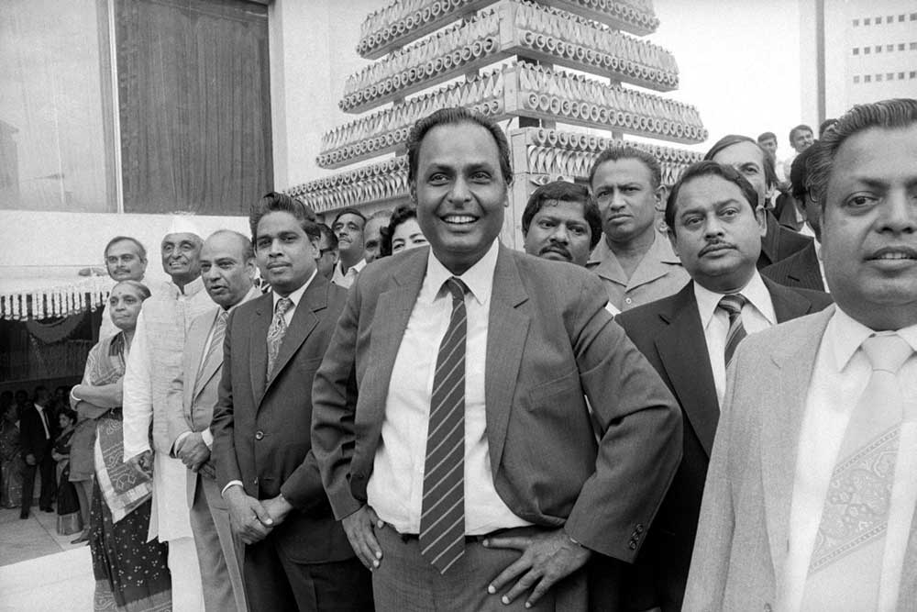

Dhirubhai Ambani

Slide 6
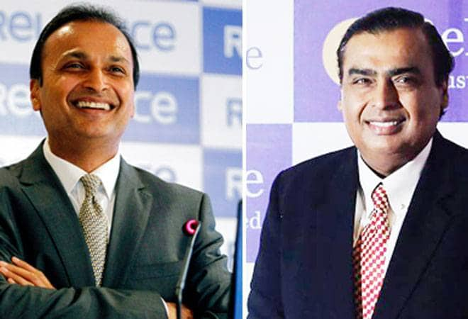
Breakup
MUKESH AMBANI
ANIL
AMBANI

Slide 7
Mukesh Ambani
Reliance Industries Limited is an Indian conglomerate, headquartered in Mumbai, India. The company, which was formed after Dhirubhai Ambani business was divided up, is headed by his elder son Mukesh Ambani.
Companies under Reliance Industries Limited :-
1. Reliance Jio
2. Reliance Retail Limited
3. Reliance Petroleum
4. Reliance Petrochemicals Corporation Limited (RPCL)
5. Reliance Textiles Industry

Slide 8
Anil Ambani
Reliance Anil Dhirubhai Ambani Group or Reliance ADA Group (ADAG) is an Indian conglomerate, headquartered in Mumbai, India. The company, which was formed after Dhirubhai Ambani business was divided up, is headed by his younger son Anil Ambani.
Reliance ADA Group has six listed companies : -
1. Reliance Power
2. Reliance communications
3. Reliance Infrastructure
4. Reliance Capital
5. Reliance Entertainment
6. Reliance Health

Slide 9
Reliance Industries Limited Reliance Jio
Reliance jio Infocomm Limited (RJIL), a subsidiary of Reliance Industries Limited (RIL), India's largest private sector company, is the first telecom operator to hold pan India Unified License.
Reliance jio provides 4G only.
Reliance jio was founded in February 2007, but Jio soft launched in December 2015 with the free subscription for 6 months , in which the voice call, and 4G internet service was free.
It became publicly available on 5 September 2016.
From May 2019, it is the largest mobile network operator in India and the third largest mobile network operator in the world with over 339.74 million subscribers.
LYF is a subsidiary of Reliance jio as we have the mobile phones of LYF.
Services provided by Reliance jio are Mobile phones(jio phones and LYF phones), Wireless Broadbands(jio-fi), Internet services, OTT services.

Slide 10
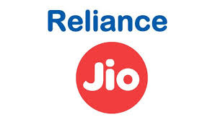
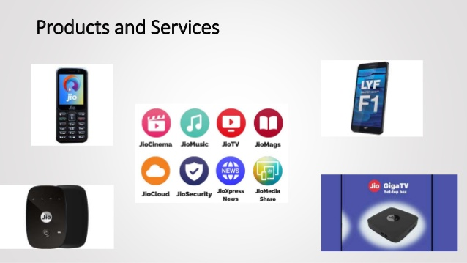
Reliance Jio
Reliance jio is a big supporter of Digital India program also.
Because of reliance jio a new era came to India , in which far off villages getting digitalized.
Data of 2019
Revenue :- ₹11,679 crore (US$1.7 billion)
Operating Income :- ₹3,631.2 crore (US$530 million)
Net Income :- ₹1,148 crore (US$530 million)
Total Assets :- ₹187,720 crore (US$27 billion)

Slide 11
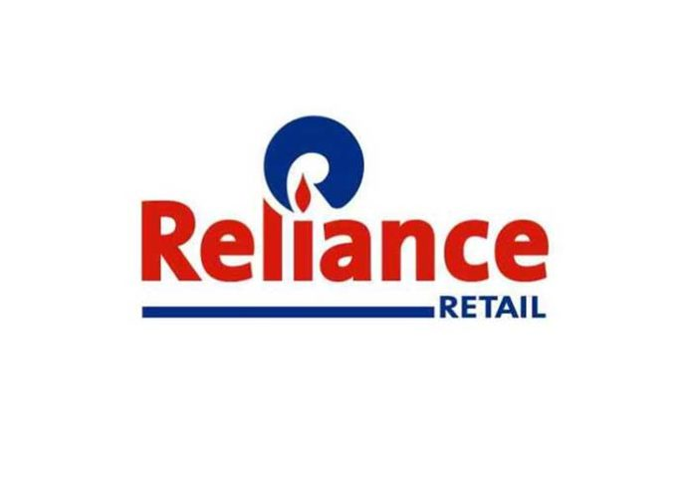
Reliance Retail Limited
Founded in 2006 by Mukesh Ambani and it’s headquarter is in Mumbai.
Its retail outlets offer foods, groceries, apparel and footwear, lifestyle and
home improvement products, electronic goods, and farm implements
and inputs.
The company’s outlets also provide vegetables, fruits, and flowers.
It focuses on consumer goods, consumer durables, travel services, energy, entertainment and leisure, and health and well-being products, as well as on educational products and services.
Revenue :- ₹450 billion
Operating Income :- ₹ 7 billion

Slide 12
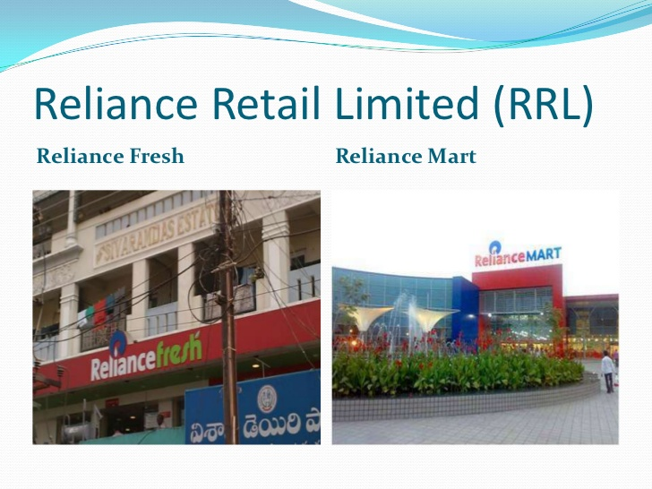
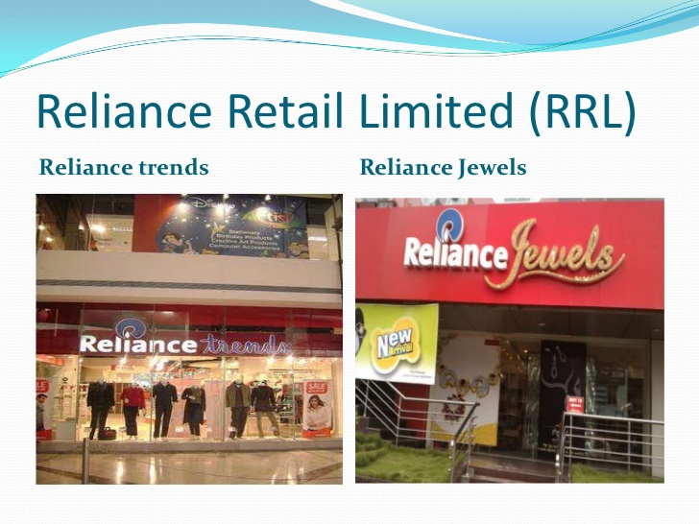

Slide 13

Reliance Petroleum
Reliance Petroleum Limited is a company owned by Reliance Industries Limited (RIL), one of India's largest private sector companies and it was founded in 2008.
Its headquarter is in Ahmedabad, Gujarat, India.
The refinery project is being implemented at a capital cost of
Rs 270,000 million being funded through a mix of equity and debt.
Basically, it produces crude oil and natural gas.
Reliance, BP to jointly set up 2,000 petrol pumps in India.
While Reliance already independently runs 1,343 petrol pumps in India.
Revenue :- ₹440.78 billion (US$6.4 billion)
Net Income :- $ 2.2 billion

Slide 14
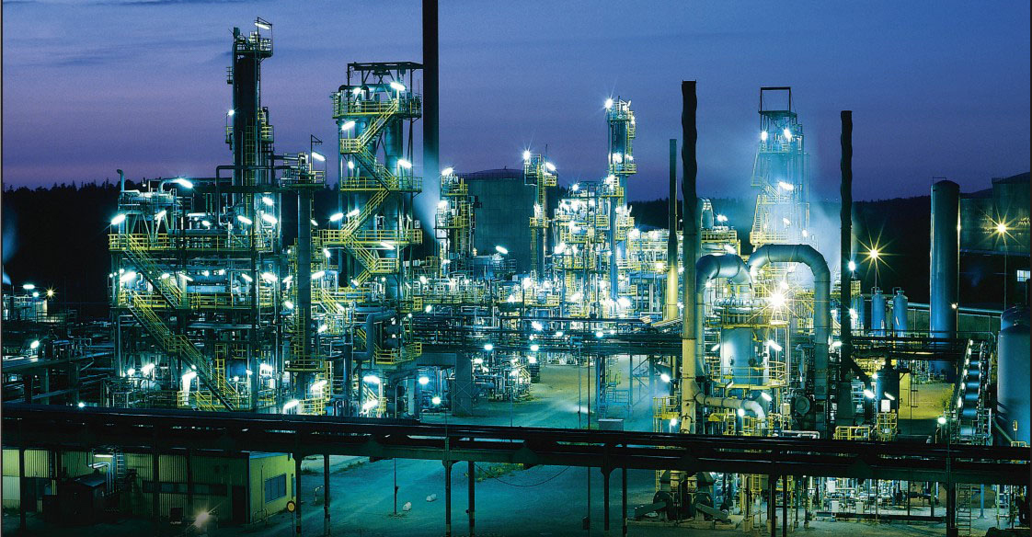
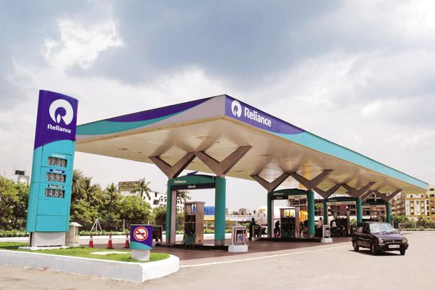
Jamnagar , Gujrata
Petrol Refinery, Jamnagar , Gujrata Reliance Petrol Pump

Slide 15

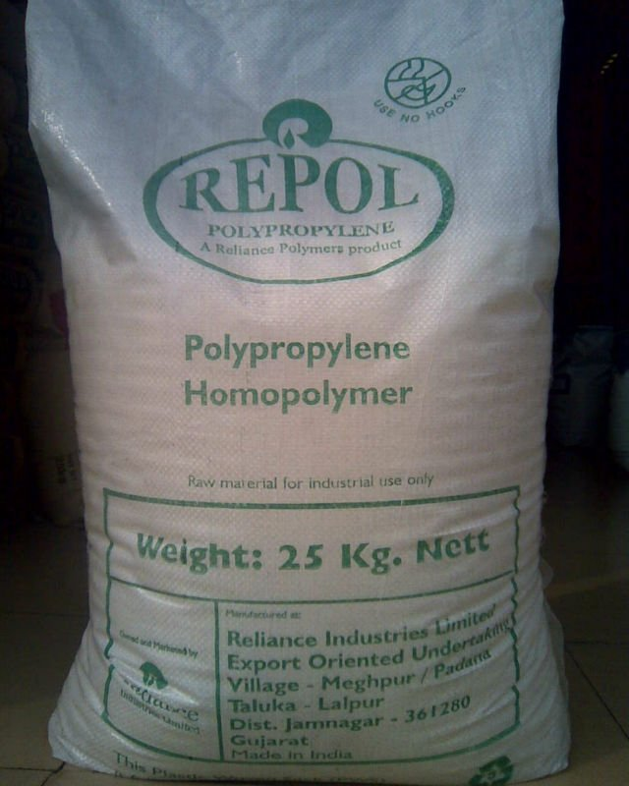
Reliance Petrochemicals Corporation Limited (RPCL)
Indian Petrochemicals Corporation Limited (IPCL) was a petrochemicals company in India. It was established on 22 March 1969, with a view to promote and encourage the use of Plastics in India.
Later it merged with RIL (Reliance Industries Limited) in the year of 2008.
Its business consists of Polymers, synthetic fibre, solvents,industrial chemicals,
catalysts, and polyesters.
Reliance is the largest producer of polyester fibre and yarn in the world.
Products are also exported to more than 60 countries.
It also produce synthetic rubber which is used to manufacture sports good,
footwear, jackets etc.

Slide 16

Reliance Textiles Industry
Textiles was the only theme when the Reliance Industry was founded in 1960’s.
At that time the company was exporting spices to the other countries to get the raw material.
When the company had established “Vimal“ had chosen as the brand name of the textile.
At that time Vimal was most trusted brand of the country and Vimal is still very popular among us.
This was the first retail product from which the Reliance company had came to the market.
Later the other sectors merged with reliance.
One of the largest and most modern textile complexes of reliance industry in the world, is in Naroda houses, Gujarat .

Slide 17
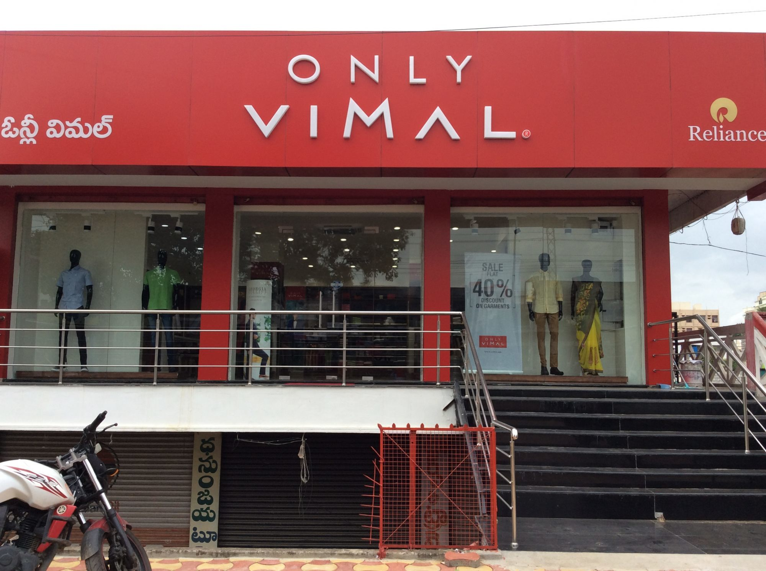
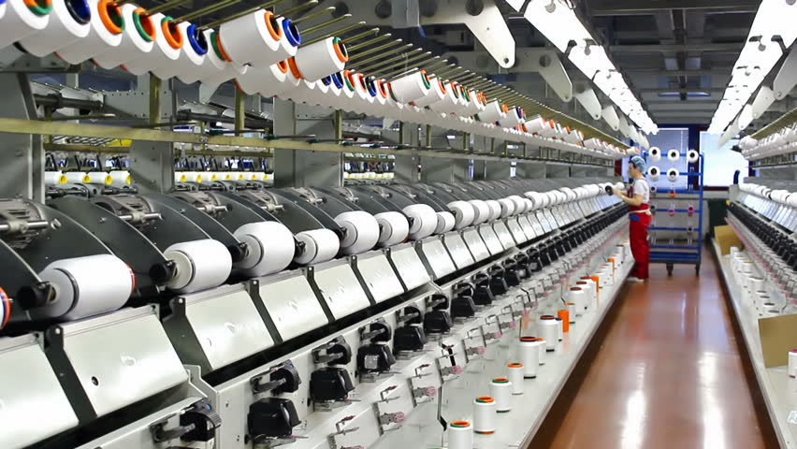
Vimal Showroom Reliance Textiles

Slide 18
The rise of a billionairstrenthen e
He focused on its core business that are reliance petroleum , reliance petrochemical and reliance textiles.
The jio was aleardy founded on 2007 but launched in 2016. Between 2007 to 2016 it was working to strengthen the foundation and invested $34B USD.
Reliance Retail is still in under growth.
He also has debt but he also has incomes from the core business . So , he invest these profits to establish new business.
When the Reliance Industry was split
He is now the richest of India as well as the richest person of Asia with $49.7B USD.

Slide 19
Reason behind it
Good management skills.
Proper strategy to start any business.
Dedication can be seen in meetings.
Sincerity toward the business.
He uses the human resources in efficient manner.
Passionate about business since childhood.
Friendly nature with employees.

Slide 20

Reliance ADA Group (ADAG) Reliance power
Reliance Power Limited (R-Power), is a part of the Reliance Anil Dhirubhai Ambani Group, founded in 17 January 1995.
It was established to develop, construct, operate and maintain power projects in the Indian and international markets.
The company is the sole distributor of electricity to consumers in the suburban area of Mumbai.
It also runs power generation, transmission and distribution businesses in other parts of Maharashtra, Goa and Andhra Pradesh.
R-Power was ranked as the 124th largest corporation in India
with 9th rank in 'Power sector' category.
Revenue:- ₹101.2 billion (US$1.5 billion) (2018)
Net Income :- ₹10.3 billion (US$150 million) (2018)

Slide 21
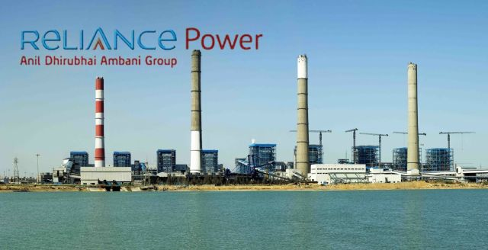
Reliance Power

Slide 22

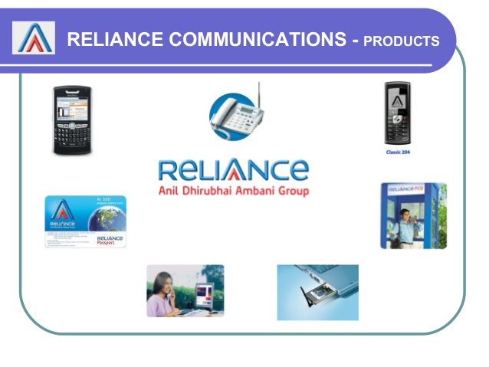
Reliance Communications
Reliance Communications was founded in India on 31 July 2002 as Reliance Infocomm Limited and renamed in 2006.
Its products are Mobile Telephony, Wireless Internet, Digital Television.
Reliance Communications Limited was an Indian mobile network provider headquartered in Navi Mumbai that offered voice and 2G, 3G and 4G data services.
The company ended its CDMA operations in 2016, and migrated its subscribers to its GSM and LTE networks by September the same year.
Reliance and Lenovo introduced their co-branded Android smartphones in
India in 2013.
Revenue:- ₹40.15 billion (US$580 million)
Net Income :- ₹8.67 billion (US$130 million)

Slide 23


Reliance Infrastructure
In April 2008, Reliance Energy Limited had changed its name to Reliance Infrastructure Limited.
Reliance Infrastructure Limited (R-Infra), is an Indian private sector enterprise involved in power generation, infrastructure, construction and defence.
The corporate headquarters is in Navi Mumbai.
In April 2008, Reliance Energy Limited had changed its name to Reliance Infrastructure Limited.
Reliance Infrastructure's interests are in the fields of power plants,
metro rail, airports, bridges, toll roads, and defence.
Revenue:- ₹114.3 billion (US$1.7 billion)
Net Income :-₹16.65 billion (US$240 million)

Slide 24

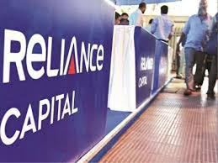
Reliance Capital
Reliance Capital Limited is an Indian diversified financial services holding company promoted by Reliance Anil Dhirubhai Ambani Group .
Reliance Capital Limited was incorporated in 1986 at Ahmedabad in Gujarat as Reliance Capital & Finance Trust Limited.
The name Reliance Capital came into effect on January 5, 1995.
In 2002, Reliance Capital Ltd shifted its registered office to Jamnagar in Gujarat before it finally moved to Mumbai in Maharashtra, in 2006
The company operates across India and has over 20 million customers
and workforce of approximately 15, 595 as of May 1, 2017.
Revenue:- ₹3.3 billion (US$48 million)
Net Income :- ₹0.8 billion (US$12 million)

Slide 25

Reliance Entertainment
Reliance Entertainment Pvt Ltd is a division of the Reliance Anil Dhirubhai Ambani Group handling its media and entertainment business, across content and distribution platforms.
It was founded in February 15, 2005.
Its headquarter is in Maharastra, Mumbai.
The key content initiatives are across movies, music, sports, gaming, Internet & mobile portals, leading to direct opportunities in delivery across the emerging digital distribution platforms: digital cinema, IPTV, DTH and mobile TV.
Reliance Entertainment also has production house for movies.

Slide 26

Reliance Entertainment

Slide 27

Reliance Health
Reliance Health is a company in the Reliance Anil Dhirubhai Ambani Group, headed by the Indian businessman Anil Ambani.
Kokilaben Dhirubhai Ambani Hospital- Mumbai, this is one of the popular hospital in Mumbai.
The hospital is named after the wife of Dhirubhai Ambani, who was the founder of the Reliance group of companies.
Reliance Hospital - Navi Mumbai was inaugurated on 8 July 2018.
This is second hospital opened by Reliance ADAG.
Its headquarter is in Andheri - West, Mumbai

Slide 28
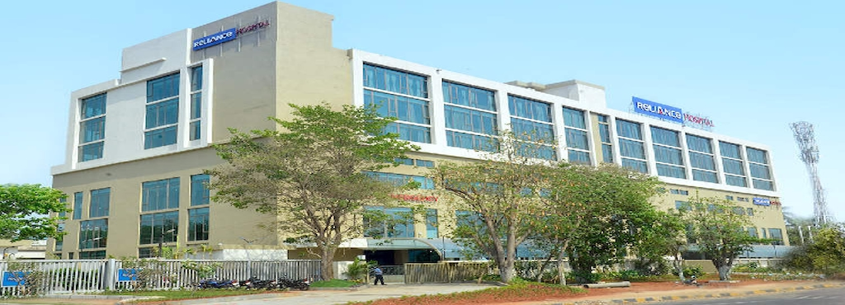
Reliance Hospital

Slide 29
The fall of a Billionaire (from 43B USD to 2B USD )
The Reliance Entertainment was in loss so, to pay the debt Anil Ambani has to sold most of it’s big screens to pay the debt.
In 2017 , the Reliance Entertainment has a loss of 553 cr. and in 2018 the loss was 606 cr.
Once Reliance Communication was 2nd largest company in india in 2007. It was providing the 3G mobile data at 60% cheaper rate than the market. But later it doesn’t updated the company with the changes in technology and also jio with 4G service arrived to the market so ,the company ended in 2017 and it has a debt of Rs 43000 cr.
In 2014 his power and Infra companies has huge debts.
It has to sold it’s assets to pay the debt.
In 2018 , the total debt of ADA Group was Rs 1.7 lakhs cr.
In 2019, the supreme court of India told Anil Ambani to pay the debt of 550 cr. to the Swedish or he will have to face jail.
Recent news is Mukesh Ambani has paid the debt of Rs 453 cr. On the behalf of Anil Ambani.

Slide 30
Reason behind it
Poor management skills
Wrong decision making
Not understanding the market
Ignorance of pre-established business
Lack of technical updation
Establishment of more businesses simultaneously

Slide 31
T
Completed
H
A
N
K
Y
O
U

