Slide 1
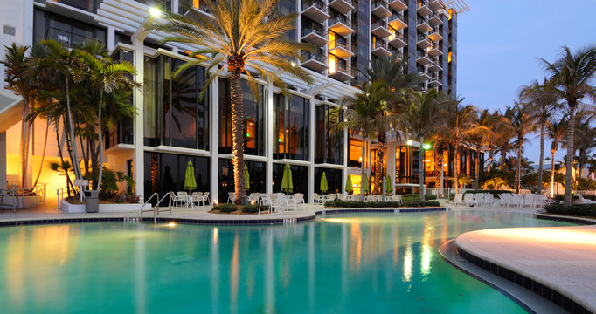

AtliQ Grands’ Hospitality Analysis
By:- Anupam Anand Singh

Slide 2

About AtliQ Grands
AtliQ Grands is a chain of hotels harboring multiple five-star hotels and have been operating in hospitality domain for more than 20 years in the cities of Bangalore, Delhi, Hyderabad and Mumbai

Slide 3

Categories
AtliQ Grand
AtliQ City
AtliQ Exotica
Luxury
AtliQ Palace
Business
AtliQ Blu
AtliQ Seasons
AtliQ Bay
Room Class
Standard
Elite
Premium
Presidential

Slide 4
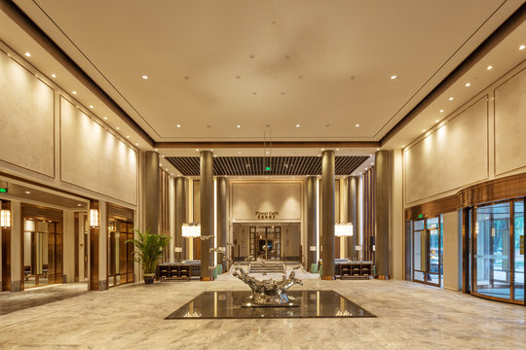
Challenges
Facing a decline in market share and revenue due to strategic moves by competitors and ineffective management decisions, AtliQ Grands is struggling in the luxury/business hotel sector. To counter this, the managing director aims to leverage "Business and Data Intelligence" to reclaim their market position. However, they lack an in-house data analytics team to deliver these crucial insights.
The revenue management team decided to engage a third-party service provider to analyze their historical data and deliver valuable insights.

Slide 5

Objectives
Leverage Business and Data Intelligence solutions to enhance decision-making processes and strategic planning at AtliQ Grands. This initiative aims to identify and capitalize on market opportunities, optimize operational efficiencies, and develop data-driven strategies to regain market share and increase revenue in the luxury and business hotels category across India. By integrating advanced analytics and intelligence tools, AtliQ Grands seeks to improve customer satisfaction, drive competitive advantage, and ensure sustainable growth in a highly competitive hospitality industry.

Slide 6
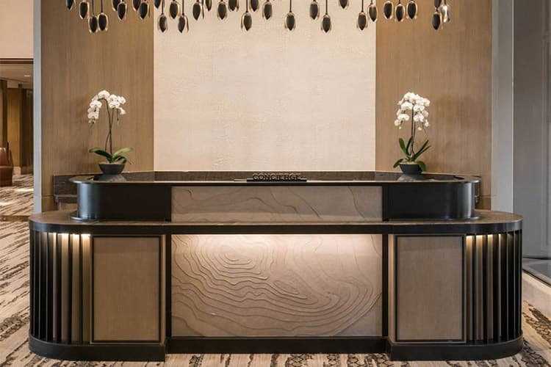
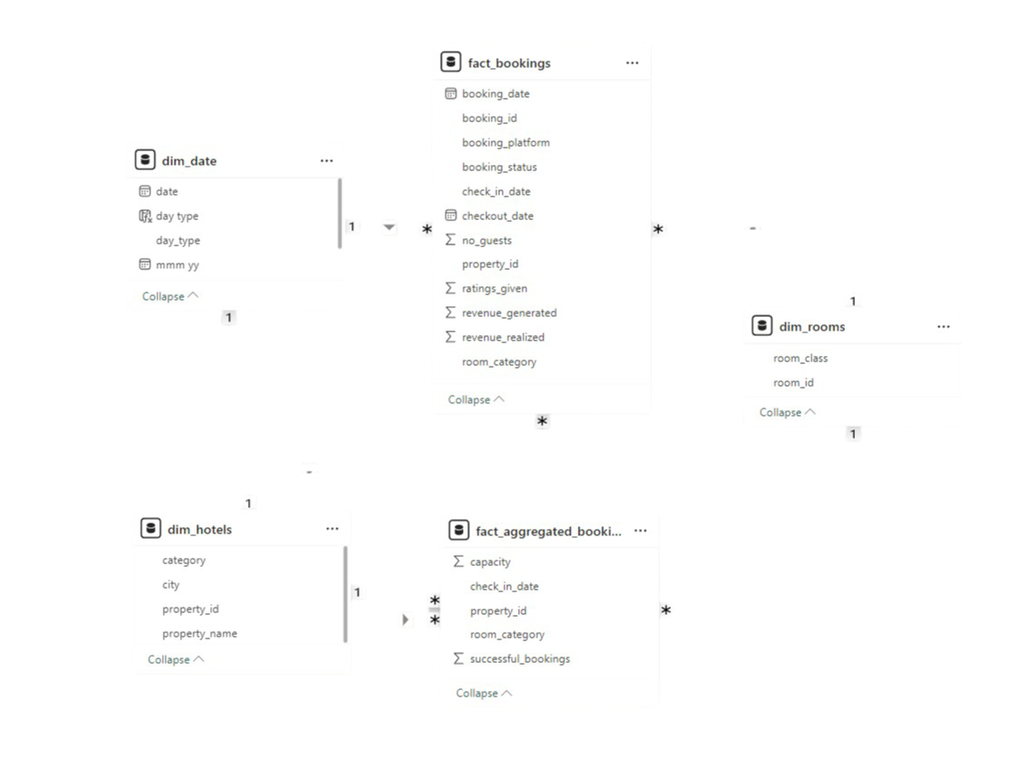
Data Model

Slide 7

ADR(Average Daily Rate): Average revenue per room sold during a specific time frame.
DBRN(Daily Booking Room Nights): Average daily room bookings over a specific time period.
DSRN(Daily Sellable Room Nights): Average daily room availability over a specific time period.
DURN(Daily Utilized Room nights): Average daily successful room utilization over a specific time period
RevPAR(Revenue Per Available Room): Indicates the revenue generated per available room, regardless of whether or not they are occupied.
PDC/LDC(Profit/Loss Due to Cancellation): Measures the financial impact of booking cancellations, indicating profit gained or loss incurred.
Realisation %: Percentage of successful check-outs compared to total bookings.
Occupancy %: The ratio of total successful bookings to total available rooms.
Domain KPIs

Slide 8
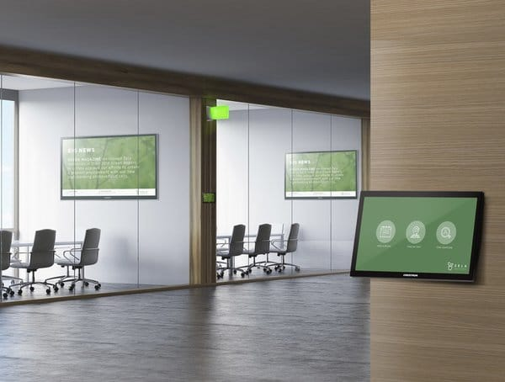
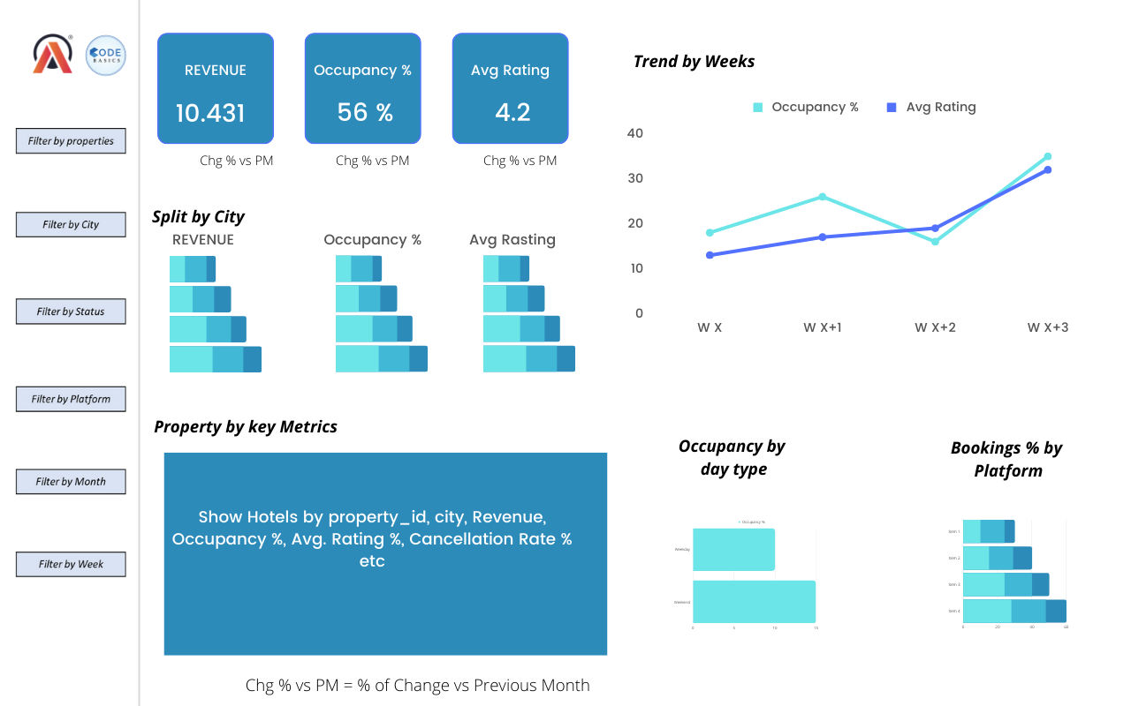
Mockup Dashboard

Slide 9


Slide 10
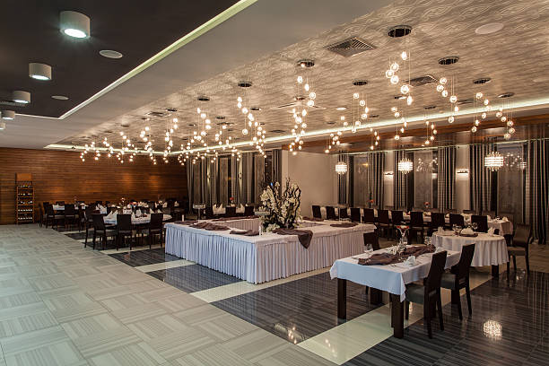
Insights
Revenue Performance:
Mumbai stands as the best performer in regards to revenue generation grossing $660.04M followed by Bangalore with $415.03M, Hyderabad with $321.17M and Delhi with $290.2M.
The group raked in a total revenue of $1.69 billion, with the luxury segment shining at 61.62% and the business segment bolstering 38.82%.
Overall Occupancy Rate:
The group's properties saw the highest occupancy rate of 60.44% in Delhi, while Bangalore recorded the lowest at 55.68%.
Property Performance:
AtliQ Exotica emerged as the top performer, generating $316M in revenue, boasting an average rating of 3.62, and maintaining a cancellation rate of 24.39%.
Weekend Highlights:
Weekend occupancy peaked at 62.64%, surpassing weekday rates by 7%, and featured a lower Profit/Loss due to cancellation (PDC/LDC).
Monthly Overview:
The month of May dazzled with the highest revenue at $581.93M, closely trailed by June at $553.93M and July at $551.90M.
Room Class Insights:
The Elite room class soared to the top with a revenue of $553.74M and an occupancy rate of 55.75%, whereas the Standard room class trailed with a revenue of $305.64M and an occupancy rate of 57.78%.

Slide 11
Insights
Booking Platform Performance Overview:
Customers flocked to Other sources for bookings, totaling 54.36K (Avg. 19K bookings per month), while direct offline bookings lagged behind with 6.67K total bookings (Avg. 2.2K bookings per month).
Overall Performance Analysis:
Revenue: $1.69 billion
Occupancy Rate: 57.79%
Cancellation Rate: 24.8%
Average Rating: 3.62
Profit/Loss due to Cancellation: $295.23M

Slide 12

Recommendations
Enhancing Customer Satisfaction Ratings
Thorough attention to improving service quality, food taste and quality, and hygiene standards.
Offering supplementary amenities such as airport and in-city transportation options enhances the customer journey, resulting in heightened satisfaction, increased bookings, revenue, and improved overall ratings.
Optimize pricing strategies through dynamic adjustments.
Enhance revenue potential by introducing dynamic pricing strategies across all properties and platforms, ensuring optimal rates reflect varying demand patterns, including weekdays and weekends
Provide seasonal and festive promotions to enhance customer engagement and satisfaction, offering special discounts during peak periods to enrich their experience and drive sales.
Managing Cancellation Challenges:
Despite securing the second-highest number of bookings, MakeyourTrip also holds the record for the highest cancellation rate at 25.03%.
Management should investigate the factors contributing to the elevated cancellation rates for deeper insights and potential improvements.
Enhancing Occupancy Rates:
At 57.79% overall occupancy, there's room to elevate the performance.
The Management should implement pricing strategies in properties and room classes with low occupancy rates to attract more guests.
By adopting the above recommendations, AtliQ Grands can anticipate a surge in customer satisfaction, occupancy rates, and bookings, consequently boosting revenue.

Slide 13
