Slide 1
Air Quality Data Analysis
Hourly Readings Across 6 Cities, 2024 | PRG-330 Final Project
Team: Aishmita · Aaska · Anupam
1

Slide 2
Our Storyline
▸ The Problem -- why air quality, and what we set out to answer
▸ The Dataset -- 52,704 hourly readings, 6 cities, one full year
▸ Module 1-5 -- building the Python foundation by hand: variables, operators, loops, functions, file I/O
▸ Module 6-7 -- scaling up with Pandas, NumPy, and Matplotlib to analyze the full dataset
▸ Module 8 -- the findings, what decided each conclusion, and the bottom line
▸ Team Contribution -- how the work was split
2

Slide 3
The Story: Why Air Quality?
MODULE 0
Air pollution is one of the largest environmental health risks worldwide — and the risk is not the same everywhere. It changes by city, by season, and by which pollutant is driving it.
▸ We had a full year of real hourly data for 6 cities — enough to actually answer, with evidence, questions that usually get answered with guesses.
▸ So before writing a single line of code, we asked: which city is really the worst? Is pollution predictable by season, or driven by one-off events? Which pollutant matters most?
▸ And partway through, the data itself raised a problem we had to solve: one full column (CO2) was missing 81.7% of the time. We had to find out why before we could trust any conclusion built on it.
3

Slide 4
Problem Identification
MODULE 0
Four concrete questions this project answers:
1
Which cities have the worst and best air quality — and by how much?
2
Does air quality change predictably across the year, and when is it worst?
3
Are the worst pollution hours spread evenly across the year, or concentrated in specific events?
4
Which pollutants are the strongest drivers of the overall Air Quality Index (AQI)?
+ a data-quality problem: the CO2 column is missing 81.7% of all rows. Why — and what do we honestly do about it?
4

Slide 5
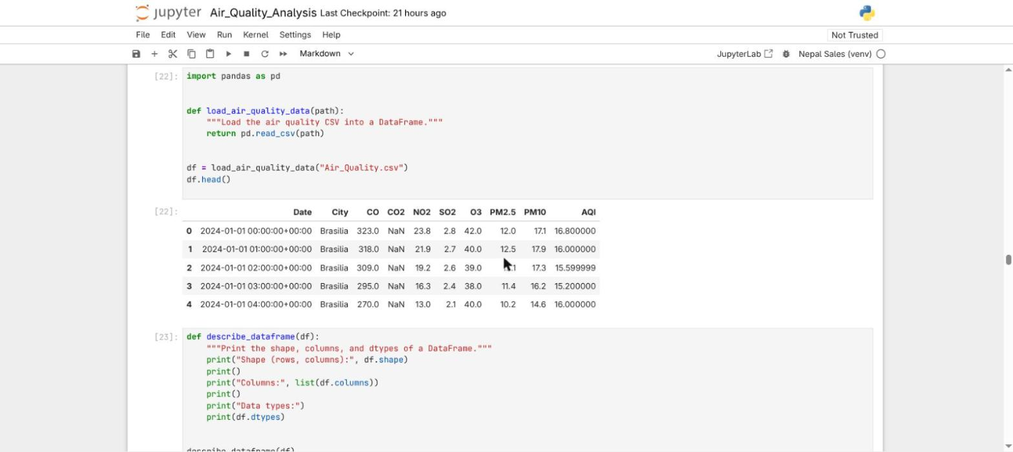
The Dataset
MODULE 0
▸ 52,704 hourly readings
– 366 days x 24 hours x 6 cities (2024 is a leap year)
▸ 6 cities, 6 continents
– Brasilia, Cairo, Dubai, London, New York, Sydney
▸ 10 columns
– Date, City, 7 pollutants, and AQI
Column | What it is | Unit
CO | Carbon Monoxide | ppb
CO2 | Carbon Dioxide (from 26 Oct 2024 only) | ppm
NO2 / SO2 / O3 | Nitrogen Dioxide / Sulfur Dioxide / Ozone | ppb
PM2.5 / PM10 | Fine / coarse particulate matter | ug/m3
AQI | Overall Air Quality Index | 0-500 index
Real screenshot: df.head() in our Jupyter notebook (Module 6)
AQI is the column every question in this project comes back to -- the single number that summarizes all seven pollutant readings into one comparable score per hour, which is why city, month, and pollutant comparisons all use it as the common yardstick.
5

Slide 6
Objective
MODULE 0
Find out which city has the worst air quality, why, and what's driving it — using a full year of real hourly data across six cities.
▸ Rank the six cities by air quality and measure how big the gap actually is
▸ Check whether pollution follows a predictable pattern across the year
▸ Find out whether the dataset's worst hours are a trend or a one-off event
▸ Identify which pollutants most strongly drive the overall AQI
▸ Decide, honestly, what to do with a pollutant column (CO2) that's mostly missing
6

Slide 7
MODULE 1
Variables and Data Types
Pulling one real observation apart, by hand
7

Slide 8
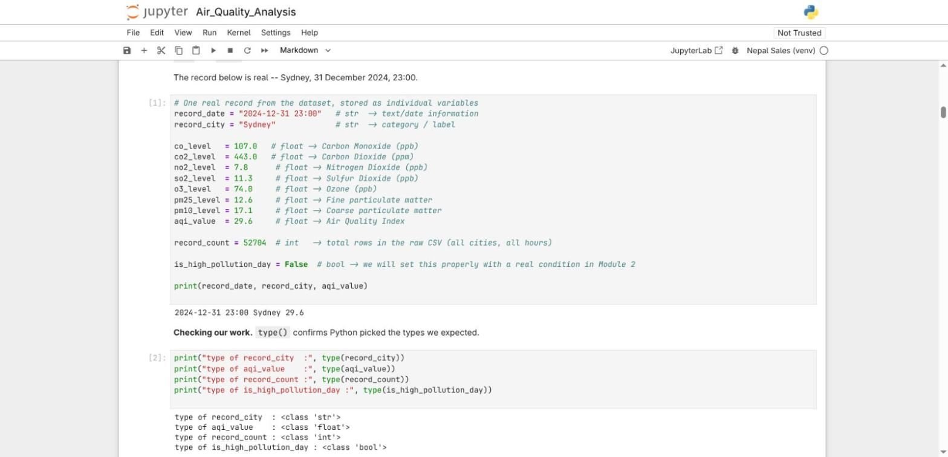
Module 1 -- Variables & Data Types
MODULE 1
▸ Every pollutant reading is stored as its own named variable, then checked with type() -- real screenshot from our Jupyter notebook.
8

Slide 9
MODULE 2
Operators & Conditional Statements
Arithmetic, comparison, logical operators, and a hand-written AQI classifier
9

Slide 10
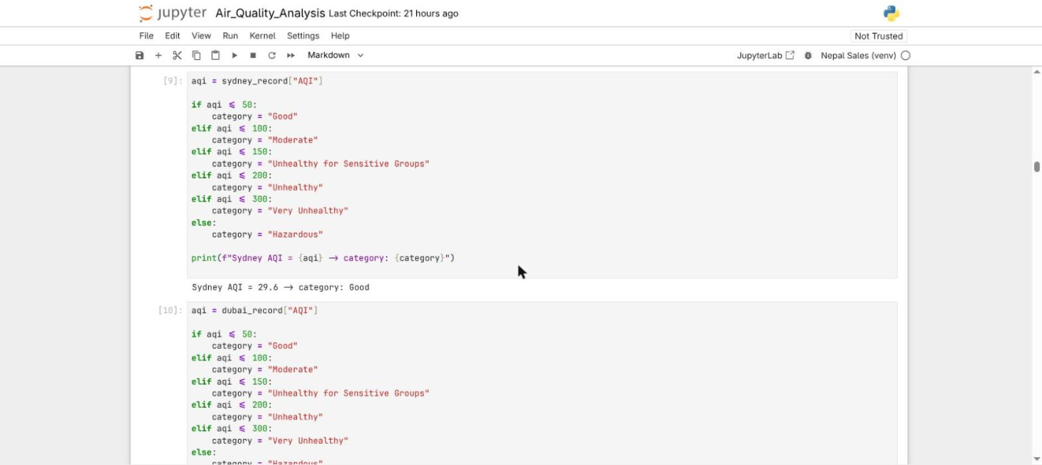
Module 2 -- AQI Classification
MODULE 2
▸ Classifying AQI by hand with an if / elif / else chain using the actual EPA breakpoints -- both Sydney and Dubai run through the same logic.
10

Slide 11
MODULE 3
Loops
for, conditional for, and while — over 12 real records
11

Slide 12
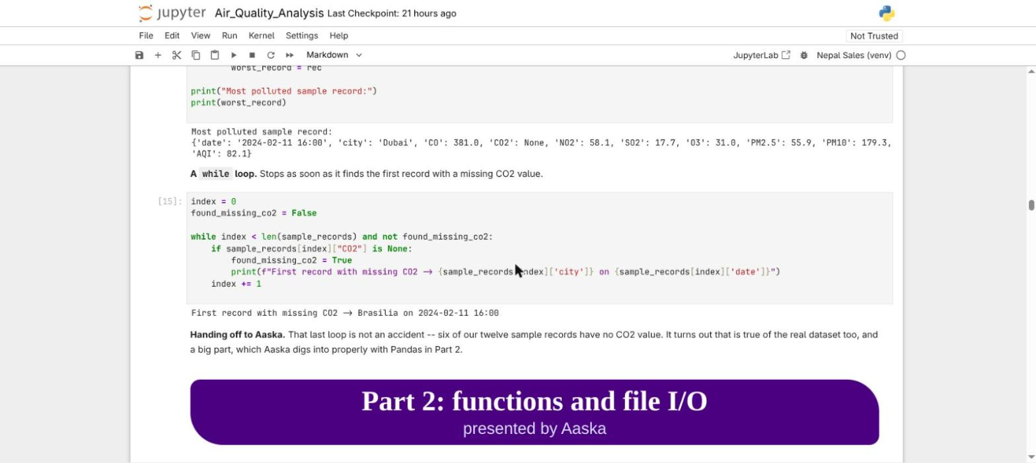
Module 3 -- The while Loop
MODULE 3
▸ A while loop stops the instant it finds what it's looking for -- the first sign of the CO2 gap we investigate properly in Module 6.
12

Slide 13
MODULE 4
Functions
Wrapping Module 2 & 3's logic into reusable building blocks
13

Slide 14
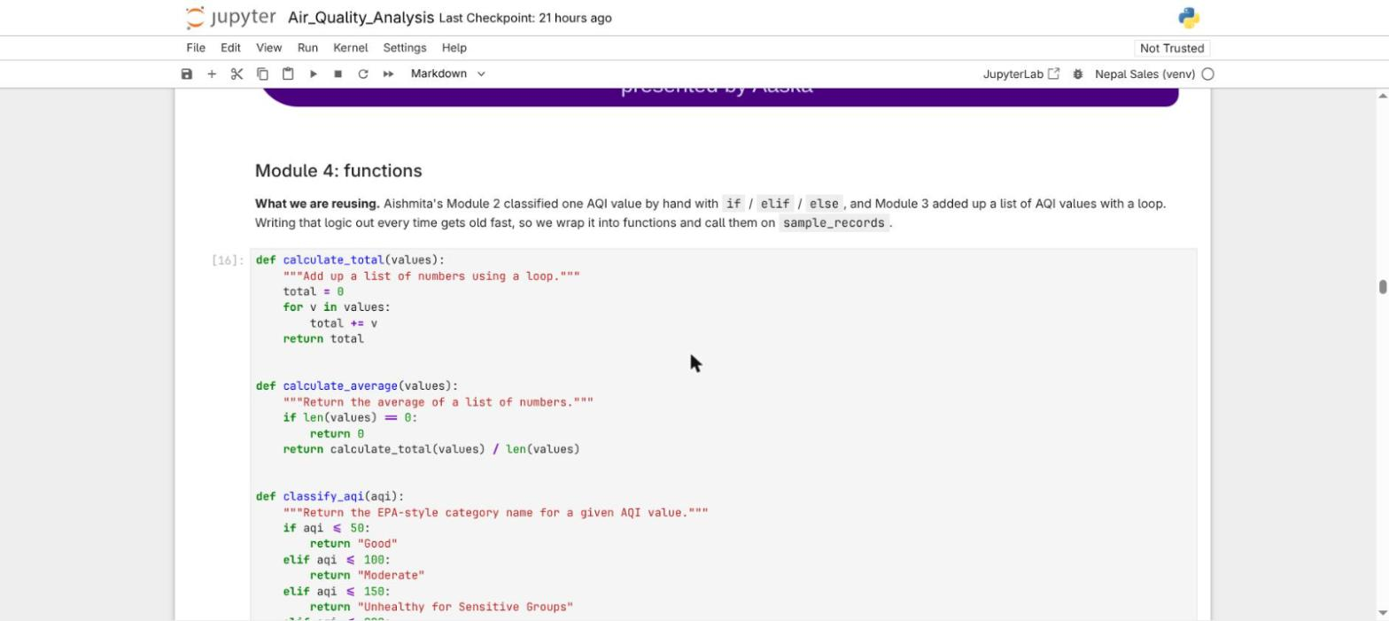
Module 4 -- Reusable Functions
MODULE 4
▸ Four functions replace logic that was previously written out by hand: calculate_total, calculate_average, classify_aqi, and is_high_pollution.
14

Slide 15
MODULE 5
File I/O
Reading the real 52,704-row CSV directly with open()
15

Slide 16
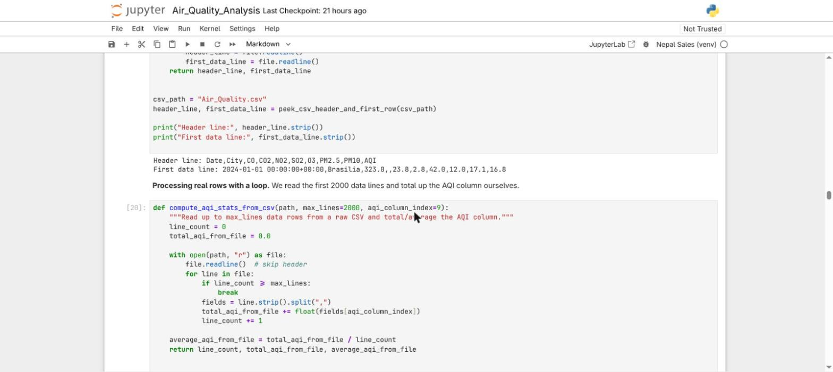
Module 5 -- Reading the Raw CSV
MODULE 5
▸ No Pandas yet -- open(), readline(), and a loop with break read rows directly from the file and total the AQI column by hand.
16

Slide 17
MODULE 6
Pandas + NumPy Analysis
Scaling up to the full dataset — and the CO2 investigation
17

Slide 18
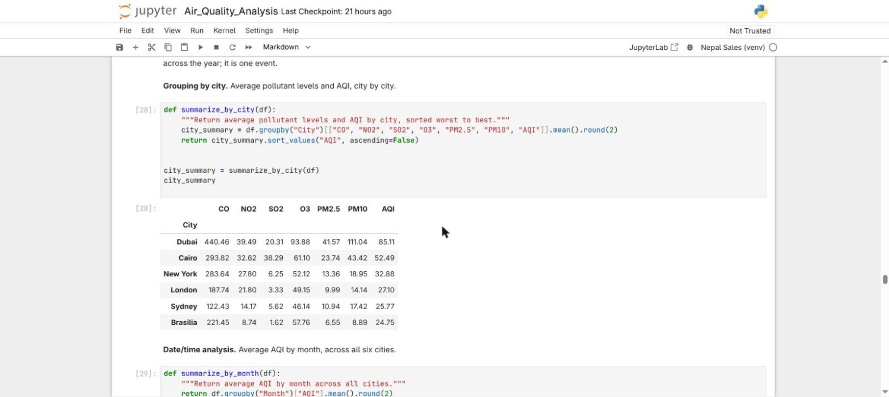
Module 6 -- The City Ranking
MODULE 6
▸ One groupby call ranks all six cities by average pollutant levels and AQI -- Dubai worst, Brasilia best becomes the project's #1 finding.
18

Slide 19
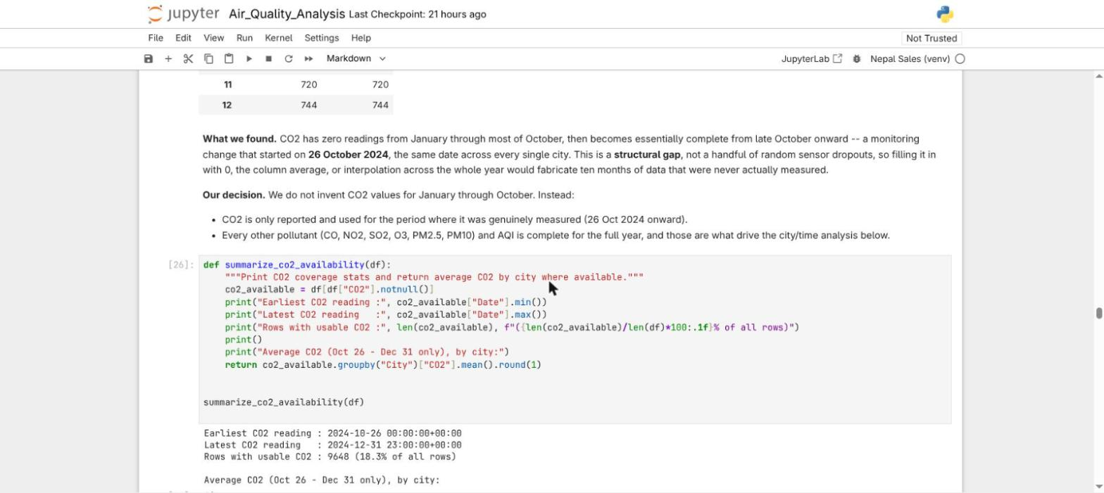
Module 6 -- The CO2 Investigation
MODULE 6
▸ 81.7% of CO2 readings are missing -- but a month-by-month breakdown shows a hard cutoff at 26 Oct 2024 across every city, not random noise.
19

Slide 20
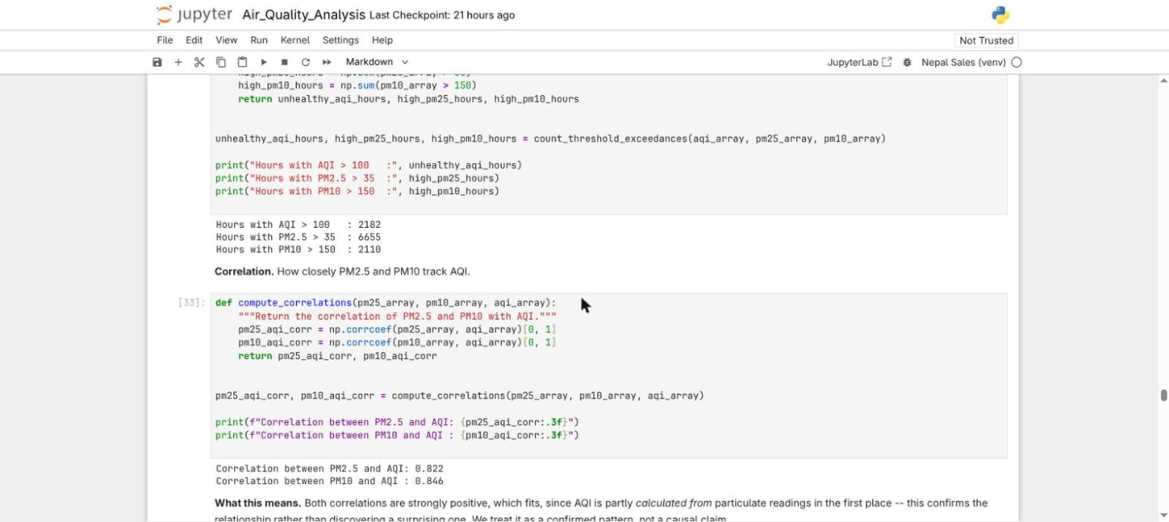
Module 6 -- NumPy Correlations
MODULE 6
▸ Switching to NumPy: pollutant columns become arrays, and np.corrcoef() measures how closely PM2.5 and PM10 track AQI -- both clear 0.7.
20

Slide 21
MODULE 7
Matplotlib Visualization
Four charts, each answering one question
21

Slide 22
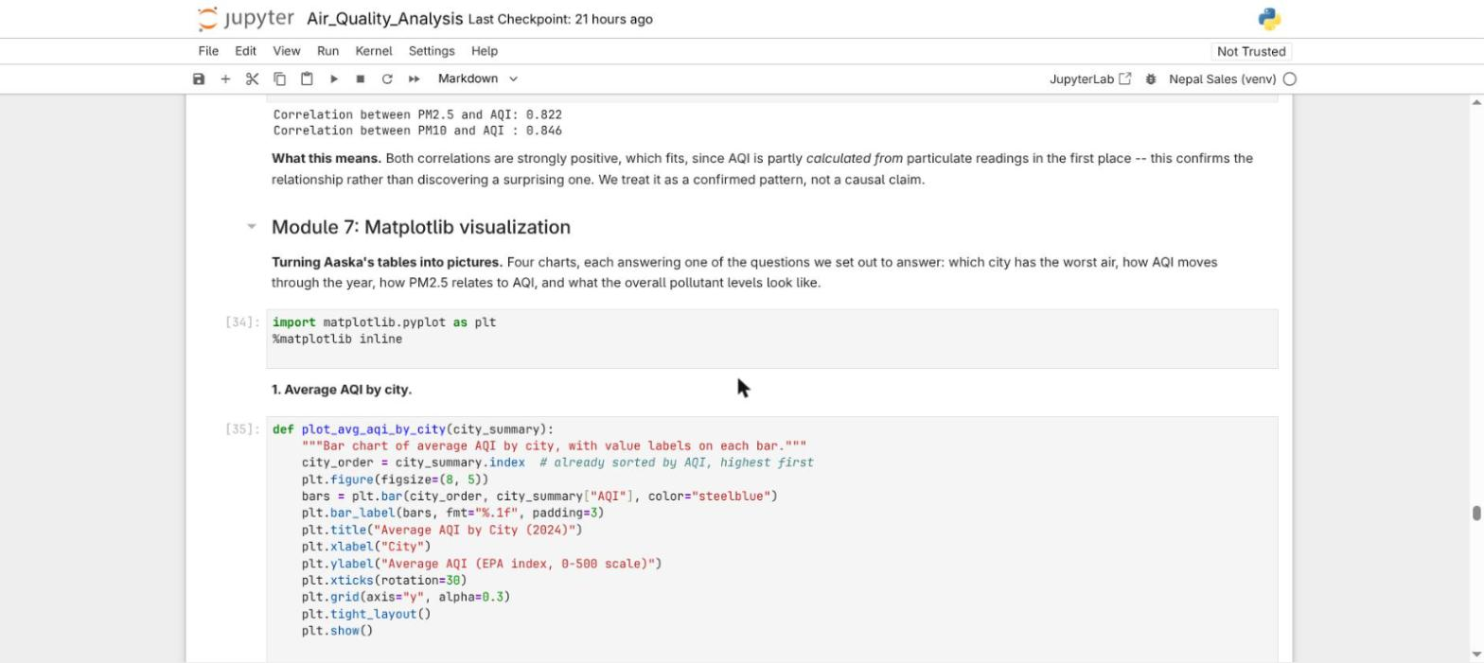
Module 7 -- Chart Code Example
MODULE 7
▸ Every chart follows the same pattern: build it, label every axis with units, add gridlines and data labels, then plt.show().
22

Slide 23
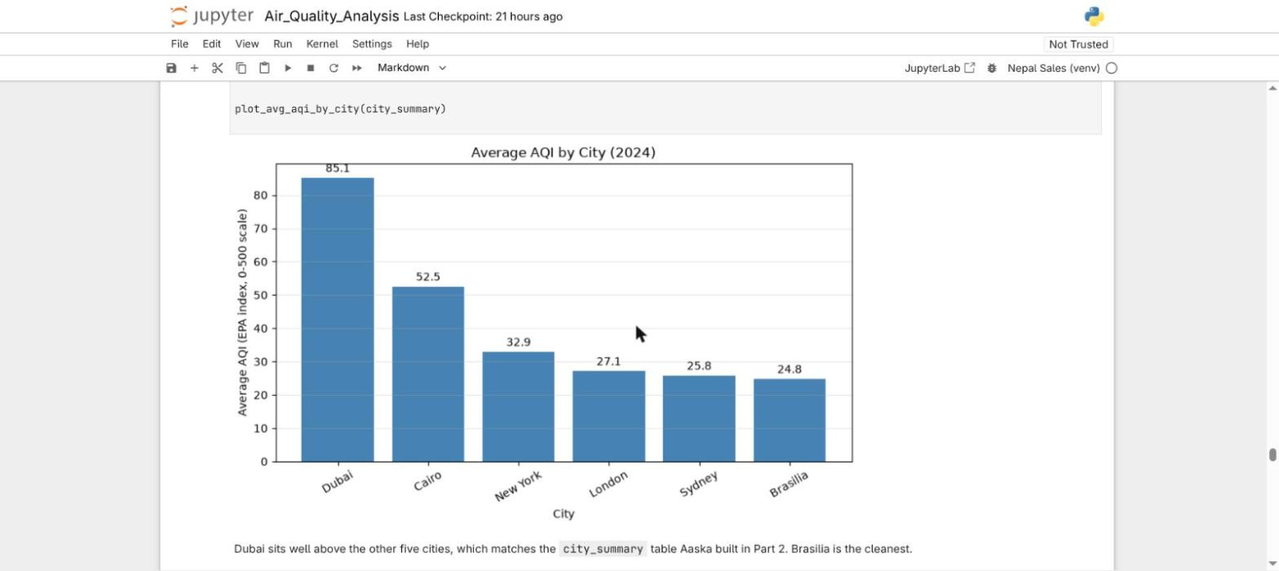
Module 7 -- Average AQI by City
MODULE 7
▸ Dubai sits well above the other five cities, matching the city_summary table from Module 6.
23

Slide 24
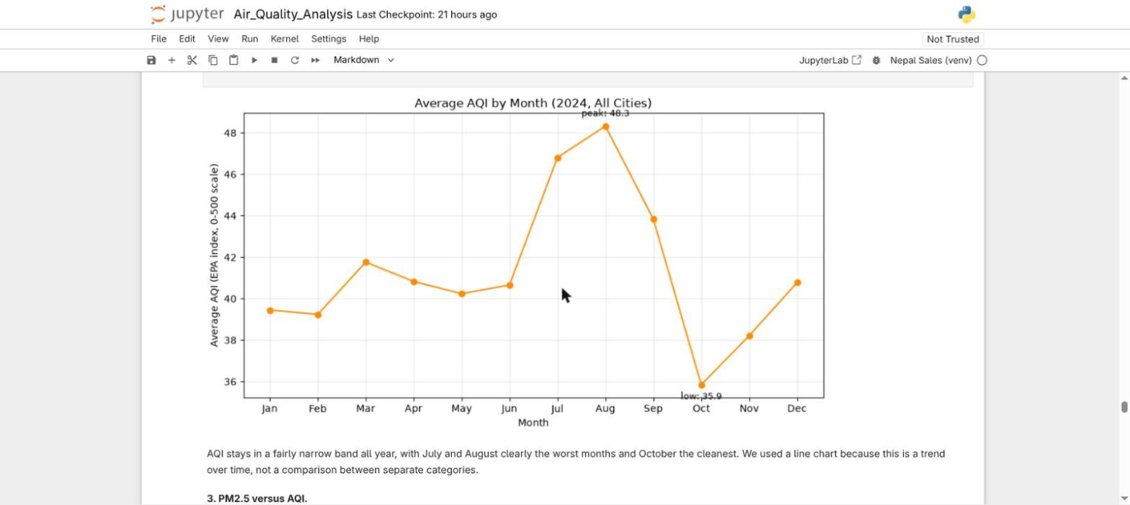
Module 7 -- Average AQI by Month
MODULE 7
▸ AQI stays in a fairly narrow band all year, with July/August the worst months and October the cleanest.
24

Slide 25
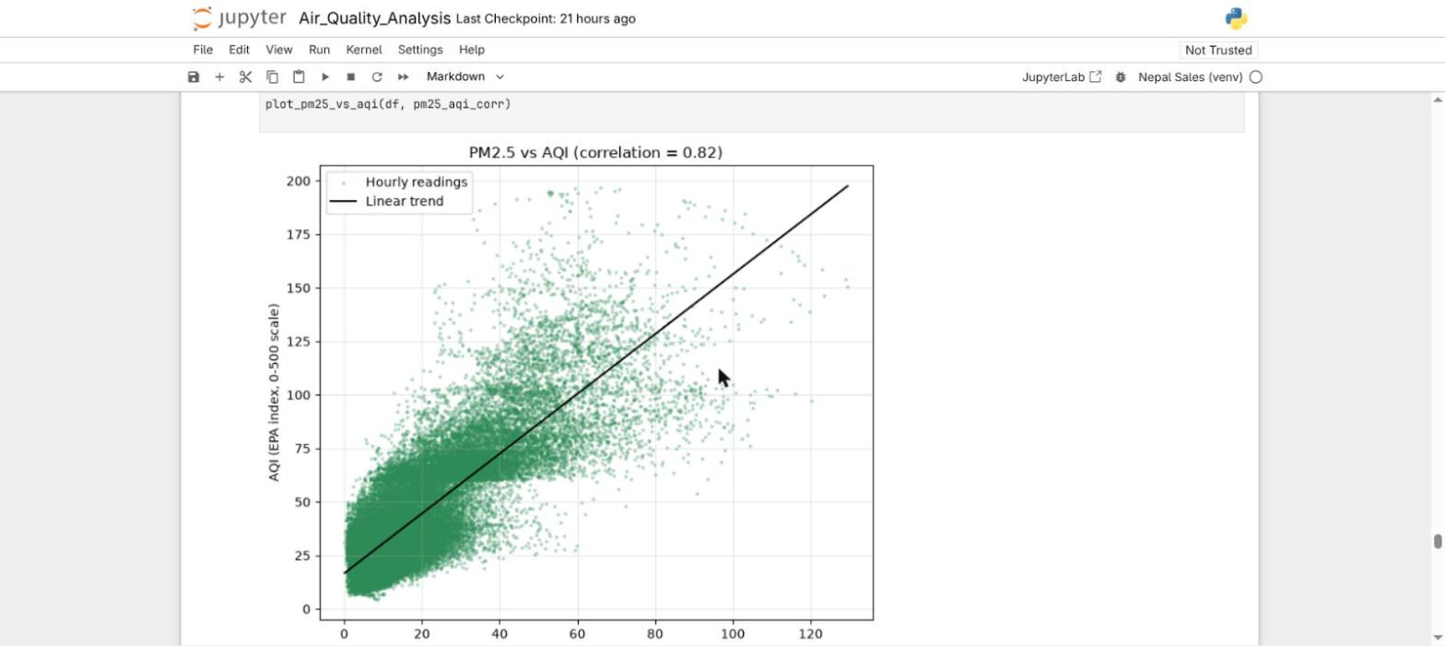
Module 7 -- PM2.5 vs AQI
MODULE 7
▸ The upward pattern backs up the 0.82 correlation calculated with NumPy in Module 6.
25

Slide 26
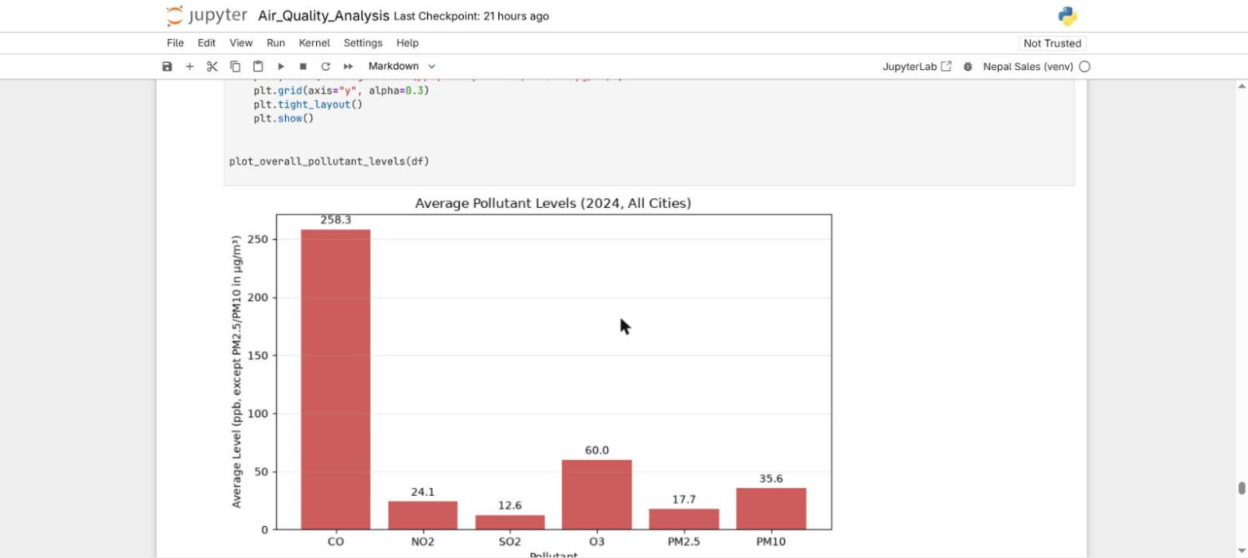
Module 7 -- Average Pollutant Levels
MODULE 7
▸ CO sits on a different scale from the rest -- a unit difference, not 10x more presence in the air.
26

Slide 27
MODULE 8
Conclusion
Findings, deciding factors, and the bottom line
27

Slide 28
Module 8 -- Major Findings (1-3)
MODULE 8
▸ 1. Dubai has by far the worst air quality, Brasilia the best.
– AQI 85.1 (Dubai) vs 24.7 (Brasilia) — a ~60-point gap from city_summary.
– Deciding factor: that gap dwarfs normal year-to-year variation.
▸ 2. AQI stays fairly steady across the year, worst in Jul/Aug.
– 36-48 range all year; peaks Aug (48.3), dips Oct (35.9) — a 12-point swing.
– Deciding factor: a fifth the size of the city-level gap — city matters more than month.
▸ 3. One event drives almost all "Unhealthy" hours.
– 2,182 of 52,704 hours (4.1%) exceed AQI 100; all top-10 worst hours: Dubai, 18 Aug 2024.
– Deciding factor: same city AND same date — a single event, not a seasonal trend.
28

Slide 29
Module 8 -- Major Findings (4-6)
MODULE 8
▸ 4. Particulate matter is strongly linked to AQI.
– PM2.5: r = 0.82, PM10: r = 0.85 — both clear the 0.7 "strong correlation" bar.
– Deciding factor: consistent with AQI being partly calculated from particulate readings.
▸ 5. The missing CO2 data is a monitoring gap, not random noise.
– 81.7% missing; monitoring started 26 Oct 2024, identically across all six cities.
– Deciding factor: a hard cutoff at one date is a reporting start date, not sensor drift.
▸ 6. Even inside the CO2 window, city rankings looked different.
– New York highest avg CO2 (~488 ppm), Sydney lowest (~443 ppm) — not the AQI order.
– Deciding factor: a pollutant that ranks cities differently can't stand in for overall AQI.
29

Slide 30
Conclusion Analysis -- What Actually Decided It
MODULE 8
Rank | Deciding Factor | Why It Outweighed the Alternatives
1 | City (~60-pt AQI gap) | Largest source of variation — 4x the month-to-month swing.
2 | A single event (Dubai, 18 Aug) | All 10 worst hours share one city AND one date — not seasonal.
3 | Particulate correlation (r = 0.82 / 0.85) | Both clear the "strong correlation" bar; PM10 edges out PM2.5.
4 | Seasonality (12-pt swing) | Real, but only ~1/5 the size of the city-level gap — secondary.
This ranking is also why CO2 never entered the table: the data couldn't support including it honestly across the full year, so we under-used a column rather than let ten months of invented values bias the rankings above it.
30

Slide 31
Final Conclusion
Dubai has the worst air quality of the six cities studied (AQI 85.1), Brasilia the best (24.7) — a gap big enough that which city you're in matters more than what month it is. Pollution peaks in July/August and dips in October, but that swing is smaller than the gap between cities. Almost all the year's worst hours trace to a single event in Dubai on 18 August 2024, not a general trend. Particulate matter (PM2.5, PM10) is the strongest driver of AQI (r = 0.82 / 0.85). And 81.7% of CO2 readings are missing because monitoring only started in late October — reported honestly rather than guessed at.
Bottom line: air quality here is driven far more by WHERE you are than WHEN — and the single worst event we found was a one-off spike in Dubai, not a seasonal pattern.
31

Slide 32
Team Contribution
All three of us contributed an equal, one-third share — each owning a complete stage of the workflow end-to-end.
Member | Modules Owned | What They Built | Cells
Aishmita | Modules 1-3 | Python foundation: variables, operators, conditionals, all 3 loop patterns | 33
Aaska | Modules 4-6 (Pandas) | Functions, file I/O, full Pandas load + missing-value / CO2 investigation | 32
Anupam | Module 0, 6 (NumPy), 7, 8 | Problem framing, NumPy analysis, all charts, findings & conclusion | 33
Each of us wrote exactly 18 markdown explanation cells — equal written analysis as well as equal code. Anupam's modules have the fewest code cells, but bookend the whole notebook with Module 0 (framing every question) and Module 8 (answering all of them). Everyone read through and re-ran the full notebook together before submission.
32

Slide 33
Thank You
Questions?
Air Quality Data Analysis -- Aishmita · Aaska · Anupam
33

