Slide 1
REPORT
IoT Based Soil Moisture Monitoring System Using NodeMCU(ESP32), Work WI and Adafruit IO Cloud
By: Anupam Yadav
Roll no: 5638

Slide 2
Abstract
The MQTT-based soil moisture monitoring system is an Internet of Things (IoT) solution designed to monitor soil moisture levels remotely using the ESP32 microcontroller and a soil moisture sensor. The ESP32 reads analog moisture values and transmits the data to the Adafruit IO cloud platform using the MQTT protocol over Wi-Fi. The system also provides local indication through an LED when soil becomes dry. This project enables real-time monitoring, remote accessibility, and efficient irrigation management. It demonstrates low-cost smart agriculture using IoT technologies.

Slide 3
Introduction
The Internet of Things (IoT) enables physical devices to collect and exchange data over the internet. Cloud platforms play an important role in IoT systems by storing, analyzing, and visualizing data in real time.
In this project, an ESP32 microcontroller is used to collect soil moisture data from a analog sensor and send it to Adafruit IO Cloud using the MQTT protocol. The data is visualized using real-time time-series charts on the cloud dashboard. An LED is indication when the soil becomes dry.
Objectives
To interface a soil moisture sensor with ESP32
To connect ESP32 to WiFi
To send sensor data to Adafruit IO using MQTT
To indicate dry soil condition using an LED
To monitor real-time soil data remotely

Slide 4
About ThingsBoard Cloud
ThingsBoard Cloud is an open-source IoT cloud platform that allows:
Device management
Real-time data visualization
Telemetry storage
Dashboard creation
Rule engine and alarm system
MQTT/HTTP protocol support
In this project, ThingsBoard Cloud is used to:
Register the ESP32 as a device
Generate an Access Token
Receive telemetry data (temperature & humidity)
Display data using time-series charts
Store historical data
The device sends data using:
MQTT Broker: mqtt.thingsboard.cloud Port: 1883 Topic: v1/devices/me/telemetry Authentication: Access Token

Slide 5
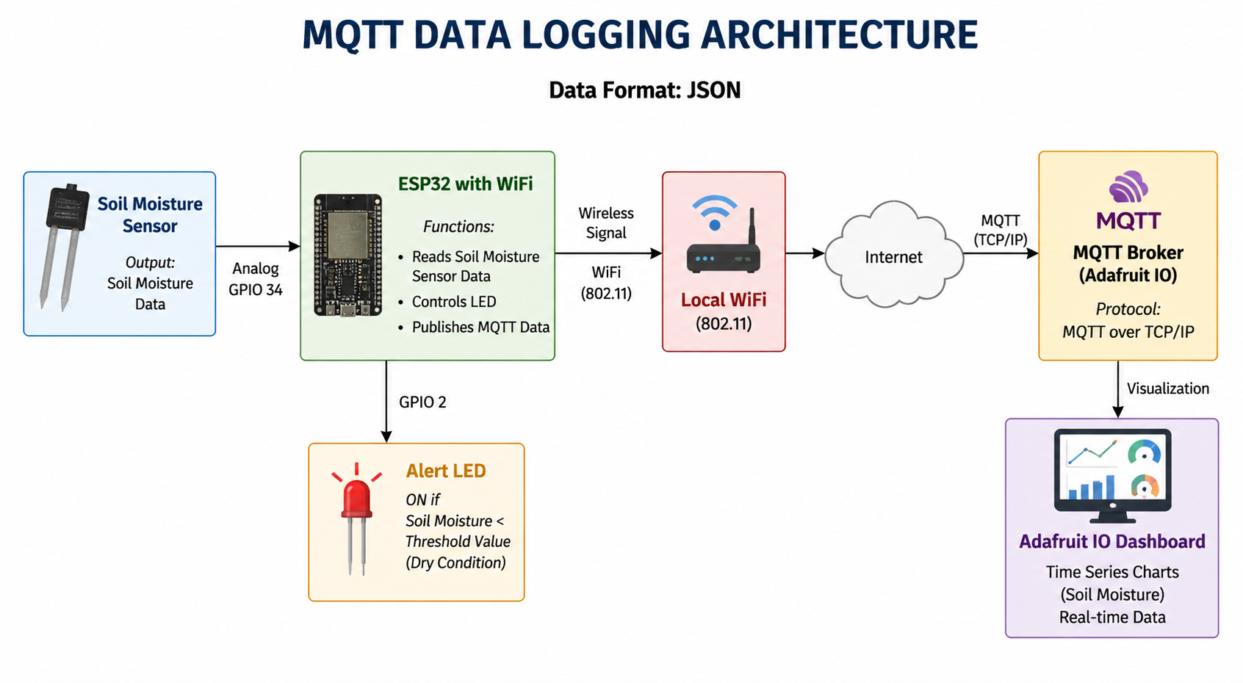
System Architecture
The system consists of three main layers:
Device Layer – Soil Moisture Sensor + ESP32
Communication Layer – WiFi + MQTT + TCP/IP
Cloud Layer – Adafruit IO Cloud Dashboard
Architecture Flow:
Soil Moisture Sensor → ESP32 → WiFi → Internet → Adafruit IO → Dashboard

Slide 6
Working of the System
The soil moisture sensor detects the moisture level present in the soil.
ESP32 reads the sensor data through the analog input pin.
The measured value is converted into JSON format for data transmission.
ESP32 connects to the local WiFi network.
Sensor data is published to Adafruit IO cloud using MQTT protocol.
Adafruit IO receives, stores, and processes the real-time data.
The dashboard displays live soil moisture values, and LED turns ON when soil becomes dry.
Components Used:
Components | Description
ESP32 | WiFi-enabled microcontroller
Soil Moisture Sensor | Measures moisture level in soil
LED | Output indicator
220Ω Resistor | Current limiting
Wokwi | Simulation environment
Adafruit IO Cloud | Stores sensor data and displays dashboard
USB Cable | Powers ESP32 and uploads code
Potentiometer | Used to simulate soil moisture sensor input by varying analog values

Slide 7
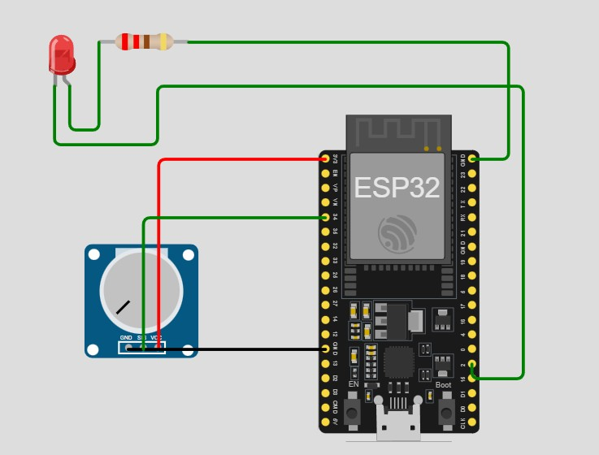
Circuit Design Explanation
Soil Moisture Sensor → ESP32
VCC → 3.3V
GND → GND
AO → GPIO 34
LED → ESP32
Anode (+) → GPIO 2
Cathode (–) → GND (via resistor)
Power
ESP32 powered via USB

Slide 8
Algorithm for MQTT Data Logging System :
Start the system.
Initialize ESP32, serial monitor, LED pin, and analog input pin.
Connect ESP32 to the WiFi network using SSID and password.
Establish connection with Adafruit IO MQTT broker using username and key.
Read analog value from potentiometer / soil moisture sensor.
Display the sensor value on the serial monitor.
Compare the sensor value with predefined threshold.
If value is greater than threshold, turn ON LED to indicate dry condition.
Otherwise, turn OFF LED to indicate normal moisture condition.
Convert the sensor value into string or JSON format.
Publish the data to Adafruit IO MQTT feed.
Dashboard receives and displays real-time data in graphs and gauges.
Wait for 10 seconds.
Repeat steps 5 to 13 continuously.
Stop only when power is disconnected.

Slide 9
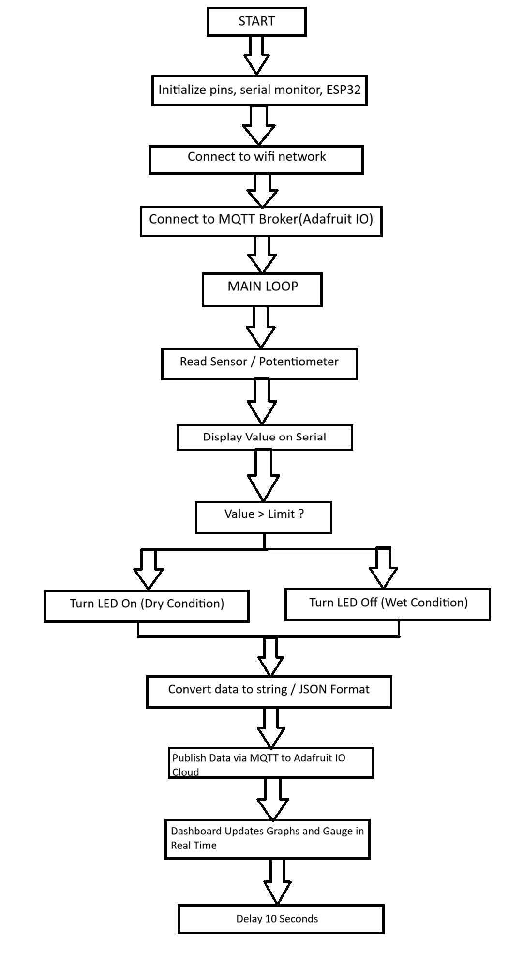
Flowchart for MQTT Data Logging System :

Slide 10
Code:
#include <WiFi.h> // WiFi library for ESP32 connectivity
#include <PubSubClient.h> // MQTT client library
// ---------------- WIFI ----------------
const char* ssid = "Wokwi-GUEST"; // WiFi network name
const char* password = ""; // WiFi password
// ---------------- ADAFRUIT IO ----------------
const char* mqtt_server = "io.adafruit.com"; // MQTT broker address
const int mqtt_port = 1883; // MQTT port number
const char* mqtt_user = "Anupam_31"; // Adafruit IO username
const char* mqtt_password = "aio_zeJw7479Bq5nqD6wHeiNsTJnj5XP"; // Adafruit IO key
String topic = "Anupam_31/feeds/soil-moisture"; // MQTT feed topic
WiFiClient espClient; // Create WiFi client object
PubSubClient client(espClient); // Create MQTT client object
#define SOIL_PIN 34 // Soil moisture sensor analog pin
#define LED_PIN 2 // LED output pin
// ---------------- WiFi Connection Function ----------------
void setup_wifi() {
delay(10); // Short delay for stability
Serial.println("Connecting to WiFi..."); // Status message
WiFi.begin(ssid, password); // Start WiFi connection
while (WiFi.status() != WL_CONNECTED) { // Wait until connected
delay(500);
Serial.print("."); }
Serial.println("\nWiFi Connected!"); } // Connected message
// ---------------- MQTT Reconnect Function ----------------
void reconnect() {
while (!client.connected()) { // Loop until MQTT connected
Serial.print("Connecting to MQTT...");
if (client.connect("ESP32Client", mqtt_user, mqtt_password)) {
Serial.println("Connected!"); } // Success message
Else {
Serial.print("Failed, rc=");
Serial.print(client.state()); // Error code
Serial.println(" retrying in 5 seconds...");
delay(5000); }}} // Retry delay

Slide 11
// ---------------- Arduino Setup ----------------
void setup() {
Serial.begin(115200); // Start serial monitor
pinMode(LED_PIN, OUTPUT); // Set LED as output
pinMode(SOIL_PIN, INPUT); // Set sensor pin as input
setup_wifi(); // Connect WiFi
client.setServer(mqtt_server, mqtt_port); // Set MQTT server
reconnect(); } // Connect MQTT
// ---------------- Arduino Loop ----------------
void loop() {
if (!client.connected()) { // Check MQTT connection
reconnect(); }
client.loop(); // Maintain MQTT connection
int soilValue = analogRead(SOIL_PIN); // Read soil moisture value
Serial.print("Soil Moisture: ");
Serial.println(soilValue); // Print value
// Dry soil condition check
if (soilValue > 2000) {
digitalWrite(LED_PIN, HIGH); } // Turn LED ON (dry)
else {
digitalWrite(LED_PIN, LOW); } // Turn LED OFF (wet)
String payload = String(soilValue); // Convert value to string
// Publish data to Adafruit IO
if (client.publish(topic.c_str(), payload.c_str())) {
Serial.println("Data published to Adafruit IO!"); }
else {
Serial.println("Publish failed"); }
delay(10000); } // Send data every 10 seconds

Slide 12
Communication Protocols Used
1. WiFi (IEEE 802.11)
Provides wireless connectivity
Operates at Physical and Data Link Layer
2. TCP (Transmission Control Protocol)
Ensures reliable communication
Provides error checking
Works at Transport Layer
3. IP (Internet Protocol)
Routes packets through internet
Works at Network Layer
4. MQTT (Message Queuing Telemetry Transport)
Lightweight IoT protocol
Uses Publish/Subscribe model
Works at Application Layer
5. JSON
Data formatting method
Structured key-value format
Protocol Stack Used
Application Layer → MQTT + JSON Transport Layer → TCP Network Layer → IP Data Link Layer → WiFi Physical Layer → Wireless Signals

Slide 13
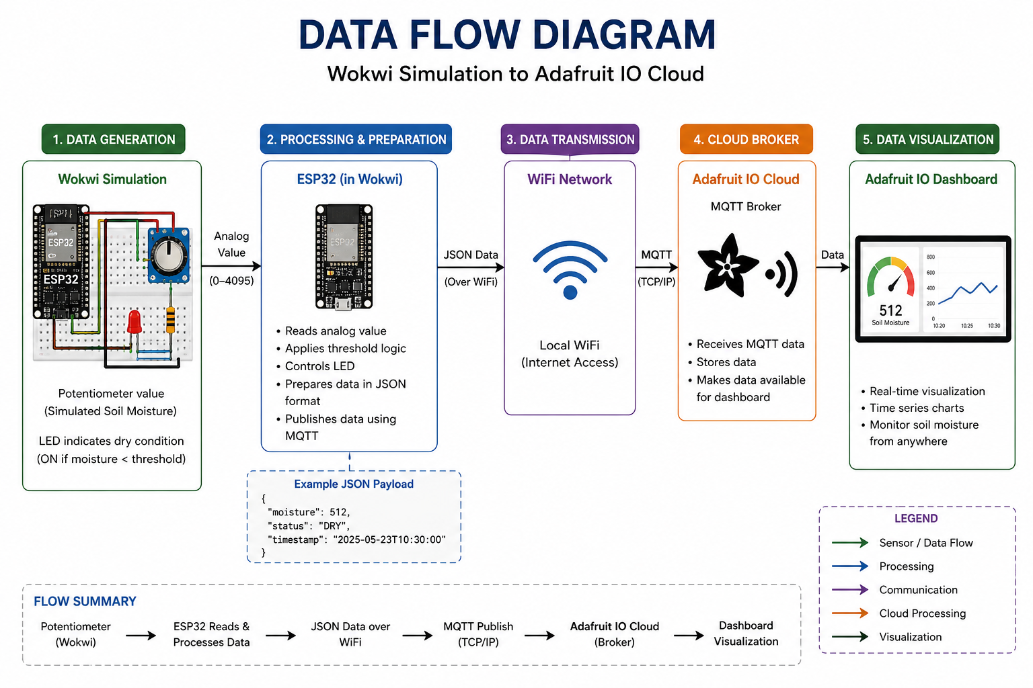
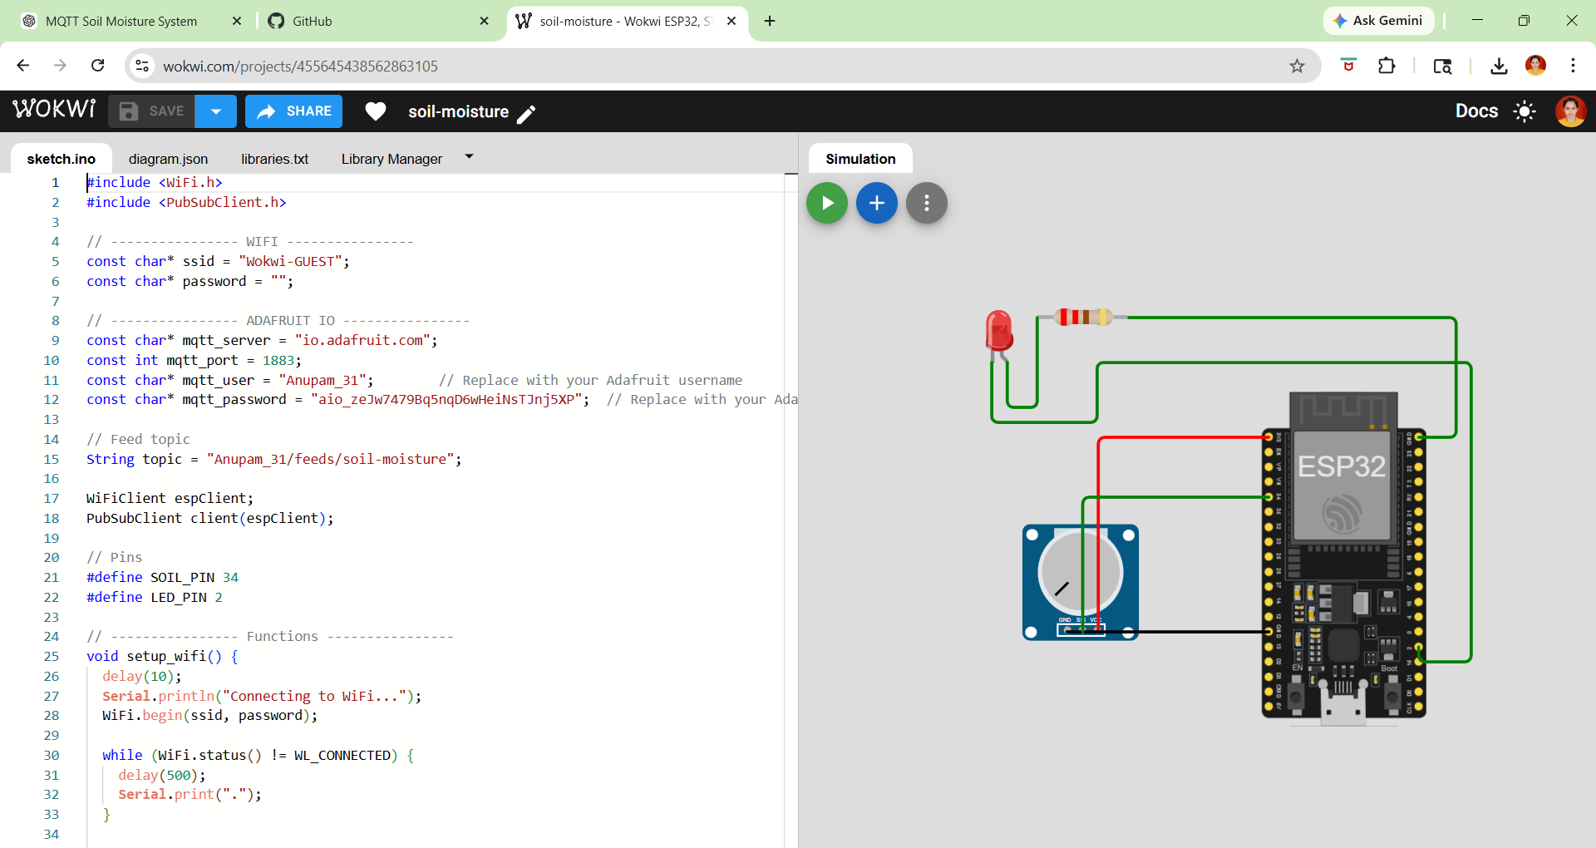
WOKWI DASHBOARD :

Slide 14
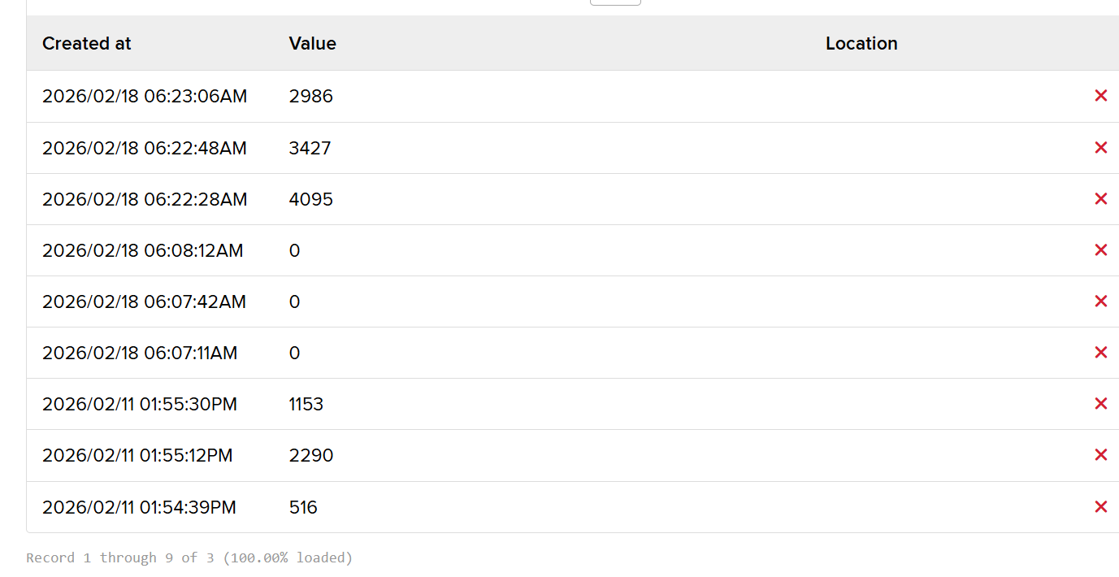
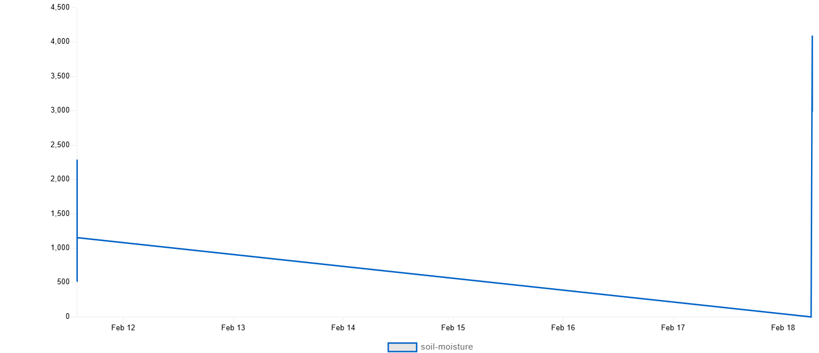
TELEMETRY UPDATES:
GRAPHS:

Slide 15
Dashboard and Graphs Used
1. Gauge Chart – Soil Moisture Level Displays current soil moisture value in real time. Helps identify dry or wet soil condition instantly.
2. Line Chart / Time Series Chart – Moisture Data Shows soil moisture values over time. Useful for monitoring changes and trends continuously.
3. Feed Data Table Displays published MQTT data records with timestamps. Helps in checking historical sensor readings.
4. Indicator / Status Block Shows LED status (Dry / Normal). Useful for alert monitoring.
5. Combined Dashboard Panel Includes gauge, graph, and feed values on one screen. Provides complete real-time monitoring system.

Slide 16
Advantages
Real-time soil monitoring
Remote access via cloud
Low power and low cost
Easy installation
Wireless communication
Suitable for smart irrigation
Scalable IoT architecture
Applications
Smart agriculture
Greenhouse monitoring
Home gardening systems
Precision irrigation
Agricultural research
Smart farming automation
Limitations
Depends on WiFi availability
Sensor accuracy affected by soil type
Requires power source
MQTT server dependency
Limited sensing range
. Future Enhancements
Automatic irrigation pump control
Mobile app integration
Solar power supply
Multiple sensor nodes
AI-based irrigation prediction
LoRa/5G long-range communication
Weather data integration
Data analytics dashboard

Slide 17
Conclusion
The MQTT – based soil moisture monitoring system successfully demonstrates an IoT enabled smart agriculture solution using ESP32 and cloud communication. The system accurately measures soil moisture and transmits data to the Adafruit IO platform for remote monitoring while providing local dry soil indication via LED. This project highlights the effectiveness of MQTT protocol in low bandwidth IoT communication and presents a scalable, cost effective approach for modern precision irrigation and smart farming applications.

