Slide 1
DESIGNS

Slide 2
BLOCK DIAGRAM
Granting permission for GPS
Location identification and meter reading
OCR
Meter reading uploaded and sending extracted image
consumer
System level approval
Database
Bill generation and payment
Store bill and other details
Server
Send it to the server
Control Activities
Administrator(KWA)

Slide 3
Architecture Diagram
Starting
payment
Is
GPS on
false
Grant permission
Payment details sent
true
Stop
fetch the details
capture the image(a)
true
false
enter the meter reading(b)
if match
a=b
false
verify by admin
true
bill generation

Slide 4
USE CASE DIAGRAM

Slide 5
AUTOMATED METER READING
Login
CUSTOMER
Location Access
ADMIN
Extracting Details
Image Processing
Entering Meter Reading
View Previous Meter Reading
Payment

Slide 6
DESIGN

Slide 7
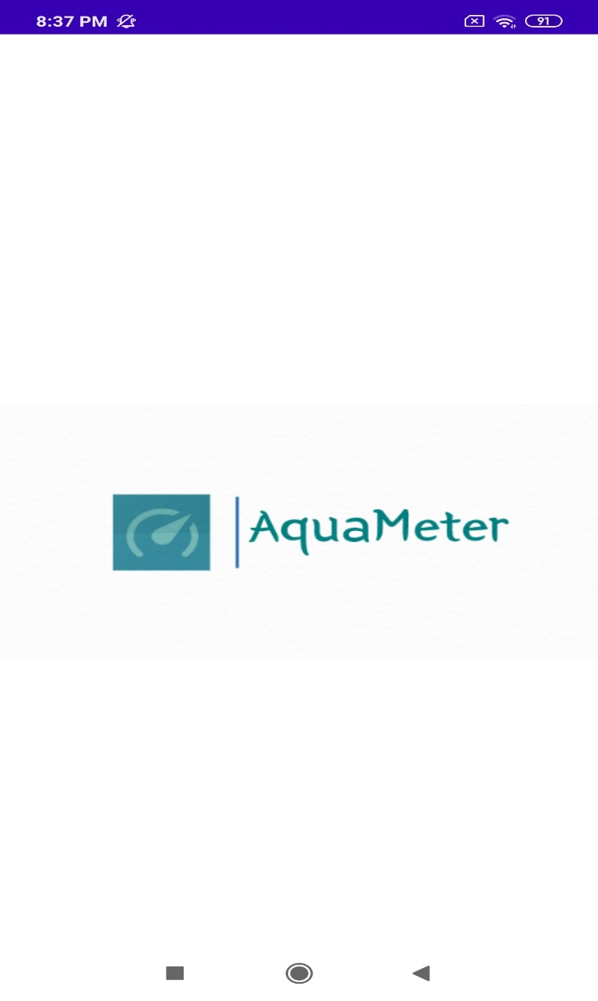
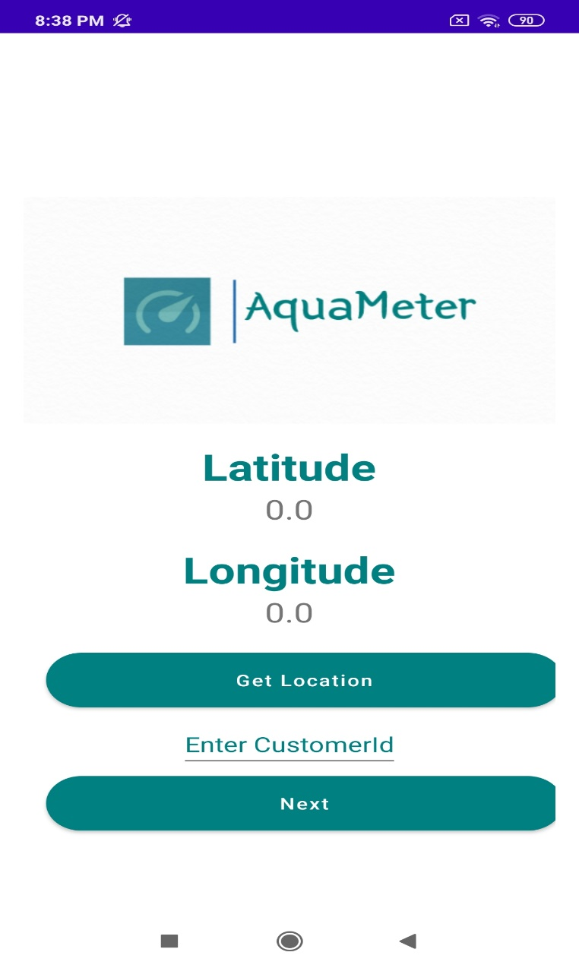

Slide 8
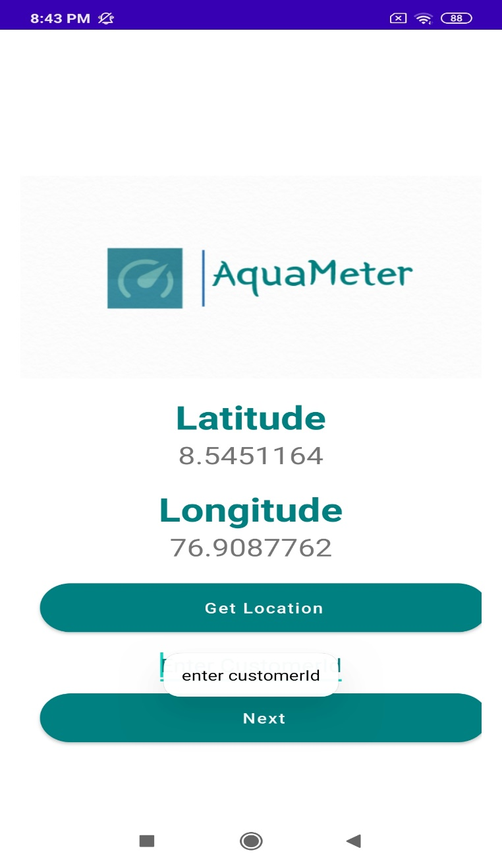


Slide 9
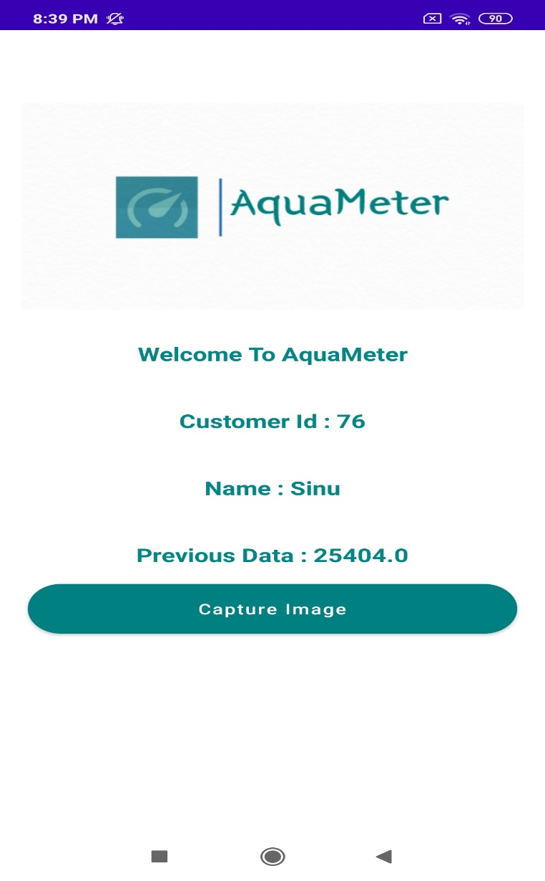
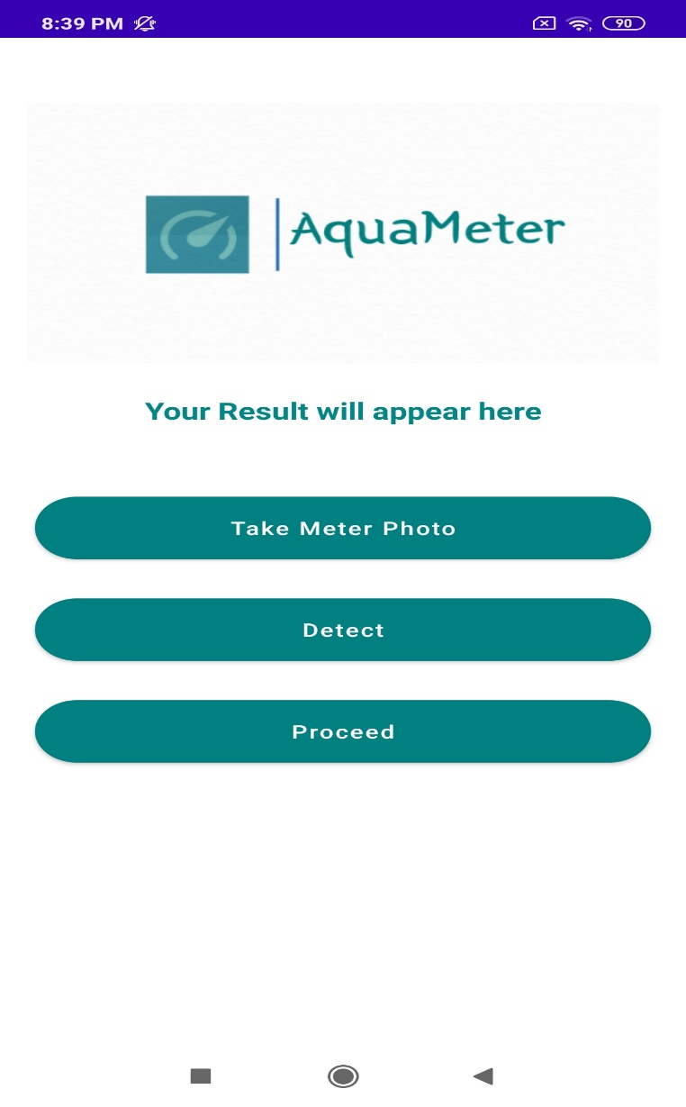

Slide 10
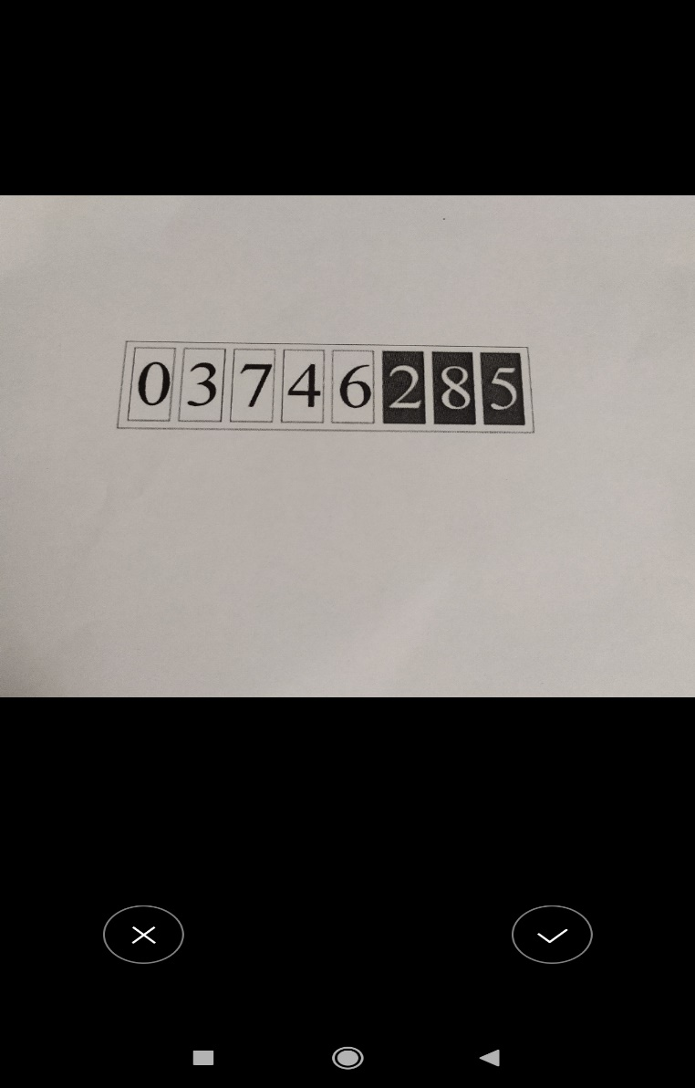
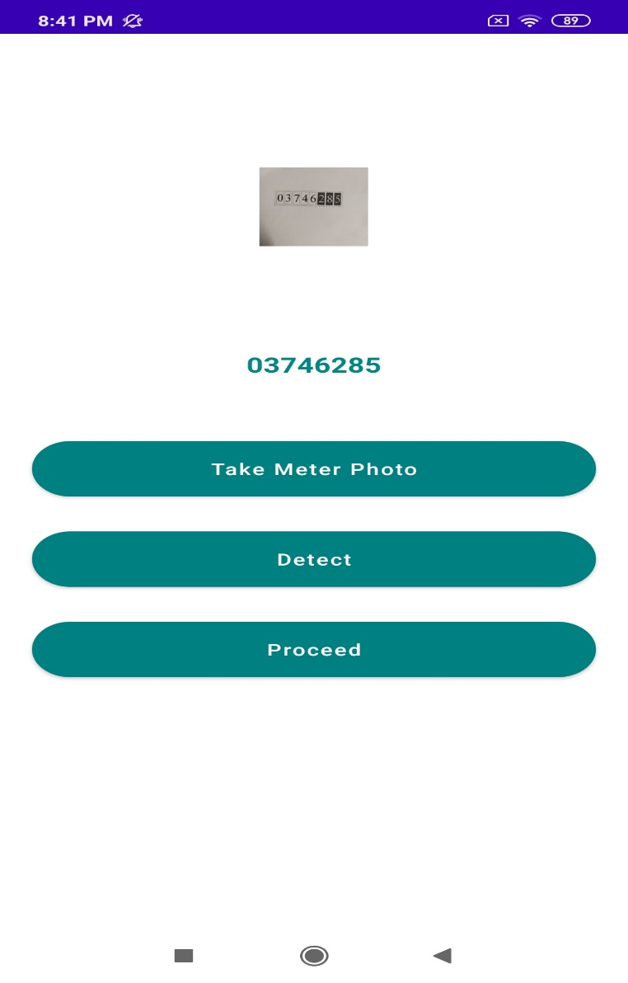

Slide 11
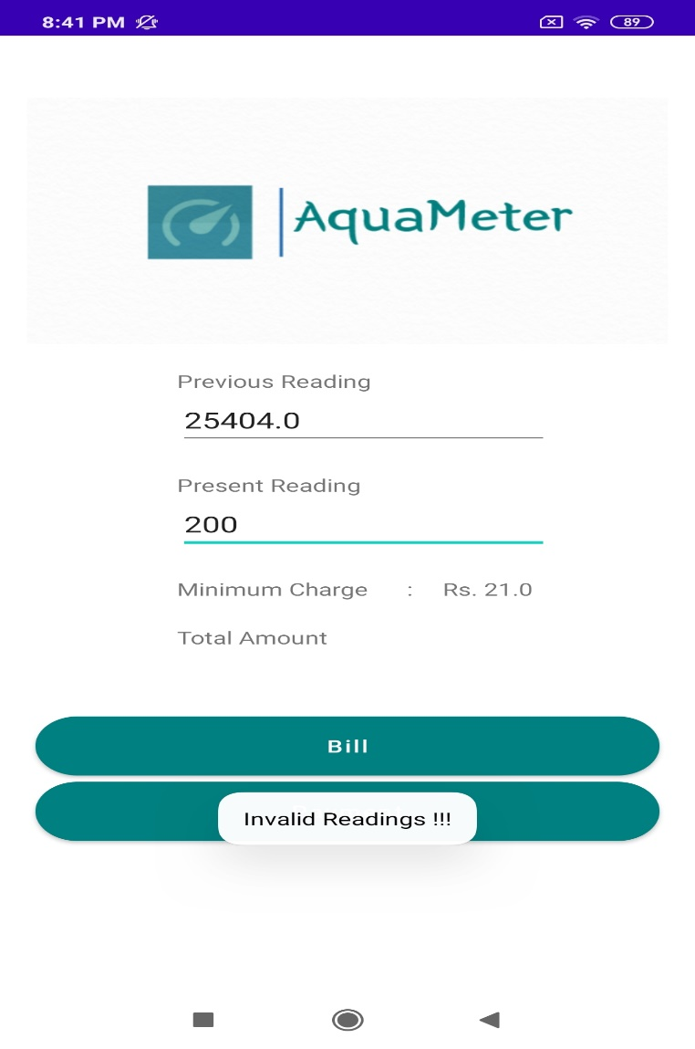

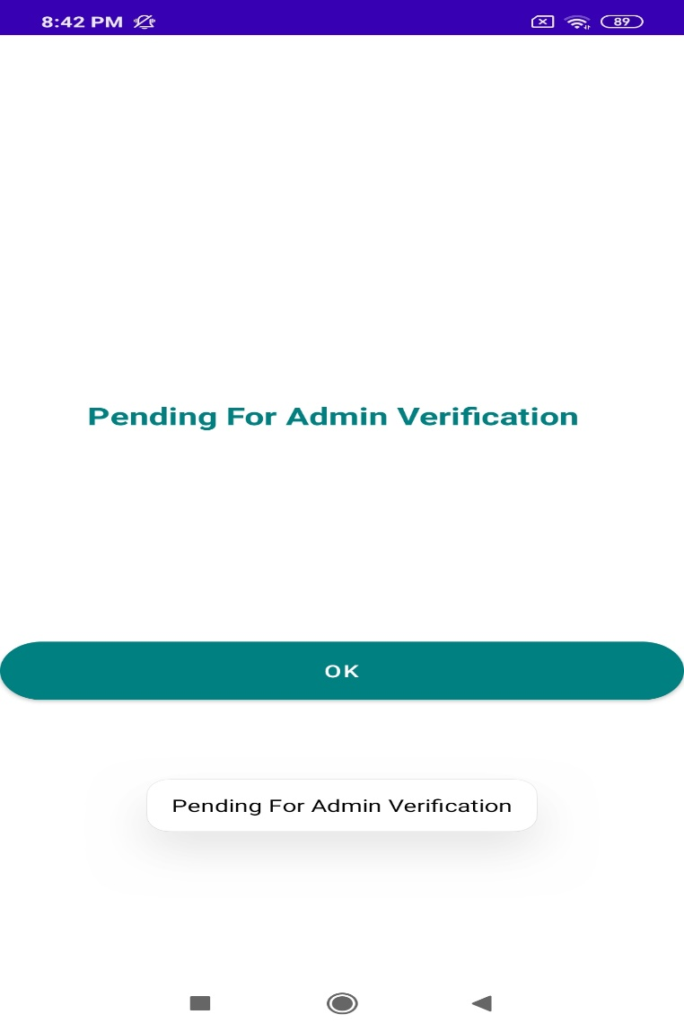

Slide 12
