Slide 1
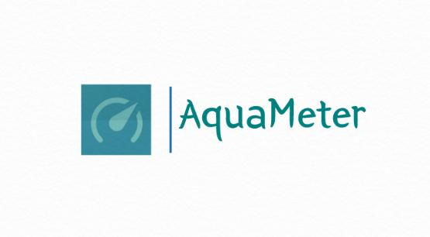

Slide 2
AquaMeter AUTOMATED WATER METER READING
UNDER THE GUIDANCE OF
Prof. DEEPA S S
SUBMITTED BY
ANUPAMA REGI
TVE20MCA-2017
ROLL NO 17
MCA S3

Slide 3
INTRODUCTION
AquaMeter is a AUTOMATED WATER METER READING APPLICATION which has been designed basically to reduce the tedious work and avoid the Human errors in meter reading.
The Application is built essentially to monitor the usage, bill payment and accessing the data which can result in better management.
The android based meter reading using OCR helps for this. Android app is for customers for reading the meter and paying the bill. This solution gives best benefits to customers as well as the authority.

Slide 4
PROBLEM STATEMENT
The present revenue system of KWA
Manual meter reading is expensive.
Pending regular payment
Deficiency of meter readers
Highly Person dependant
Billing cycle requires excessive time

Slide 5
EXPECTED OUTCOME
A user friendly mobile application
GPS and image processing approach
Instant billing and payment
Instant database updating

Slide 6
DISADVANTAGES OF EXISTING SYSTEM
According to Consumers:
Difficulty in computing current consumption and cost
Payment details is not easily available
Difficulty in identifying abnormality in consumption pattern
According to meter reader:
Difficulty in reaching remote areas
Difficulty in finding payments

Slide 7
PROPOSED SYSTEM
A Mobile App for User friendly bill payment
Image capturing using OCR
Automatic reading identification using image processing technique
Instant bill generation and payment
Two Type of Billing approvals :
Automatic (For Majority Readings)
Manual Approval with the help of water meter image by Admin

Slide 8
Highlights of the system
What is AquaMeter ?
By tracing the GPS location the meter can access the details of registered consumers.
Reduces physical effort of employees
Instant bill generation and make payment by just capturing the image of meter reading and sending it by using mobile App.

Slide 9
SCOPE
Designed for water meter reading. But can be extended to other type of meter reading.
Implement fully automated meter reading and capturing system to encompass entire consumers of water.
Any consumer with smart phone and network connectivity can access this application.

Slide 10
Technologies Used OCR GPS
Users
Customers
Admin

Slide 11
OCR (Optical Character Recognition )
Recognizing optically processed characters.
Performance is directly dependent upon the quality of the input documents, which is unique.
It does not require control of the process that produces the information.

Slide 12
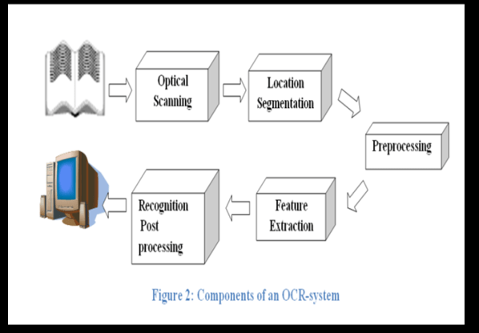
Components of an OCR system

Slide 13
GPS (Global Positioning System)
GPS units receive signals from United States Government satellites that they use to determine location.
Depending on the unit, a GPS can pinpoint your position in up to three dimensions—latitude, longitude and altitude .
The remarkable thing about GPS is that the satellite navigational information is available to anyone, anywhere, free of charge.

Slide 14
LITERATURES
Madhubala Talwar, Pooja Nimbalkar, Sima Bodage, Bharati Gavit, Prof. Shreelekha Mankhair , “Android based Meter Reader using OCR Technique” , April 2016 , Department of Computer Engineering, Modern Education Society's College of Engineering, Pune, India
Riddhi Gor, Priyanka Karkate, Vidyalaxmi Selvaraj, Prof. Harsh N. Bhor B.E IT Student, KJSIEIT, Sion, Mumbai, Asst Professor, KJSIEIT, Sion, Mumbai, Maharashtra, India , “Android Application for Meter Reading Using OCR” , International Journal for Research in Engineering Application & Management (IJREAM) Vol-01, Issue 03, June 2015.

Slide 15
BLOCK DIAGRAM
Granting permission for GPS
Location identification and meter reading
OCR
Meter reading uploaded and sending extracted image
consumer
System level approval
Database
Bill generation and payment
Store bill and other details
Server
Send it to the server
Control Activities
Administrator(KWA)

Slide 16
Architecture Diagram
Starting
payment
Is
GPS on
false
Grant permission
Payment details sent
true
Stop
fetch the details
capture the image(a)
true
false
enter the meter reading(b)
if match
a=b
false
verify by admin
true
bill generation

Slide 17
USE CASE DIAGRAM

Slide 18
AUTOMATED METER READING
Login
CUSTOMER
Location Access
ADMIN
Extracting Details
Image Processing
Entering Meter Reading
View Previous Meter Reading
Payment

Slide 19
FUTURE ENHANCEMENT
Admin App Development
Bill Integration
Designed for water meter reading. But can be extended to other type of meter reading.

Slide 20
CONCLUSION
Simple, accurate and efficient application is developed successfully for reading meter using OCR technique.
App provides user friendly and online method for bill generation and payment
Automated system of meter reading will reduce the burden on employees.
It will avoid human errors and incorrectness in bill generation.
Provide user friendly method for bill generation and payment.
Authority can easily check details including payment.

Slide 21
REFERENCES
Madhubala Talwar, Pooja Nimbalkar, Sima Bodage, Bharati Gavit, Prof. Shreelekha Mankhair , “Android based Meter Reader using OCR Technique” , April 2016 , Department of Computer Engineering, Modern Education Society's College of Engineering, Pune, India, Journal of Emerging Technologies and Innovative Research (JETIR)
Riddhi Gor, Priyanka Karkate, Vidyalaxmi Selvaraj, Prof. Harsh N. Bhor B.E IT Student, KJSIEIT, Sion, Mumbai, Asst Professor, KJSIEIT, Sion, Mumbai, Maharashtra, India , “Android Application for Meter Reading Using OCR” , International Journal for Research in Engineering Application & Management (IJREAM) Vol-01, Issue 03, June 2015.
Websites
https://www.itransition.com/blog/ocr-algorithm
https://www.w3schools.com
https://www.developers.google.com
https://www.geeksforgeeks.org/text-detector-in-android-using-firebase-ml-kit/

